Slide 1
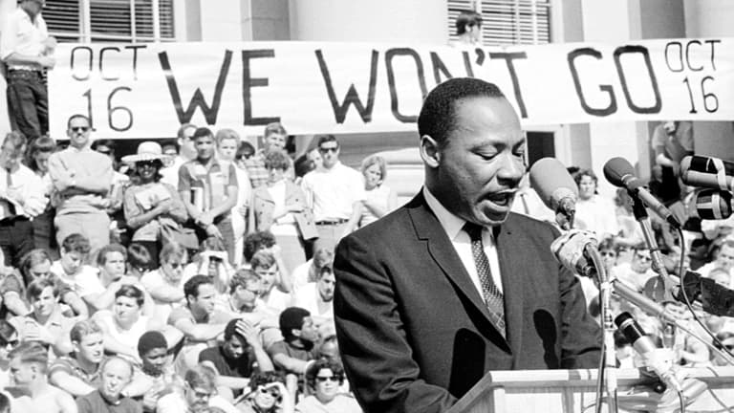
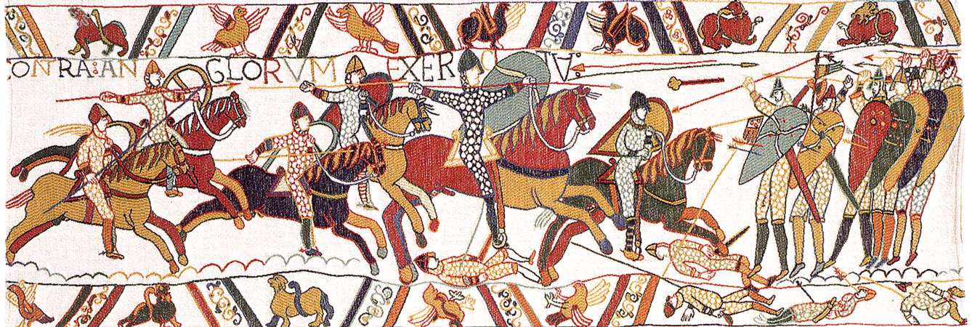

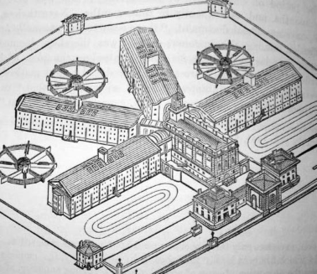
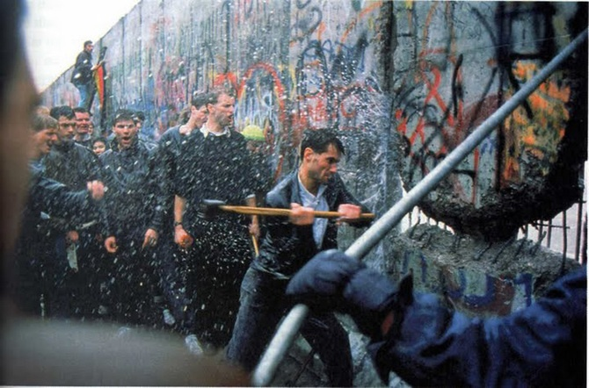
Yr. 9 - Welcome to
GCSE History

Slide 2
Why study History?
WHY NOT? If you enjoy studying History then continue those studies. Plus, it is a well-respected and traditional academic subject!
SKILLS: History demands you to think, evaluate, analyse and make judgements about causes, situations and people. It equips you with the ability to select and compare information, to understand why things happened and why others should never be allowed to happen.
TOLERANCE & UNDERSTANDING: It gives you the opportunity to understand others and to appreciate the challenges faced by those who have gone before us. It also allows you to make sense of the world today!
SUCCESS: We have a strong record of academic success. Our last examination results saw over 50% of students achieving a grade 7-9! This was the highest performance of any subject.
It is ENJOYABLE and INTERESTING as a subject in its own right!
‘To be ignorant of what occurred before you were born is to remain always a child. For what is the worth of human life, unless it is woven into the life or our ancestors by the records of History.’ Cicero
‘A people without the knowledge of their past history, origin and culture is alike a tree without roots’. Marcus Garvey
‘I believe that the more you know about the past, the better you are prepared to study the future’. President Roosevelt.

Slide 3


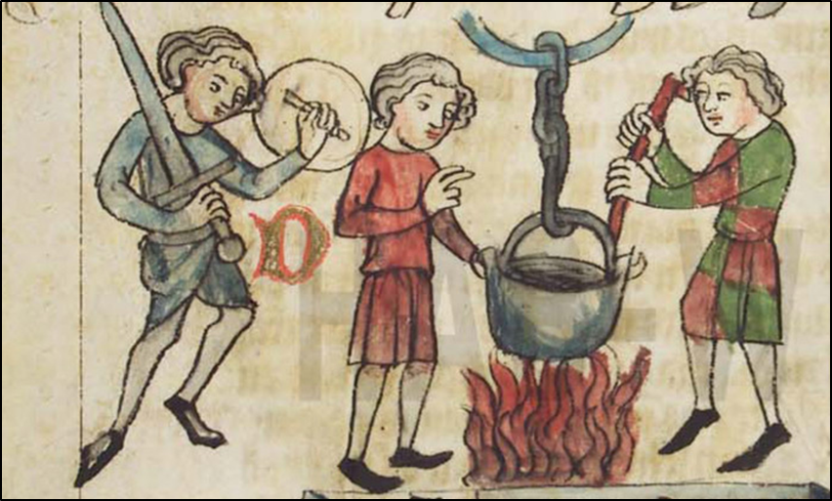
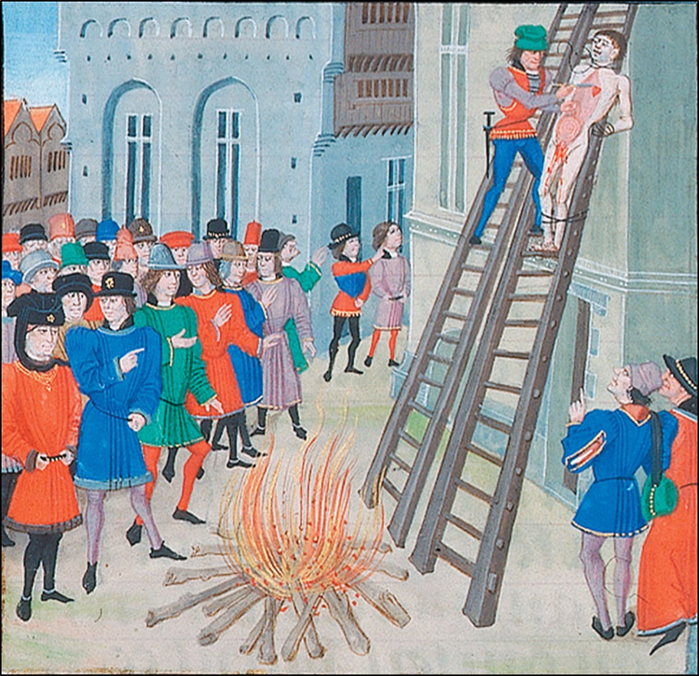
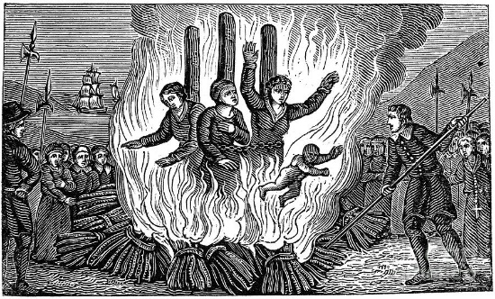
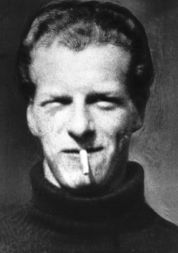
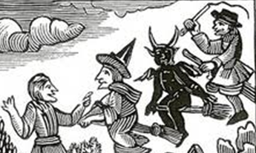
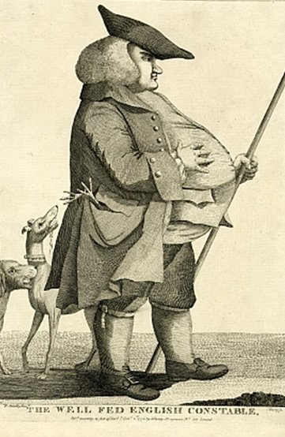
Paper 1:
Crime and Punishment 1000 – Present

Slide 4
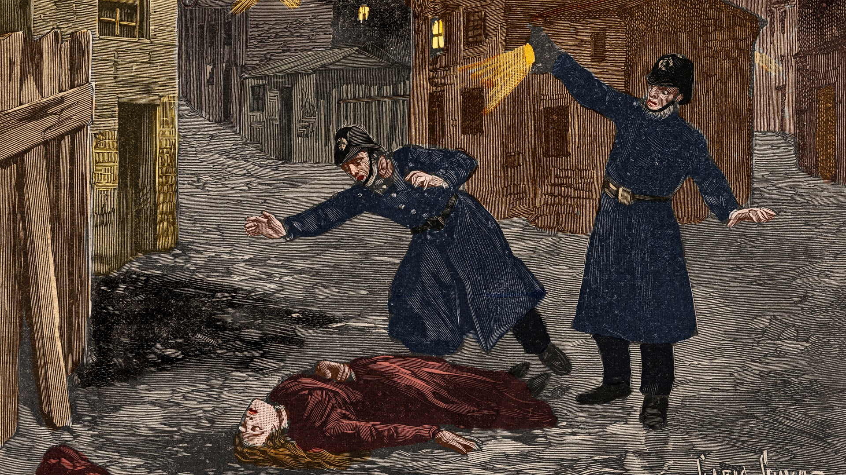
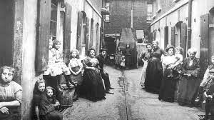
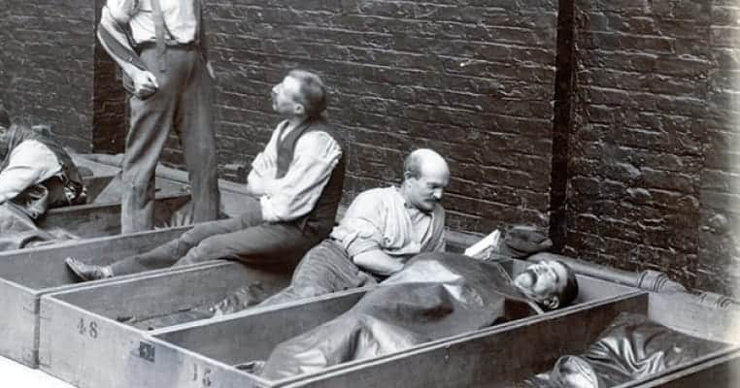
Paper 1:
Historic environment: Whitechapel, c.1870-1900: Crime and policing and the inner city.

Slide 5

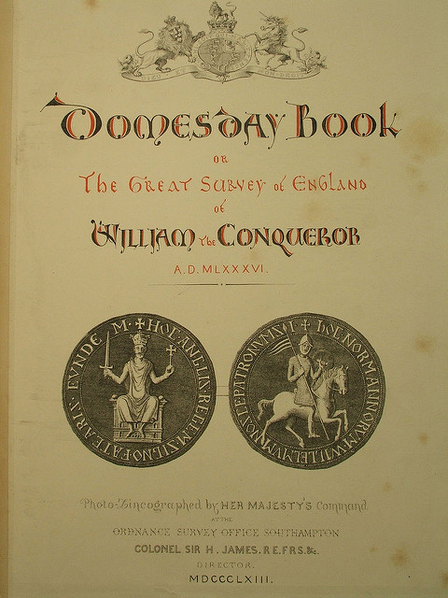
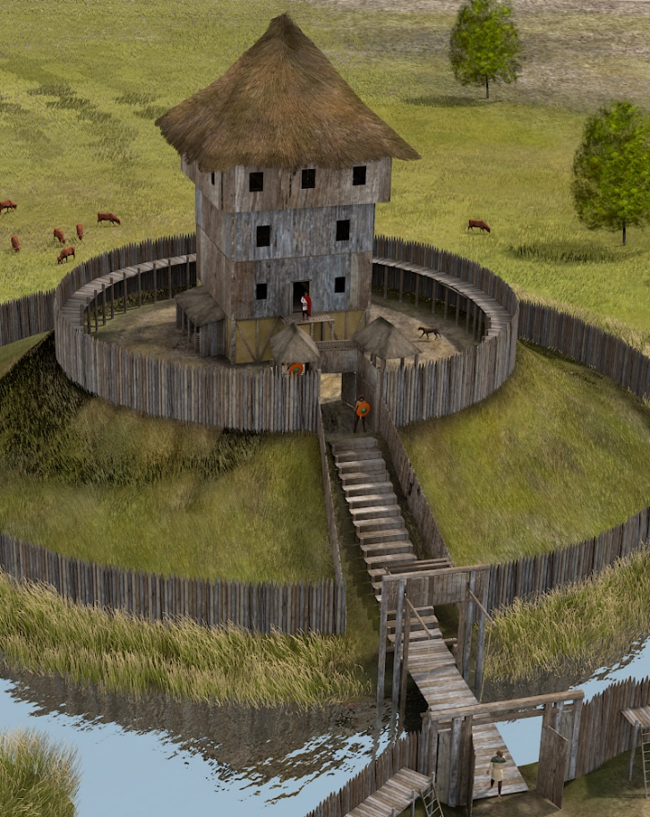
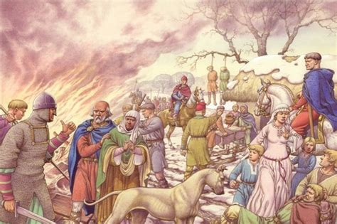
Paper 2:
Anglo-Saxon and Norman England 1060-1088.

Slide 6
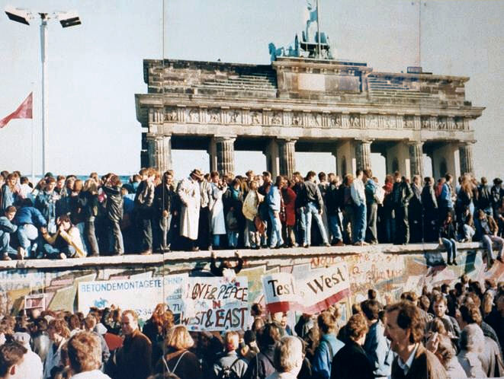
Paper 2:
Superpower relations and the Cold War, 1941-91.

Slide 7

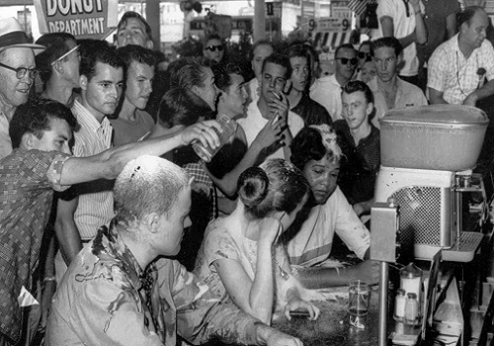
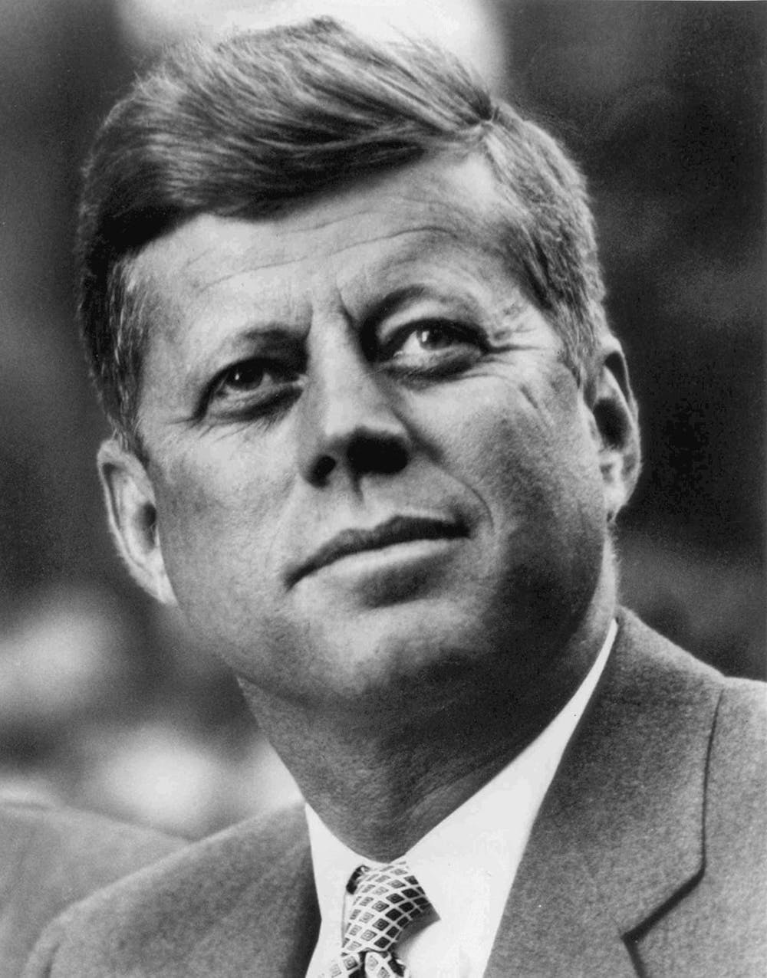
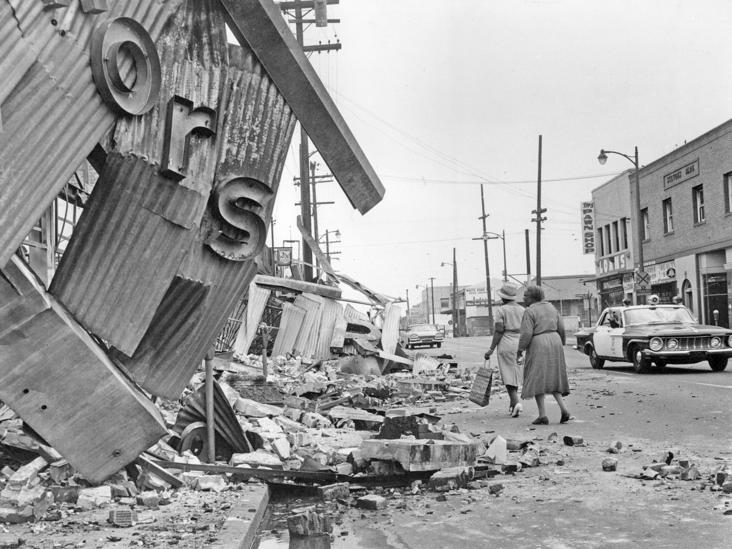
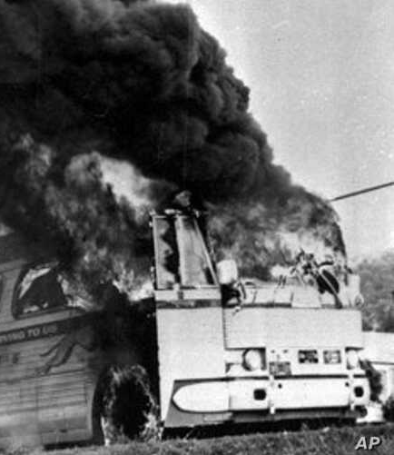
Paper 3
The USA 1954-75: Conflict home and abroad.

Slide 8
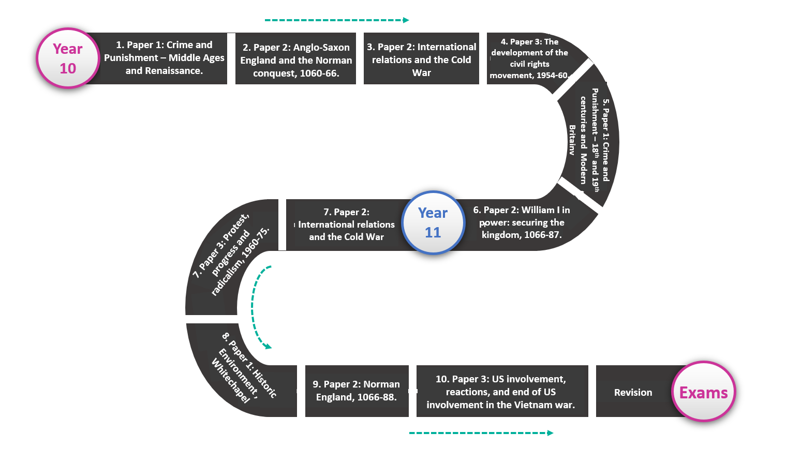
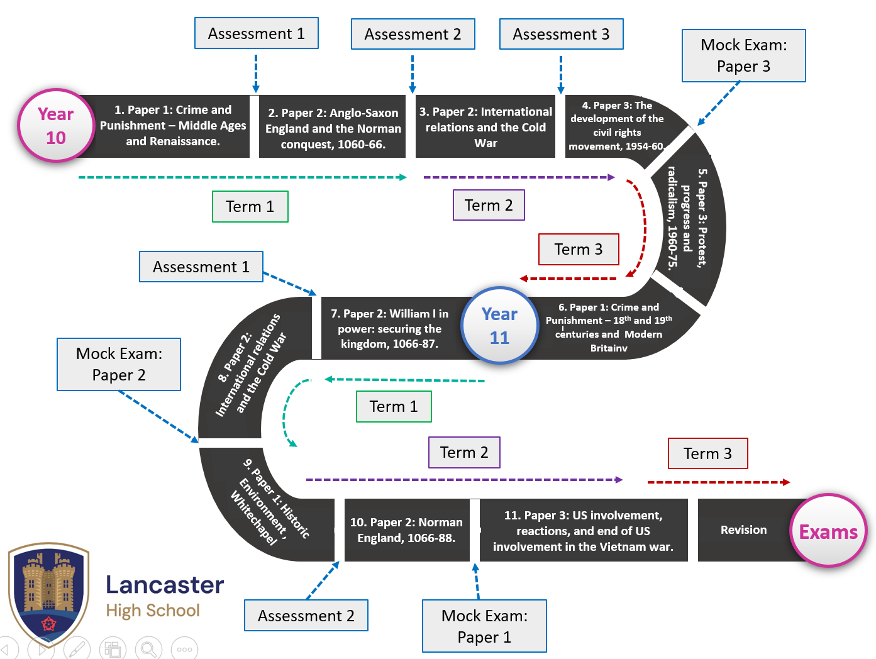
What is the course content?
Our curriculum at KS4 is interleaved or chunked.

Slide 9

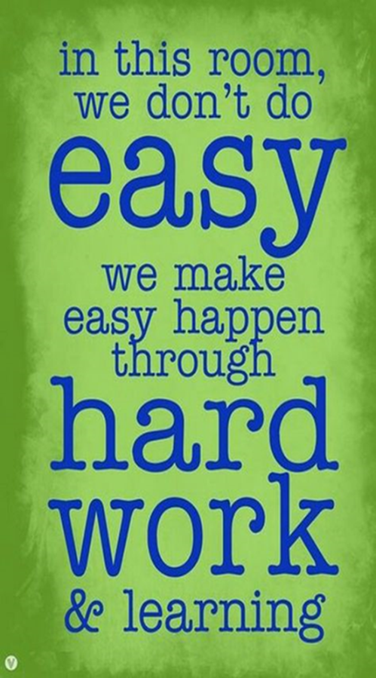
How is the course examined?
Paper I: Crime and Punishment 1000 – Present and Historic environment: Whitechapel, c.1870-1900: Crime and policing and the inner city. | Paper II: Anglo-Saxon and Norman England 1060-1088. AND Superpower relations and the Cold War, 1941-91. | Paper III: The USA 1954-75: Conflict home and abroad.
Weighting: 30% Exam Duration: 1hr 15 mins Part A: 3 questions on Whitechapel. It is largely source-based. Part B: 3 questions about crime and punishment. Extended writing is required. SPaG: 4 marks | Weighting: 20% for each topic (40% in total) Exam Duration: 1hr 45 minutes for both papers. Anglo-Saxon and Norman England: 3 questions requiring extended answers. Superpower relations and the cold war: 3 questions requiring extended answers. | Weighting: 30% Exam Duration: 1hr 20 minutes. Part A: 1 source based question (inference) and 1 extended answer. Part B: Sources and Interpretations section. 4 questions.

Slide 10

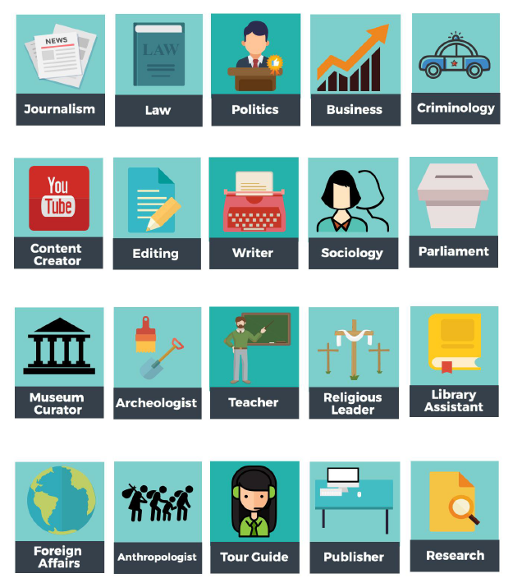
Where can GCSE History lead?
History develops knowledge and transferable skills which can lead to the
most varied career paths……..
Academia
Research
Civil Service
Media
Journalism
Law
Politics
Playwrights
Police
Consultancy
Business and Finance
Prison Officers
Security Services
Marketing
Accountancy

Slide 11
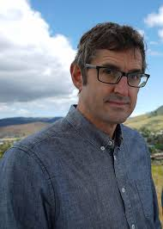
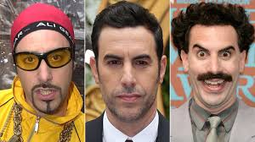
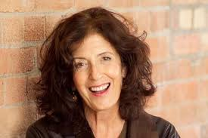
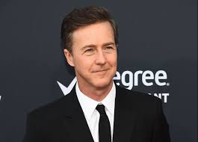
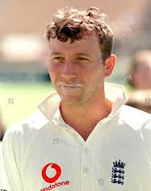
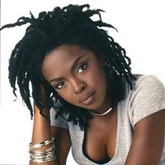
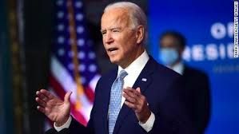
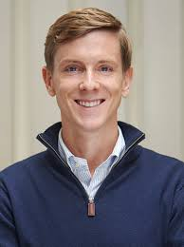
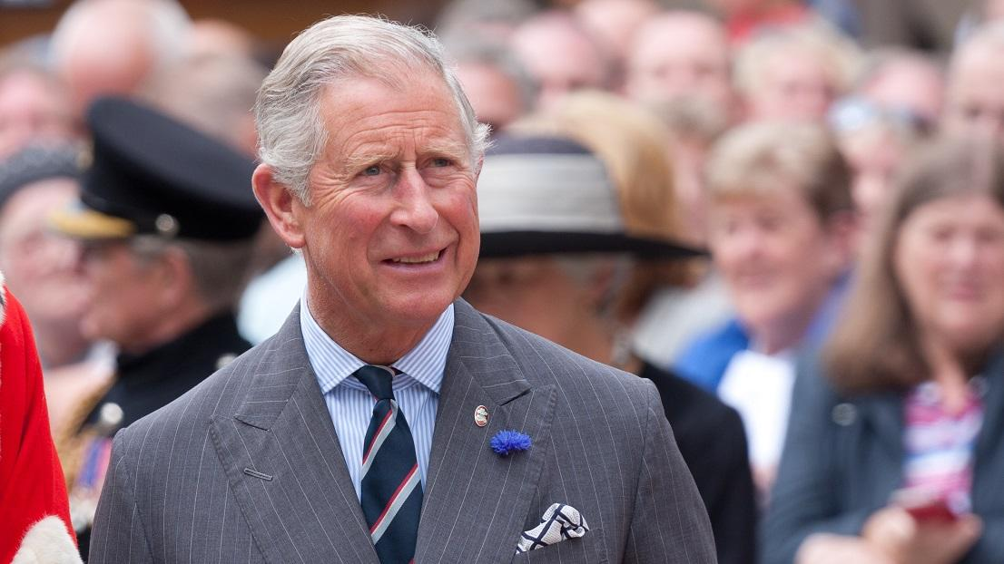
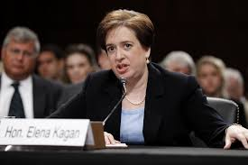
People who studied History at university include…
Sasha Baron Cohen – actor, comedian, writer and producer.
Anita Roddick – Founder of the Body Shop
Ed Norton - Actor
Louis Theroux – Filmmaker, author, broadcaster and journalist.
Michael Atherton - Cricketer
Prince Charles.
Elena Kagan – Dean of Harvard Law School and Supreme Court Justice
Lauryn Hill - Musician
Joe Biden – US President Elect
Chris Hughes – co-founder of Facebook.

Slide 12


Further Details
If you have any further questions about the course then please contact:
jwhite@lancasterhigh.lancs.sch.uk
Alternatively, feel free to speak to your History teacher in lesson.

