Slide 1
Year 11 homework schedule
Week | Description | Resources
Week 4 | Topic 1: Sit-ins By the end of this homework, you should understand the events of the Greensboro sits-ins, and the impact it had in the civil rights movement. Work your way through the revision resources to the right, before completing the 9-question quiz. Complete each one of the questions on the sheet provided. | Revision guide and revision pack. Youtube: The Greensboro Four Make Civil Rights History – YouTube BBC Bitesize: Greensboro and the sit-in movement - Peaceful protest in the 1960s - Edexcel - GCSE History Revision - Edexcel - BBC Bitesize Seneca: Seneca - Learn 2x Faster (senecalearning.com) GCSE Pod: GCSEPod (See from 2 mins 50 seconds)
Week 5 | Topic 2: Brown vs Topeka By the end of this homework, you should understand the causes, events and consequences of the Brown vs Topeka case. Work your way through the revision resources to the right, before completing the revision quilt. Each box on the grid describes the causes, events and consequences of the Brown Vs Topeka case. Categorise each information box under one of the following headings. | Revision guide and revision pack. GCSE Pod: GCSEPod Seneca: Seneca - Learn 2x Faster (senecalearning.com) Youtube: Brown v. Board of Education | BRI's Homework Help Series – YouTube BBC Bitesize: Segregated education - the Brown v Topeka case - Fighting for civil rights - Edexcel - GCSE History Revision - Edexcel - BBC Bitesize
Week 6 | Topic: Little Rock By the end of this homework, you should understand the causes, events and consequences of the events of Little Rock. Work your way through the revision resources to the right, before completing the brain dump (mind map) with everything you know on the topic of Little Rock. | Revision guide and revision pack. GCSE Pod: GCSEPod (see from 2 mins 30 secs) Seneca: Seneca - Learn 2x Faster (senecalearning.com) Youtube: Little Rock- School Integration - YouTube BBC Bitesize: Little Rock 1957 - Civil rights campaigns 1945-1965 - National 5 History Revision - BBC Bitesize
Week 7 | Topic: James Meridith By the end of this homework, you should understand the reasons why James Meridith was accepted to Mississippi university, and the reasons why this is significant. Work your way through the revision resources to the right, before completing the evaluation question ‘There was significant progress in education between the years 1954-1962’ How far do you agree? You should fill in the grid with evidence from this session, and previous revision sessions. Ensure you provide evidence that both supports and opposes the statement, before coming to an overall conclusion. | Revision guide and revision pack. Seneca: Seneca - Learn 2x Faster (senecalearning.com) Youtube: James Meredith Enrolls at Univ. of Mississippi - YouTube BBC Bitesize: Progress in civil rights, 1960 - 1962 - Peaceful protest in the 1960s - Edexcel - GCSE History Revision - Edexcel - BBC Bitesize See at the bottom of the page.

Slide 2
Year 11 homework schedule
Week | Description | Resources
Week 8 | Topic: Opposition to the Civil rights Movement By the end of this homework, you should understand key opposition to the civil rights movement, including the KKK, the White Citizens’ Council and the Dixiecrats. Work your way through the revision resources to the right, before completing a plan for the 12-mark question ‘Explain why there was opposition to the civil rights movement, 1950-1963’. For each paragraph you need to add a point, 3 pieces of evidence and analysis in the spaces provided. | Revision guide and revision pack. GCSE Pod: GCSEPod Seneca: Seneca - Learn 2x Faster (senecalearning.com) Youtube: Resurgence of the Ku Klux Klan - YouTube BBC Bitesize: Success of, and opposition to, the civil rights movement - Life for black Americans after World War Two - Edexcel - GCSE History Revision - Edexcel - BBC Bitesize
Week 9 | Topic: The Tet Offensive By the end of this homework, you should understand the causes, events and consequences of the Tet offensive. Work your way through the revision resources to the right, before completing the following exam style question: How useful is sources B for an enquiry into the Tet Offensive. Space has been left at the bottom of the worksheet for you to complete this. | Revision guide and revision pack. GCSE Pod: GCSEPod Seneca: Seneca - Learn 2x Faster (senecalearning.com) Youtube: How The Tet Offensive Changed The Vietnam War | History - YouTube BBC Bitesize: The Tet Offensive - US involvement in the Vietnam War - Edexcel - GCSE History Revision - Edexcel - BBC Bitesize
Week 10 | Topic: Peaceful protests and their impact By the end of this homework, you should understand the causes, events and consequences of the peaceful protests that took place between 1963-1965. Work your way through the revision resources to the right, before completing the revision clock. You should plot everything you know about the different protests under the different headings. Finally, you should complete the and exam wrapper as a reflection on your revision so far. | Revision guide and revision pack. GCSE Pod: GCSEPod Seneca: Seneca - Learn 2x Faster (senecalearning.com) Youtube: March on Washington: Bet You Didn't Know: March on Washington | History - YouTube Birmingham campaign: Alabama City Remembered as Climactic Battle of Civil Rights Movement – YouTube Freedom summer: Remembering Freedom Summer - YouTube
Week 11 | Topic: Malcolm X and Black Power, 1963-70. By the end of this homework, you should understand the role of Malcolm X, Stokely Carmichael, The 1968 Olympics and the Black Panther movement in leading progress in the civil rights. Work your way through the revision resources to the right, before completing the 10-question quiz on this topic. Finally, you should complete the and exam wrapper as a reflection on your revision so far. | Revision guide and revision pack. GCSE Pod: GCSEPod Youtube: Malcolm X - The Life of Malcolm X | Biography - YouTube The Black Panther Party - History Brief: the Black Panther Party - YouTube BBC bitesize: The Black Power movement - Post-war American society - AQA - GCSE History Revision - AQA - BBC Bitesize

Slide 3
Year 11 revision homework 1: Quiz
Answer the questions on the sheet below:
What does the term ‘direct action’ mean?
_________________________________________________
2. What is a sit-in?
_________________________________________________
3. Who carried out the first sit-in at Greensboro?
_________________________________________________
4. How many people had joined the sit-in by the fifth day?
_________________________________________________
5. Students then began to boycott shops that had segregated lunch counters. What is a boycott?
_________________________________________________
6. Why were boycotts effective in advancing the civil rights movement?
__________________________________________________________________________________________________
6. How did the public react to the Greensboro sit in?
_________________________________________________
7. Why was it important for the civil rights activists to remain peaceful throughout their protest?
__________________________________________________________________________________________________
8. Which civil rights group was formed following the success of the sit-ins?
_________________________________________________
9. Which other campaigns did this group get involved in?
__________________________________________________________________________________________________

Slide 4
Year 11 revision homework 2: Revision Quilt
Read through the information below about the Brown vs Board of Topeka case. You should categorise each box under one of the following headings:
1. Causes | 2. Events | 3. Consequences
Black Americans were not allowed to attend white schools. | The judgement did not state when desegregation should be carried out. Some areas began to desegregate in 1957, however, 2.4 million black students were still being educated in ‘Jim Crow’ schools. | Lawyers from the NAACP presented evidence to the supreme court stating that separate education created low self-esteem and was psychologically harmful.
The NAACP also pointed out that educational achievement was restricted because of the lack of provision in black schools. | The provision in black schools was far inferior to the quality of education in white schools. E.g., in South Carolina, they spent 3 times as much money in white schools. | 300,000 black children were attending schools that had formally being desegregated.
Linda Brown’s parents wanted her to attend a neighbourhood school, rather than the school for black Americans. | Some states in the south took deliberate action to keep schools separate. President Eisenhower did not step in as he did not want to cause further opposition in the south. | The KKK had been extremely popular in the 1920’s and began to re-emerge.
Many parents joined the White Citizen’s Council, and 100 senators and congressmen signed the southern manifesto as a result of the ruling. | The judgement took 18 months and the decision to ban school segregation was announced on the 17th May 1954. Chief Justice Warren of the Supreme Court gave the final decision. | Some southern states acted as they did because they thought it was wrong the Federal Government had acted in a dictatorial manner.
Task 2: Look back through the consequences. Decide which describe positive (+) or negative (-) consequences from the Brown vs Topeka case.

Slide 5
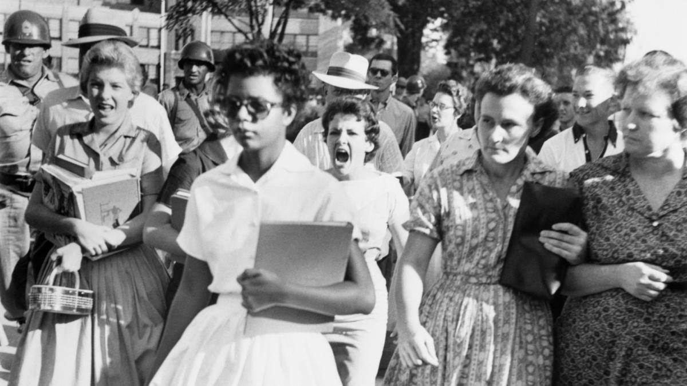
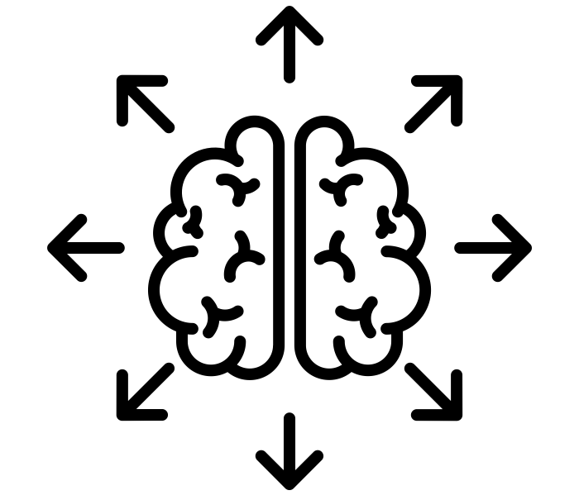
Year 11 revision homework 3: Brain Dump
Work your way through the various resources available on the events of little Rock High School. Once you have done so you should plot everything you know about little rock onto the brain dump (mind map) below:
E.g. Nine Black Americans enrolled at Little Rock High School in 1957.

Slide 6
Year 11 revision homework 4: Debate
‘There was significant progress in education between the years 1954-1962’ How far do you agree?
j
You may include the following in your answer:
Brown Vs Board of Topeka
Little Rock
James Meredith
There was significant progress | There was not significant progress
Overall: I believe…
________________________________________________________________________________________________________ ____________________________________________________

Slide 7
Year 11 revision homework 5: 12-mark plan
Explain why there was opposition to the civil rights movement, 1950-1963. [12 marks]
Point – State one reason why there was opposition to the Civil Rights movement.
Reason:
Evidence- Add 3 pieces of evidence to support your point:
1)
2)
3)
Analyse- Explain why this led to opposition in the civil rights movement.
This led to opposition because…
Point – State one reason why there was opposition to the Civil Rights movement.
Reason:
Evidence- Add 3 pieces of evidence to support your point:
1)
2)
3)
Analyse- Explain why this led to opposition in the civil rights movement.
This led to opposition because…
Point – State one reason why there was opposition to the Civil Rights movement.
Reason:
Evidence- Add 3 pieces of evidence to support your point:
1)
2)
3)
Analyse- Explain why this led to opposition in the civil rights movement.
This led to opposition because…

Slide 8
Year 11 revision homework 6: Utility
How useful is source B for an enquiry into the Tet Offensive. (8 marks)
C.O.P
Source B: From an interview given by Huong Van Ba, an artillery officer in the NVA, to an American interviewer, about the Tet offensive.
When the Tet campaign was over, we didn’t have enough men left to fight a major battle, only to make hit and run attacks on posts. So many men had been killed that morale was very low. We spent a great deal of time hiding in tunnels, trying to avoid being captured. We experienced desertions and many of our men filtered back to their homes to join local guerilla forces instead of staying with the main NVA units. We heard that in the north there were more young people trying to avoid the draft.
Step 1: What can you learn from the content of the source? Summarise in your own words and add quotes to support.
Step 2: Does this fit with your own knowledge? Describe what you know (linking it back to the points you’ve made about the sources content).
Step 3: Is the provenance of the source trustworthy? Consider the Nature, origin or purpose of the source.
Step 4: Overall, how useful is the source?
Remember all sources are useful!
Source B is useful as I can learn ________________________ ________________________________________________________________________________________________________________________________________________________________________________________________It is also useful as I know _____________________________ ________________________________________________________________________________________________________________________________________________________________________________________________The source is ______________________________________ ________________________________________________________________________________________________Overall, I believe the source is _________________________ ________________________________________________

Slide 9
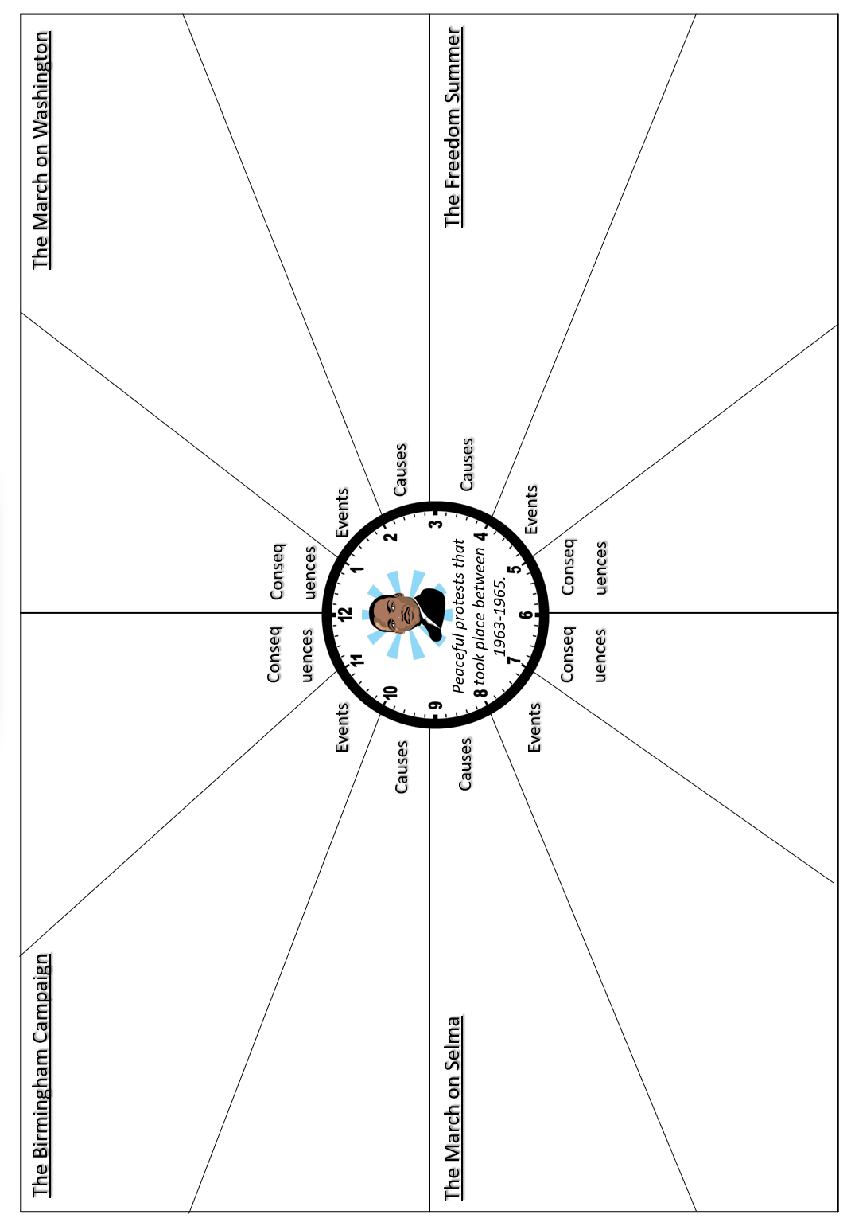

Slide 10
Year 11 revision homework 8: Quiz
Answer the questions on the sheet below:
What does the term ‘separatism’ mean?
_________________________________________________
2. Identify one of the aims of Malcolm X and Nation of Islam?
_________________________________________________
3. Why was Malcolm X so critical of Martin Luther King?
_________________________________________________
4. How did the views of Malcolm X change after 1964?
_________________________________________________
5.What was the aim of Stokely Carmichael and the SNCC?
__________________________________________________________________________________________________
6. What did Tommie Smith and John Carlos do to raise awareness of black power?
__________________________________________________________________________________________________
6. Why were Tommie Smith and John Carlos sent home from the 1968 Olympics?
_________________________________________________
7.Who founded the Black Panther Party in 1966?
_________________________________________________
8. Give one aim of the Black Panther Party?
_________________________________________________
9. Give one achievement of the Black Panther Party.
_________________________________________________
10. Give one reason why the success of the Black Panther Party was limited?
_________________________________________________

Slide 11
Year 11 revision exam wrapper
How much time did these revision tasks take you? _________________
Do you feel are more confident going into the mock?
_____________________________________________
Which one of these revision tasks helped you the most?
Which strategies or resources did you use to prepare? Tick/cross. Highlight a different one you will try next time.
Revision guide |  | YouTube videos
Reviewing class notes |  | BBC bitesize
GCSE Pod |  | Quiz
Seneca learning |  | Revision Quilt
Practise questions |  | Revision clock
Brain dump |  | Planned debate
Others:
What do you still need to work on? – List any areas you still need to focus on before your mock exam.
Positive reflection: List something you are proud of from your revision so far.

