Slide 1
Options Information Evening
Please ensure you have signed in at the front desk
Please put phones on silent

Slide 2

This can be a daunting time for pupils and parents. This evening is to help you to support your child in making well-informed choices.

Slide 3
What are the main differences between Key Stage 3 and Key Stage 4?
Pupils take fewer subjects and become more ‘specialist’ in the options they choose
There is more lesson time dedicated to each option subject
Homework increases and there is more need for pupils to take responsibility for their own learning
There are mock and final examinations in most subjects
The exam results from KS4 help pupils to move onto their next phase of education.

Slide 4
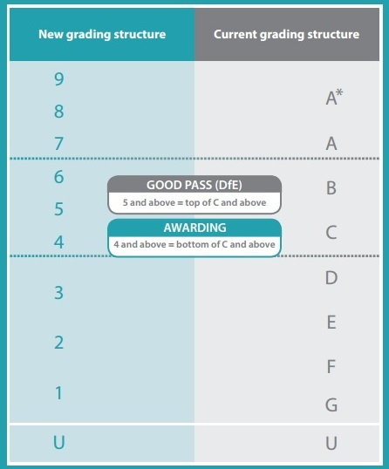
How are GCSEs graded?

Slide 5
What is the Ebacc?
The Ebacc is not a qualification in its own right, it is a suite of qualifications.
A child is considered to have achieved the EBacc if they have got ‘good passes’ (currently grade 4 or above) in English, maths, science, history or geography and a language.
At LHS we offer the opportunity for pupils to take these subjects together and encourage them to experience a broad and balanced curriculum.

Slide 6
Should my child be taking the EBacc?
We encourage our pupils to take the EBacc it as offers a good basis to build on for later study, for example, the languages element helps to improve vocabulary, and sentence construction; reinforcing the literacy needed in English, history and geography. It also deepens an understanding of other cultures.
Some of the top universities consider EBacc combinations when making offers, and employers understand these subjects and qualifications.

Slide 7
What are the compulsory subjects which pupils must study?
All pupils must study:
English literature and language (GCSE)
Mathematics (GCSE)
Science (GCSE) – either combined or triple
History and/or geography (GCSE), and/or French and/or Spanish – more than one can be taken
Core PE – not examined
Life lessons – not examined
Final courses are subject to group sizes. So, while we endeavour to give 1st choices to ALL pupils, we ask you to indicate 2 reserve choices too.

Slide 8
What are the optional subjects?
Art and Design | GCSE
Computer Science | GCSE
Creative iMedia (ICT) | Vocational
Design Technology | GCSE
Enterprise (Business Studies) | Vocational
French | GCSE
Geography | GCSE
History | GCSE
Hospitality and Catering | Vocational
Music | GCSE
Religious Studies | GCSE
Spanish | GCSE
Sports Studies | Vocational
Triple Science | GCSE

Slide 9
How do I best support my child in making these decisions?
Talk to them about their future and what they would like to do as a career. Help them to research the qualifications needed to get into these jobs
If they don’t have a career aim, they should be aiming to get the best grades possible so discuss the subjects they enjoy studying. These are likely to be the ones they will achieve well in
Consider subjects which naturally work well together, such English, history and French, or Enterprise and iMedia
Please discourage your child from taking a subject because their friends are taking it, or because they like the teacher
Explore a range of options, not all subjects may run as this is based on demand from pupils.

Slide 10
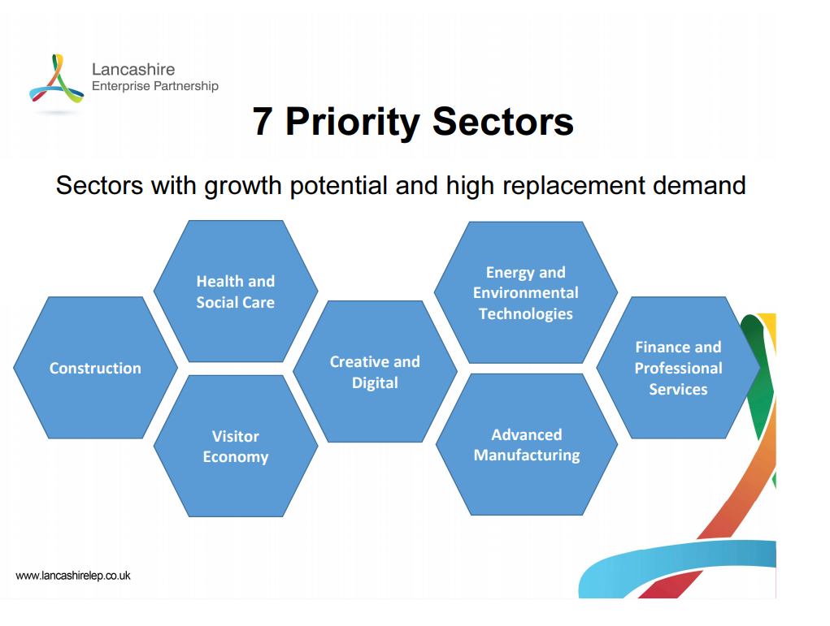

Slide 11
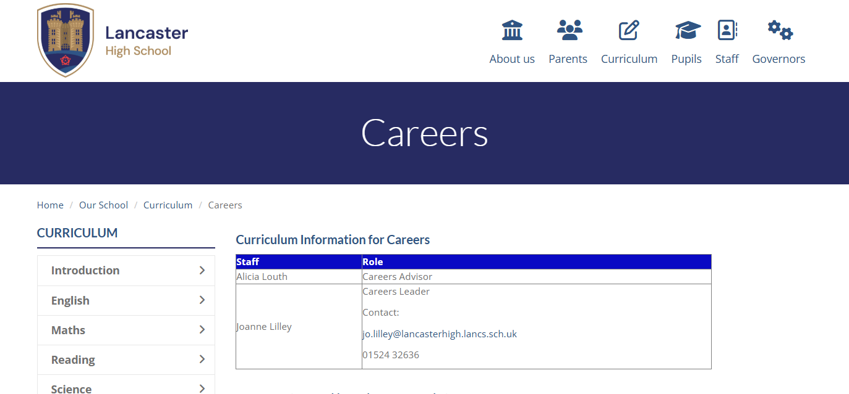
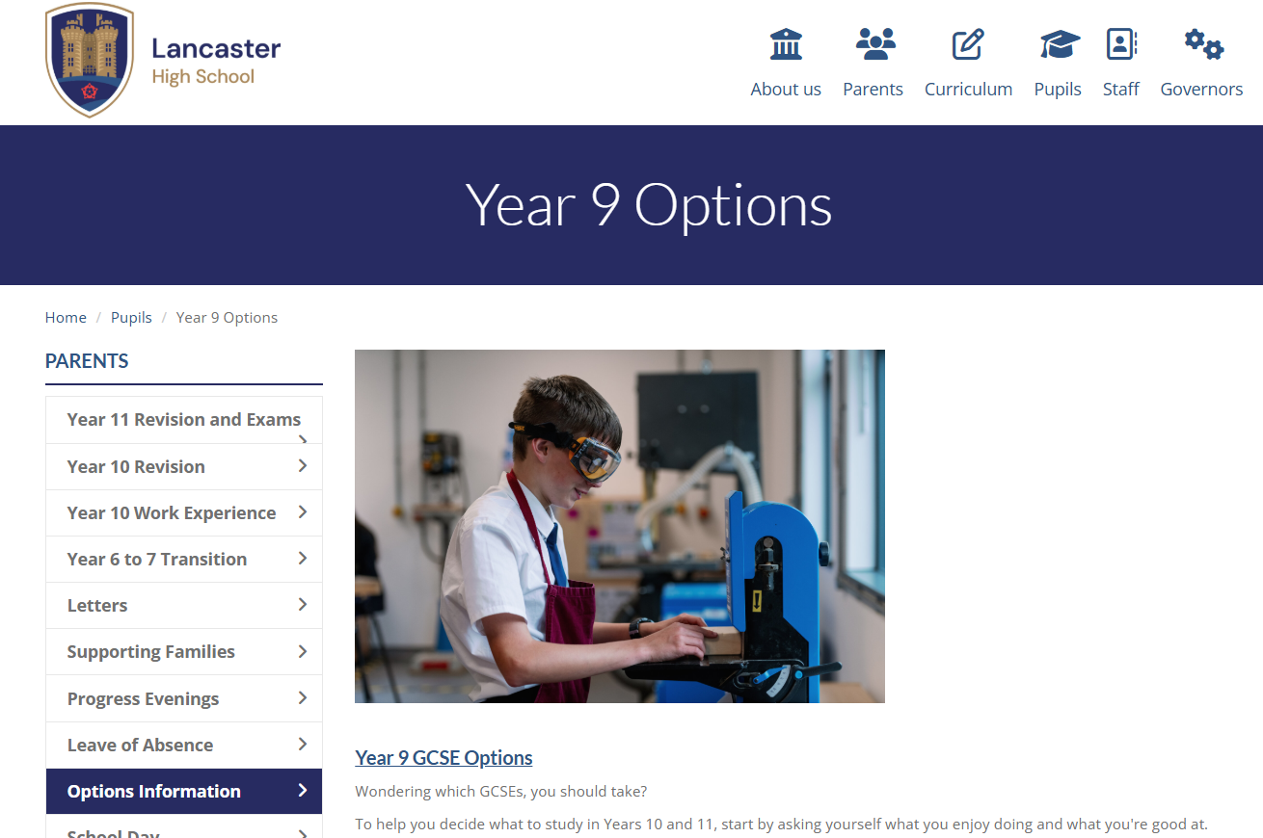
Further Information - School Website​

Slide 12
Other support available tonight
Mr Auger– SENDCO
Mr Clark– Head of Year 9
Ms. Louth - Independent Careers Advisor
Ms. Lilley – Careers Leader

Slide 13
















Careers Fair - A Floor
Find out about the wide range of courses, careers and training available to you when you leave Lancaster High School.
Take the opportunity to check entry requirements and career routes.

Slide 14
Dates for your diary
Thursday 12th February:
Options taster day for Year 9 pupils
On this day all Year 9 pupils will experience a lesson in the subjects which will be new to them should they choose to study them next academic year. This will include Sports Studies, Enterprise (Business Studies), Computing, iMedia and Hospitality and Catering. They will also have a careers session with an independent careers advisor focusing on the local labour market and how option choices might have an impact on their future employability.
Year 9 Progress Evening, face-to-face 4.00pm – 6.30pm
This evening provides you with a final opportunity to discuss your child’s academic progress to date and ask any follow up questions regarding KS4 study.

Slide 15
Dates for your diary
5th March 2026: Initial Interest Microsoft Form
9th March – 16th April 2026: 1-1 interviews to discuss initial options
23rd April 2026: Options Form Deadline
24th June 2026: Confirmed options to pupils and parents

Slide 16
Subject presentations – 6.20, 6.45, 7.10 and 7.35
Subject | Room
Art and Design | M2
Computer Science: 6.45 and 7.10 | M4
Creative iMedia: 6.20 and 7.35 | M4
Enterprise / | E2
French / Spanish | M3
Geography | M5
History | E1
Hospitality and Catering / Design Technology | T1
Music | M1
Religious Studies | E3
Sports Studies | E4
Triple Science | E5

