Slide 1

Literacy CPD session
2020 – Reading Introduction

Slide 2
Your reading test for starters:
How many animals did Moses bring onto the Ark?
There is a plane that is flying close to the border between Canada and the U.S.A. There is an engine failure and the plane crashes right on the border of Canada and U.S.A. Where do they bury the survivors?
A woman shoots her husband, then holds him underwater for five minutes. A little while later, they both go out and enjoy a wonderful dinner together. How can this be?

Slide 3

What is Literacy? Debunking the myths
Literacy is how we communicate and make sense of the world we live in.
Literacy is about giving students a voice!
We are ALL teachers of literacy!
Reading
Writing
Speaking
Listening

Slide 4
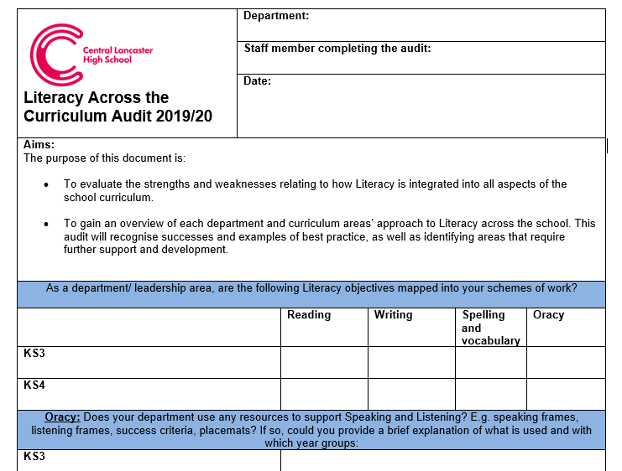
Feedback from the Literacy Audit
A number of departments did not see that Reading was part of their curriculum area and focus.
Reading: exams? Textbooks? Revision Guides?
All subject areas involve some form of reading and writing. The average reading age for an exam question is 13. Some of our students will have LOWER reading age than this; it is vital that reading skills are taught to ensure that students can decode their exam questions.

Slide 5
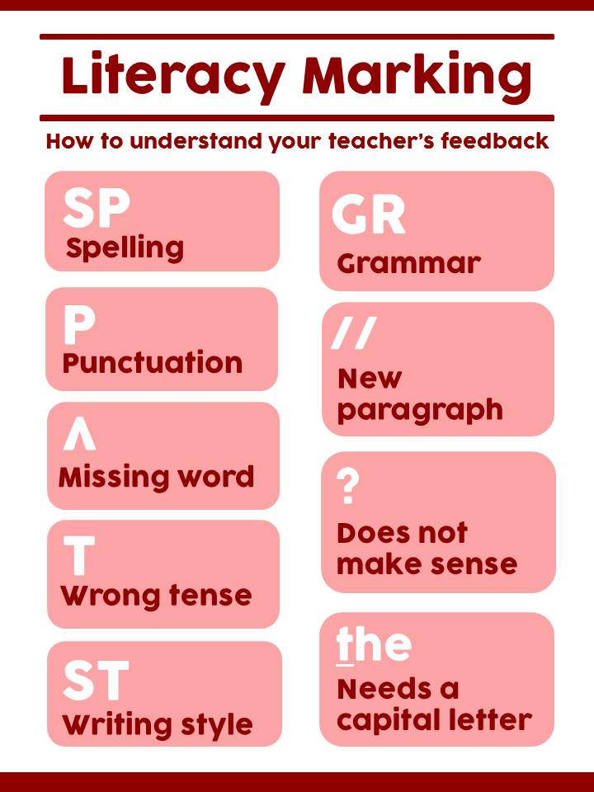
What we tend to focus on
But this is about honing skills.
Great writers are great readers.
Writing is a complex issue – we are focusing on here on elements that come towards the end - should we really be focusing on spellings when students only use low level words? Should we be focusing on capital letters when students are writing one or two sentences or missing out whole exam questions?
Should we mark for spelling and grammar at all if a student has misread a question??? Or should we instead focus on Reading and the explicit teaching of this?

Slide 6

What we need to focus on this year – reading
Only 73% of children in 2019 left primary school with the expected level of reading. Imagine what that % might be in this year’s climate!
This will see many unprepared for the challenging demands of academic reading and with little time to catch-up.
Children who were read to daily as a child will have over 1.4 million more words at their grasp than peers who were not read to.
Fewer than 1 in 5 of students who did not meet expected levels in literacy at primary school will achieve a level 4 at GCSE. What are we doing to overcome this issue at KS3?

Slide 7

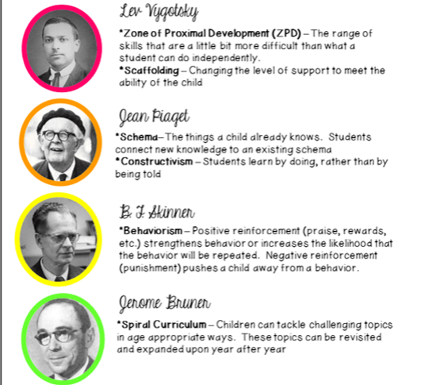
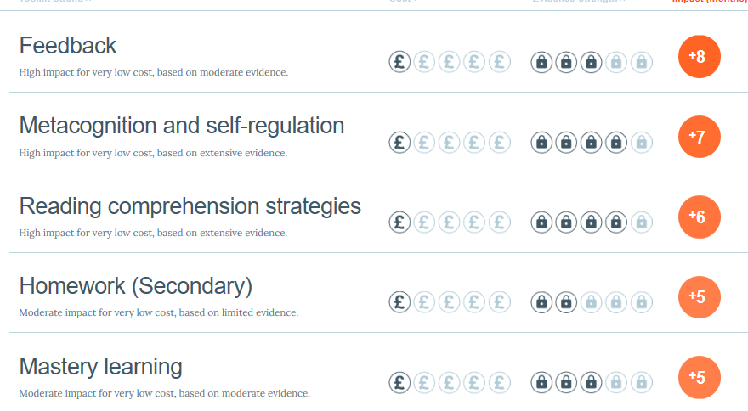
Links to theories…

Slide 8
Read this – what words do you think could replace the gaps?
"Hold your noise!" cried a _____voice, as a man started up from among the graves at the side of the church porch. "Keep still, you little devil, or I'll cut your _____!"
A ______ man, all in coarse grey, with a great iron on his leg. A man with no hat, and with broken shoes, and with an old ____ tied round his head. A man who had been ____ in water, and _____ in mud, and lamed by stones, and cut by flints, and stung by nettles, and torn by briars; who limped, and shivered, and glared and growled; and whose teeth _____ in his head as he _____ me by the chin.
"O! Don't cut my throat, sir," I ______ in terror. "Pray don't do it, sir."
"Tell us your name!" said the man. "Quick!"
"Pip, sir."
"Once more," said the man, staring at me. "Give it mouth!"
"Pip. Pip, sir."
"Show us where you live," said the man. "Pint out the place!"
I pointed to where our village lay, on the flat in-shore among the alder-trees and pollards, a mile or more from the church.
The man, after looking at me for a moment, turned me upside down, and emptied my pockets. There was nothing in them but a piece of bread. When the church came to itself - for he was so ____ and ______ that he made it go head over heels before me, and I saw the steeple under my feet - when the church came to itself, I say, I was seated on a high tombstone, trembling, while he ate the bread ______.

Slide 9
The answers – how close were you?
"Hold your noise!" cried a terrible voice, as a man started up from among the graves at the side of the church porch. "Keep still, you little devil, or I'll cut your throat!"
A fearful man, all in coarse grey, with a great iron on his leg. A man with no hat, and with broken shoes, and with an old rag tied round his head. A man who had been soaked in water, and smothered in mud, and lamed by stones, and cut by flints, and stung by nettles, and torn by briars; who limped, and shivered, and glared and growled; and whose teeth chattered in his head as he seized me by the chin.
"O! Don't cut my throat, sir," I pleaded in terror. "Pray don't do it, sir."
"Tell us your name!" said the man. "Quick!"
"Pip, sir."
"Once more," said the man, staring at me. "Give it mouth!"
"Pip. Pip, sir."
"Show us where you live," said the man. "Pint out the place!"
I pointed to where our village lay, on the flat in-shore among the alder-trees and pollards, a mile or more from the church.
The man, after looking at me for a moment, turned me upside down, and emptied my pockets. There was nothing in them but a piece of bread. When the church came to itself - for he was so sudden and strong that he made it go head over heels before me, and I saw the steeple under my feet - when the church came to itself, I say, I was seated on a high tombstone, trembling, while he ate the bread ravenously.

Slide 10
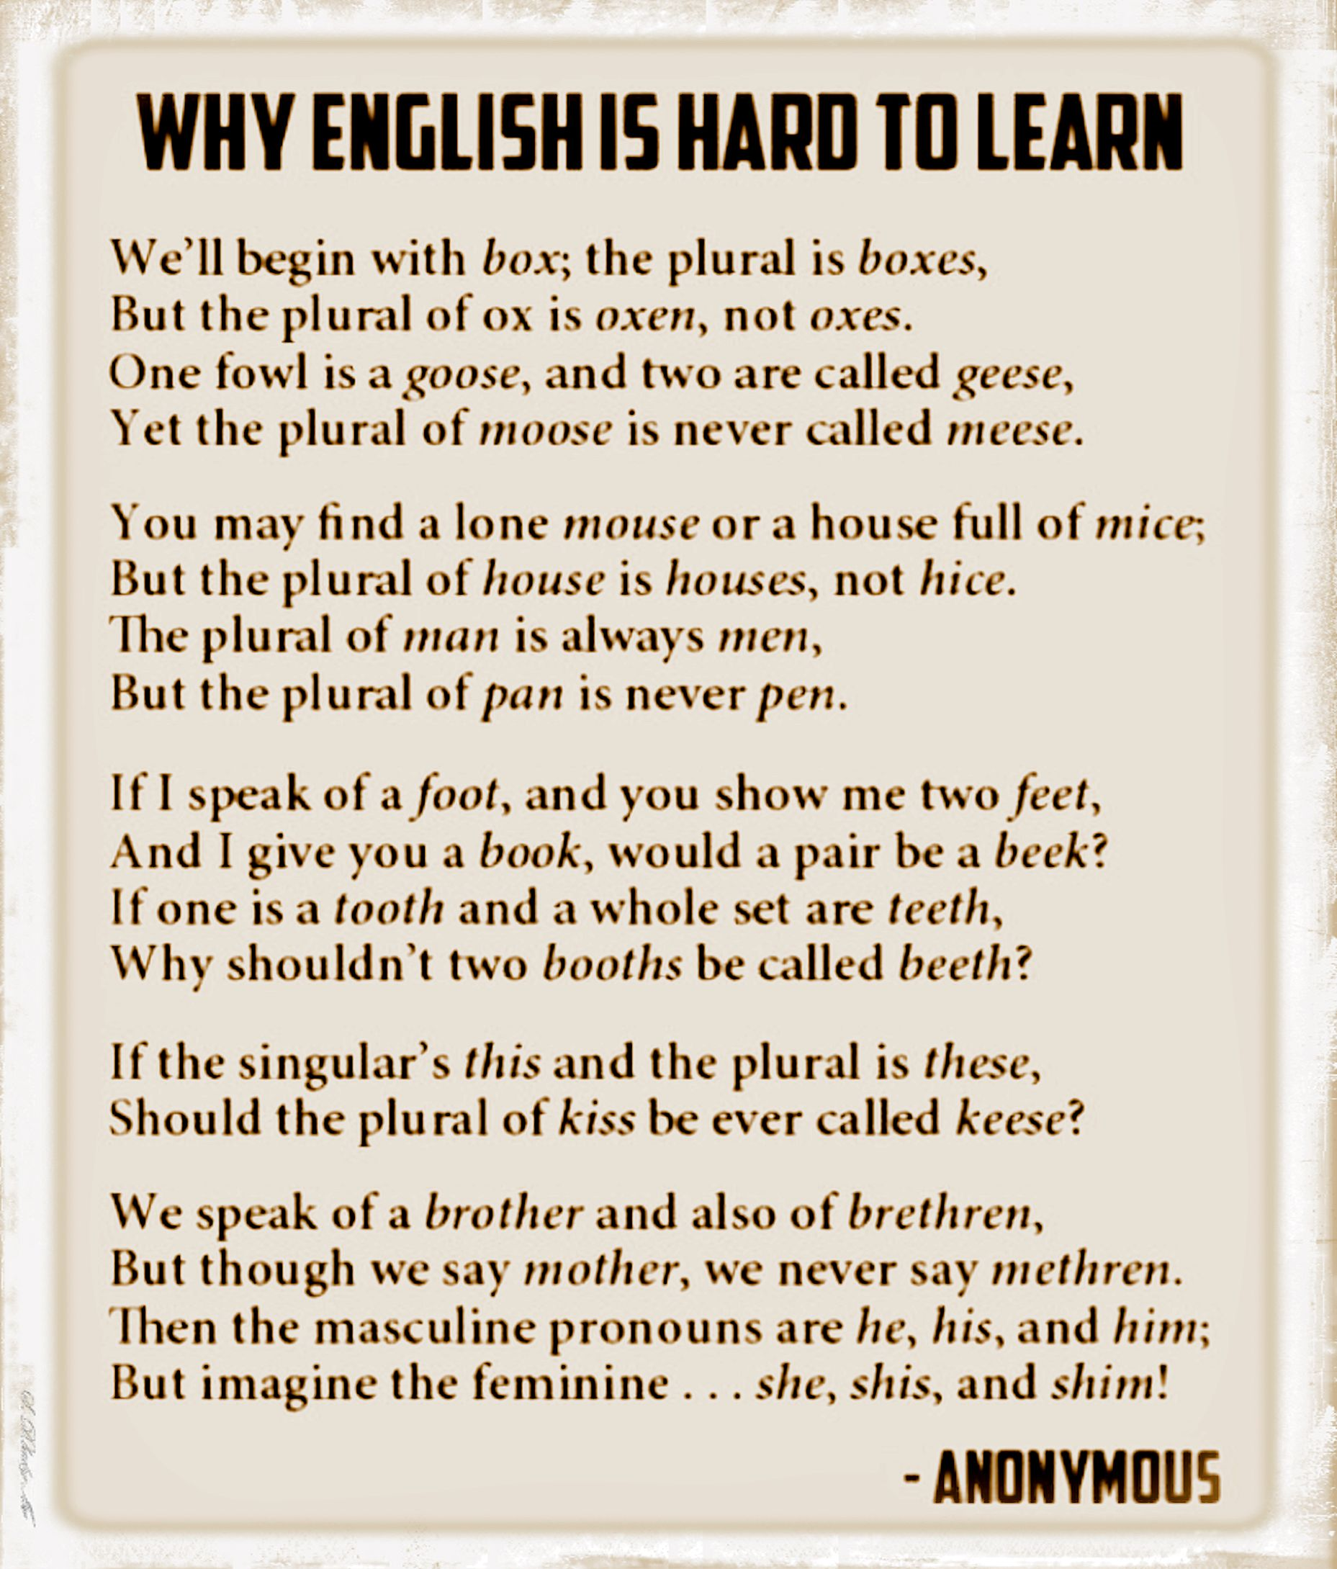
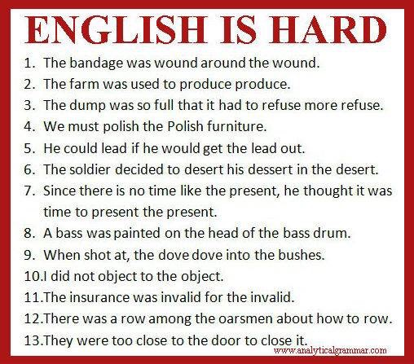
English has borrowed words from over 350 languages. 3x as many words as German and 6 x as many as French!

Slide 11
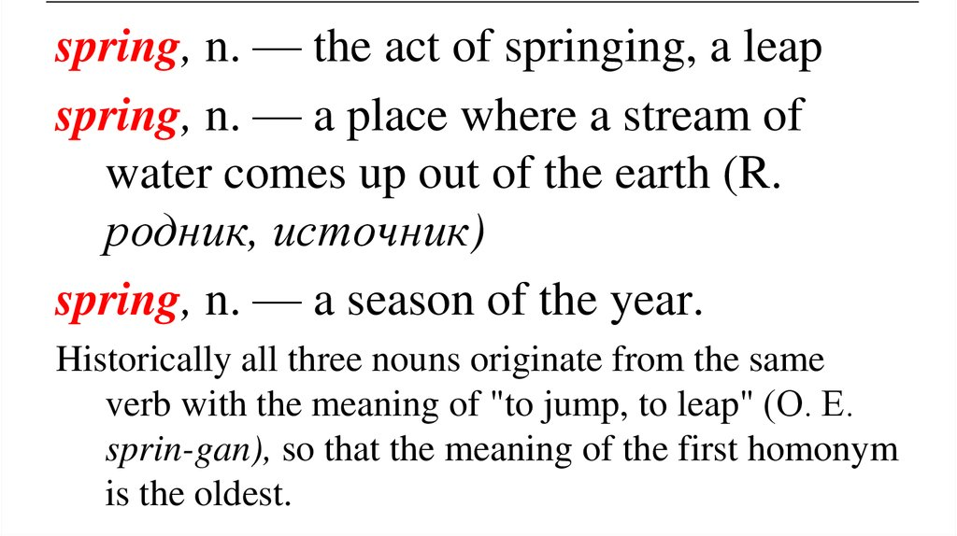
Difficulties continued…
80% of words in English are polysemous – have multiple meanings.
Solution in science has a different meaning to that in history.
Bleeding in art has a different meaning to bleeding in a Literature tragedy.

Slide 12

We take for granted that students can read as fluently as we can.
For a child to read an extract individually, they need to be able to read with 95% word recognition.
If we ask students to read texts that are too difficult, then we run the risk of putting them off altogether.
If we ask students to read texts that are too easy, then they will not develop.

Slide 13
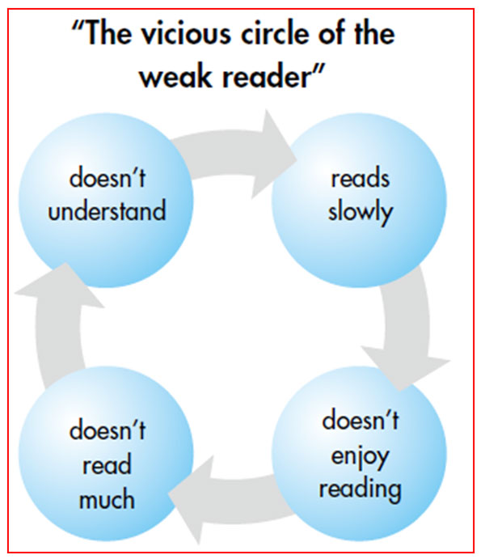
If we do not teach students how to be adaptable, the cycle continues. Students get frustrated with texts. They deem it frustrating and boring. Reading practice is avoided and so the cycle continues.

Slide 14

READ THIS:
How quickly did you read?
Did you read EVERY word?
What questions do you have after reading?
It was a bright cold day in April, and the clocks were striking thirteen. Winston Smith, his chin nuzzled into his breast in an effort to escape the vile wind, slipped quickly through the glass doors of Victory Mansions.

Slide 15
As an effective reader…
Each word would have received 250 milliseconds of fame. You will have read each line in a regular rhythm, moving quickly as does the character of Winston.
You would have drawn on your knowledge of words, phrases and syntax (order and structure of sentences). The word thirteen might have been highlighted to your brain as something unusual and you may have made links to Friday 13th – unlucky for some.
All this happens in such a short time frame and we often take for granted that students can do this without any guidance and support from us.

Slide 16

Why is it so important?
We often take for granted that you can simply give a student a text and they can read it – understand it – follow and recall it – locate information easily and then regurgitate what they have read in order to transfer the skills.
Cognitive overload for some. Therefore, we need to teach explicit reading skills

Slide 17
Exam issues…
Let’s look at some examples:

Slide 18

Text from a Primary Reader
Katje had an easy life. She lived with Nico the miller in a Dutch village by the sea. While Nico ground grain in his windmill, Katje chased mice. Up and down the ladders she prowled., searching behind sacks of grain and along beams dusty with flour.
Which words in this text might hinder a reader?

Slide 19
That was for a 6 year old …imagine what it is like by the time we get to GCSE…
Physics paper – foundation 2018
A student wanted to determine the density of a small piece of rock.
Describe how the student could measure the volume of the piece of rock.
Need to be able to decode BEFORE figuring out how to calculate a volume BEFORE then figuring out how to write to describe!

Slide 20
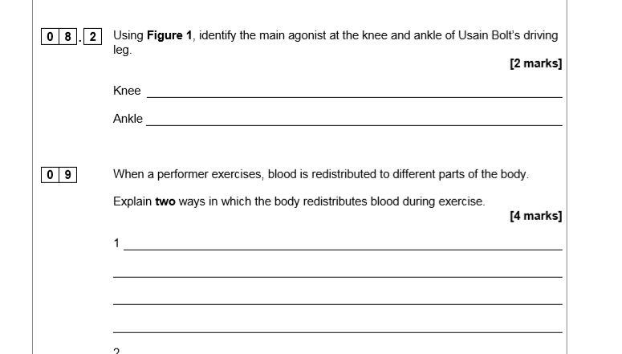
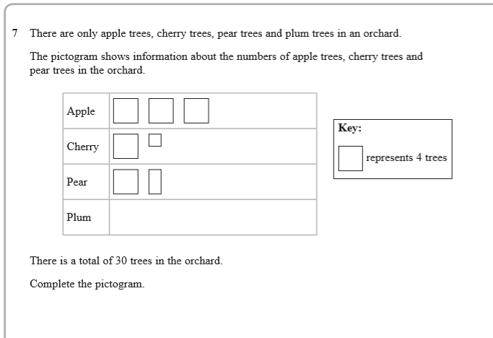
PE and Maths
These are real exam questions – what issues may arise here?

Slide 21
Reading Paradox
Paradox between the reading that students do at Primary – focused on condensing texts and focused on Literacy and maths at the deficit of other subject areas. Yet it is the navigation of subjects such as science and geography that helps students with the ability to read complex academic texts.
We need to:
Train teachers to be experts in how pupils ‘learn to read’ and ‘read to learn.’
Develop and teach a coherent and cumulative reading rich curriculum
Teach with a focus on reading access, practice and enhancing reading ability
Teach, model and scaffold pupils’ reading so that they become strategic and knowledgeable readers
Nurture pupils’ motivation to read with purpose and for pleasure
Foster a reading culture within and beyond the school gates.
Narrowing down and making things ‘easier’ for students can have the effect of making the curriculum harder as students progress through the years. We still teach Shakespeare in Year 7. We will give guided support and scaffolds in which to do this, but we will not dumb down the language as this will have a detrimental effect later in KS4.

Slide 22
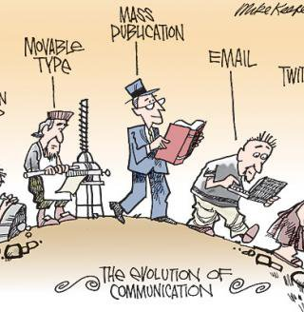
We need to act - now!
The sobering reality is that only in the last couple of hundred of years, most people in the West could read and write. Only in the last 5,000 years has reading been a ‘thing’ – very short in our evolutionary path. Literature specifically for children has only been around for the last couple of hundred of years yet a lot of our lives revolve around the stories of Beatrix Potter’s rabbits, Harry Potter’s spells, Alice and her Looking Glass or Tom Brown and his school days. Reading is fragile: technologies are threatening the sharing of a paperback or the depth of concentration students have.

Slide 23
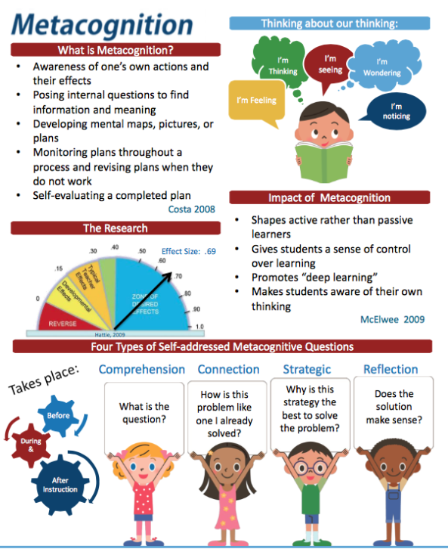
Students who plan, monitor and question what they read are more likely to access a text. Therefore, they are more likely to show independence and resilience in an exam = fewer questions missed out and fewer students putting their pens down aften ten minutes or less in an exam!

Slide 24
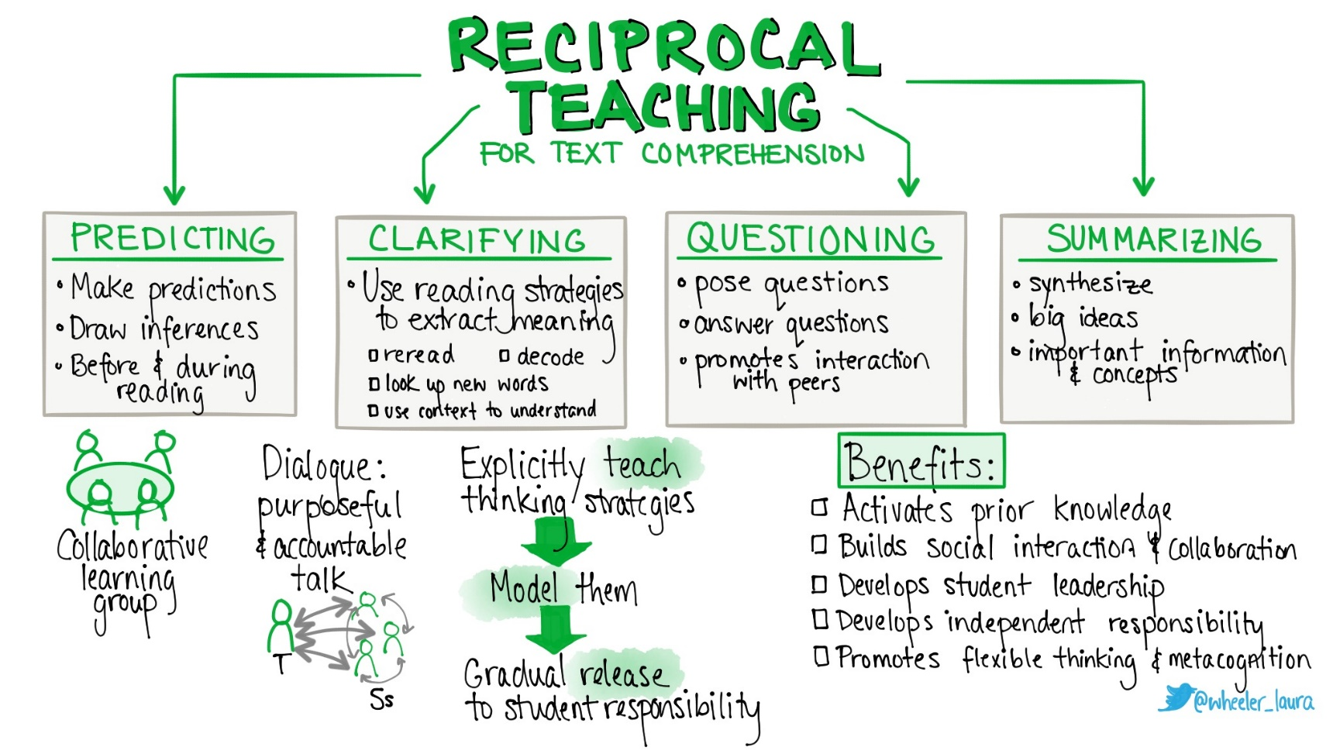
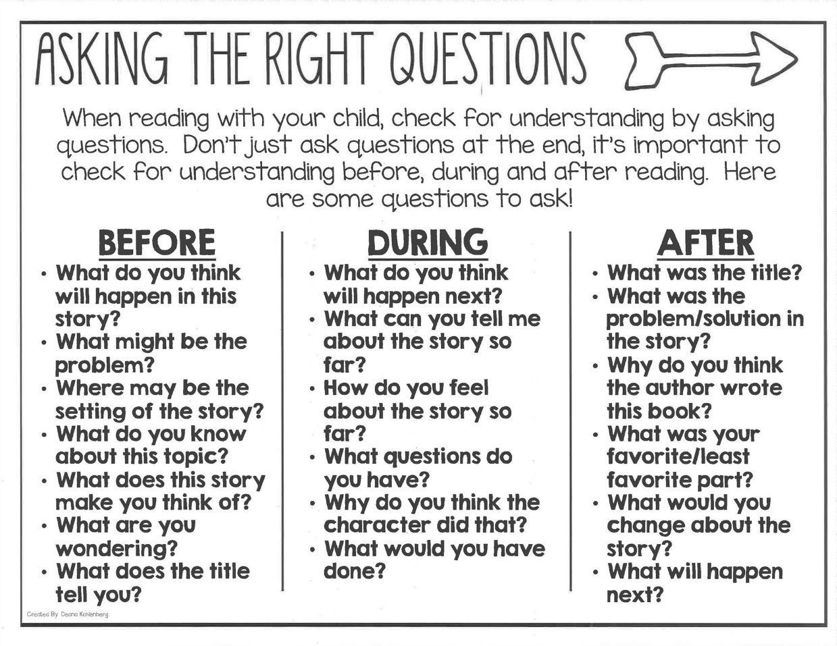
How deliberately do you chunk down the act of reading? How consistently do you model and highlight comprehension monitoring? Asking questions? Modelling rereading? How often do you assume that a text has been read and understood?

Slide 25
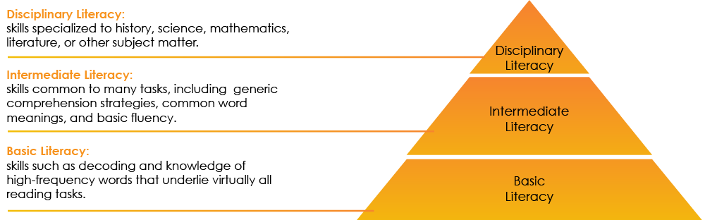
Disciplinary Literacy
By paying attention to the specialised ways of reading, knowing and doing, in each subject discipline, we can recognise that there are both general reading skills and subject-specialism strategies that our students need to develop.

Slide 26
Maths: seldom the one we associate with reading. Reading the unique language of mathematics has been described as tantamount to reading Anna Karenina in Russian. Maths questions and textbooks have more concepts per word, per sentence, per paragraph than any other area.
Example: fractions of a whole rod might have students looking for a fishing rod – this is their prior knowledge that they bring to this area. Combine maths problems and set them out in a written way needs a two-fold approach as this requires students to be able to work out the reading of the words and their meanings and apply alongside this their maths knowledge.
Pupils can find it difficult to move between text and graphics
Pupils can find maths problems difficult as some words only found in maths (isosceles), alongside those that have a wider and more common use both within and outside of maths (prime, factor). Added to that some sound familiar but aren’t pi and not pie.
Have to be able to interpret words that can have similar meanings: increase, positive, add and more can denote +
Easily confuse related maths terms e.g. Denominator and numerator.

Slide 27
Next sessions:
The next CPD session in going to be in subject teams.
You will have several tasks to complete specific to your subject area.
Feedback to LS on strengths and weaknesses or areas of support needed, and the third session will deal with these. We will have a carousel of activities to support reading based on your wants and needs.

Slide 28
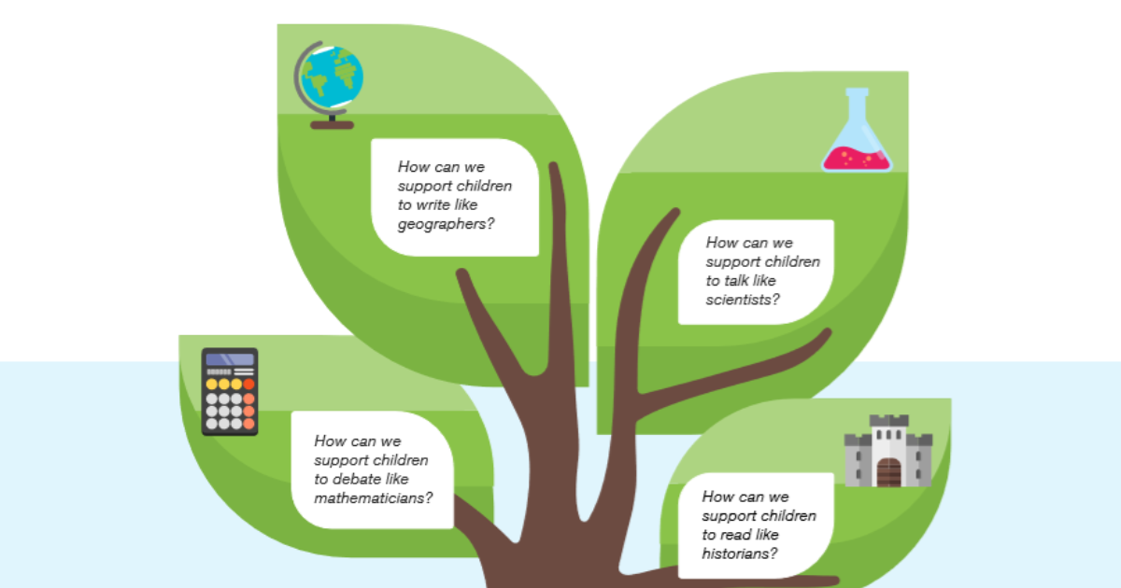

Slide 29
Then, we want you to identify what specifics are needed for your own subject specialism.
Example: How does a Geographer read? What text types might they encounter? What viewpoints (political, environmental etc) and perspectives do they need to consider? What specialist language do they need explicitly teaching?
Curriculum SOLs – where is evident the micro detail of important vocabulary alongside the decisions that attend extended teaching text choices? Can we identify the ‘essential’ and ‘additional’ reading for topics to ensure we map our desirable wider reading that would enrich our pupils’ required understanding and background knowledge?

Slide 30
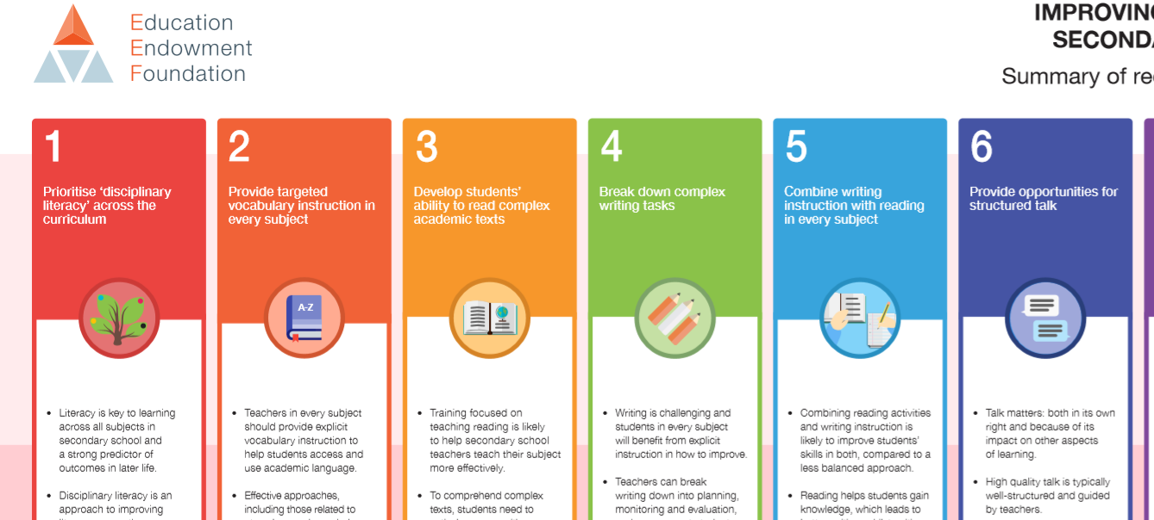
You will be given one of these for your Department Areas

Slide 31
The real challenge for secondary school teachers is not so much teaching children how to read, but teaching children how to read to learn. This is not just semantics: it’s a reorientation away from the notion of reading as being some kind of general ability that students can deploy equally across the curriculum. It involves seeing reading in terms of specific disciplinary practices.
Reading in religious studies is not the same as reading in geography; what scientists read and how they read it is very different to the reading processes undertaken by mathematicians. Similarly, being a good reader in English - being able to interpret characters and themes in stories - doesn’t really help in learning the process of evolution from a biology textbook. These reading ‘skills’ are not transferable.

Slide 32
In your subject areas, this Thursday, you will be given a sheet and an English Teacher to support ☺
Maths & Science With LMS (A12) | Geography, History & RE With AEN (D Floor) | MFL and visual arts With NC (conference room)
PE, Performing Arts, Music MT (A1) | The technologies (IT, DT etc) and business With CH (A3)

Slide 33
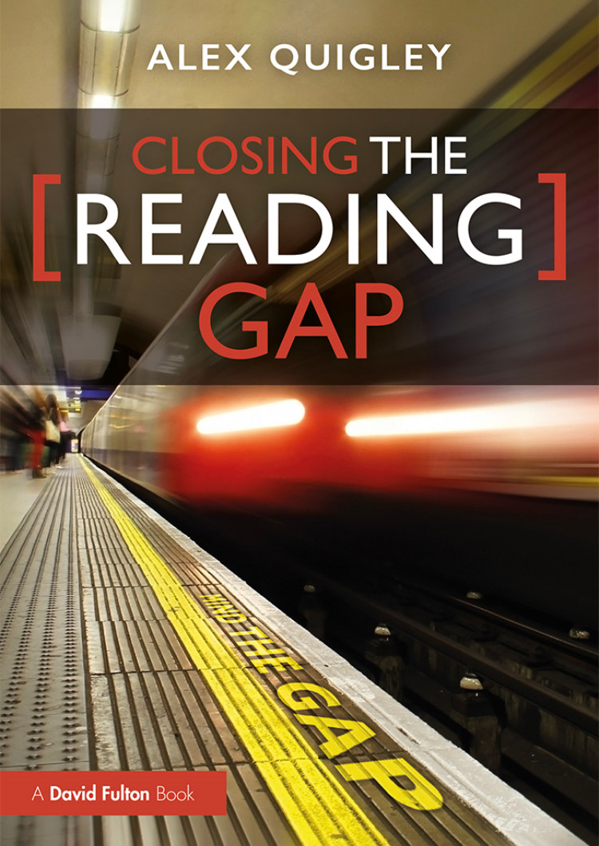

Further reading…

Slide 34


Slide 35
Resources and subject specific content to be sent out for the Thursday session
Not complete yet.

Slide 36
History: look to acquire ‘period sensitivity’ – recognising patterns of change and continuity over time. Own unique strategies:
Sourcing: who wrote it? What message? Implicit or explicit?
Contextualising: source – time and place. Social and political influences. Who was the intended audience?
Corroborating – what is the relative reliability of a text in conjunction with another text?
Tentative – modal verbs ‘’may’ could’ and ‘might’ and attended by familiar language such as ‘revive’ ‘remain’ ‘parallel’ and ‘re-establish’.

Slide 37
MFL: For this we must go back to the building blocks of English. Outline the differences in pronunciation examples: o sound in English low (L/o/w) has many combinations in French to achieve the same sound – bateau, faux, drole for example.

Slide 38
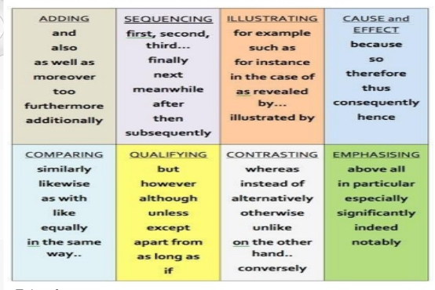
How do you teach skills of:
Description
Sequence
Cause and effect
Compare and contrast
Problem and solution

Slide 39
What extra reading – homework etc?

Slide 40
Send ideas for the following to LS.
Promoting Reading Fluency
Developing strategic Readers
Developing high quality dialogue:
Promoting Quality Questioning
Vocabulary instruction to support reading
There is a huge leap from Year 6 to 7 in terms of the vocabulary used in each subject area – what are we doing in KS3 to facilitate this?

Slide 41
Session 3

Slide 42

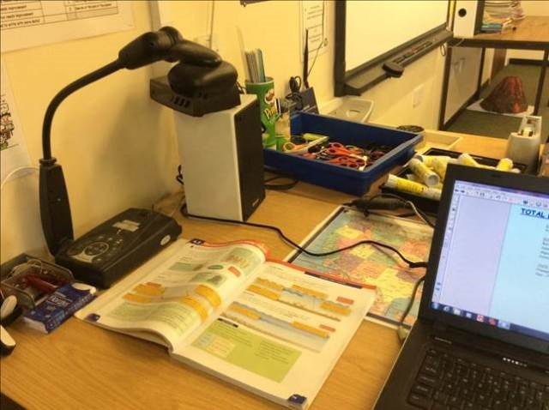

Predict

Slide 43
Clarify and summarise – summarise key sections – track. Ask students to highlight words they don’t understand. Questions – what is happening? What have we learned? What connections can we make? Why specific words and phrases?
We slept in what had once been the gymnasium. The floor was of varnished wood, with stripes and circles painted on it, for the games that were formerly played there; the hoops for the basketball nets were still in place, though the nets were gone. A balcony ran around the room, for the spectators, and I thought I could smell, faintly like an afterimage, the pungent scent of sweat, shot through with the sweet taint of chewing gum and perfume from the watching girls, felt-skirted as I knew from pictures, later in miniskirts, then pants, then in one earring, spiky green-streaked hair. Dances would have been held there; the music lingered, a palimpsest of unheard sound, style upon style, an undercurrent of drums, a forlorn wail, garlands made of tissue-paper flowers, cardboard devils, a revolving ball of mirrors, powdering the dancers with a snow of light.
There was old sex in the room and loneliness, and expectation, of something without a shape or name. I remember that yearning, for something that was always about to happen and was never the same as the hands that were on us there and then, in the small of the back, or out back, in the parking lot, or in the television room with the sound turned down and only the pictures flickering over lifting flesh.
We yearned for the future. How did we learn it, that talent for insatiability? It was in the air; and it was still in the air, an after-thought, as we tried to sleep, in the army cots that had been set up in rows, with spaces between so we could not talk. We had flannelette sheets, like children's, and army-issue blankets, old ones that still said U.S. We folded our clothes neatly and laid them on the stools at the ends of the beds. The lights were turned down but not out. Aunt Sara and Aunt Elizabeth patrolled; they had electric cattle prods slung on thongs from their leather belts.
No guns though, even they could not be trusted with guns. Guns were for the guards, specially picked from the Angels. The guards weren't allowed inside the building except when called, and we weren't allowed out, except for our walks, twice daily, two by two around the football field, which was enclosed now by a chain-link fence topped with barbed wire. The Angels stood outside it with their backs to us. They were objects of fear to us, but of something else as well. If only they would look. If only we could talk to them. Something could be exchanged, we thought, some deal made, some tradeoff, we still had our bodies. That was our fantasy.

Slide 44
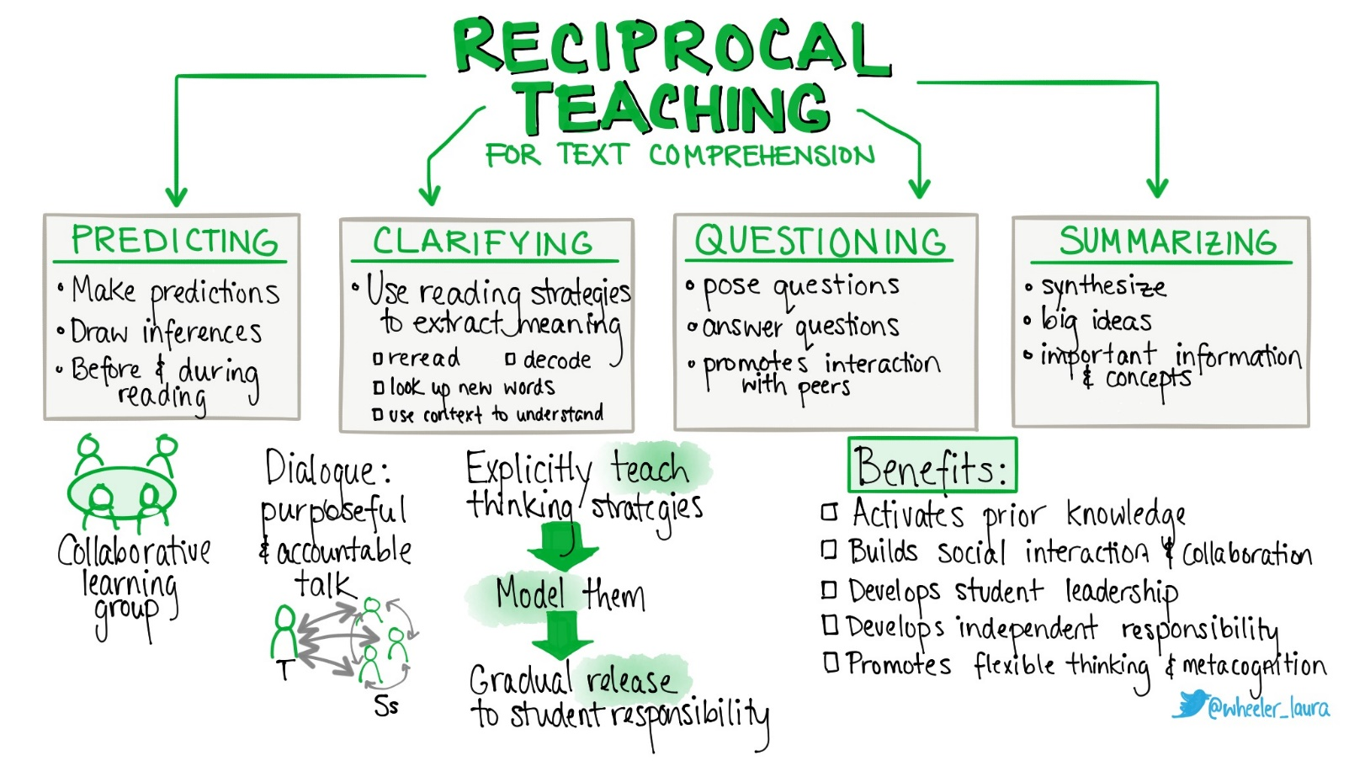
How might we approach the text opposite using the reciprocal reading approach?
5 mins in your teams …
On a foggy August afternoon in 1875, a lone swimmer dived from Admiralty Pier in Dover into the cold waters of the English Channel. Nearly 22 hours later, the exhausted man staggered onto the French soils at Calais ad became an instant hero. Captain Matthew Webb had become the first person to swim across the English Channel.

Slide 45
Captain Matthew Webb
We are going to read an extract about this chap. What predictions might we make about his character from his name and title?

Slide 46
Clarify – the geography and challenge of crossing the Channel? Any words we are unsure of?
Question – our predictions of his character? Motivations etc? Why we need to be told it was foggy?
Summarise – what he did and achieved and the attitudes to Webb after reading?
On a foggy August afternoon in 1875, a lone swimmer dived from Admiralty Pier in Dover into the cold waters of the English Channel. Nearly 22 hours later, the exhausted man staggered onto the French soils at Calais ad became an instant hero. Captain Matthew Webb had become the first person to swim across the English Channel.

Slide 47
Read the two passages about lighthouses and consider their similarities, differences and where and when a pupil may encounter them in the school curriculum. What might cause issues for some weaker readers?
For the great plateful of blue water was before her; the hoary lighthouse, distant, austere I the midst; and on the right, as far as the eye could see, fading and falling, in soft, low pleats, the green sand dunes with the wild flowing grasses on them.
Belle Toute lighthouse is a famous landmark on the top of the cliffs at Beachy Head, on the South coast of England… erosion of the cliff has continued since the lighthouse was moved back, and a series of wet winters and very dry summers has caused the erosion to speed up.

Slide 48
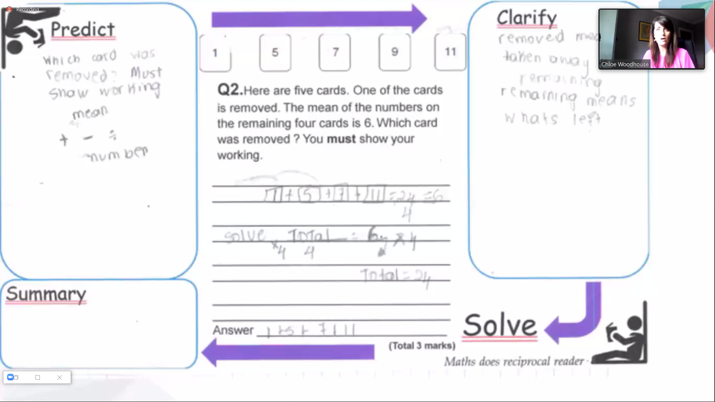
Examples from other schools:

Slide 49
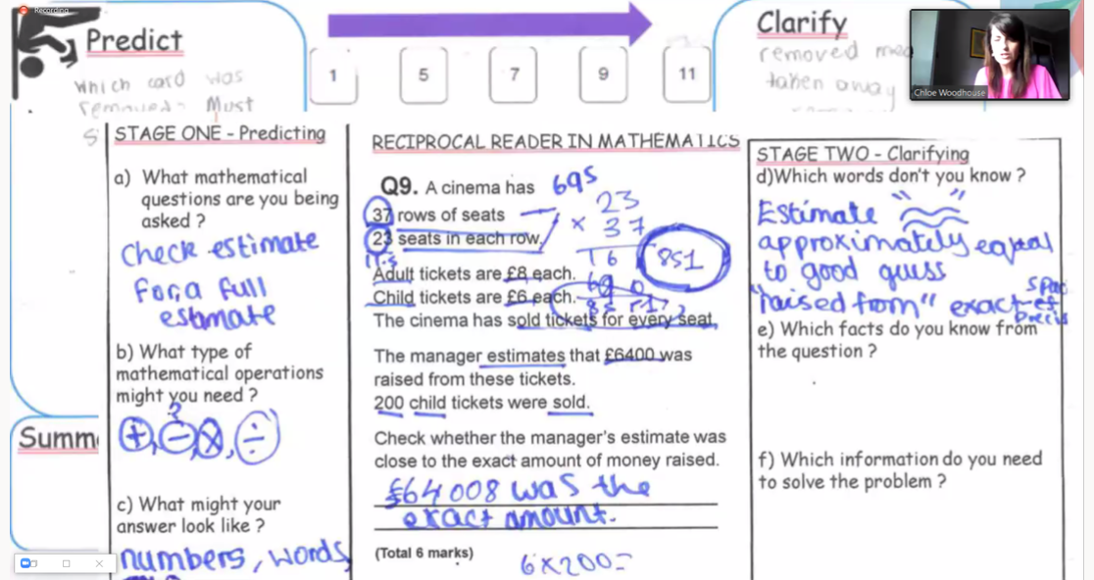

Slide 50

Question: Give students a question to find the answer to when reading. Ask questions to monitor understanding
Examples:
Who…?
What…?
Where…?
When…?
Why…?
How…?
What have you learnt so far about…?
Why is that word/ phrase/ sentence important?
Question: Give students a question to find the answer to when reading. Ask questions to monitor understanding
Examples:
Who…?
What…?
Where…?
When…?
Why…?
How…?
What have you learnt so far about…?
Why is that word/ phrase/ sentence important?
Reading
Strategies
Reading
Strategies
PREDICT: Activate Prior Knowledge
Examples:
What did we learn last lesson about this topic?
What do you already know about…?
What do you think…
What methods might we need for this question?
PREDICT: Activate Prior Knowledge
Examples:
What did we learn last lesson about this topic?
What do you already know about…?
What do you think…
What methods might we need for this question?
Clarify : Define new vocabulary. Check understanding of previously learnt vocabulary. Check understanding of previously learnt concepts. Share clues about the text.
Examples:
Remind us what ….means.
Define…
What can you remember about…?
What multiple meanings does the word … have?
Summarise : Check students’ understanding of the text.
Examples:
Explain...
Summarise…
Overall, what…?
Judge…
Determine…
Review…
Clarify : Define new vocabulary. Check understanding of previously learnt vocabulary. Check understanding of previously learnt concepts. Share clues about the text.
Examples:
Remind us what ….means.
Define…
What can you remember about…?
What multiple meanings does the word … have?
Summarise : Check students’ understanding of the text.
Examples:
Explain...
Summarise…
Overall, what…?
Judge…
Determine…
Review…

Slide 51
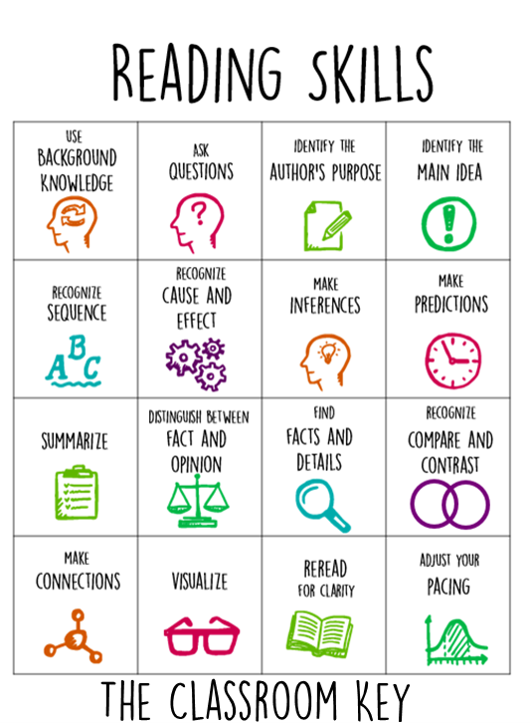

Others…

Slide 52
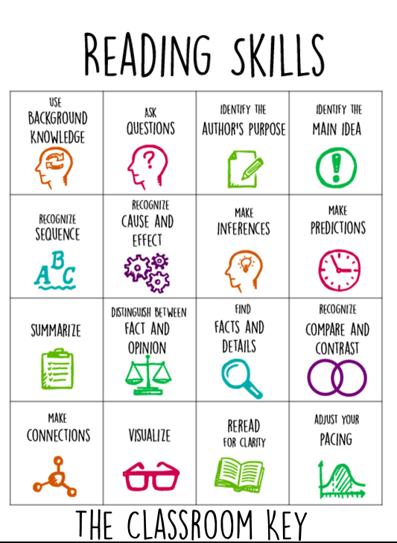
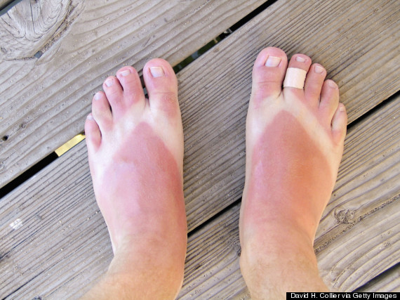
Example from an English SOL
Year 7
What can we infer from the image below?
Example: they have burnt their feet? They were wearing…

Slide 53
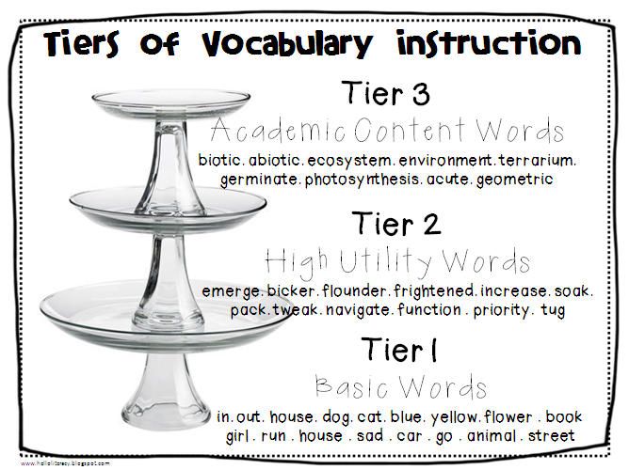

Vocabulary instruction
Step 3: Model the use.
Example:
What might we imply about a character if they speak using colloquial language?
In your essays you should avoid using colloquial language.
Ask: Why is colloquial language inappropriate?
What is the opposite?
What might we imply about a character if they speak using colloquial language?
Vocabulary
Instruction
Step 1: Select word.
Example: Colloquial.
Step 2: Define the word
Make sure the definition is accurate and student friendly. Often helpful to compare to other words students might be more familiar with.
Example: To describe how the characters speak in a play, we can use the work colloquial. Everyone say colloquial. Colloquial describes language which is ordinary and used in everyday conversation.
Informal.
Similar to SLANG.
Highlight the use of the word in your glossary/ knowledge organiser.
Step 4: Practice
Who uses colloquial language in the play?
Which characters don’t?
Create an overview of the character of … using the word colloquial in your response.

