Slide 1

Literacy CPD session
2020 – Reading Introduction

Slide 2
History: look to acquire ‘period sensitivity’ – recognising patterns of change and continuity over time. Own unique strategies:
Sourcing: who wrote it? What message? Implicit or explicit?
Contextualising: source – time and place. Social and political influences. Who was the intended audience?
Corroborating – what is the relative reliability of a text in conjunction with another text?
Tentative – modal verbs ‘’may’ could’ and ‘might’ and attended by familiar language such as ‘revive’ ‘remain’ ‘parallel’ and ‘re-establish’.

Slide 3
MFL: For this we must go back to the building blocks of English. Outline the differences in pronunciation examples: o sound in English low (L/o/w) has many combinations in French to achieve the same sound – bateau, faux, drole for example.

Slide 4
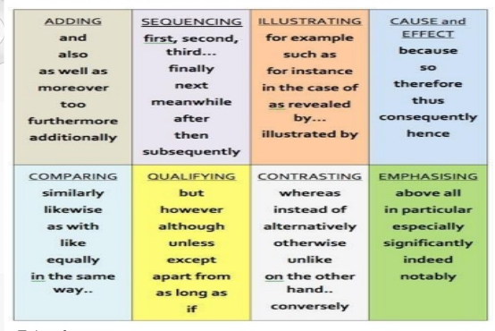
How do you teach skills of:
Description
Sequence
Cause and effect
Compare and contrast
Problem and solution

Slide 5
Send ideas for the following to LS.
Promoting Reading Fluency
Developing strategic Readers
Developing high quality dialogue:
Promoting Quality Questioning
Vocabulary instruction to support reading
There is a huge leap from Year 6 to 7 in terms of the vocabulary used in each subject area – what are we doing in KS3 to facilitate this?

Slide 6
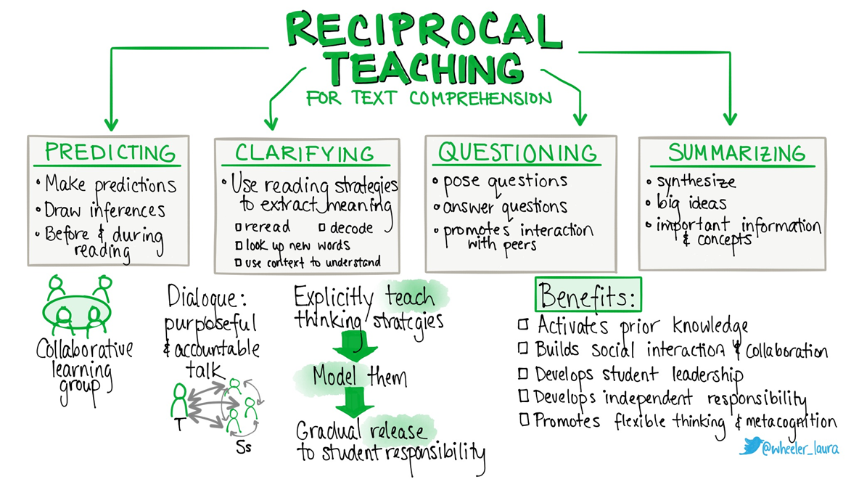
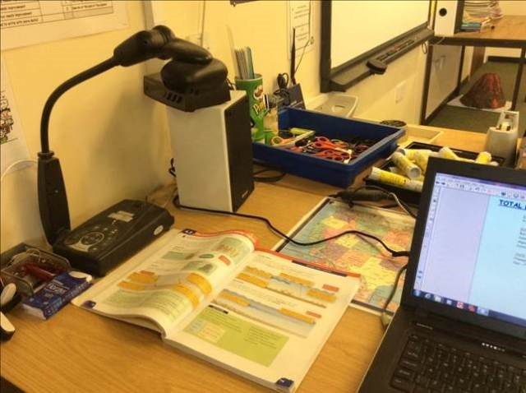
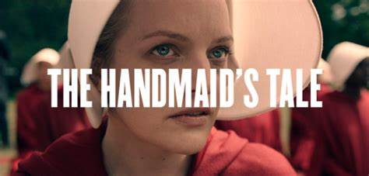
Predict

Slide 7
Clarify and summarise – summarise key sections – track. Ask students to highlight words they don’t understand. Questions – what is happening? What have we learned? What connections can we make? Why specific words and phrases?
We slept in what had once been the gymnasium. The floor was of varnished wood, with stripes and circles painted on it, for the games that were formerly played there; the hoops for the basketball nets were still in place, though the nets were gone. A balcony ran around the room, for the spectators, and I thought I could smell, faintly like an afterimage, the pungent scent of sweat, shot through with the sweet taint of chewing gum and perfume from the watching girls, felt-skirted as I knew from pictures, later in miniskirts, then pants, then in one earring, spiky green-streaked hair. Dances would have been held there; the music lingered, a palimpsest of unheard sound, style upon style, an undercurrent of drums, a forlorn wail, garlands made of tissue-paper flowers, cardboard devils, a revolving ball of mirrors, powdering the dancers with a snow of light.
There was old sex in the room and loneliness, and expectation, of something without a shape or name. I remember that yearning, for something that was always about to happen and was never the same as the hands that were on us there and then, in the small of the back, or out back, in the parking lot, or in the television room with the sound turned down and only the pictures flickering over lifting flesh.
We yearned for the future. How did we learn it, that talent for insatiability? It was in the air; and it was still in the air, an after-thought, as we tried to sleep, in the army cots that had been set up in rows, with spaces between so we could not talk. We had flannelette sheets, like children's, and army-issue blankets, old ones that still said U.S. We folded our clothes neatly and laid them on the stools at the ends of the beds. The lights were turned down but not out. Aunt Sara and Aunt Elizabeth patrolled; they had electric cattle prods slung on thongs from their leather belts.
No guns though, even they could not be trusted with guns. Guns were for the guards, specially picked from the Angels. The guards weren't allowed inside the building except when called, and we weren't allowed out, except for our walks, twice daily, two by two around the football field, which was enclosed now by a chain-link fence topped with barbed wire. The Angels stood outside it with their backs to us. They were objects of fear to us, but of something else as well. If only they would look. If only we could talk to them. Something could be exchanged, we thought, some deal made, some tradeoff, we still had our bodies. That was our fantasy.

Slide 8
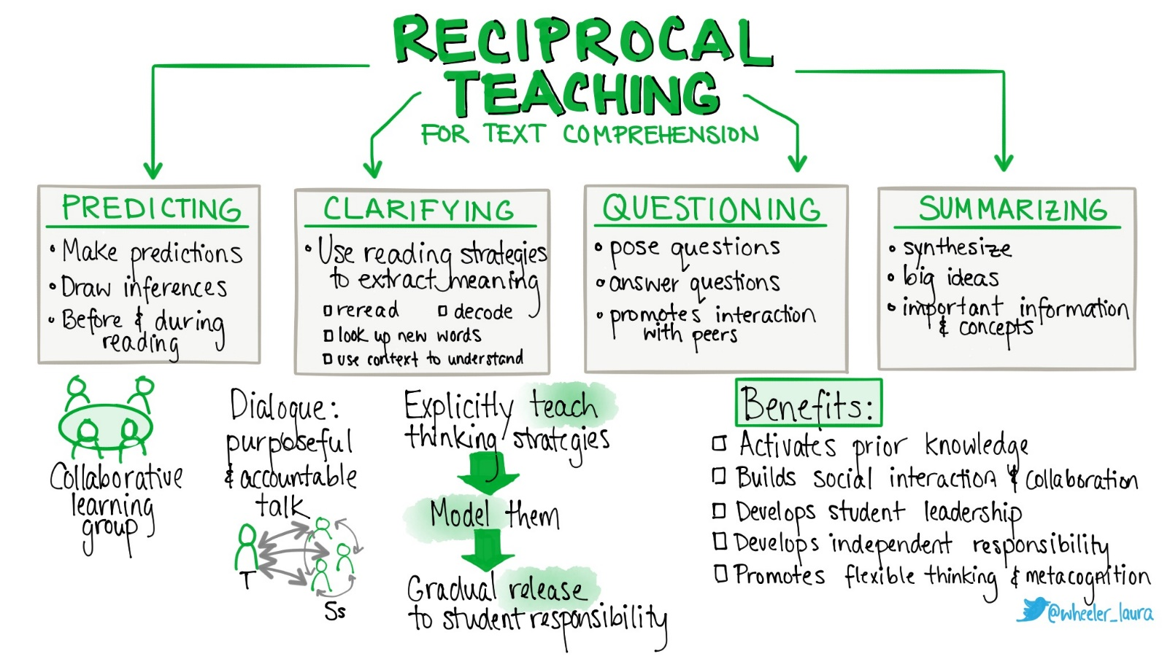
How might we approach the text opposite using the reciprocal reading approach?
5 mins in your teams …
On a foggy August afternoon in 1875, a lone swimmer dived from Admiralty Pier in Dover into the cold waters of the English Channel. Nearly 22 hours later, the exhausted man staggered onto the French soils at Calais ad became an instant hero. Captain Matthew Webb had become the first person to swim across the English Channel.

Slide 9
Captain Matthew Webb
We are going to read an extract about this chap. What predictions might we make about his character from his name and title?

Slide 10
Clarify – the geography and challenge of crossing the Channel? Any words we are unsure of?
Question – our predictions of his character? Motivations etc? Why we need to be told it was foggy?
Summarise – what he did and achieved and the attitudes to Webb after reading?
On a foggy August afternoon in 1875, a lone swimmer dived from Admiralty Pier in Dover into the cold waters of the English Channel. Nearly 22 hours later, the exhausted man staggered onto the French soils at Calais ad became an instant hero. Captain Matthew Webb had become the first person to swim across the English Channel.

Slide 11
Read the two passages about lighthouses and consider their similarities, differences and where and when a pupil may encounter them in the school curriculum. What might cause issues for some weaker readers?
For the great plateful of blue water was before her; the hoary lighthouse, distant, austere I the midst; and on the right, as far as the eye could see, fading and falling, in soft, low pleats, the green sand dunes with the wild flowing grasses on them.
Belle Toute lighthouse is a famous landmark on the top of the cliffs at Beachy Head, on the South coast of England… erosion of the cliff has continued since the lighthouse was moved back, and a series of wet winters and very dry summers has caused the erosion to speed up.

Slide 12
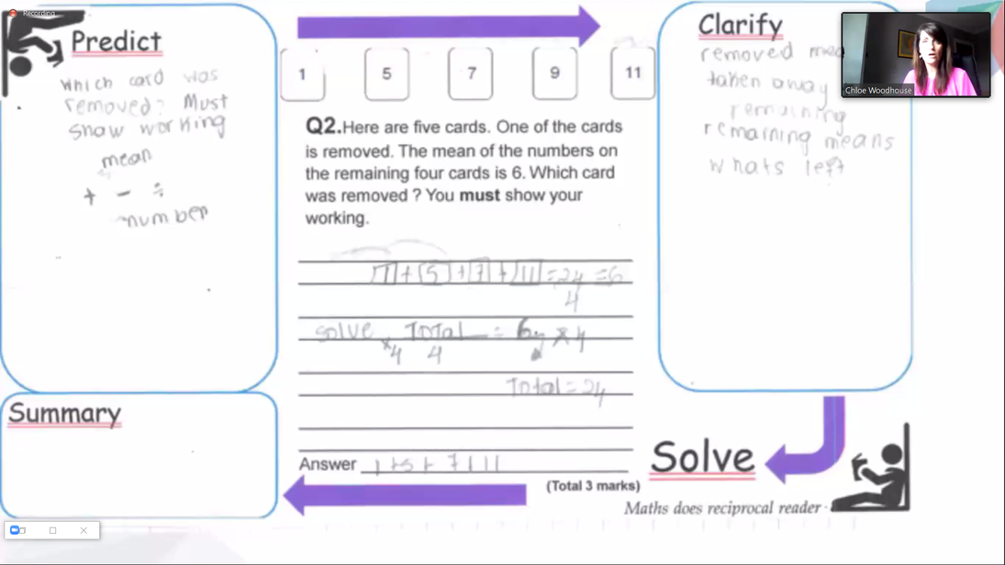
Examples from other schools:

Slide 13
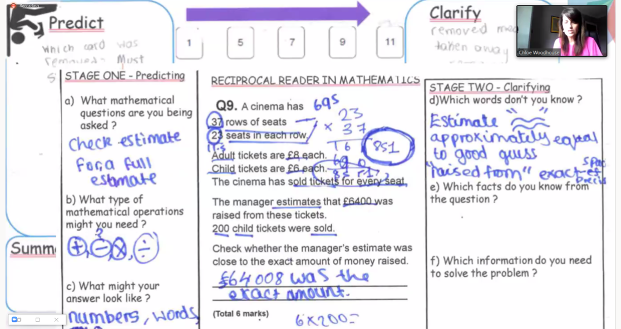

Slide 14

Question: Give students a question to find the answer to when reading. Ask questions to monitor understanding
Examples:
Who…?
What…?
Where…?
When…?
Why…?
How…?
What have you learnt so far about…?
Why is that word/ phrase/ sentence important?
Question: Give students a question to find the answer to when reading. Ask questions to monitor understanding
Examples:
Who…?
What…?
Where…?
When…?
Why…?
How…?
What have you learnt so far about…?
Why is that word/ phrase/ sentence important?
Reading
Strategies
Reading
Strategies
PREDICT: Activate Prior Knowledge
Examples:
What did we learn last lesson about this topic?
What do you already know about…?
What do you think…
What methods might we need for this question?
PREDICT: Activate Prior Knowledge
Examples:
What did we learn last lesson about this topic?
What do you already know about…?
What do you think…
What methods might we need for this question?
Clarify : Define new vocabulary. Check understanding of previously learnt vocabulary. Check understanding of previously learnt concepts. Share clues about the text.
Examples:
Remind us what ….means.
Define…
What can you remember about…?
What multiple meanings does the word … have?
Summarise : Check students’ understanding of the text.
Examples:
Explain...
Summarise…
Overall, what…?
Judge…
Determine…
Review…
Clarify : Define new vocabulary. Check understanding of previously learnt vocabulary. Check understanding of previously learnt concepts. Share clues about the text.
Examples:
Remind us what ….means.
Define…
What can you remember about…?
What multiple meanings does the word … have?
Summarise : Check students’ understanding of the text.
Examples:
Explain...
Summarise…
Overall, what…?
Judge…
Determine…
Review…

Slide 15
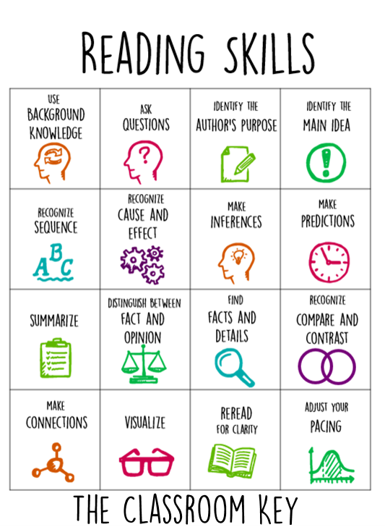

Others…

Slide 16
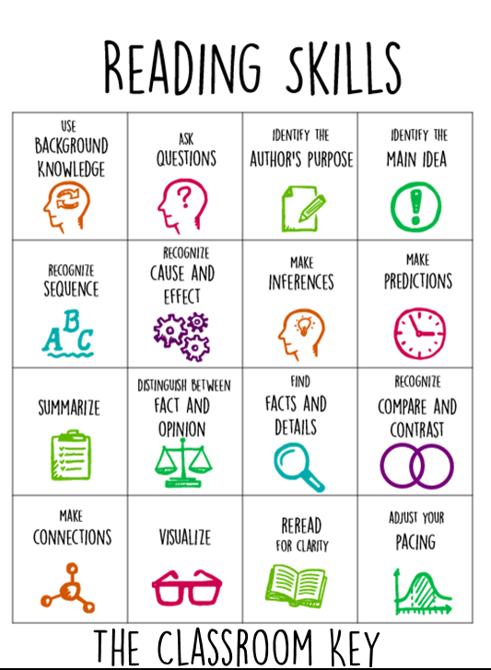
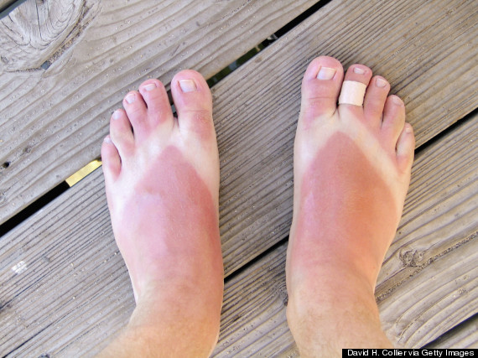
Example from an English SOL
Year 7
What can we infer from the image below?
Example: they have burnt their feet? They were wearing…

Slide 17
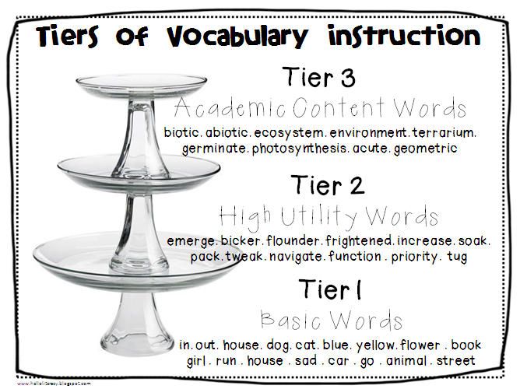

Vocabulary instruction
Step 3: Model the use.
Example:
What might we imply about a character if they speak using colloquial language?
In your essays you should avoid using colloquial language.
Ask: Why is colloquial language inappropriate?
What is the opposite?
What might we imply about a character if they speak using colloquial language?
Vocabulary
Instruction
Step 1: Select word.
Example: Colloquial.
Step 2: Define the word
Make sure the definition is accurate and student friendly. Often helpful to compare to other words students might be more familiar with.
Example: To describe how the characters speak in a play, we can use the work colloquial. Everyone say colloquial. Colloquial describes language which is ordinary and used in everyday conversation.
Informal.
Similar to SLANG.
Highlight the use of the word in your glossary/ knowledge organiser.
Step 4: Practice
Who uses colloquial language in the play?
Which characters don’t?
Create an overview of the character of … using the word colloquial in your response.

Slide 18
Feedback from Maths and Science
Greater use of the glossaries =
Key finding. Not being used effectively
Too much time being spent filling them in – have them pre-prepared.
Need to utilise them – part of R&R which will be a focus next term. Use in Do Nows. Use as part of revision process for Knowledge Tests. Revise key words from across topics to aid with retention. Photocopy onto coloured paper so students can locate easily in their books – or maths suggested having a booklet at the start of the year that they keep.

Slide 19
Revision techniques for the glossaries
Cards
Clock

Slide 20
Techniques
Alphabet game
When giving a large text to read, students focus on retaining words in the text using the alphabet – see video

Slide 21
5 monkeys

Slide 22
Liaise with subjects more with key core reading skills needed
Graphs and their functions – geog/ maths and science use – do others IT? DT?
Do we have share a similar approach or are confusing students? Which subject discipline needs the focus – E.G. maths can be penalised in an exam, whereas geography they won’t be – therefore the ‘maths’ way is key.

Slide 23
DEAR
A few staff members mentioned the drive for reading in their subject and outside of their subect area is often left out. Prmote this in HWK tasks and after half term, the reading ‘silent’ focus in form is going to change. – instead the focus will be DEAR tasks – see next slide – wth a focus on non-fiction texts and reading for meaning.

Slide 24
Add an example here from the Twitter ones

Slide 25
After Easter
Can HODs have a look to see if they could add to these – send to LS who will create another

Slide 26
Martin – this year will be focusing on helping support with etymology
Dual coding. Martin to discuss?

Slide 27
Estelle

Slide 28
Cloze activities

Slide 29
Spelling
Lots of research into this shows that random spellings with no clear focus does not help
If you wish to carry these out, please focus on paring words relating to the elements in the words – prefixes or suffixes for example:
Auto
Autograph
Autobiography
Autocratic
Automotive

Slide 30
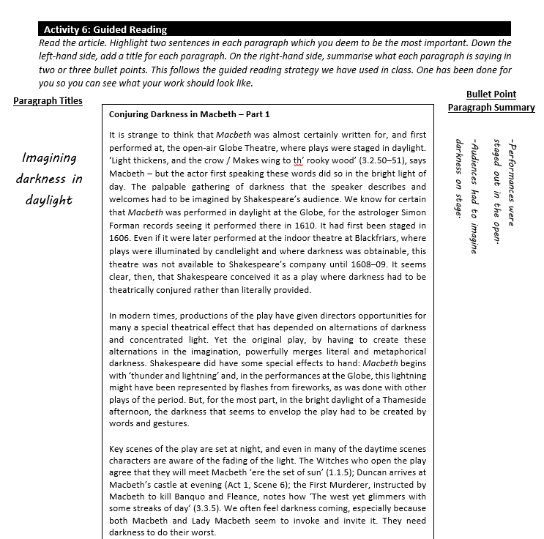
HWK and core skills to support reading

Slide 31
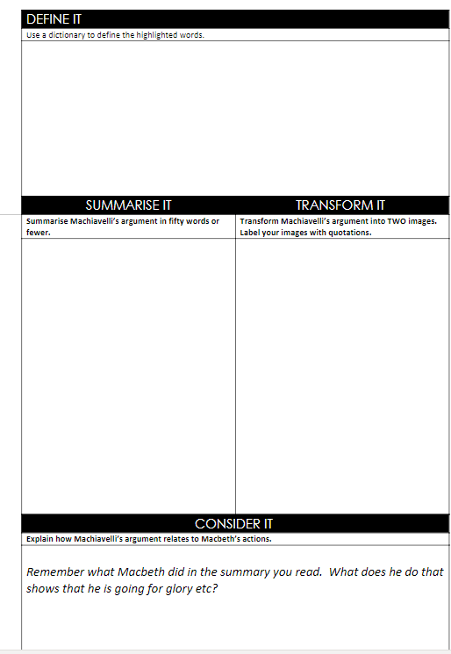

Slide 32
Question tables – as they read a text, students to self enquire…
 | When | Where | Which | Who | What | How | why
Is…? | Retrieval /Knowledge
Are….?
Was…?
Does…?
Did…?
Will…?
Can…?
Could…?
Would…?
Might…? |  |  |  |  |  |  | Evaluate
Notes:
Questions get generally more difficult as you go across the table - Link to blooms

Slide 33
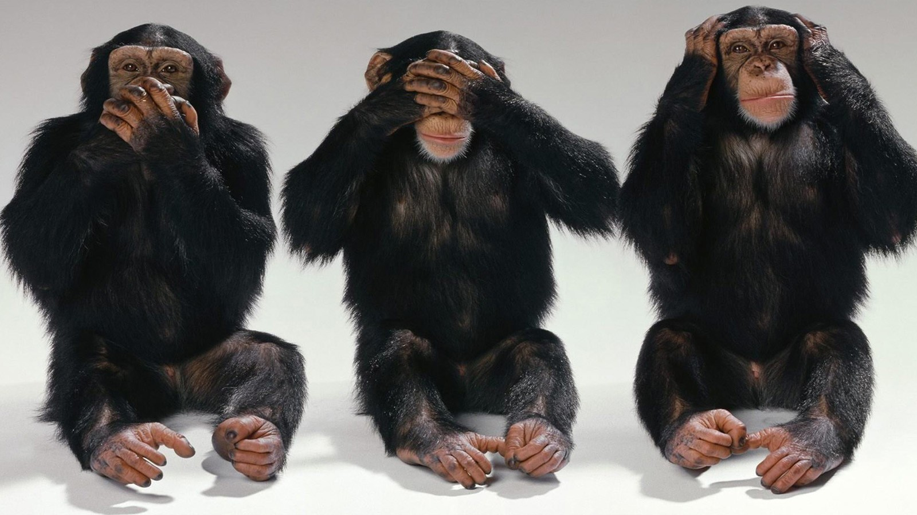
Three monkeys…
Draw
Add Words
Discuss
Notes:
This started off as the 6 monkeys but I lost the will to live

Slide 34
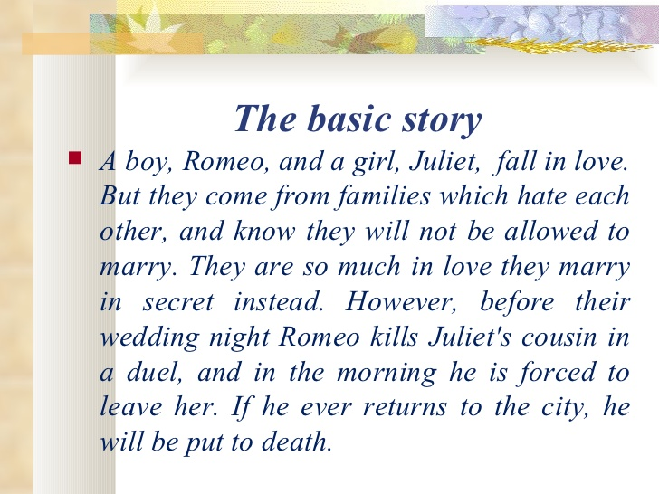
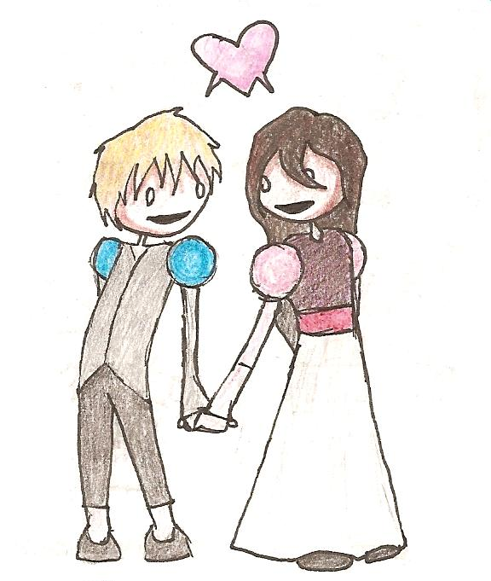
Monkey 1
As the teacher reads the ‘story’ or the ‘extract’, students to depict the ideas through pictures…
A boy, Romeo and a girl, Juliet, fall in love.

Slide 35
Monkey 2 – Add Words
You would re-read the text, but this time add in important words:
Juliet Capulet
Romeo Montague
A boy, Romeo MONTAGUE and a girl, Juliet CAPULET, fall in love.
LOVE

Slide 36
Monkey 3– Discuss
This third time, the teacher would ask the class to discuss their narration of the story or text to another student. The other student to check they have the grasp of the text and correct as they went. The idea here is that they will have listened, described and then consolidated their ideas.
Juliet Capulet
Romeo Montague
“The story is about a boy called Romeo Montague and Juliet Capulet who meet and fall in love.”
LOVE

Slide 37

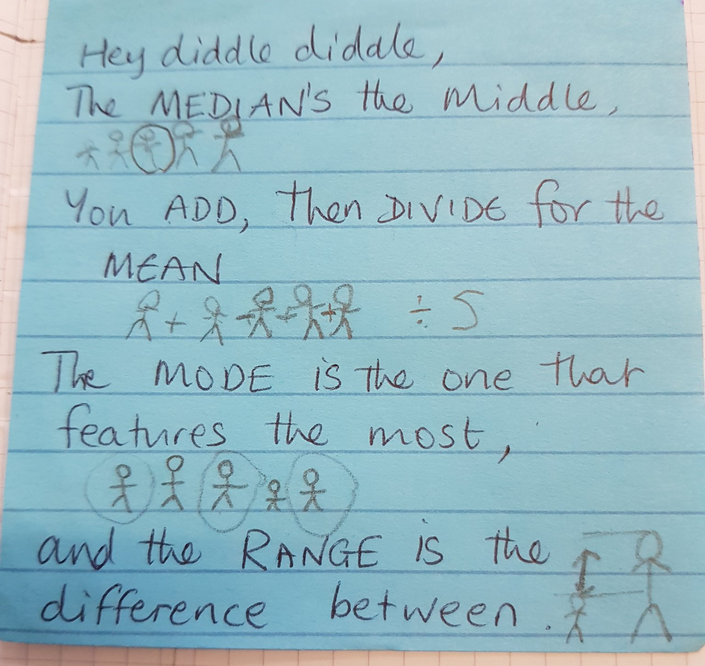
Consider how this might work for :
History – the events in the Battle of Hastings?
Drama – basic overview of the drama plot to TT?
Geography – adaption relating to the energy generation creating economic development in the Thar Desert.

Slide 38

Infographics
Another way dual coding is useful is through transferring long pieces of text into infographics:

Slide 39
Example: The Great Fire of London…facts, statistics
The Great Fire of London was a major conflagration that swept through the central parts of the English city of London, from Sunday, 2 September to Wednesday, 5 September 1666. The fire gutted the medieval City of London inside the old Roman City Wall. It threatened, but did not reach, the aristocratic district of Westminster, Charles II's Palace of Whitehall, and most of the suburban slums. It consumed 13,200 houses, 87 parish churches out of 109, St. Paul's Cathedral and most of the buildings of the City authorities. It is estimated to have destroyed 436 acres and the homes of 70,000 of the City's 80,000 inhabitants. The death toll is unknown but traditionally thought to have been small, as only six verified deaths were recorded. This reasoning has recently been challenged on the grounds that the deaths of poor and middle-class people were not recorded, while the heat of the fire may have cremated many victims leaving no recognisable remains.
The Great Fire started at the bakery of Thomas Farriner (or Farynor) on Pudding Lane, shortly after midnight on Sunday, 2 September, and spread rapidly west across the City of London. The use of the major firefighting technique of the time, the creation of firebreaks by means of demolition, was critically delayed owing to the indecisiveness of the Lord Mayor of London, Sir Thomas Bloodworth. By the time large-scale demolitions were ordered on Sunday night, the wind had already fanned the bakery fire into a firestorm which defeated such measures. The fire pushed north on Monday into the heart of the City.

Slide 40
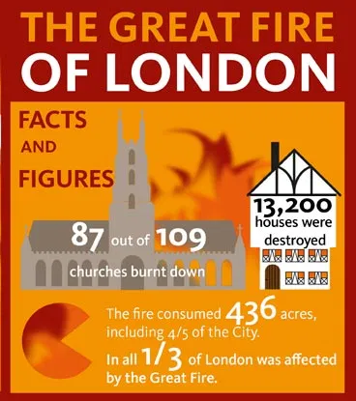
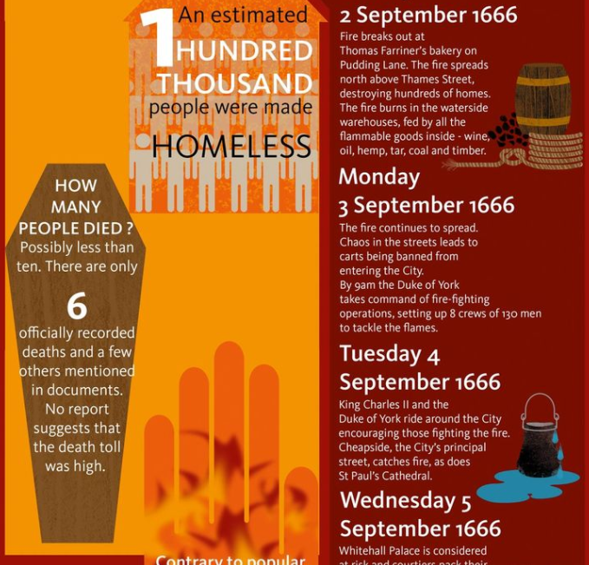
Be specific in terms of what you require…
Number lines
Days of the week
Temperature ranges
Pictures
Bar chart (making sure it is the same as in a maths lesson)
Time

Slide 41
Supporting students to read longer texts – the alphabet model
In the United States, the counterculture of the 1960s became identified with the rejection of conventional social norms of the 1950s. Counterculture youth rejected the cultural standards of their parents, especially with respect to racial segregation and initial widespread support for the Vietnam War.
In the United Kingdom, the counterculture of the 1960s was mainly a reaction against the social norms of the 1940s and 1950s, although "Ban the Bomb" protests centered around opposition to nuclear weaponry.
As the 1960s progressed, widespread tensions developed in American society that tended to flow along generational lines regarding the war in Vietnam, race relations, sexual mores, women's rights, traditional modes of authority, and a materialist interpretation of the American Dream. White, middle-class youth — who made up the bulk of the counterculture — had sufficient leisure time to turn their attention to social issues. These social issues included support for civil rights, women's rights, and gay rights movements, and a rejection of the Vietnam War. Hippies became the largest countercultural group in the United States. The counterculture also had access to a media eager to present their concerns to a wider public. Demonstrations for social justice created far-reaching changes affecting many aspects of society.
Rejection of mainstream culture was best embodied in the new genres of psychedelic rock music, pop-art and new explorations in spirituality. Musicians who exemplified this era include The Beatles, The Grateful Dead, Jefferson Airplane, Jimi Hendrix, The Doors, Cream, The Rolling Stones, Neil Young, Bob Dylan, and Janis Joplin.
Sentiments were expressed in song lyrics and popular sayings of the period, such as "do your own thing," "turn on, tune in, drop out", "whatever turns you on," "Eight miles high", and "light my fire." Spiritually, the counterculture included interest in astrology, the term "Age of Aquarius" and knowing people's signs. This led Theodore Roszak to state "A [sic] eclectic taste for mystic, occult, and magical phenomena has been a marked characteristic of our postwar youth culture since the days of the beatniks."
The counterculture in the United States reached its peak between 1966 and the early 1970s. It eventually waned for several reasons: mainstream America's disdain for unrepentant hedonism and conspicuous drug use, and the troubles caused by these excesses; the death of many notable countercultural figures; the end of the Vietnam War; and the end of Civil Rights protests following passage of remedial legislation. The counterculture continues to influence social movements, art and society in general. Unconventional appearance, music, drugs, communitarian experiments, and sexual liberation were hallmarks of the sixties counterculture, most of whose members were white, middle-class young Americans. To some Americans, these attributes reflected American ideals of free speech, equality, and pursuit of happiness. Other people saw the counterculture as self-indulgent, pointlessly rebellious, unpatriotic, and destructive of America's moral order.
Authorities banned the psychedelic drug LSD, restricted political gatherings, and tried to enforce bans on what they considered obscenity in books, music, theater, and other media. Parents argued with their children and worried about their safety. Some adults accepted elements of the counterculture, while others became estranged from sons and daughters.
600 words!

Slide 42
Ask students to identify words in the text that begin with…
A American, attention
B Bob Dylan, bulk
C counterculture …
D
E
F
G
H
I
J
K
L
M
N
O
P
Q
R
S
T
U
V
W
X
Y
Z
Notes:
This can then be used to get students to clarify anything that they do not understand or write a summary of their findings – ofucsing on a few key words rather than the whole think. You could guide students to focus on omitting proper nouns – those that begin with a capital letter etc.

