Slide 1
GCSE
French and Spanish
at
Lancaster High School

Slide 2

Why study French or Spanish GCSE?

Slide 3




Benefits…
Notes:
Average salary 10 to 15% higher with languages skills
Research has explored the benefits of foreign language learning on the brain!
Facilitating subjects are the subjects most commonly required or preferred by universities to get on to a range of degree courses. They help you keep your options open when choosing a degree, and many of the top universities will ask you to have at least one A-level in a facilitating subject when you apply.

Slide 4
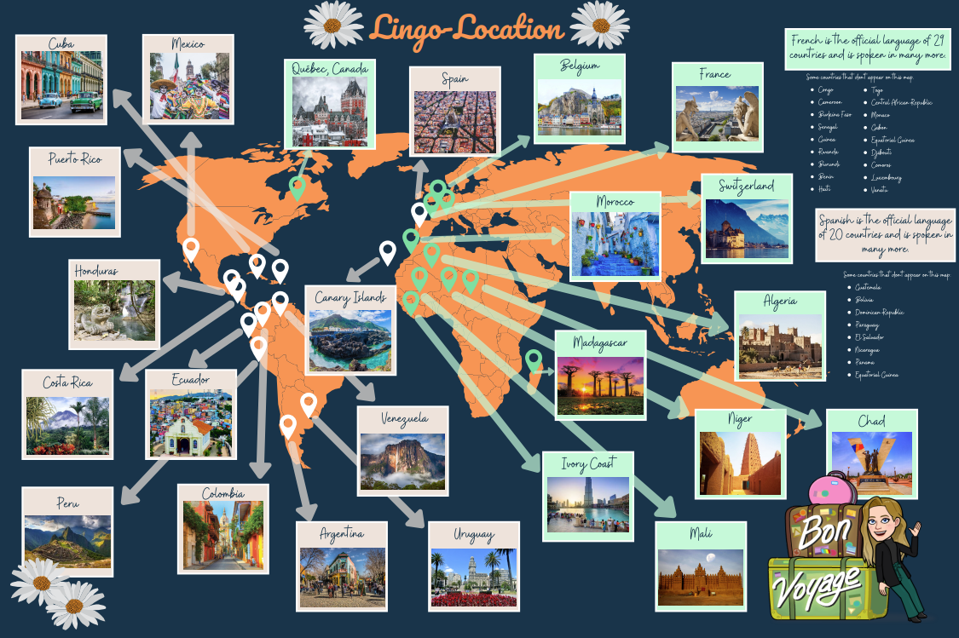

Slide 5


Why study French/Spanish GCSE at Lancaster High School?

Slide 6

Exam board: AQA
Click here to access the French GCSE specification
Click here to access the Spanish GCSE specification.

Slide 7




Methods of assessment
What does the course involve?
Four assessments at the end of Year 11, each worth 25% of the final grade

Slide 8









Overview
GCSE topics are:

Slide 9
Exam:
Foundation - 7-9 minutes Higher - 10-12 minutes
50 marks
15 minutes preparation time
Speaking
A read-aloud task
A role-play task with a follow up short conversation
A photocard description and unprepared conversation
Teacher tests student and recording is sent to Exam Board for marking

Slide 10
Reading
Exam:
Foundation – 45 minutes
Higher – 60 minutes
50 marks
Comprehension task
Translation into English
Multiple choice tasks

Slide 11
Listening
Exam:
Foundation -35 minutes
Higher - 45 minutes
40 marks Foundation
50 marks higher
Comprehension tasks
Dictation tasks

Slide 12
Writing
Exam:
Foundation – 1h10
Higher – 1h15
50 marks
Translation into French
Grammar task- Foundation
50 words/90 words Foundation
90 words and 150 words Higher
in French
Describing a photo in 5 sentences. Foundation

Slide 13
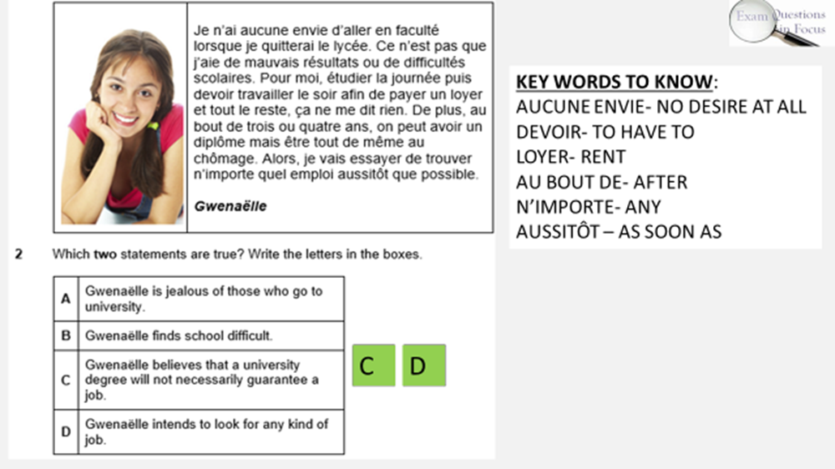
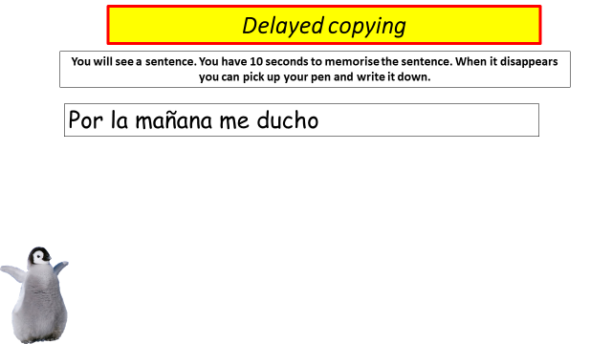


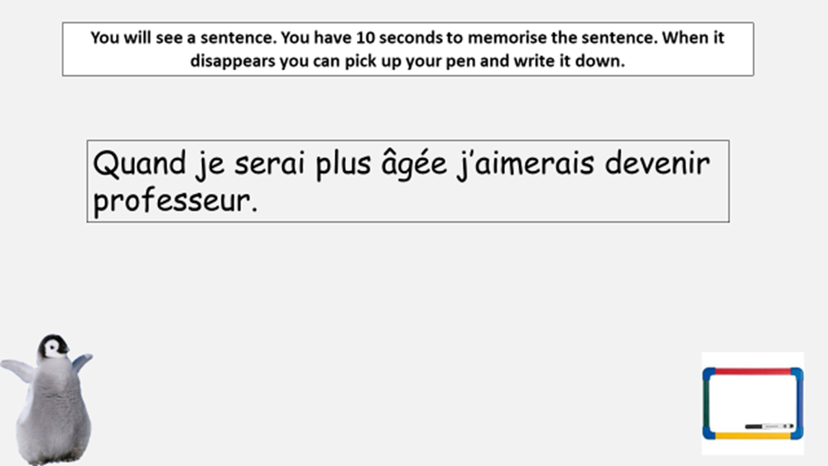
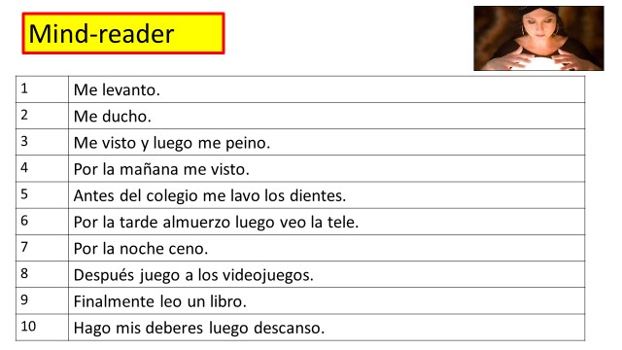
Mixing things up!

Slide 14
Pathways:
Sixth form and A-level, University Degree
Careers: A modern language provides skills that are highly in demand with recruiters in a wide range of industries, all around the world. Examples of careers where a language is in high demand are teaching, journalism, travel and tourism services, publishing, banking, the Armed Forces and marketing.

Slide 15
For more information about the French / Spanish GCSE course, please speak to your child’s French / Spanish teacher at Progress Evening.

