Slide 1

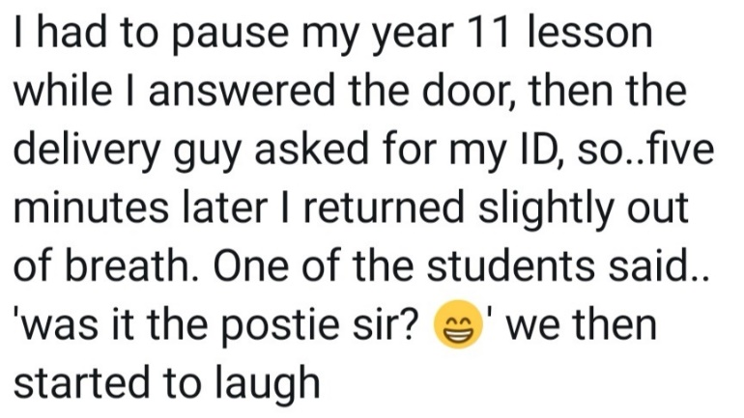
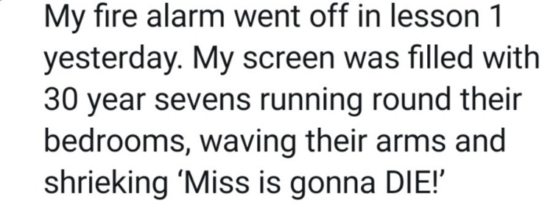


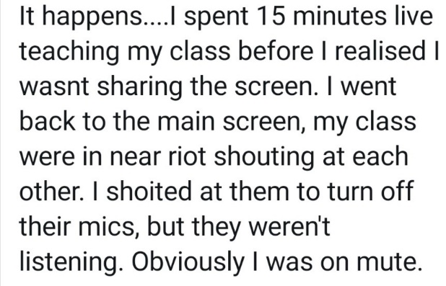
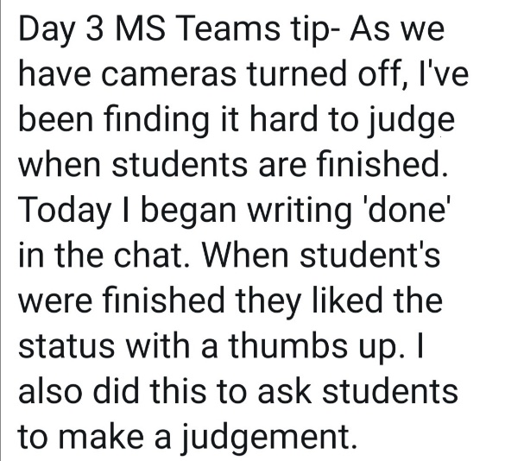
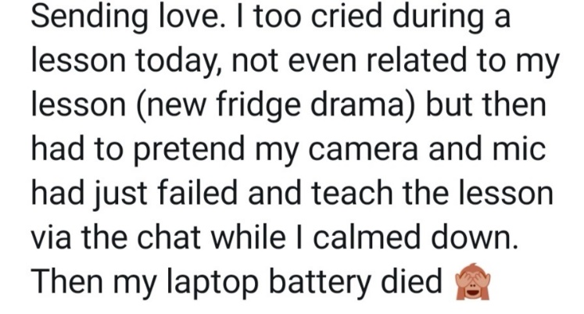


Retrieval Practice
DATE: 18/01/2021
Objective:
To understand what retrieval practice is and how it links to memory models and science of learning.
To share success criteria for planning effective retrieval practice.
To look at practical, easy retrieval strategies to employ when teaching remotely.
While you wait:

Slide 2

Retrieval Practice
The Central Line to Learning

Slide 3



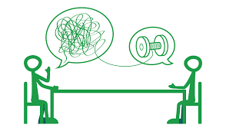
18th Jan
1st Feb
15th March
Notes:
18th Jan: Introductions: session dates/ focus of 18th- clarifying what is RP and its role in cycle of learning/ sharing layout of all sessions and rationale for it/ sharing support materials and models/ sharing success criteria/ setting out the practice- multiple choice / retrieval grid.

Slide 4


Retrieval Practice?
An assessment strategy. A way to get knowledge in. About memorisation only. Limited to KS4 and exams. Limited to starters and plenaries. Mainly relevant to more academic subjects. | A learning strategy allowing students to access knowledge more easily and confidently. A way to pull knowledge out and connect it to prior learning. Building students’ metacognitive skills. Teaching & practising effective learning strategies for all students. Using a wide range of strategies at any point in the lessons to challenge students’ recall and misconceptions. Relevant to any subject areas where learning occurs. A reduction in anxiety for students.
Notes:
Intro- then time to read.

Slide 5
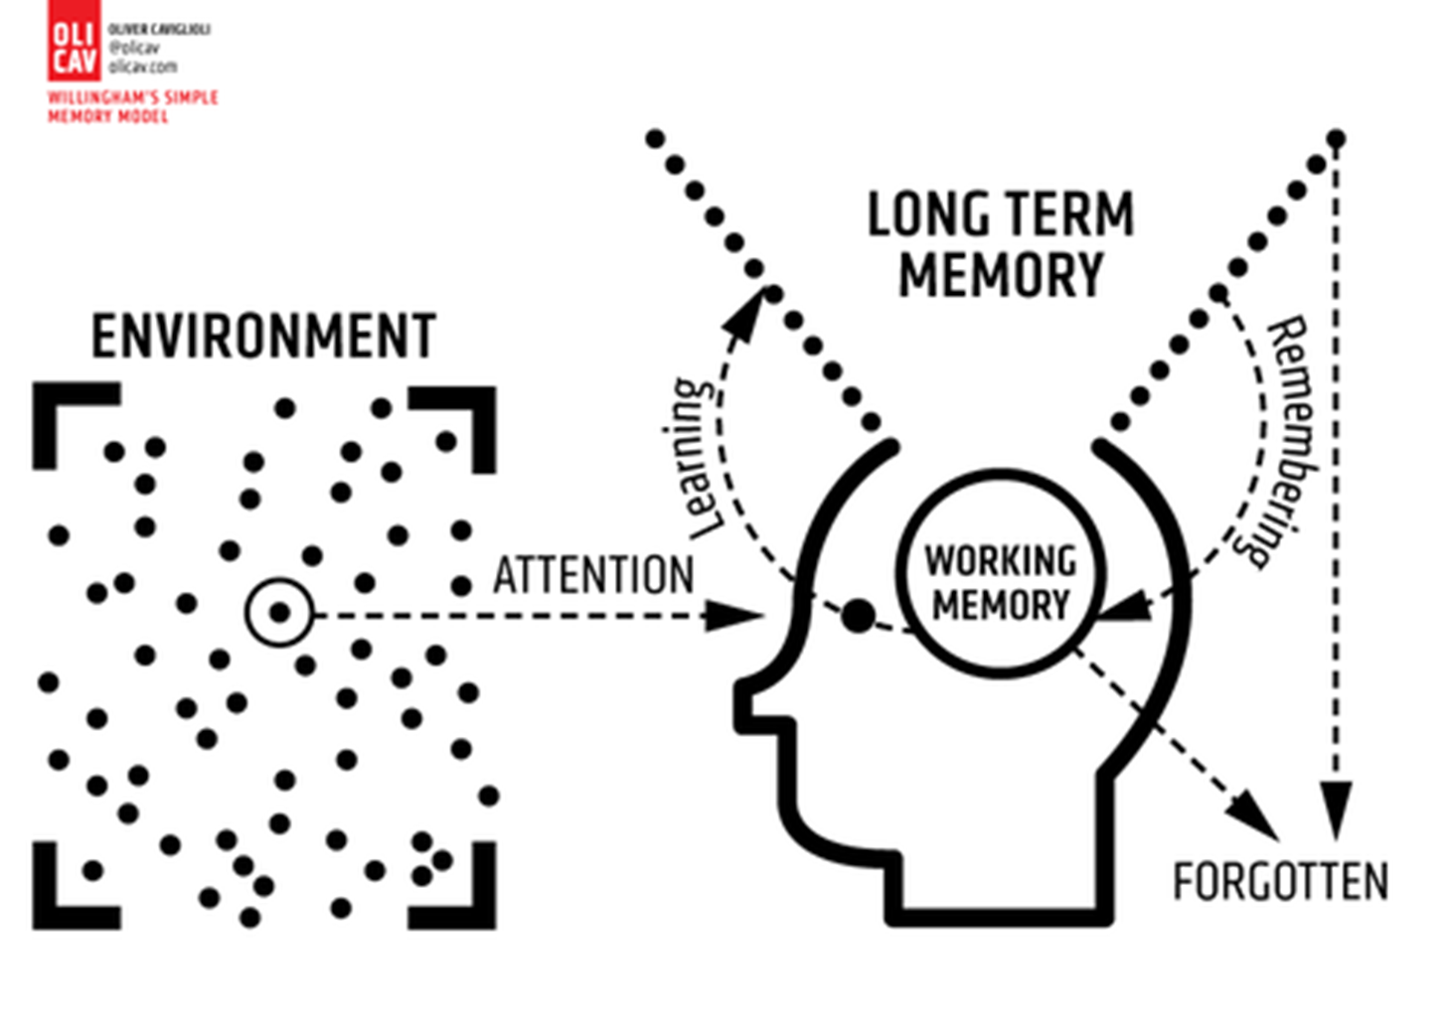
Notes:
Can’t go through RP without brief overview – that is RP in itself!
The benefits of RP are overwhelming. However, it is crucial to understand that in order for retrieval to be effective, the stages of learning must have been followed when introducing new concepts and skills. 1. We need to have secured students’ attention and planned for this attention to be directed at a specific learning focus. 2. We need to have secured an environment that allows students to focus their attention and this happens through BfL routines. 3. We must remember that new information will never reach long-term memory without a good deal of practice over time and that scaffolding will be required to avoid overloading students. 4. We know that knowledge that did land in LT memory will need to be challenged and prodded over time

Slide 6
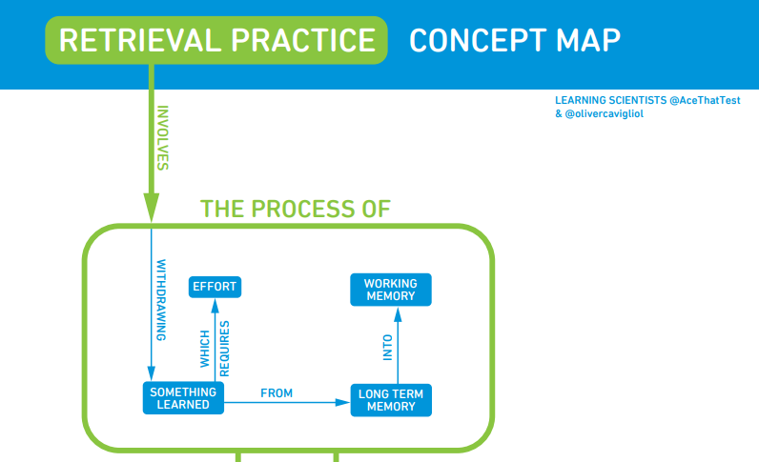
Notes:
Give a minute to look at diagram.

Slide 7

Notes:
Support materials- link to pics: learning/ planning/ practising/ collaborating.
Learning= Padlet page/ T&: websites with dedicated area to RP to enhance professional learning/fortnightly newsletter
Planning: models of tasks/ templates/ success criteria/ collaborating
Practising: in sessions: practice through planning of RP task/ with peers/ with specific group/ of specific strategy/ share your reflections in newsletter or Padlet.
Collaborating: retriever buddy- find someone to work with – does not need to be in dpmt- regularly exchange on planning/ practice and reflection.
All of it can help build evidence for appraisal purposes.

Slide 8
Success Criteria
1 | The task is low stake and involves no grading from you or students
2 | The task is challenging and focuses on students’ thinking hard.
3 | The retrieval task is used to identify gaps in knowledge and potential misconceptions
4 | The retrieval is spaced: it happens a week/ a few weeks even after the learning has taken place-spaced practice
5 | The retrieval targets different areas of the curriculum- interleaving
6 | Feedback is given to student to aid metacognition (what can they improve/target)
7 | Students are reassured the difficulty is normal and part of the learning process.
“The more difficult the retrieval practice, the better it is for long-term learning.” How to use Retrieval Practice to Improve learning.

Slide 9
Success Criteria
1 | The task is low stake and involves no grading from you or students
2 | The task is challenging and focuses on students’ thinking hard.
3 | The retrieval task is used to identify gaps in knowledge and potential misconceptions
4 | The retrieval is spaced: it happens a week/ a few weeks even after the learning has taken place-spaced practice
5 | The retrieval targets different areas of the curriculum- interleaving
6 | Feedback is given to student to aid metacognition (what can they improve/target)
7 | Students are reassured the difficulty is normal and part of the learning process.
“The more difficult the retrieval practice, the better it is for long-term learning.” How to use Retrieval Practice to Improve learning.

Slide 10
Success Criteria
1 | The task is low stake and involves no grading from you or students
2 | The task is challenging and focuses on students’ thinking hard.
3 | The retrieval task is used to identify gaps in knowledge and potential misconceptions
4 | The retrieval is spaced: it happens a week/ a few weeks even after the learning has taken place-spaced practice
5 | The retrieval targets different areas of the curriculum- interleaving
6 | Feedback is given to student to aid metacognition (what can they improve/target)
7 | Students are reassured the difficulty is normal and part of the learning process.
“The more difficult the retrieval practice, the better it is for long-term learning.” How to use Retrieval Practice to Improve learning.

Slide 11
Success Criteria
1 | The task is low stake and involves no grading from you or students
2 | The task is challenging and focuses on students’ thinking hard.
3 | The retrieval task is used to identify gaps in knowledge and potential misconceptions
4 | The retrieval is spaced: it happens a week/ a few weeks even after the learning has taken place-spaced practice
5 | The retrieval targets different areas of the curriculum- interleaving
6 | Feedback is given to student to aid metacognition (what can they improve/target)
7 | Students are reassured the difficulty is normal and part of the learning process.
“The more difficult the retrieval practice, the better it is for long-term learning.” How to use Retrieval Practice to Improve learning.

Slide 12
Success Criteria
1 | The task is low stake and involves no grading from you or students
2 | The task is challenging and focuses on students’ thinking hard.
3 | The retrieval task is used to identify gaps in knowledge and potential misconceptions
4 | The retrieval is spaced: it happens a week/ a few weeks even after the learning has taken place-spaced practice
5 | The retrieval targets different areas of the curriculum- interleaving
6 | Feedback is given to student to aid metacognition (what can they improve/target)
7 | Students are reassured the difficulty is normal and part of the learning process.
“The more difficult the retrieval practice, the better it is for long-term learning.” How to use Retrieval Practice to Improve learning.

Slide 13
Success Criteria
1 | The task is low stake and involves no grading from you or students
2 | The task is challenging and focuses on students’ thinking hard.
3 | The retrieval task is used to identify gaps in knowledge and potential misconceptions
4 | The retrieval is spaced: it happens a week/ a few weeks even after the learning has taken place-spaced practice
5 | The retrieval targets different areas of the curriculum- interleaving
6 | Feedback is given to student to aid metacognition (what can they improve/target)
7 | Students are reassured the difficulty is normal and part of the learning process.
“The more difficult the retrieval practice, the better it is for long-term learning.” How to use Retrieval Practice to Improve learning.

Slide 14
Success Criteria
1 | The task is low stake and involves no grading from you or students
2 | The task is challenging and focuses on students’ thinking hard.
3 | The retrieval task is used to identify gaps in knowledge and potential misconceptions
4 | The retrieval is spaced: it happens a week/ a few weeks even after the learning has taken place-spaced practice
5 | The retrieval targets different areas of the curriculum- interleaving
6 | Feedback is given to student to aid metacognition (what can they improve/target)
7 | Students are reassured the difficulty is normal and part of the learning process.
“The more difficult the retrieval practice, the better it is for long-term learning.” How to use Retrieval Practice to Improve learning.

Slide 15
Success Criteria
1 | The task is low stake and involves no grading from you or students
2 | The task is challenging and focuses on students’ thinking hard.
3 | The retrieval task is used to identify gaps in knowledge and potential misconceptions
4 | The retrieval is spaced: it happens a week/ a few weeks even after the learning has taken place-spaced practice
5 | The retrieval targets different areas of the curriculum- interleaving
6 | Feedback is given to student to aid metacognition (what can they improve/target)
7 | Students are reassured the difficulty is normal and part of the learning process.
“The more difficult the retrieval practice, the better it is for long-term learning.” How to use Retrieval Practice to Improve learning.

Slide 16

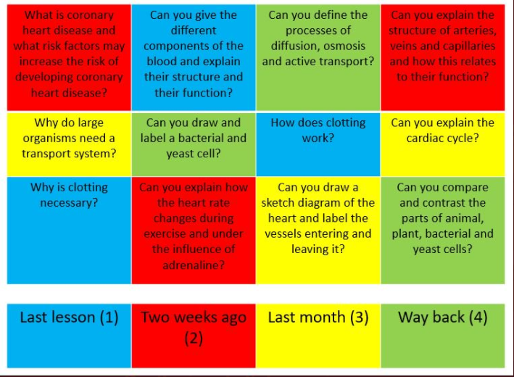
Strategy 1:
Retrieval grids and recall/challenge boxes
“The more difficult the retrieval practice, the better it is for long-term learning.” How to use Retrieval Practice to Improve learning.

Slide 17
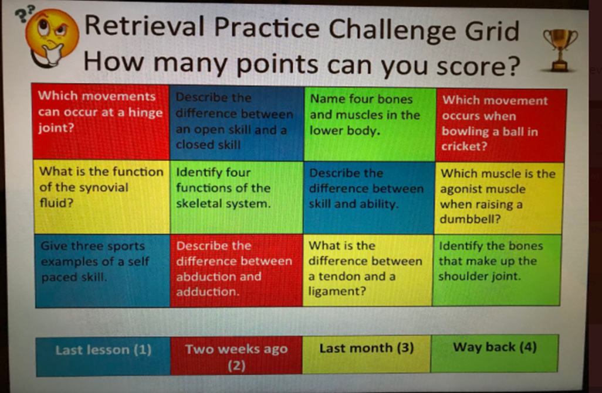
Strategy 1:
Retrieval grids and recall/challenges boxes
“The more difficult the retrieval practice, the better it is for long-term learning.” How to use Retrieval Practice to Improve learning.

Slide 18
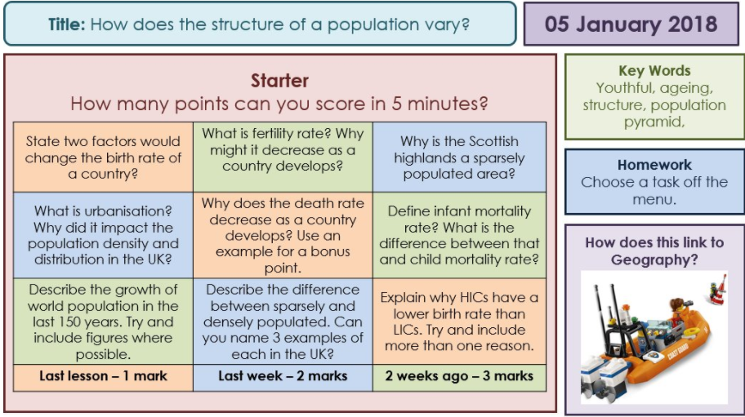
Strategy 1:
Retrieval grids and recall/challenge boxes
“The more difficult the retrieval practice, the better it is for long-term learning.” How to use Retrieval Practice to Improve learning.

Slide 19
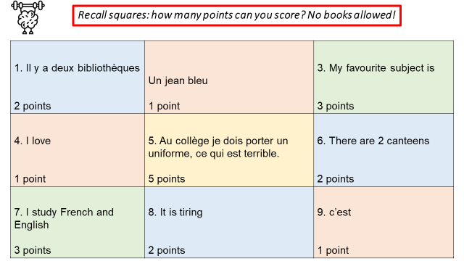
Strategy 1:
Retrieval grids and recall/challenge boxes
“The more difficult the retrieval practice, the better it is for long-term learning.” How to use Retrieval Practice to Improve learning.

Slide 20
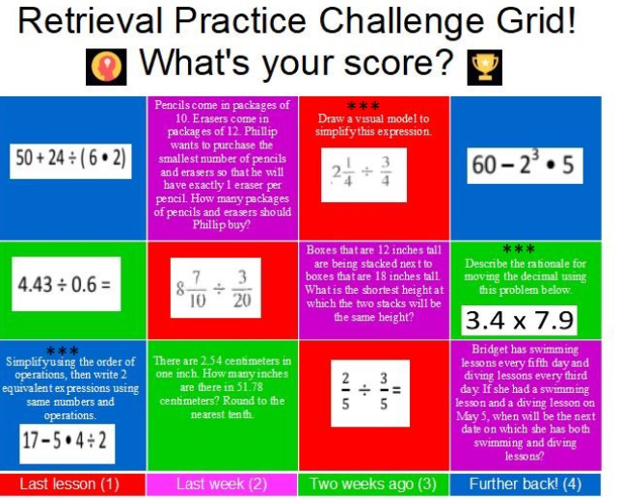
Strategy 1:
Retrieval grids and recall/challenge boxes
“The more difficult the retrieval practice, the better it is for long-term learning.” How to use Retrieval Practice to Improve learning.

Slide 21
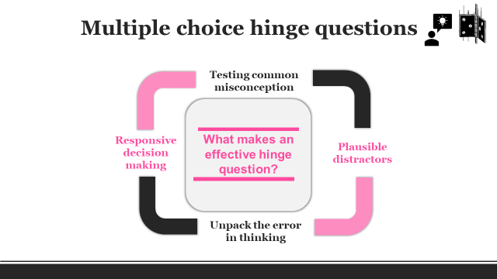
Strategy 2:
Click here for more info
“The more difficult the retrieval practice, the better it is for long-term learning.” How to use Retrieval Practice to Improve learning.

Slide 22
Strategy 2:
Blue:
Bleu
Rose
marron
2. marron
Bleu
Rose
Maroon
Brown
3. red:
Rouge
Rose
Vert
Jaune
4. A green jacket
Une verte verte
Une veste vert
Un veste vert
Une veste verte
Click here for more info
“The more difficult the retrieval practice, the better it is for long-term learning.” How to use Retrieval Practice to Improve learning.

Slide 23
Strategy 2:
Quizziz:
Allows you to conduct LIVE quizzes during the lesson.
Free account
Create class on website- no need to enter students’ details
Before the lesson, enter the link into the chat so they can register.
Create your quiz!
During the lesson, share the quiz link into the chat to get students answering live. Allows you to see who’s effectively on!
Click here to access Quizziz
“The more difficult the retrieval practice, the better it is for long-term learning.” How to use Retrieval Practice to Improve learning.

Slide 24
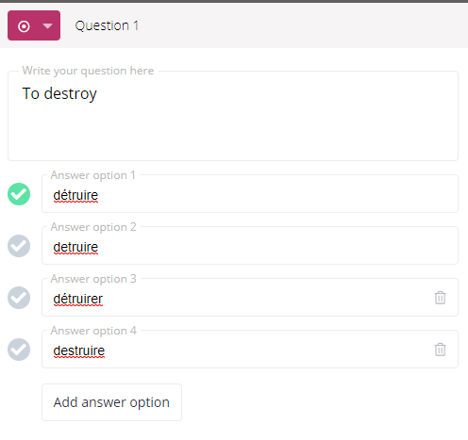
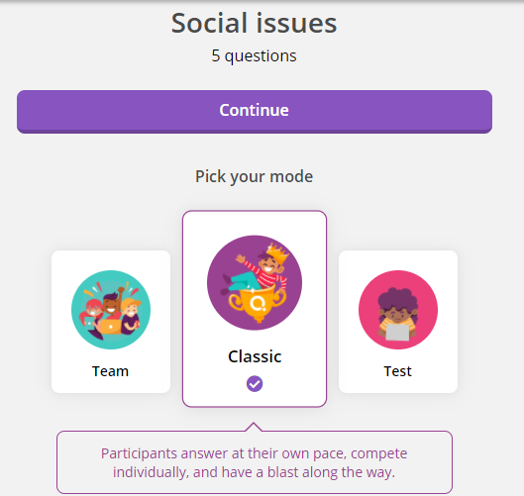
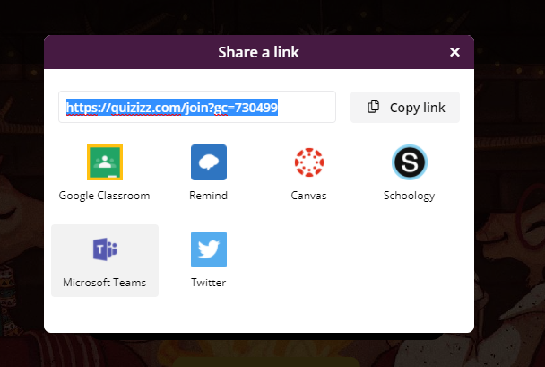
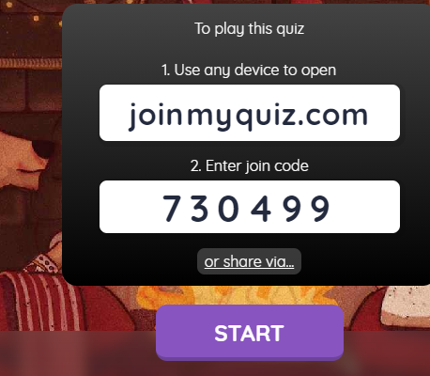
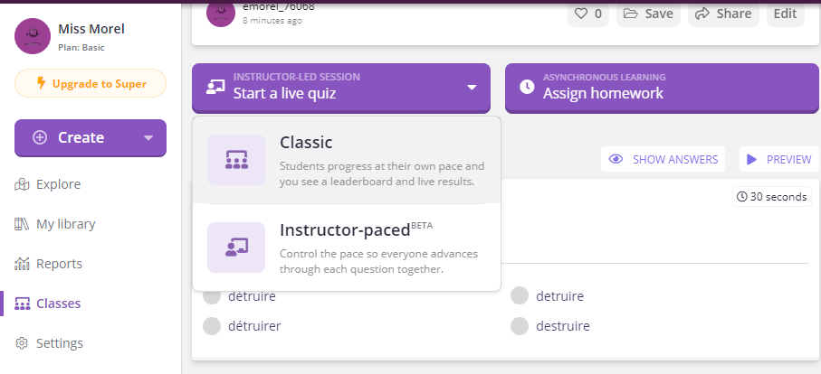

Slide 25
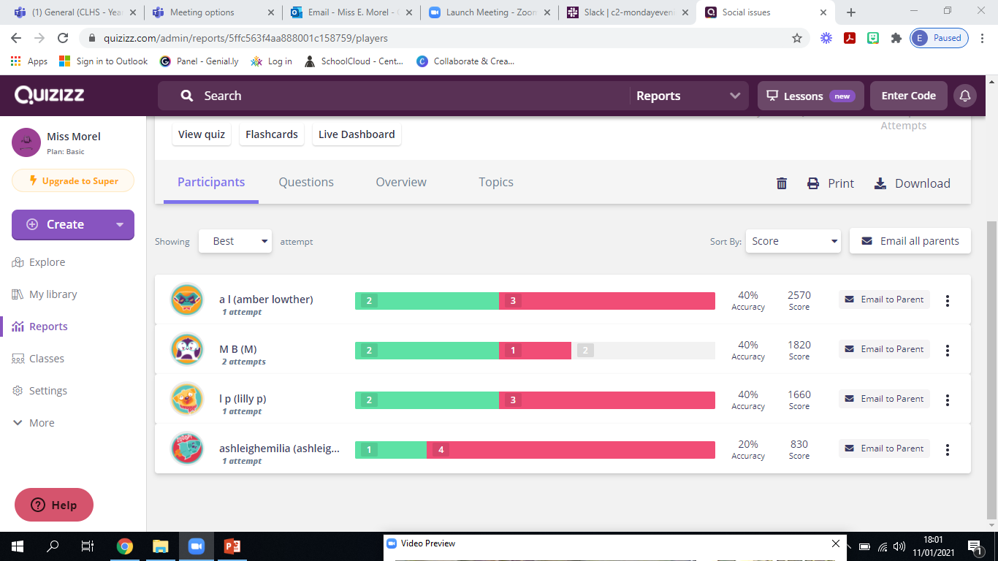

Slide 26
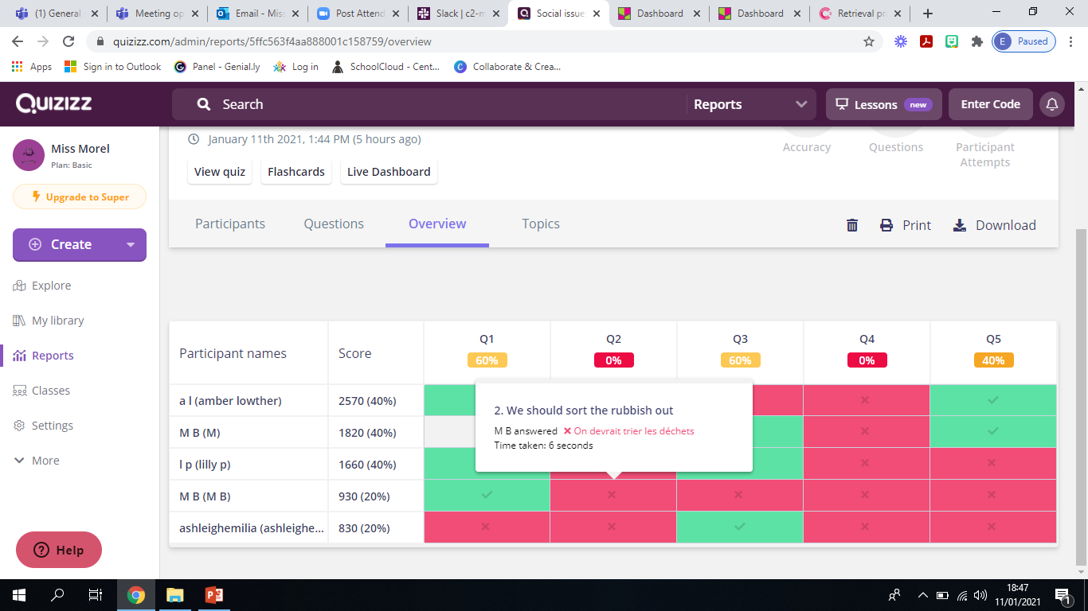

Slide 27
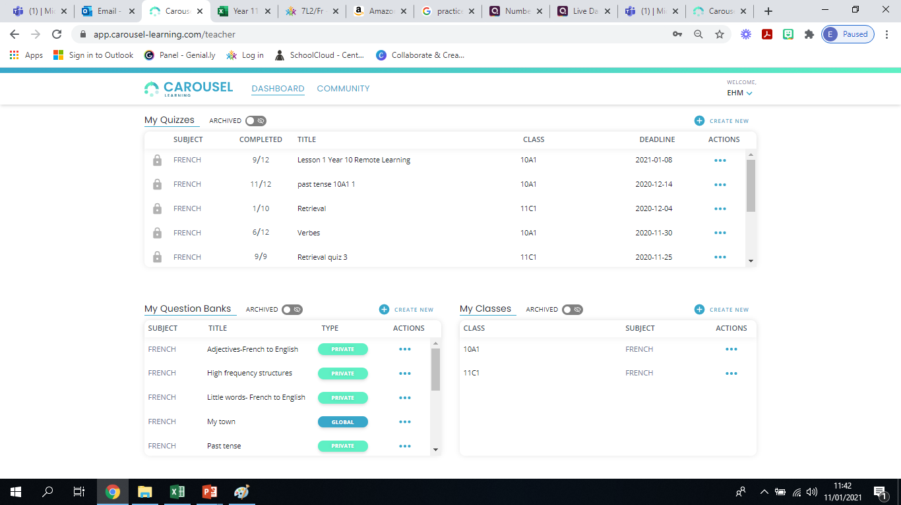
Strategy 2:
Carousel:
A retrieval practice platform rooted in retrieval roulette and cognitive science.
Create your classes/ question banks
Access some question banks already down
Self marking available for students
Question analysis
No need for students to create a login
“The more difficult the retrieval practice, the better it is for long-term learning.” How to use Retrieval Practice to Improve learning.

Slide 29
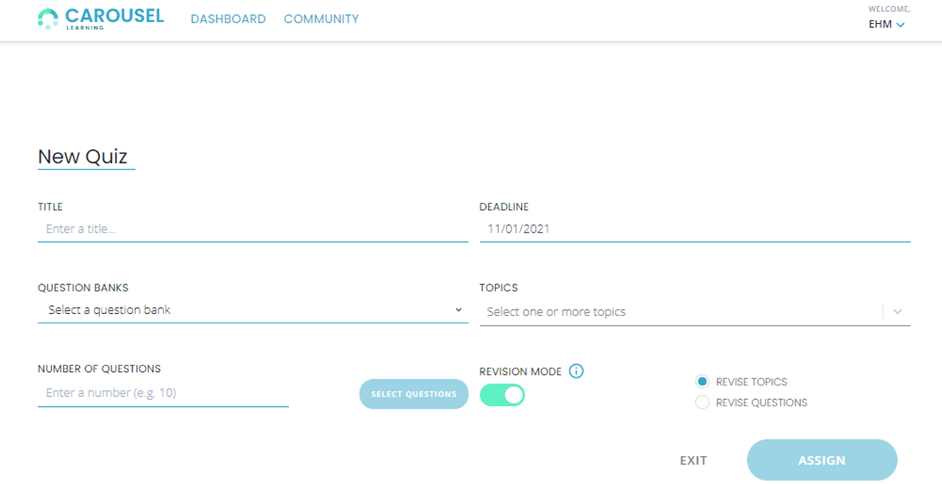

Slide 30
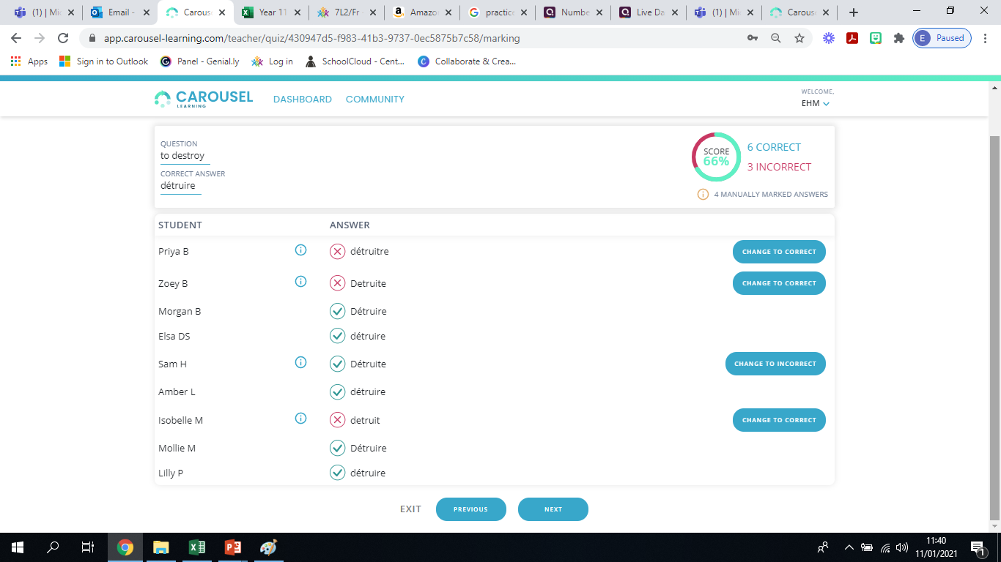

Slide 31
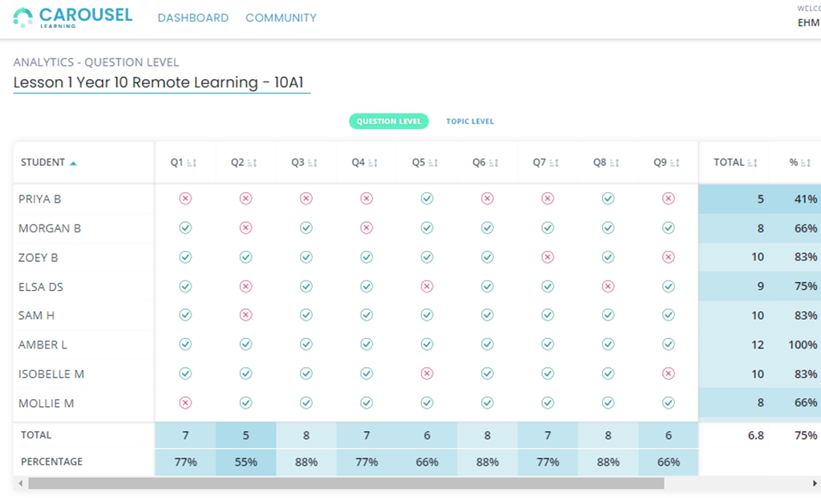

Slide 32
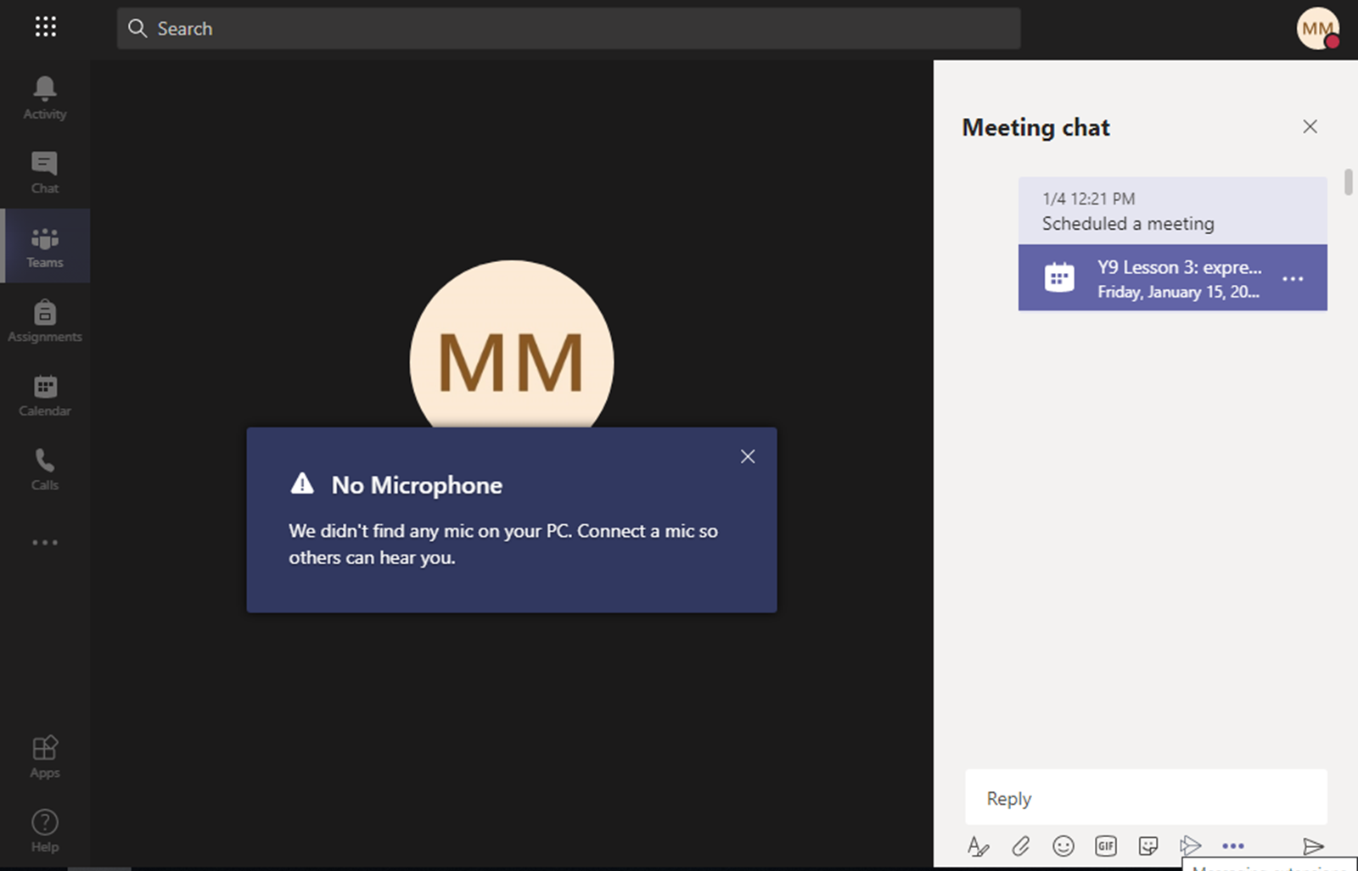

Slide 33
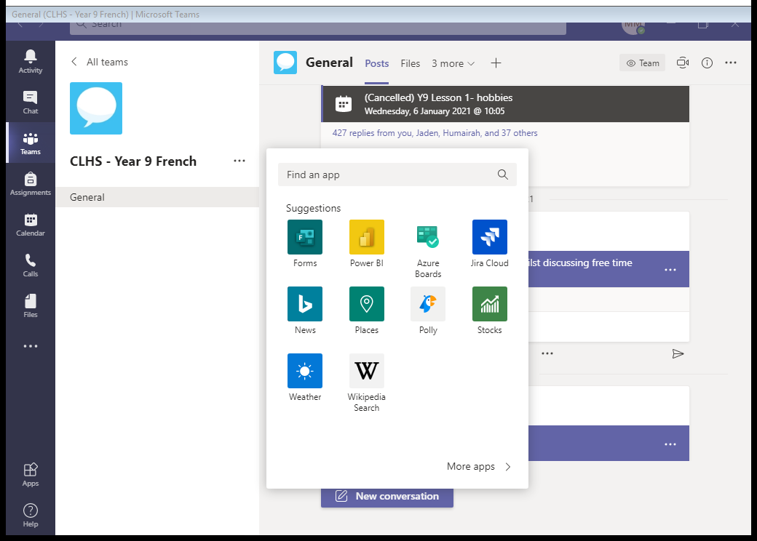

Slide 34
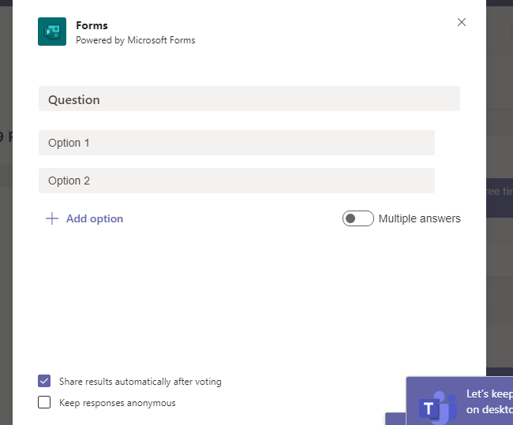

Slide 35
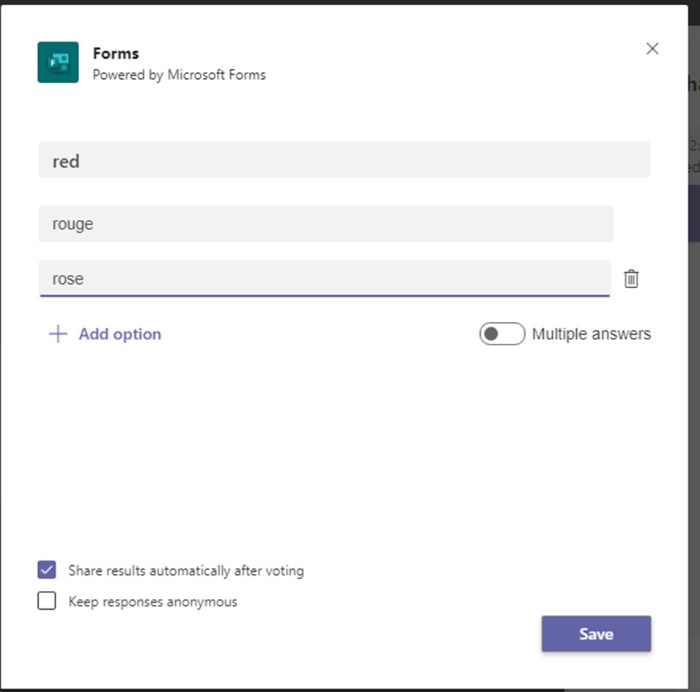

Slide 36
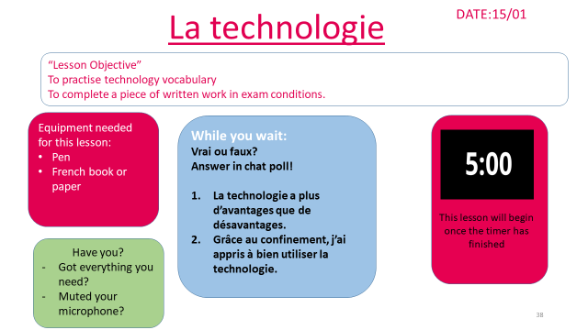
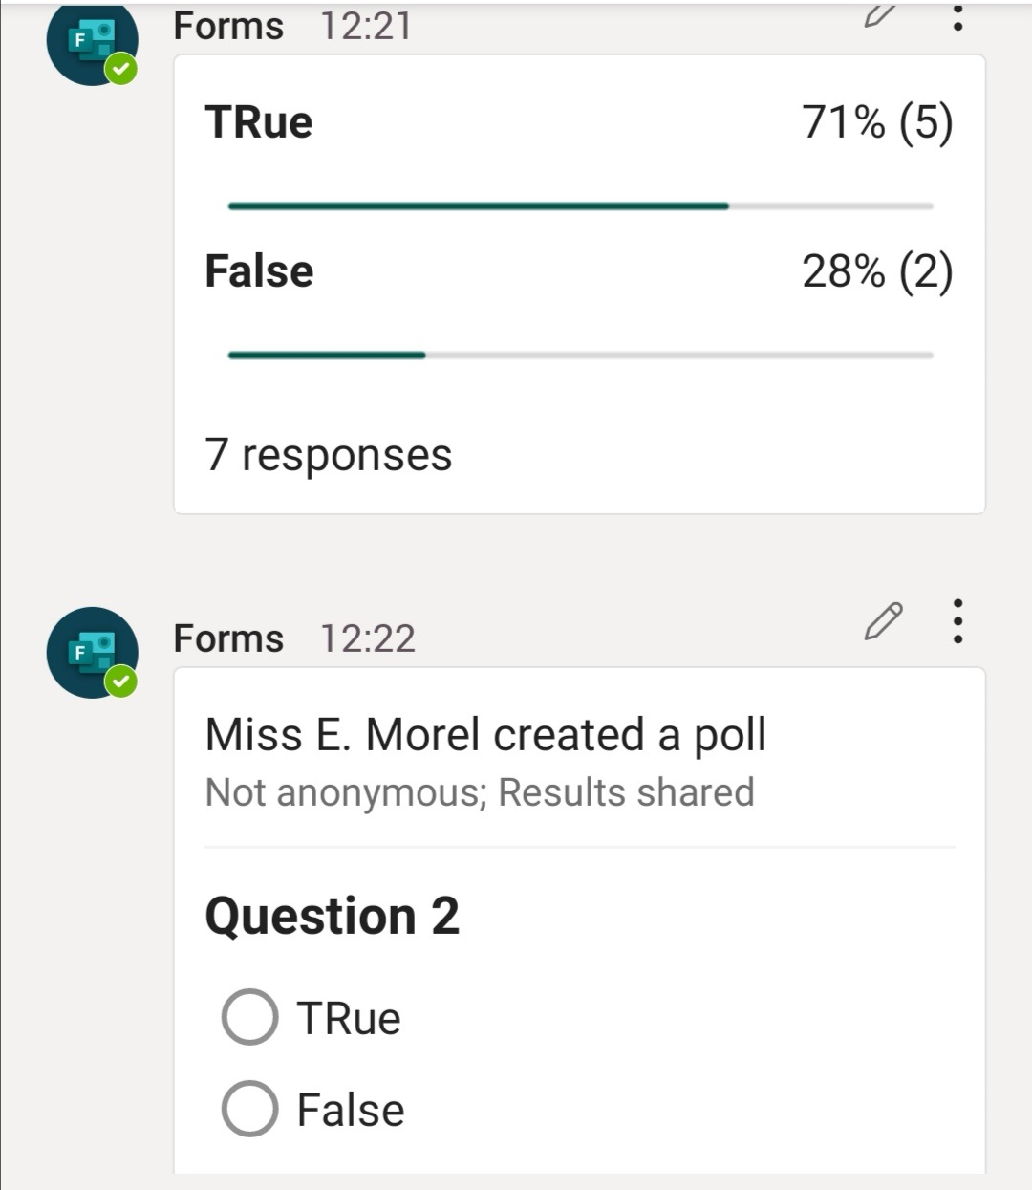

Slide 37
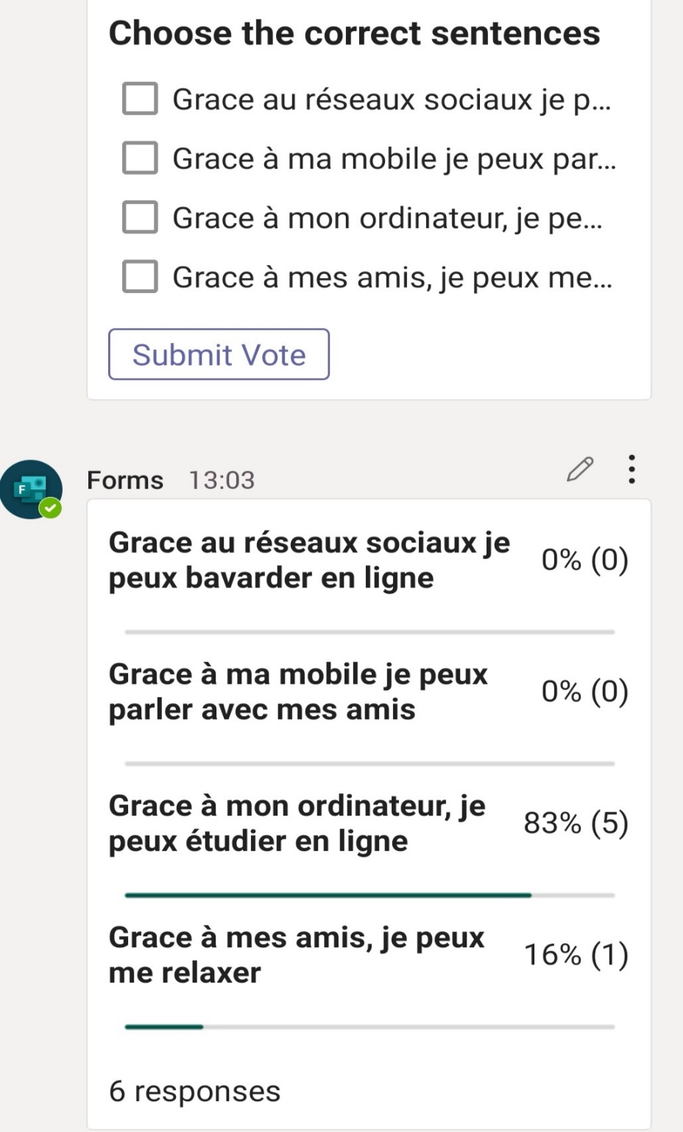

Slide 38
Lesson 3
DATE: vendredi 15 janvier
“Lesson Objective”
To identify common errors when describing our hobbies and extend our sentences.
Equipment needed for this lesson:
pen
Booklet or paper
French book or paper
While you wait:
Complete this quiz. Link in the chat!
https://forms.office.com/Pages/ResponsePage.aspx?id=8jfX3t07d0eAvV75jyg8kLd8K81MLORPlRfqYQeNN8BUQlNRR1k1S1U3VVJTVUhMVjZBMlczVjEyTi4u
Have you?
Got everything you need?
Muted your microphone?
This lesson will begin once the timer has finished
This lesson will be recorded on Teams and available to download from the chat after the lesson has ended.
Use of the chat is to ask/answer questions only; any inappropriate comments or abuse of the chat gets recorded and reported. Have a great lesson!

Slide 39
18th Jan
1st Feb
15th March
Choose and practise 1 strategy from today’s session and use within lessons- Live or not.
Read the Learning and Teaching Newsletter.
Be prepared to share your thoughts and reflection on the strategy you trialled/tweaked/worked on.
Plan a retrieval grid/ challenge grid or a few multiple choice questions for one of your lessons next week
Join back for 10 minutes at the end and share your work ideas in the chat/ you can also upload a resource in the chat to share.
Notes:
18th Jan: Introductions: session dates/ focus of 18th- clarifying what is RP and its role in cycle of learning/ sharing layout of all sessions and rationale for it/ sharing support materials and models/ sharing success criteria/ setting out the practice- multiple choice / retrieval grid.

