Slide 1


Retrieval Practice
DATE: 01/02/2021
Objective:
To use retrieval practice to challenge last session’s learning.
To learn about “desirable difficulties” and how this links to retrieval practice.
To explore how to use some broad retrieval tasks using FORMS.
While you wait:
https://forms.office.com/Pages/ResponsePage.aspx?id=8jfX3t07d0eAvV75jyg8kLd8K81MLORPlRfqYQeNN8BUNkpRTUdEUkswOU5IUTFPOEhUOEJJTEY3RS4u
When you are done, check the feedback and note down anything you had forgotten!

Slide 2





1st Feb
15th March
To use retrieval practice to challenge last session’s learning.
To learn about “desirable difficulties” and how this links to retrieval practice.
To explore how to use some broad retrieval tasks using FORMS.

Slide 3
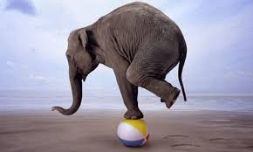
Desirable Difficulties?
Notes:
What are desirable difficulties
Activities that involve testing yourself repeatedly and over time to gain fluency and automacity. Rather than going over the information by re-reading/representing knowledge, we challenge this knowledge, over time.

Slide 4
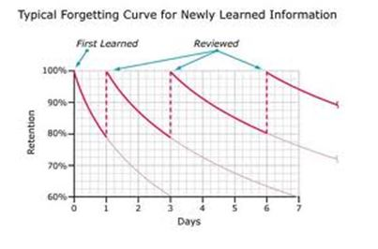
Notes:
Linsk to research- forgetting curve- can guide our planning

Slide 5
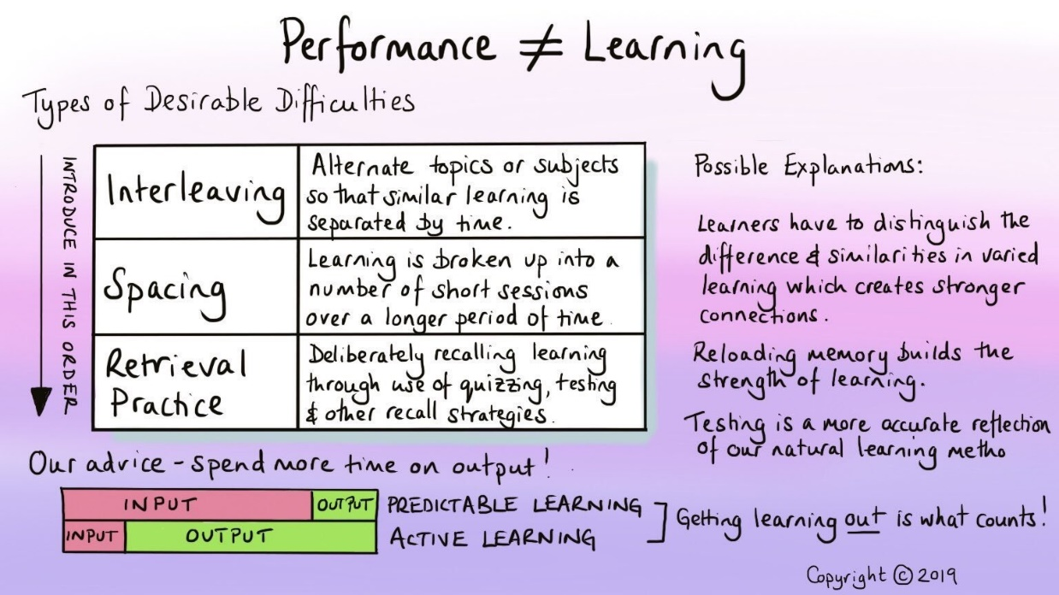
Notes:
Insert video link to interleaving/spacing video here

Slide 6
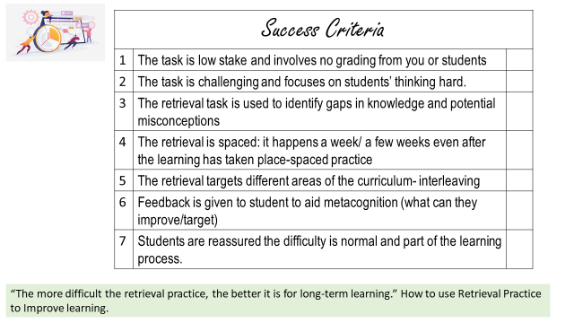
Strategy 1:
List it and Brain Dumps
List it | Brain Dumps
List as many : Facts Causes Keywords Consequences of Benefits/disadvantages of Individuals/characters Quotes from | “Dump” as much information from the brain about a specific topic/ unit of work on paper. Can be used as Do Now at start of lessons easily More suitable at KS4
Broad retrieval tasks, AKA Free recall- more challenging on memory. Both are low effort for us and high impact for students. Both can be used Live via Forms or ClassNotes/Assignments on Teams.

Slide 7
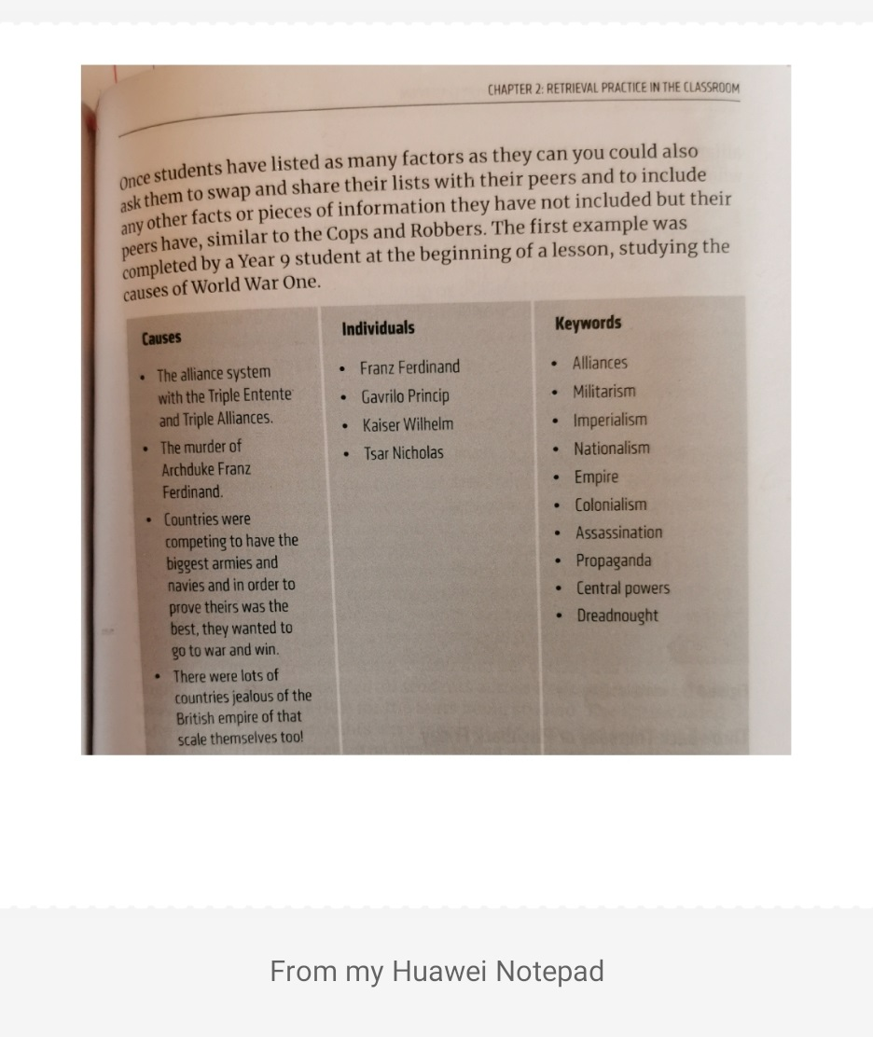
Notes:
Model from K-Jone, retrieval practice.
Suggestion: set out as a table on PP slide/ share slides on Assignment for students to complete live/ provide your version next (feedback) to ensure students check own work.

Slide 8
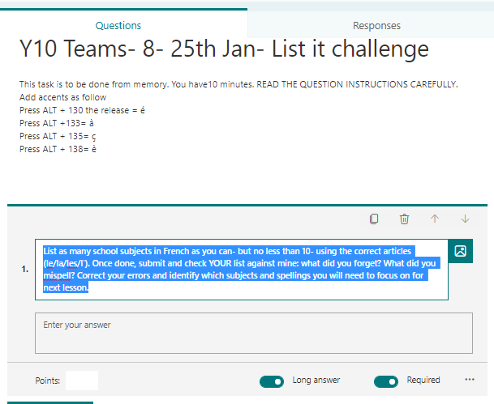
Notes:
Multiple and short text allow for correction- long text does not. A way around is to type answers in Feedback form!

Slide 9
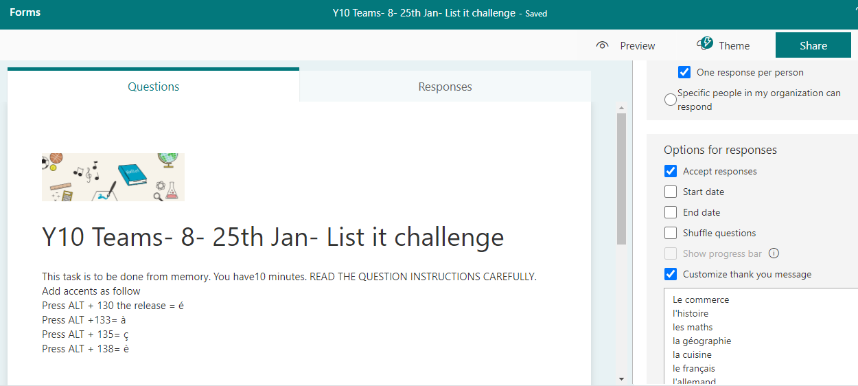

Slide 10
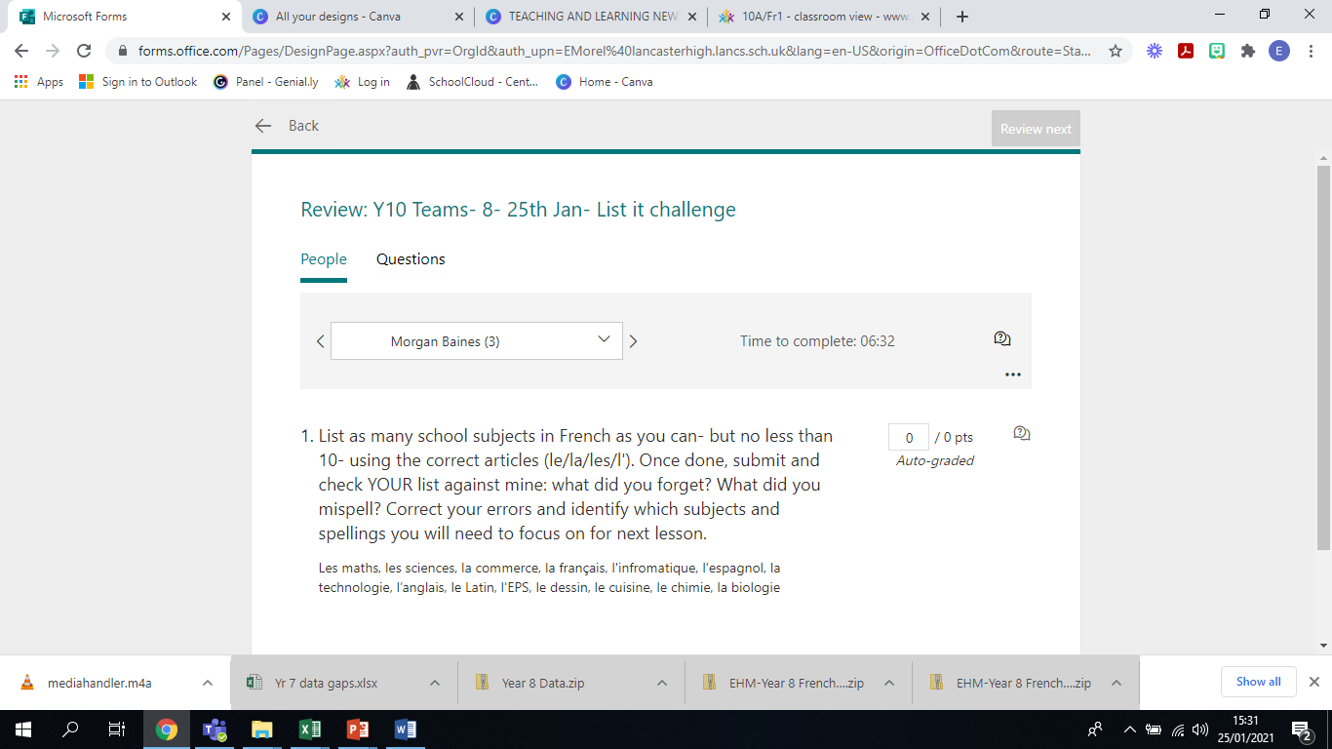

Slide 11
Making a form quiz video:
https://youtu.be/1ymXFGrQ8H8

Slide 12
Strategy 2:
Picture / Video Prompts: using pictures and videos to prompt recall.
How does this picture/clip connect to…?
Explain the role of…
Tell me about + specific
https://forms.office.com/Pages/ResponsePage.aspx?id=8jfX3t07d0eAvV75jyg8kLd8K81MLORPlRfqYQeNN8BURUg0RFRIVUc2RFYyTTk4WjlJRzZWQk1YQS4u
Notes:
Click on link for model then come back

Slide 13
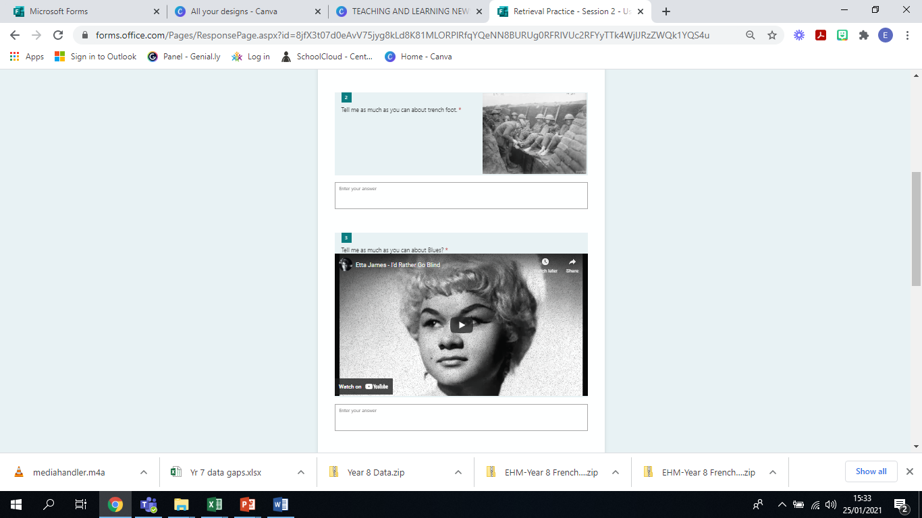
Notes:
The importance of cues

Slide 14
Adding pictures onto Form quizzes how to:
https://youtu.be/5L0PPP63i6M
Adding video clips to Form Quizzes
https://youtu.be/e5PsIWtv6kE

Slide 15
Breakout Rooms!
What have you tried since Session 1? How did it go? Could you share your reflections? What would you tweak? Why?
What could you have a go at from today’s session? How could you apply one of the strategies seen today to your subject knowledge content?

Slide 16
Target 2) To significantly improve recall and retrieval in lessons so pupils learn well.
Key Actions (including support needed): Attend all relative CPD training Adopt, plan and deliver chosen strategies with specific classes taught Evaluate and assess the effectiveness of strategies implemented Write up and share findings with colleagues across school as part of ongoing CPD

Slide 17
1st Feb
15th March
Your feedback matters! Click here
Merci!
Read the Learning and Teaching Newsletters.
Try out a couple of strategies- from Newsletters or Inset, tweak, perfect and SHARE!
Padlet: upload a resource for/ from your subject area here: Padlet
Password is “Central”- Competition to follow- keep your eyes peeled!

Slide 18

