Slide 1
GCSE Religious Studies
Mrs Pearson
February 2026

Slide 2
Why study GCSE Religious Studies?
Unique opportunity to see the world from a different perspective.
Students will develop their knowledge, skills and understanding of religion by exploring the significance and impact of beliefs, teachings, sources, practices and ways of life.
Students will be able to express their own beliefs whilst taking into account the beliefs of others.
Religious Studies allows students to express their personal responses on fundamental questions and encourages them to explore these topics and build informed, well-articulated arguments for and against these issues.
Notes:
Religious Studies is multi-disciplinary which means it links to other subjects however it gives a unique opportunity to develop knowledge and understanding of religion, philosophy and ethics
Looked at favourably as a foundation subject leading to the study of others such as law, philosophy, sociology and psychology.
Academically rigorous and requires a high level of written skills

Slide 3
Who might the course appeal to?
GCSE Religious Studies is well suited to anyone who has questions to ask and opinions to give.
This course will appeal to people who are interested in others and in human beliefs and behaviours.
You do not need a 'faith' to enjoy this course.

Slide 4
What skills are achieved?
Critical thinking
Respectful discussion and debate
Understanding others
Ethical reasoning
Literacy and interpretation
Written communication
Personal development
.

Slide 5
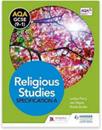
Course content:
AQA Religious Studies Specification A
GCSE Religious Studies has 2 exam papers:
Component 1: The study of religions: beliefs, teachings and practices: 1 hour 45 minutes, worth 96 marks plus 6 marks for spelling, punctuation and grammar. 50% of the GCSE grade.
Each religion has a common structure of two five-part questions of 1, 1, 4, 6 and 12 marks.
Component 2: Thematic Studies. 1 hr 45 mins, worth 96 marks, plus 3 for spelling, punctuation and grammar.
Each theme has a common structure of one five-part question of 1, 1, 4, 6 and 12 marks.

Slide 6
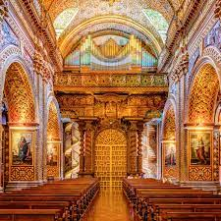


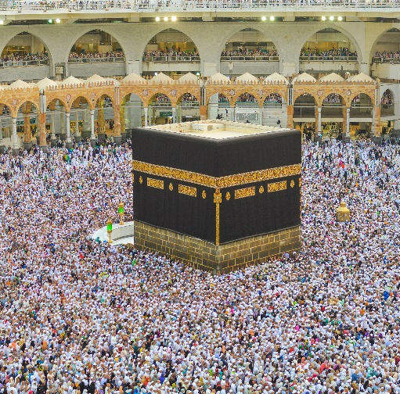
Component 1: Study of religions, beliefs, teachings and practices
Christianity and Islam
Key beliefs
Ideas about the nature of God and existence
Belief about the nature of human life
Worship and festivals
Religion and the wider community
Notes:
Students use sources of wisdom and authority from each religion and will need to refer to scripture and/or sacred texts where appropriate. Students then study the influence of the beliefs, teachings and practices studied on individuals, communities and societies.

Slide 7



Component 2: Thematic Studies
Religion, relationships and families
Religion and Life
Religion Peace and Conflict
Religion, Crime and Punishment
Notes:
This component is intended to encourage students to reflect upon ethical issues including the right to life, contemporary family issues, gender equality, animal life, environmental issues, religious attitudes to the elderly and death, euthanasia, medical ethics, religious attitudes to crime and punishment, capital punishment and attitudes to poverty.
In the examination students will be expected to illustrate their answers by reference to examples in relation to the issues raised, and to make appropriate references to two religions studied.

Slide 8
Where can it lead?
The skills developed will support you in further studies and employment.
Religious Studies will teach the skills and understanding needed to work with people of all faiths and cultures.
These skills are vitally important in all careers especially professions such as law, enforcement, teaching and the armed forces, in fact any profession that brings you into contact with other people.

Slide 9
Pathways for post-16 study
Pupils can go onto to any of the local 6th form providers to study A Level Religious Studies, Philosophy and ethics, Sociology and Law.
Post-18 students can progress to a wide range of Religious Studies degrees at universities both nationally or internationally, or, they may choose to pursue an apprenticeship or go into employment.

Slide 10
For more information about the course,
please speak to your child's teacher at progress evening.

