Slide 1
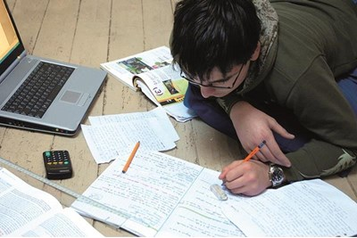
revise
Drop everything and read
Session 2

Slide 2
Today we will:
Understand what “average” strategies are
Find out what the best proven strategies are.
Practice using strategies.

Slide 3
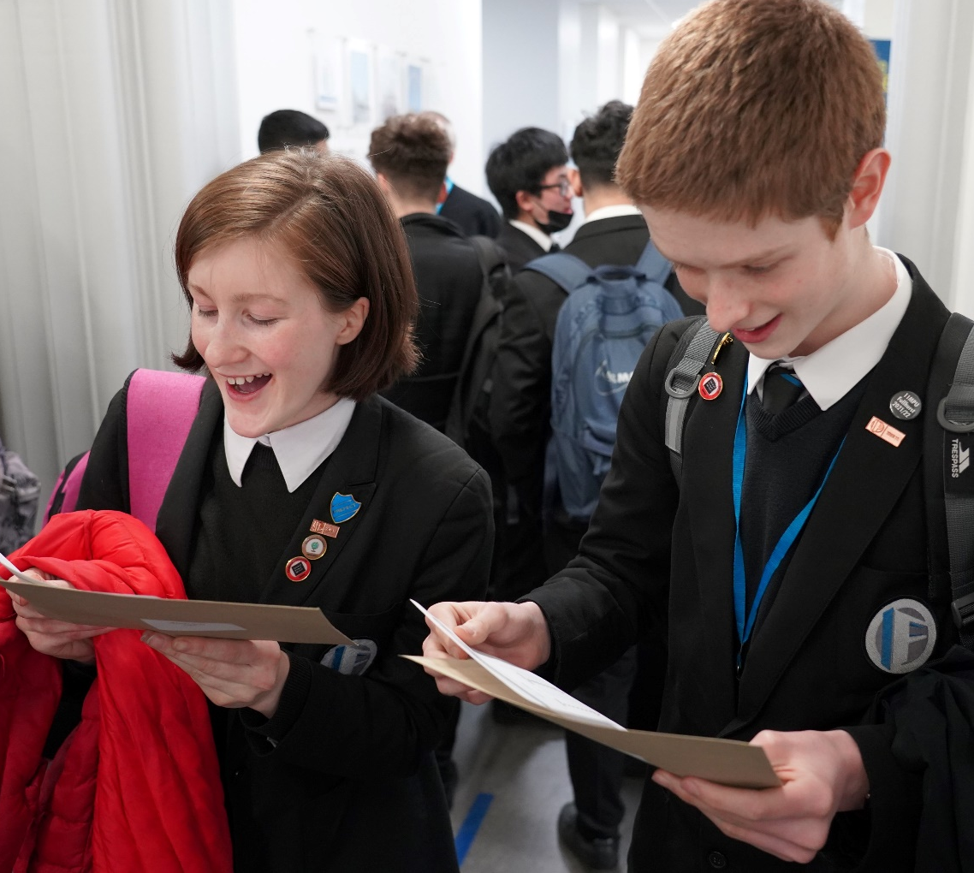
REAL
Friday 24th August
168 days
24 weeks
Friday 17th March
155 days
22 weeks

Slide 4
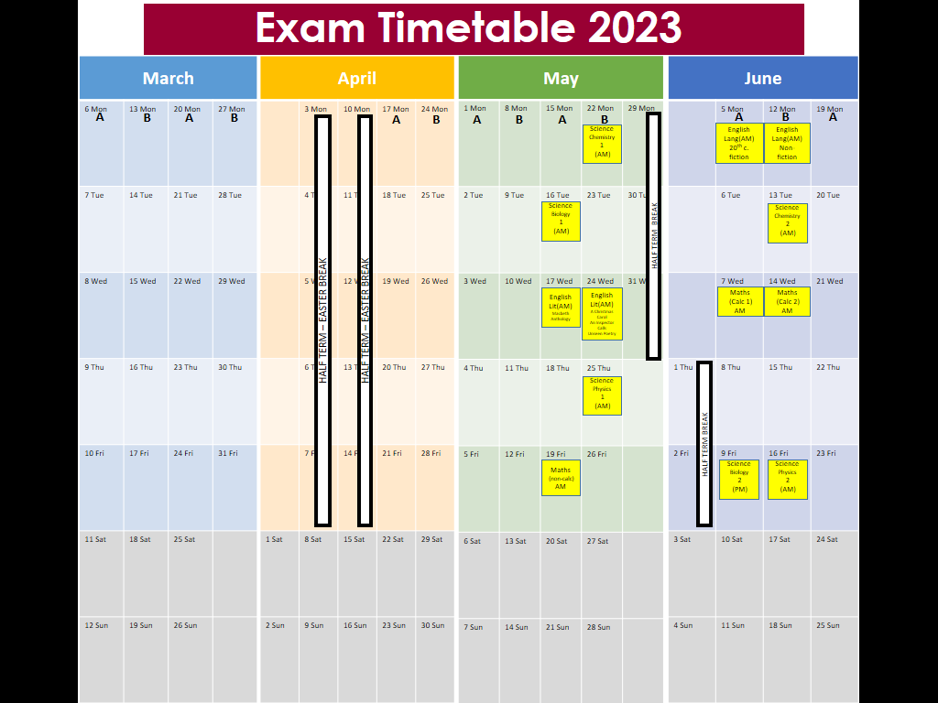

Slide 5
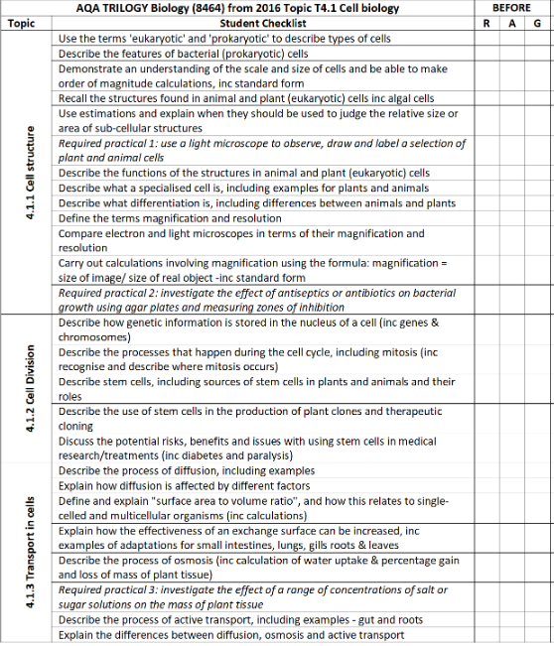
Science: Biology (Paper 1)
Topic T4.1 Cell biology
Topic T4.2 Organisation
Topic T4.3 Infection and response
Topic T4.4 Bioenergetics

Slide 6
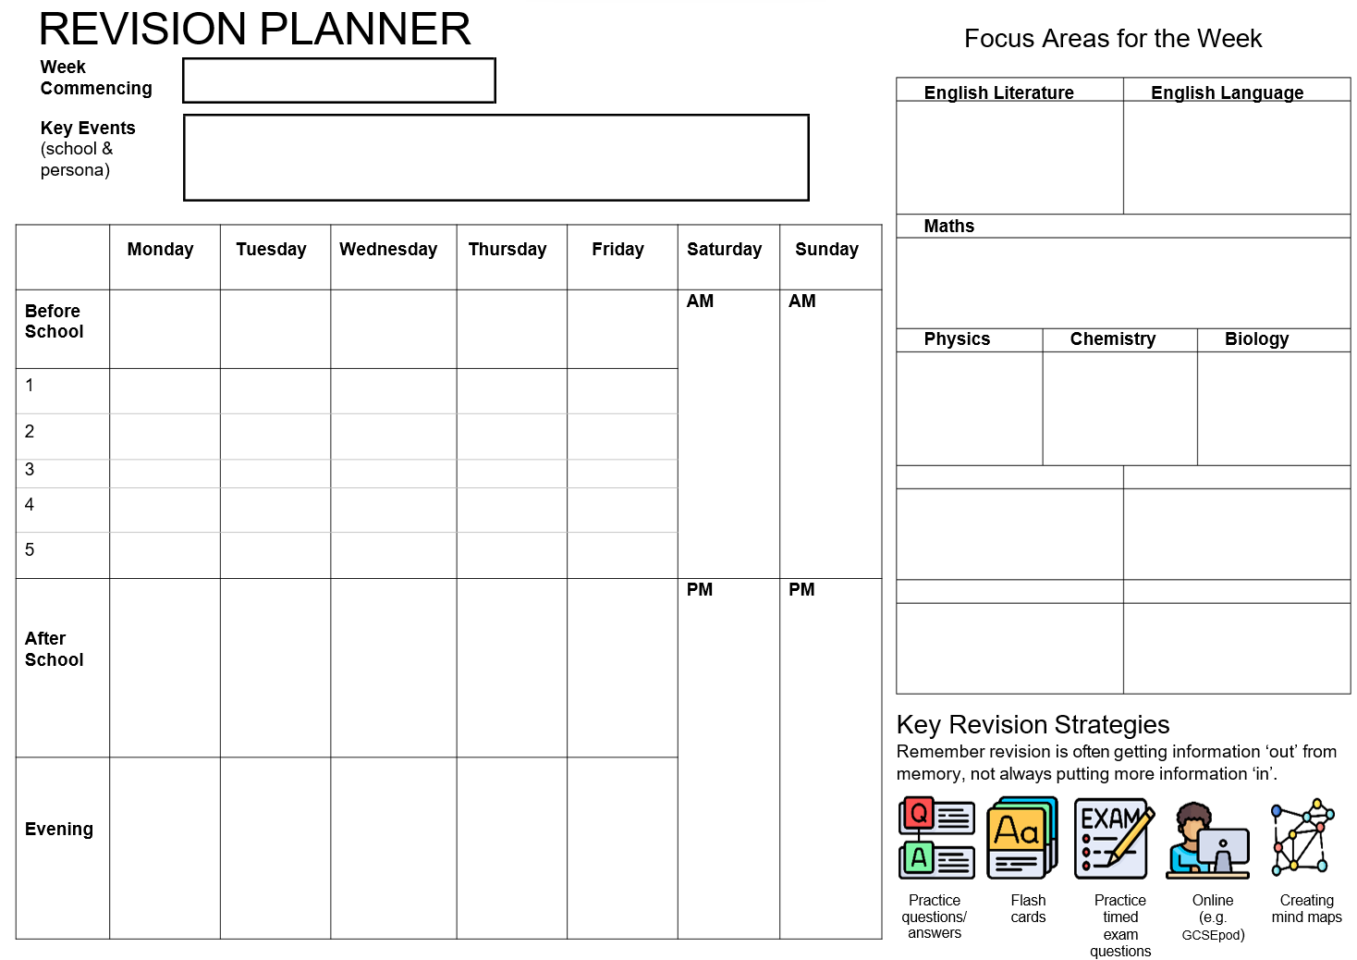
Mon 13th March
- PPE2 results - Fri 17th March
Friends birthday Thurs
Art exam preparation
Macbeth characters learn
20th C fiction reading
Algebra
GCSEpod x 1
Cell biology
Remember birthday card
PPE results today
20 C fiction REVISIT
Energy
Atomic structure & periodic table
4.1 Cell Biology
Football
Geography
History
River Landscapes – Long profile & upper middle lower
Norman Conquest Part 1
4.1.1 Cell Structure
20 mins
4.1.1 Cell Structure
REVISIT
20th C fiction reading
20 mins
4.1.2 Cell Division
REVISIT
4.1.1
4.1.2
4.1.3
REVISIT ALL & PRACTICE EXAM Q’s
Choice of topic I had most difficulty with
GCSEPODS
Macbeth characters 20 mins
4.1.2 Cell Division
20 mins
4.1.3 Transport In Cells
20 mins
Algebra
REVISIT
Alegbra
20 mins
Macbeth characters REVISIT
River Landscapes
20 mins
Norman
Conquest
20 mins
River Landscapes
REVISIT
Norman Conquest
REVISIT

Slide 7
Reading
Highlighting
Watching
Listening
Conversation
KNOWLEDGE
Brain dump
Quizzing
Talking
Exam Question Practice
FINAL EXAMS

Slide 8
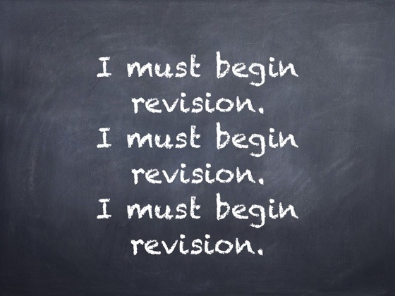
There is no perfect way to revise, but there are proven strategies.
People have success with different strategies.
Make a start.
Do some every day.

Slide 9
You could start with getting out what you already know – Brain dump.
Check your learning checklist, and empty your brain
But if you don’t know anything, that can be demoralising.

Slide 10
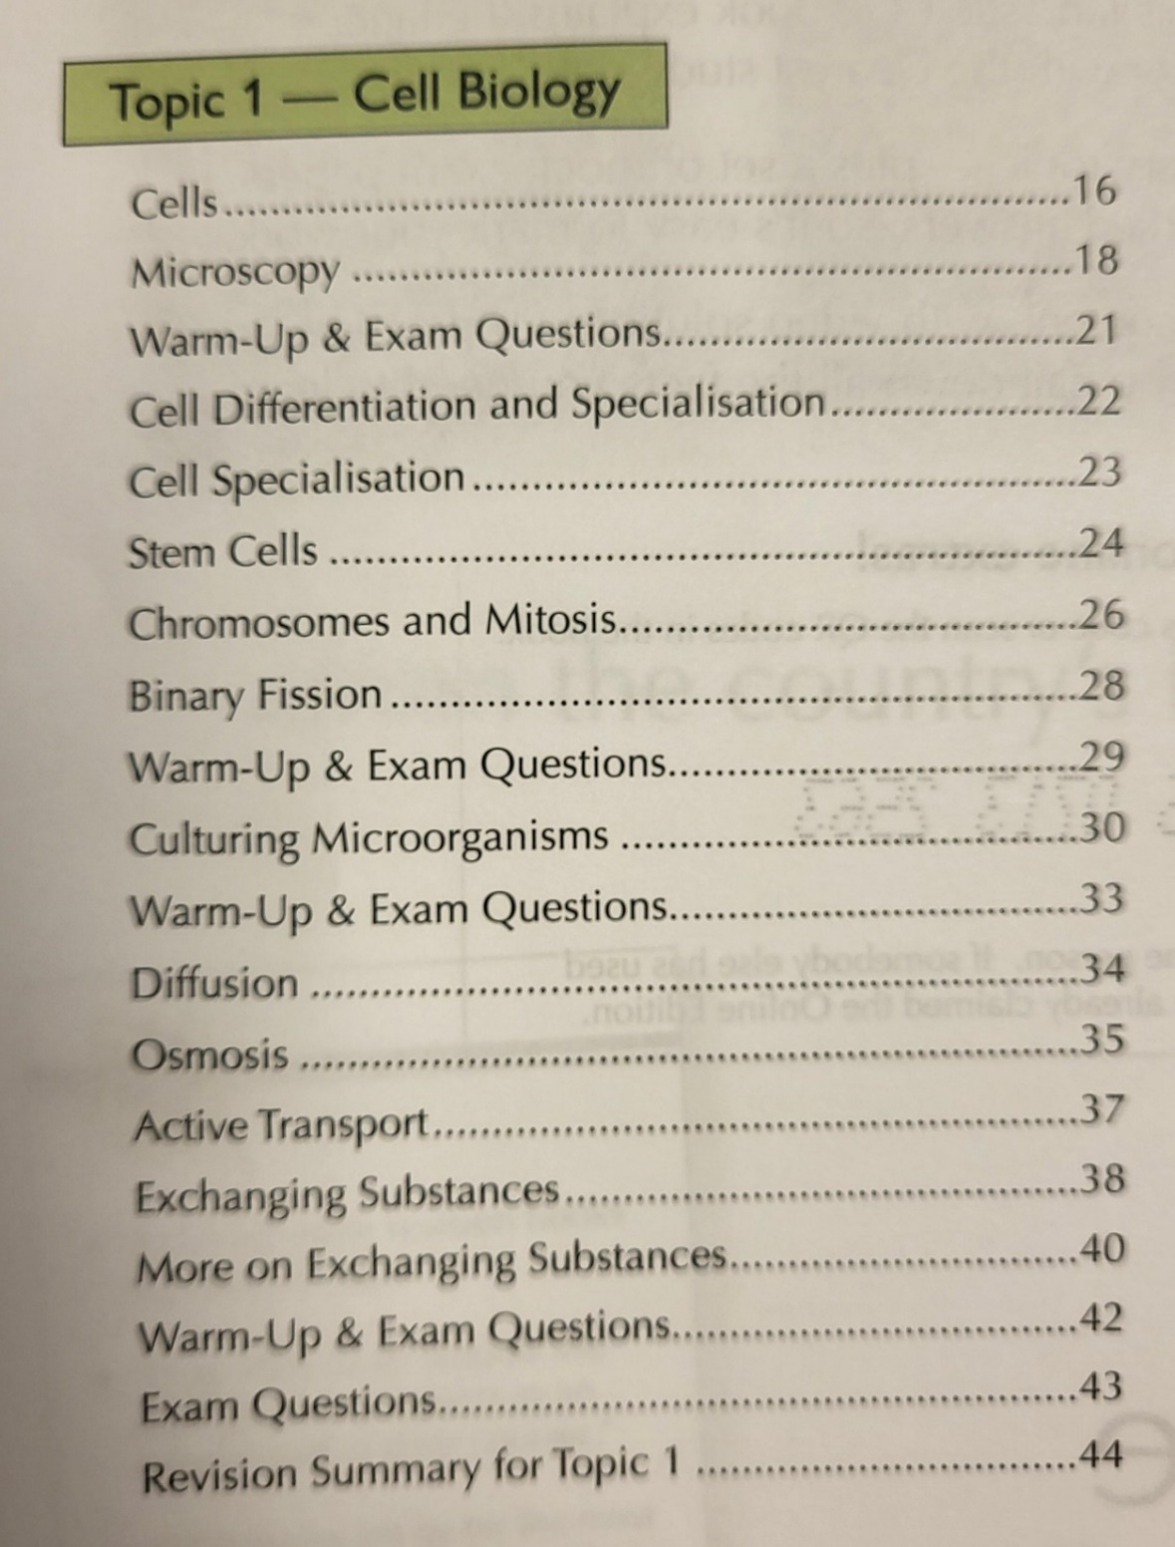
Our first revision session was about Cell Biology, specifically Cell Structure.
Before reading new information, practice what you will need to do in your exam and put your brain under some strain to extract information
TASK 1:
Take two minutes to write down everything you can remember about cell structure

Slide 11
Expect this to be hard work.
You may have written very little.
You also may have to work your brain a little harder than you are used to.

Slide 12
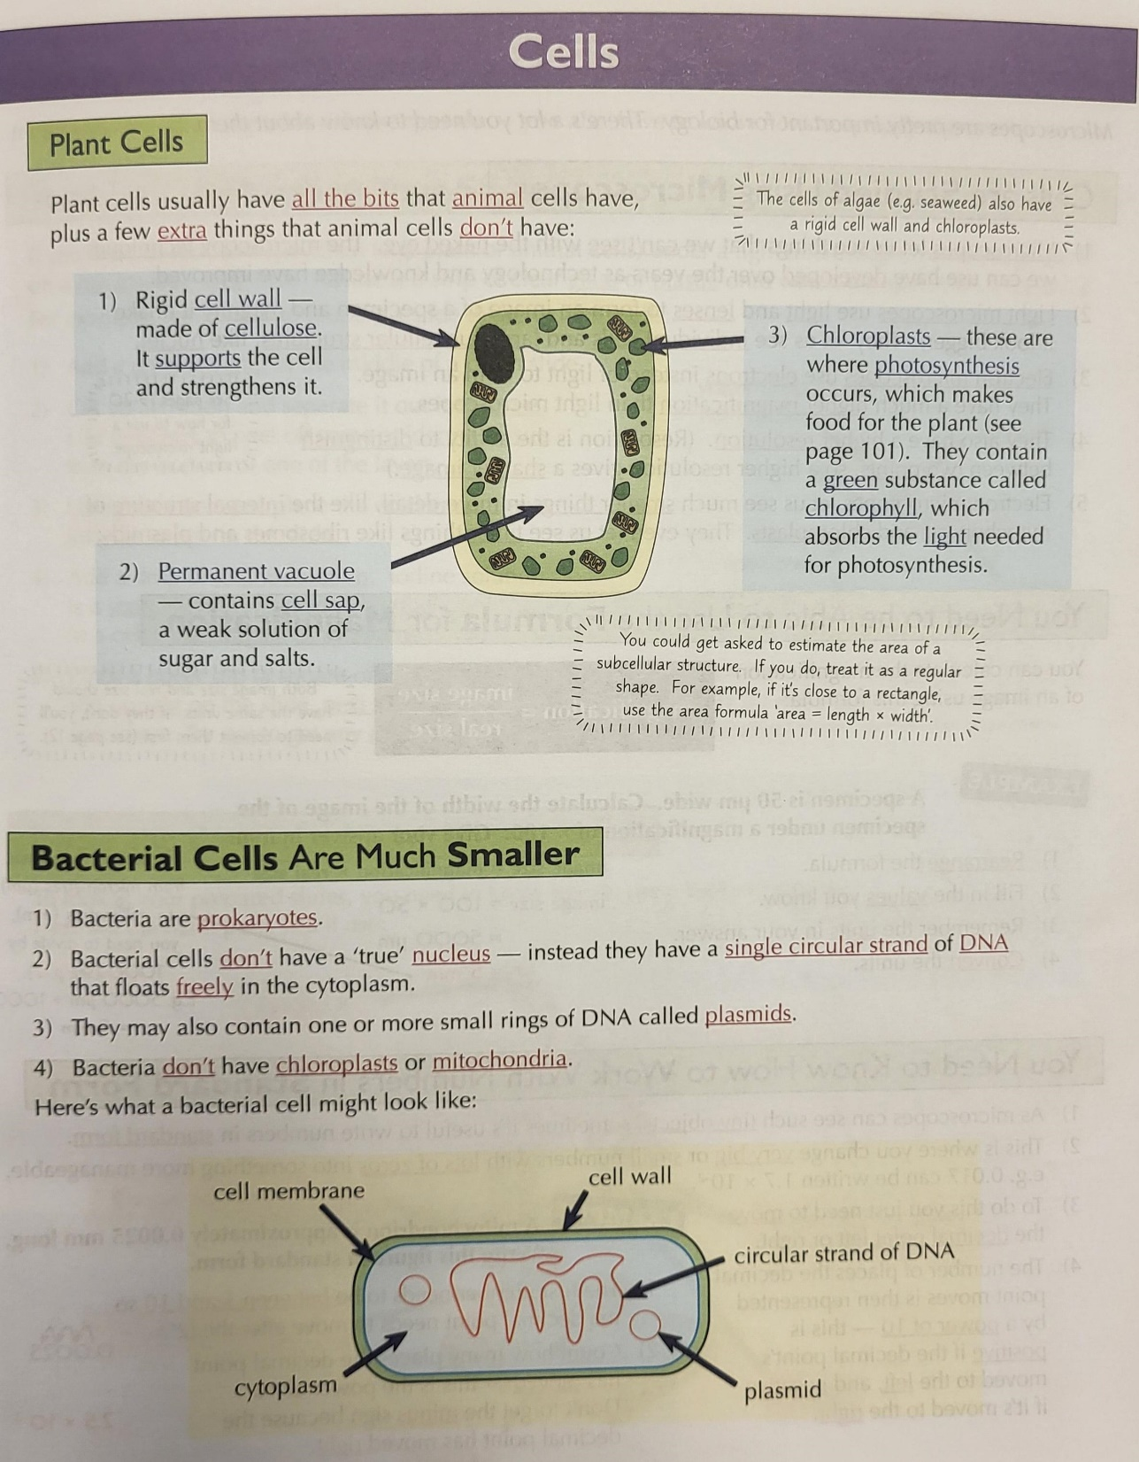
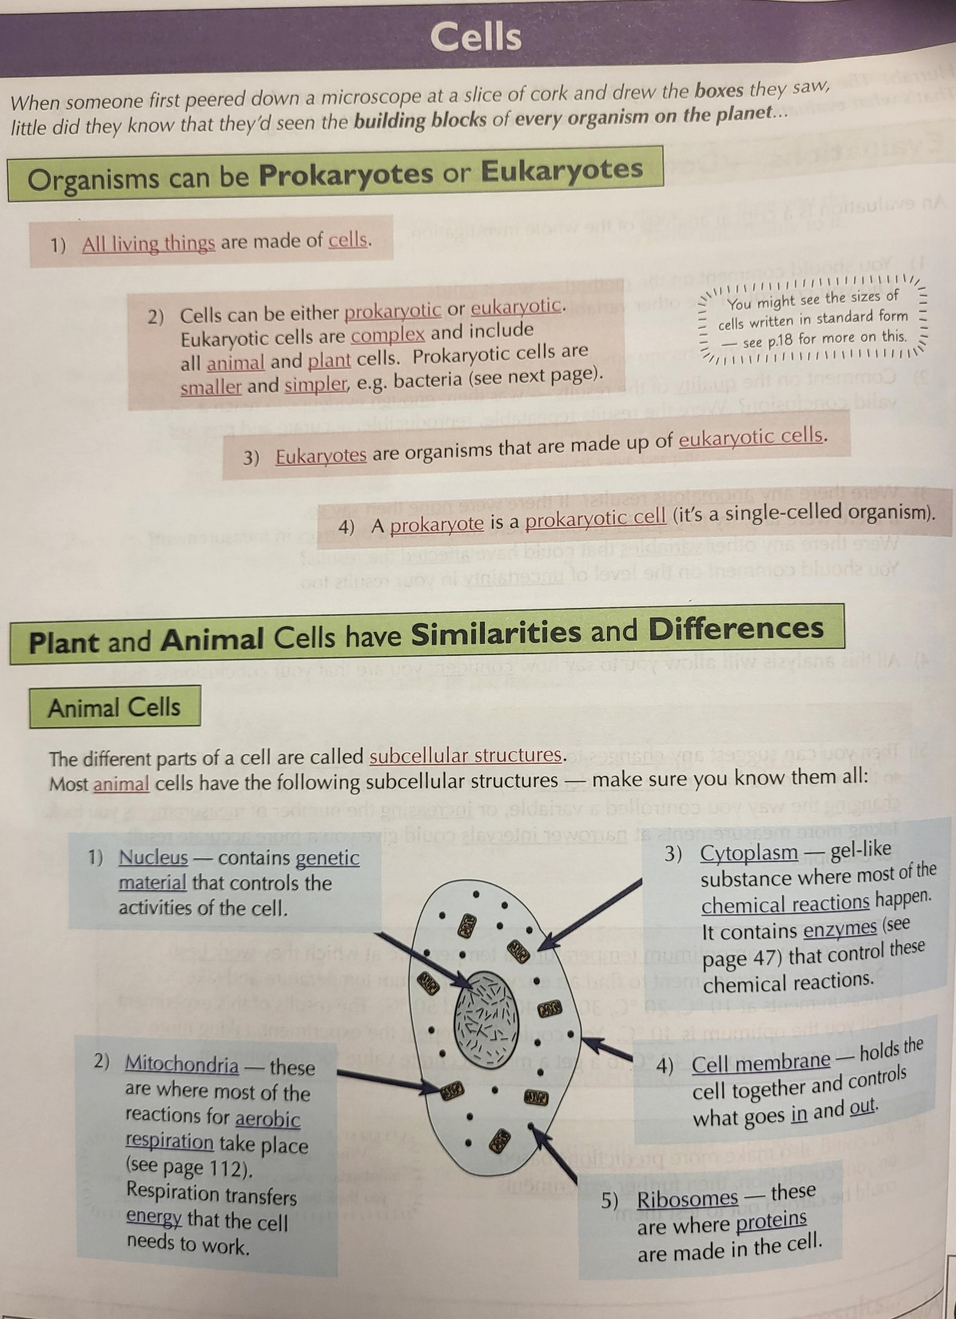
How do we now get this to go in?
Read?
Highlight?
Mind map?
Flashcards?

Slide 13
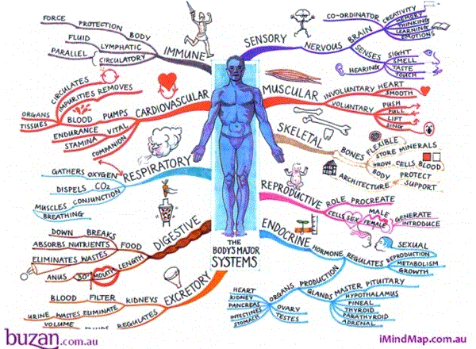
You have a choice
Smaller parts of a topic
Mind Maps
Large parts of a topic
Brief text with pictures
Stick it up somewhere to trigger strong memories

Slide 14
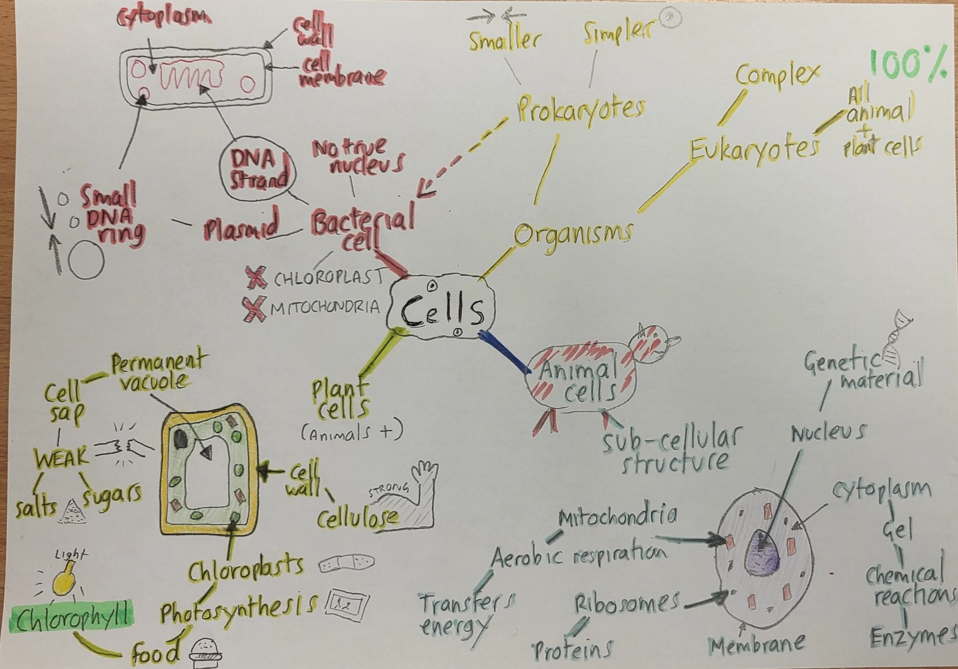

Slide 15
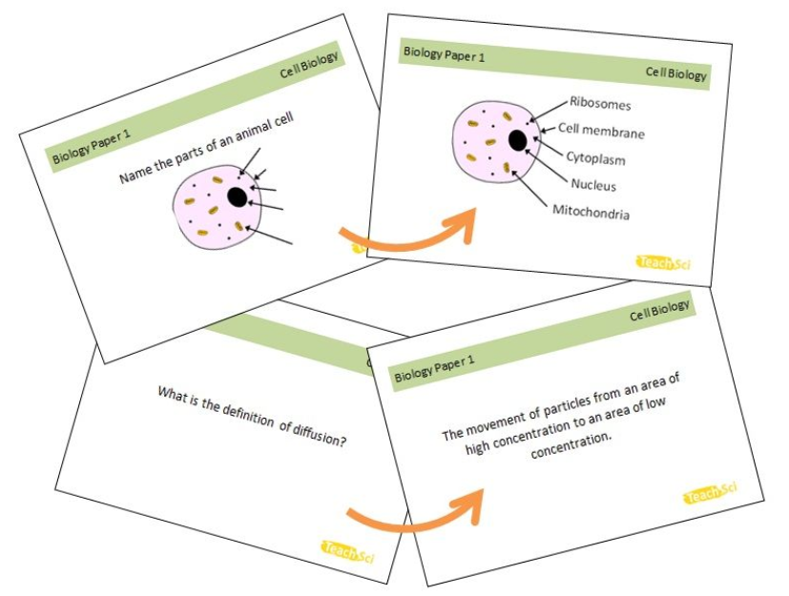
TASK 1: Create part of a flashcard for “Cell Structure”
These can be made, or can be bought
TASK 2: Swap your flashcard with the person next to you and try to answer their question

Slide 16
Exam practice
https://revisionworld.com/gcse-revision/gcse-exam-past-papers
Flashcards
https://www.brainscape.com/learn/gcse-geography-aqa

Slide 17
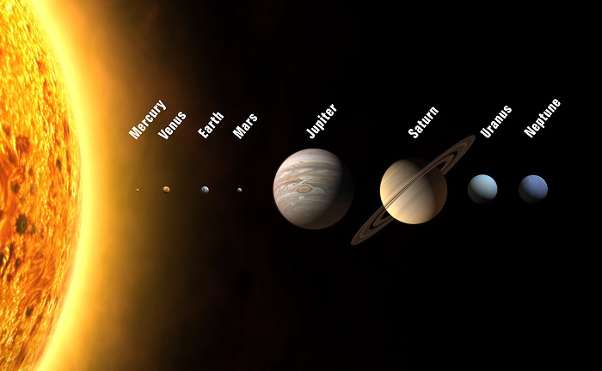
Mnemonics
For list like information, such as steps, stages, parts

Slide 18
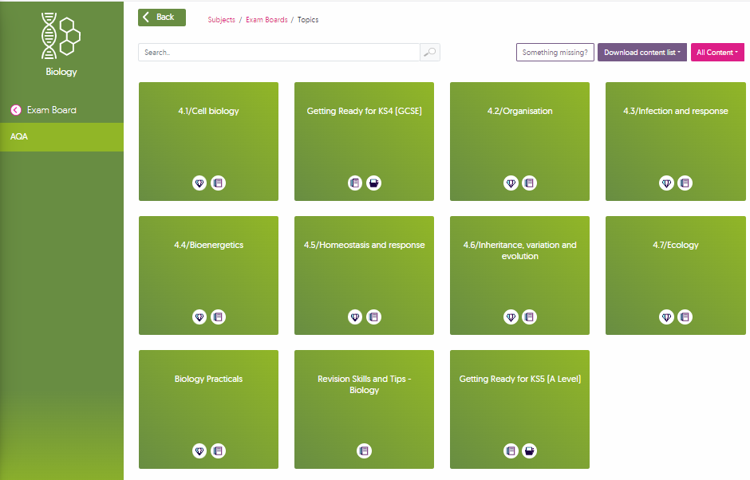

Slide 20
OVERVIEW
REVISING
PERSONAL HABITS
Know when your exams are
Add them to a timetable
Create a revision timetable each week with specific priorities, using your learning checklists and revision guides
4. Attempt to learn material (IN) and test yourself (OUT):
Braindumps OUT
Mind maps or flashcards IN
Reading IN
GCSEpods IN
Testing (quizzes, exam questions) OUT
5. Nutrition
6. Exercise
7. Sleep
Getting these right will have a HUGE impact on your stress/anxiety levels

Slide 21
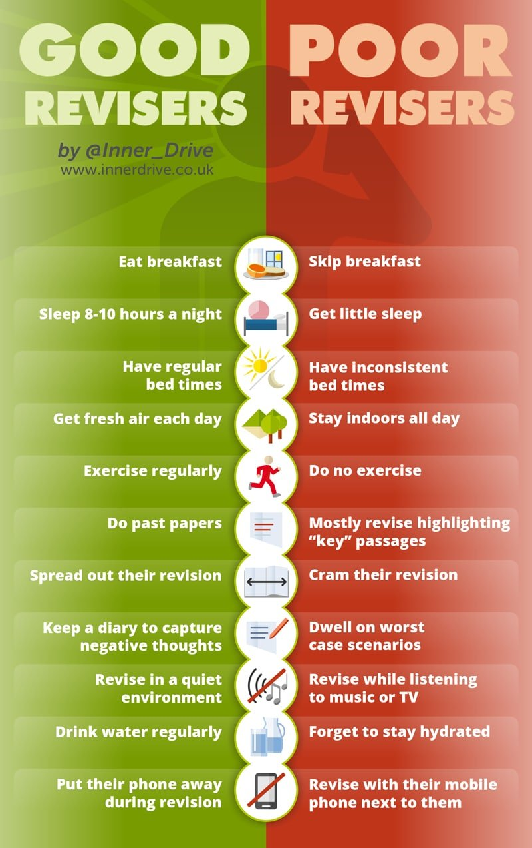
Good habits for revising
Bad habits for revising

