Slide 1


Classroom Culture
15th September

Slide 2
‘Do Now’
An activity which students complete with little to no instruction from you as you enter the classroom
Depending on your timetable and movement, can be paper based, verbal or displayed on the projector
Must require students to put pen to paper
Minutes long
Completed in silence
Reviewed

Slide 3

‘Do Now’
"scholarly work that helps them succeed"

Slide 4
‘Do Now’
Think hard
Challenging
Purposeful
Engaging

Slide 5
‘Do Now’ - Curriculum Development
What does an effective 'Do Now' look like in your subject?

Slide 6


Commitment
Creativity
Community
3Cs
Notes:
Our ethos for success

Slide 7
Commitment
Creativity
Community
Correct uniform
Correct equipment for learning
Punctual
Focused
Hard working
Committed to your own progress
Willing to take part
Extra-curricular involvement
Expression of ideas
Use of imagination
Willing to have a go or a guess
Apply ideas to a design
Problem solving
Considerate of others in the classroom
Supports others in their team community
BfL
Works well with peers
Polite to staff
Aware of the impact of their actions of others
Awareness of their learning links to the local, national and global community.

Slide 8
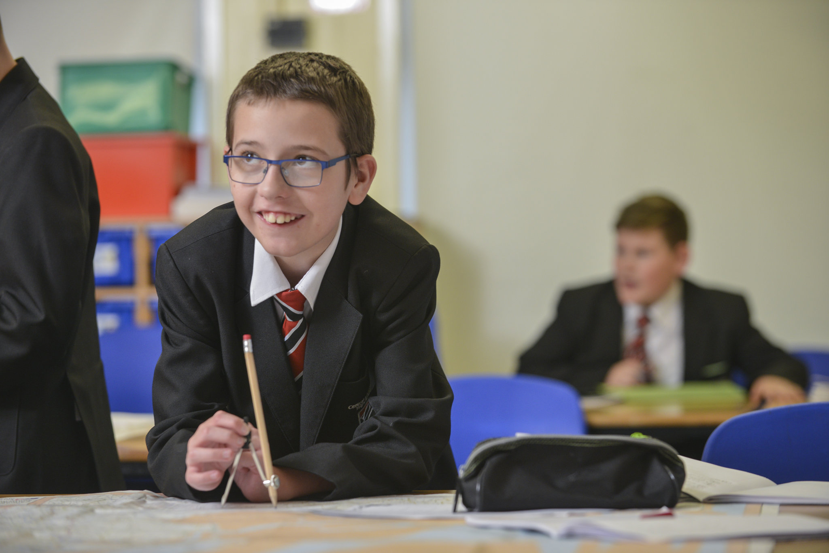
Next Step…

Slide 9
We want your input!
How do they feature in our classrooms?
Commitment
Creativity
Community

Slide 10
We want your input!
What should our ‘Central Line’ be on classrooms?

Slide 11
Department time
What does it look like?
What does it feel like?
What does it sound like?
Compile ideas
Send to us

Slide 12

What are our next steps?

Slide 13
What are our next steps?
1st October – pupil assembly about the 3 Cs and 'The Central Line on Classrooms.' Opportunity for students to share ideas
6th October – RST Classroom Culture

Slide 14
But for now....
Let's go to department areas!

