Slide 1
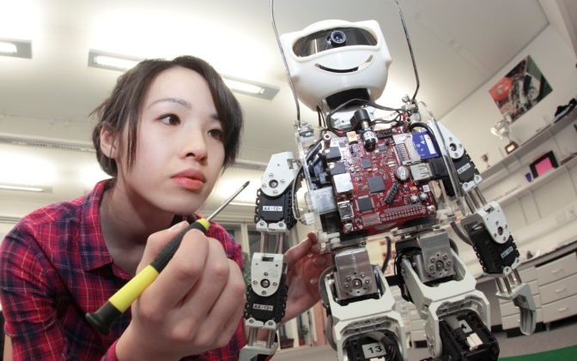
YEAR 10
WORK EXPERIENCE
13 May – 17 May 2024

Slide 2
Work experience is a chance to..
To meet new people
To find out more about industry and commerce
To experience travelling to work
To exercise more self-discipline and responsibility
To improve your self-confidence
To improve your social skills
To learn the importance of punctuality
To gain transferable skills

Slide 3
Why go on work experience?
Young people are more likely to be successful in their job hunt if they have done some good work experience.
If you haven’t got a clue what career you want to do, work experience is a perfect way to sample all the career options out there. It’s a way of exploring different jobs without actually committing to anything. You can dip your toe in the water without taking the full plunge
It enhances your understanding of the world of work

Slide 4
The Placement
Ideally matched to individual career aspirations.
YOU must be pro-active in your search for a work placement.
The placement must have up-to-date Employers Liability Insurance and a current risk-assessment.
Unfortunately, this rules out 'sole-traders'.

Slide 6
Placement dates: 13th May – 17th May 2024
ALL PLACEMENTS MUST BE FINALISED by 19th April 2024
YOU ARE RESPONSIBLE FOR FINDING YOUR PLACEMENT
– SCHOOL DOES NOT ORGANISE PLACEMENTS

