Slide 1
YEAR 10
WORK EXPERIENCE

Slide 2
Work experience is a chance to..
To meet new people
To find out more about industry and commerce
To experience travelling to work
To exercise more self-discipline and responsibility
To improve your self-confidence
To improve your social skills
To learn the importance of punctuality
To gain transferable skills

Slide 3
Why go on work experience?
To understand the everyday realities of working life
To sample what career you want to do
To make yourself more employable
An opportunity to work in a adult work environment
To work with people of different age groups
To learn about yourself
Gain greater self-confidence and belief
To take charge of your own future

Slide 4
Why go on work experience?
Young people are more likely to be successful in their job hunt if they have done some good work experience. Fact
If you haven’t got a clue what career you want to do, work experience is a perfect way to sample all the career options out there. It’s a way of exploring different jobs without actually committing to anything. You can dip your toe in the water without taking the full plunge
It enhances your understanding of the world of work

Slide 5
The Placement
Ideally matched to individual career aspirations.
YOU must be pro-active in your search for a work placement.
YOU should be viewing work experience as a learning experience.

Slide 7
Placement dates: 15th May – 19th May 2023
Research and discuss your child's placement with them.
Find a placement and gather the details on the initial form.
Ensure your child has an email address for you to enter into the initial form.
ALL PLACEMENTS SHOULD BE FINALISED by 17th April 2023

Slide 8
Workplaces which have previously offered placements:
315 Health Club
Oxfam Bookshop
Premier Inn
Local primary schools
Jo and Cass
Superdrug
Nazareth House Nursery
Infinity Print Solutions
Wolfwood
AJ Exotics
Lancaster Castle Museum
Marks and Spencer
The Entertainer
Specsavers
Carlisle Airport
Heysham Power Station

Slide 9
Introduction to Parents:

Slide 10
The Unifrog tools
Access all tools on Unifrog to learn what options are available, access good quality information, and search for opportunities to support your child.
Exploring pathways
Recording what you’ve done
Searching for opportunities
Drafting application materials
Making applications
Careers library
Activities
UK universities
UK Personal Statement
Post 18 Intentions
Subjects library
Competencies
US universities
Classes
Locker
Know-how library
Interactions
European universities
Subject References
Applications list
MOOC
Oxbridge
CV / Resumé
Personality profile
Canadian universities
Writing tool
Interests profile
Asian universities
Common App Essay
Read, Watch, Listen
Australasian universities
US recommenders
Webinars
ME and African universities
Notes for Reference writers
Irish universities
Special Opportunities
Events

Slide 11
Careers Library
Over 1000 career profiles
Presents information from a range of sources, including local and national LMI
Includes qualifications and skills needed, interviews with industry professionals and labour market information
Explores progression opportunities and what a working week really looks like

Slide 12
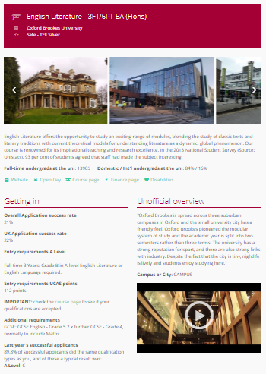
UK Universities
Students can enter subject of interest and projected grades to see all relevant university courses available in the UK
Rank and filter opportunities by factors like hours of lectures, price of accommodation and graduate job rates
Get direct links to university information pages, with impartial information on courses and institutions
Save unlimited shortlists to refer back to later

Slide 13
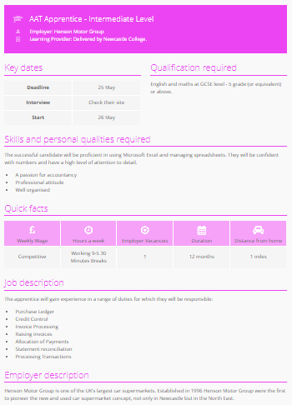
Apprenticeships
Students can find live apprenticeship vacancies
Vacancies are updated daily
Rank and filter opportunities by factors like distance from home, weekly wage and application deadlines
Direct link to the ‘apply’ page
Each apprenticeship vacancy includes practical information about the opportunity, employer and training
Save unlimited shortlists to refer back to later

Slide 14
Other cool stuff
The Unifrog platform contains so much more than what we can show you today, that was just four of their many tools.
So why not see for yourself? Sign up as a student and access the tools in exactly the same way that the students do.
You never know, there might be a new career just around the corner!

Slide 15
Using Unifrog for Work Experience (placements)
https://www.unifrog.org/teacher/resources/sort/know-how-how-to-use-the-placements-tool

Slide 16
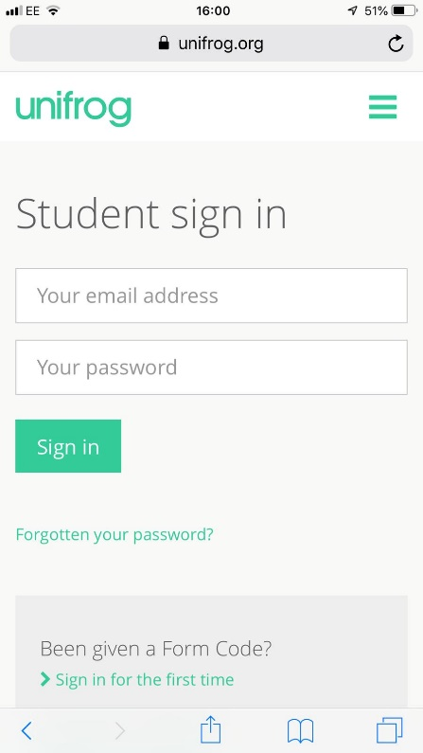
Parents & guardians, get signed up!
Scan this QR code or go to www.unifrog.org/student and click ‘Sign in for the first time’
You’ll be asked for some details and a Sign up Code. This is what you need:
'CLHSParents'
After signing up, log into Unifrog using your email address and password via the student sign-in page!

