Slide 1
Year 1 Reading and Phonics

Slide 2
The importance of Reading
Learning to read is the most important thing your child will learn at our school. Everything else depends on it, so we put as much energy as we possibly can into making sure that every single child learns to read as quickly as possible.
We want your child to love reading – and to want to read for themselves. This is why we put our efforts into making sure they develop a love of books as well as simply learning to read.

Slide 3
Our Phonics Scheme
At Chapelford Village Primary School, we use the Read Write Inc. phonics scheme.
This is a scheme we have been using for several years and all children are already used to the sounds, their rhymes and the way letters are formed.

Slide 4
What is Phonics
Phonics and reading happens daily in Reception, Year 1 and Year 2.
We have set sessions for phonics and reading during each morning and often use time in the afternoons for follow up teaching, if it is needed.
Phonics even happens in years 3, 4, 5 and 6. Children use their phonics knowledge every day to help them read and spell words.
Sounds and graphemes
44 sounds
26 letters
Over 150+ graphemes (letter combinations)
We have one of the most complex alphabetic codes in the world!
TITLE OF DOCUMENT

Slide 5
Phonics in Reception
We start teaching phonics as soon as children enter Reception.
We introduce the single sounds first, we call these Set 1.
The single sounds are…
TITLE OF DOCUMENT

Slide 6
Phonics in Reception
We model sound pronunciation
We show picture cards – things that start with the sound
We show the picture side of the sound – Maisie & mountain for m
We draw the picture and the letter on the board and model correct letter formation
We add the sound to the pack of sounds we already know, the children spot the new sound in the pack
The children have a go at writing the letter along
We recap the formation of 3 sounds we have already learnt
We read words that include our new sound using Fred Talk
You will notice that there are some Special Friends in Set 1 too.
Special Friends are when two letters join together to create one sound.
We teach these at the end of Set 1, once the children are secure with single sounds.

Slide 7
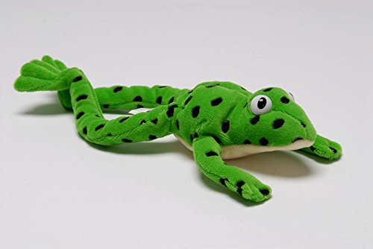
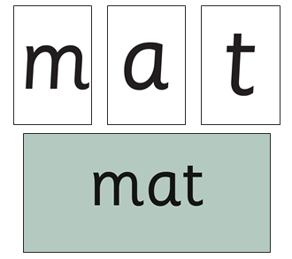
Fred Talk
This is Fred the frog.
Fred can only talk in sounds.
We use Fred and Fred Talk to teach and support blending, starting in Reception.
We play lots of games with Fred such as ‘Fred says’, ‘Fred’s adventures’ and ‘Fred’s house’.
TITLE OF DOCUMENT

Slide 8
Reading Sessions
3.Children have a go at reading the green and red words from the story with their partners.
4.The teacher introduces the story.
5.Children have their first go at reading the story.
6.The teacher reads the story.
7.The children have a second go at reading the story.
We talk about the story and question the children’s comprehension – have they understood the story?
Once children are secure with a number of Set 1 sounds, we start our word time reading sessions.
1.We read words from our focus story together, using Fred talk at first before we get speedy!
2.We look at the ‘red words’ from our story. These are the tricky words that cannot be phonetically decoded (e.g. I, me, no, of, to)
TITLE OF DOCUMENT

Slide 9
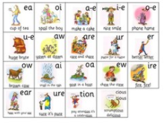
Phonics in Year 1
Some sounds in Set 3 are called split digraphs (chatty friends), this is because they split either side of another sound.
phone
smile
cake
huge
In Year 1, we recap previously taught sounds from Reception and then begin our Set 3 sounds.
The children quickly pick up our mantra of ‘Special friends, Fred Talk, Read the word’.

Slide 10
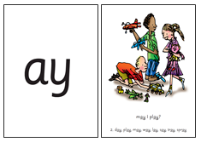
Set 2 and Set 3 Sounds
We teach set 2 sounds first, then set 3.
There are many letter combinations in set 3 that make the same sounds and some taught in set 2…
ay, ai and a-e
oy and oi
ee and ea
ow and oa
TITLE OF DOCUMENT

Slide 11
Year 1 and Year 2 Phonics Lesson
We introduce the new sound and it’s rhyme, using 3 to 4 words with the sound in as examples.
We show both sides of our phonics card, the sound side and the picture-rhyme side. We talk about what is happening in the picture.
We add our new sound card to the pack we already know and spot it as we read our sound speedily.
We show our ‘green words’. These are green cards with phonetically decodable words on them, including our
new sound. We use Fred Talk to sound out the word and then read it as a whole.
We recap sounds we already know by reading them in other words.
We read a few ‘nonsense’ words. These are words that include the sounds we know, but they are not real words.
We spell a few words on the board.

Slide 12
Reading Sessions
Reading sessions happen every day. So, it is important to have their reading diaries and books in book bags every day.
We recap and teach the sounds used in the story book.
We show the green words from the story. These are the words that can be phonetically decoded and include our focus sounds. We have a go at these until we can read them speedily!
We read the red words from the story. These are the tricky words that can not be phonetically decoded.
Partner practice – green and red words.
The teacher introduces the story.
The children read the story while the teacher listens in.
TITLE OF DOCUMENT

Slide 13
Reading Books
We have spent a large amount of money on purchasing new reading books for Reception and Key Stage One, as well as purchasing an e-library.
Each week, your child will come home with:
One new reading book
One set e-library book or reading quiz!
One published story book (bedtime story)

Slide 14
Phonics Screening Check
The test contain 40 words
Each child sits one to one and reads each word aloud to their teacher.
The test will take approximately 10 minutes per child, although all children are different and will complete the check at their own pace.
The list of words the children read is a combination of 20 real words and 20 pseudo words (nonsense words).
The pseudo words will be shown to your child with a picture of an alien. This provides the children with a context for the pseudo word which is independent from any existing vocabulary they may have.
Pseudo words are included because they will be new to all pupils; they do not favour children with a good vocabulary knowledge or visual memory of words.

Slide 15
Online Resources Available
Ruth Miskin Parents’ Page:
http://www.ruthmiskin.com/en/parents/
Ruth Miskin Facebook:
https://www.facebook.com/miskin.education
Free e-books for home reading:
http://www.oxfordowl.co.uk/Reading/
TITLE OF DOCUMENT

Slide 16
Frequently Asked Questions
TITLE OF DOCUMENT

Slide 17
Why do we only have one reading book?
The reading book will be sent on your child’s reading day.
This is fantastic, as it allows children to build their confidence with reading, as they are already familiar with the text.
There is no point in a child trying to read a book with sounds they don’t know. It can become very disheartening and can cause children to become reluctant readers.
We want children to come home excited to read to their parents, to show you how good they are at reading that specific book.
TITLE OF DOCUMENT

Slide 18
What is the e-library?
All children will be set up with an account to access the Oxford Owl E-Library.
Log in details will be stuck in your child’s reading record.
Teachers can set weekly e-books for children to read.
We will be setting one a week.
Again, these stories will only include sounds your child has learnt and will include the focus sound/s they have learnt that week.
TITLE OF DOCUMENT

Slide 19
What are the bedtime stories?
Our classrooms are full of fantastic stories, that the children really enjoy sharing with one another.
Each week, we will allow the children to choose a story from our class selection to read at home.
This book can be shared with and read by parents.
Of course you can read your own stories too!

Slide 20
How will I know how my child is getting on?
We will always let you know how well your child is doing.
We use various ways to find out how the children are getting on in reading.
We use our assessments to decide which phonics and reading group they should be in. Your child will work with children who are at the same reading level as him or her.
Children will move to a different group if they are making faster progress than the others. Your child will have one-to-one support if we think he or she needs some extra help to keep up.
Our phonics and reading assessment makes sure that all our children are at the level that they should be for their age.
In the summer term, the government asks us to do a phonics check of all the Year 1 children. That gives us extra information about their progress. We will talk to you about how well your child has done, and especially if we have any worries at all.

Slide 21
How long will it take for my child to learn how to read?
By the end of Year 2, your child should be able to read aloud books that are at the right level for his or her age and engage in a conversation about the text.
In Year 3 they continue to concentrate on understanding what they are reading, although this work begins very early on. This happens when the teacher reads to the children and also when the children read their own story book.
TITLE OF DOCUMENT

Slide 22
What can I do to help?
Please trust your child’s teacher to choose the book/s that will help them the most.
Listen to your child read the same Storybook again and again
Encourage them to use ’Special Friends’, ‘Fred Talk’, ‘read the word’
Discuss the story and encourage their storyteller voice.
Please don’t say ‘this is too easy’ when you see the book your child is reading. They are supposed to be able to read it fluently and confidently. It shouldn’t be a struggle and children shouldn’t be getting stuck on every other word.
We know parents are very busy people! If you can find time to read to and with your child as much as possible, it really helps them to love reading. In school, we teach children to read, but we also need them to continue and practice at home. Please read 5 times per week and write a comment in your child’s diary.
TITLE OF DOCUMENT

Slide 23
What if my child finds learning to read difficult?
We want children to learn to read, however long it takes us to teach them. We will find out very quickly if your child is finding reading difficult.
First, we move children to a different group, so that we can make sure that they have learnt what they need to know. If they still struggle, we give them extra time with an adult, on their own.
Your child will still be in the same group with the other children and won’t miss out on any of the class lessons.

Slide 24
My child has difficulty pronouncing some sounds. Will this stop them learning to read through phonics?
This isn’t a problem for learning to read as long as we know what sound the child is trying to say. This is not something to worry about. Many children have a few sounds that they can hear clearly but find it difficult to say, particularly the l-sound, r-sound, w-sound, th-sound, s-sound, sh-sound and j-sound.
You can help your child by encouraging him or her to look at your mouth when you say the sound. They can easily learn to read, even if they find one or two sounds difficult to say.

Slide 25
Dr Seuss
The more that you read, the more things you will know. The more that you learn, the more places you’ll go!
TITLE OF DOCUMENT

