Slide 1
Chester Residential Monday 10th June – Tuesday 11th June

Slide 2
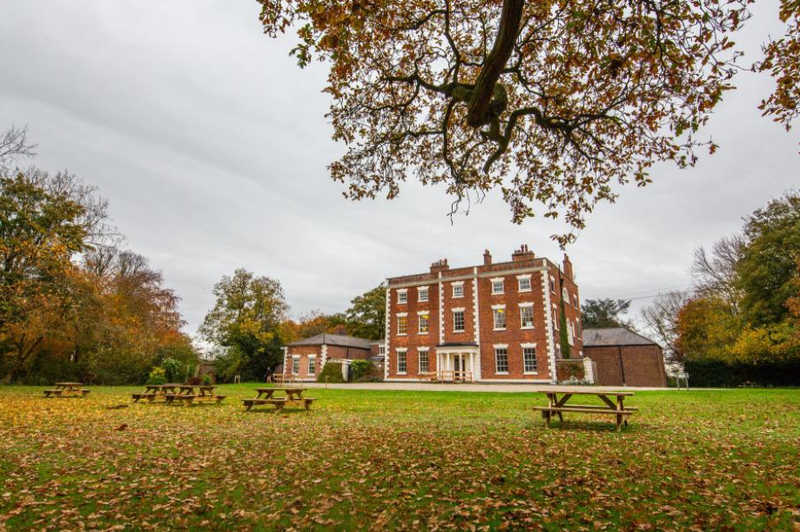
About the Trip
About The Site
Chester Trafford Hall.
Monday 10th June – Tuesday 11th June
All four classes will attend the centre on this day and stay for one night
Return to school the next day in time for the end of the school day.
All activities themed around the Alex Rider books and the children get to take a copy of Stormbreaker home!
Staff on hand all day
Year 4 teachers, TAs, members of SLT
We take lots of pictures over the two days, check out our Facebook page for regular updates!

Slide 4
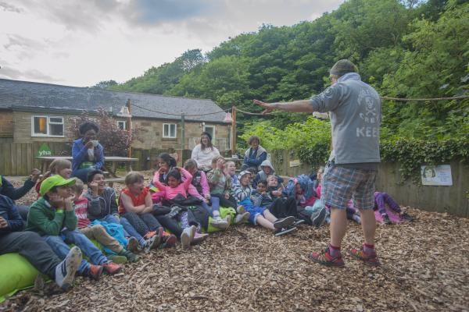
Alex Rider Programme
About The Site
Students (or ‘agents’ as they will be referred to), tackle a range of activities which may include orienteering, team building, buggy building, assault course, fencing and more – all delivered with a thrilling spy twist. This exciting package has a spy narrative running throughout and includes all daytime and evening activities, keeping our budding agents engaged from dawn to dusk.
Learning outcomes
To demonstrate the ability to listen and act accordingly to instructions.
To demonstrate the key personal skills of resilience and self-motivation.
To work collaboratively as part of a team, supporting, communicating and recognising the achievements of their peers.
To begin to understand the concept of risk and hazards, and show the development of personal risk management.
To demonstrate the ability to think strategically as an individual or a member of a team to complete complex and challenging tasks.
To demonstrate the ability to provide constructive feedback to all groups including their own.

Slide 5
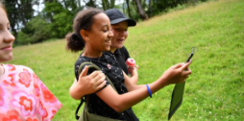
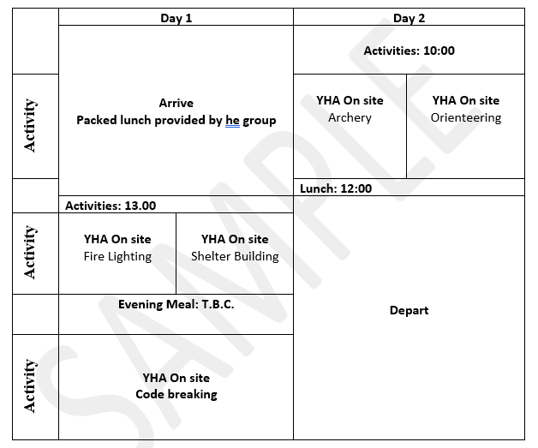
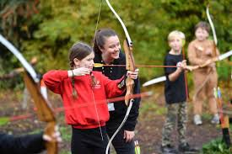
Timetable
About The Site
Example timetable – activities will be confirmed by the center closer to the event.

Slide 6
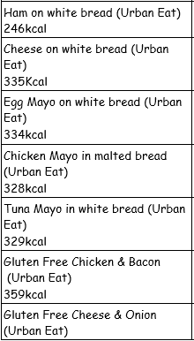
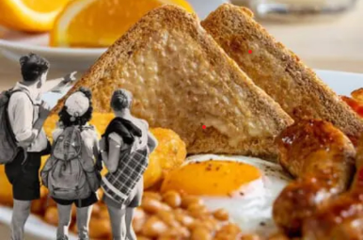
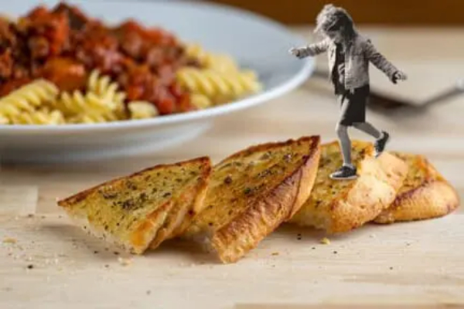
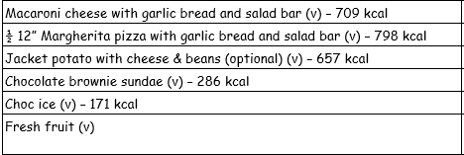
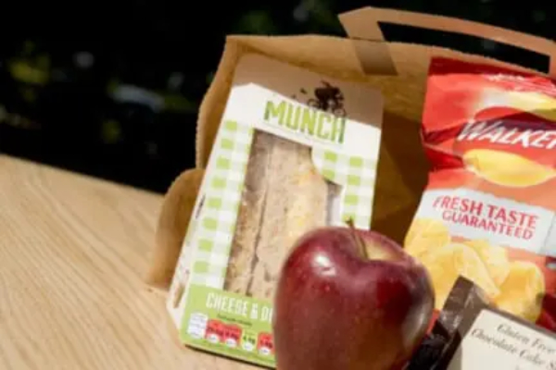
Meals
About The Site
On the first day, children will need to bring their own packed lunch in a disposable bag.
Evening meal
Buffet breakfast provided on the Tuesday morning
Packed lunch provided on second day
Allergies/dietary requirements catered for
Teachers will be in touch regarding children with specific requirements

Slide 7
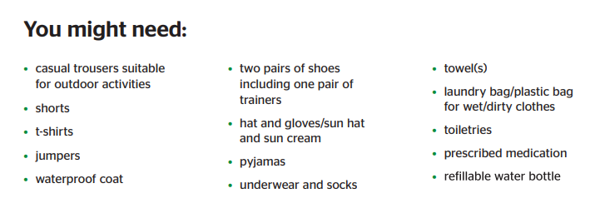
What do they need to bring?
About The Site
Please can you ensure all the children's items are labelled with their name.
No electronics, fit bits, air tags, phones or smart watches .

Slide 8
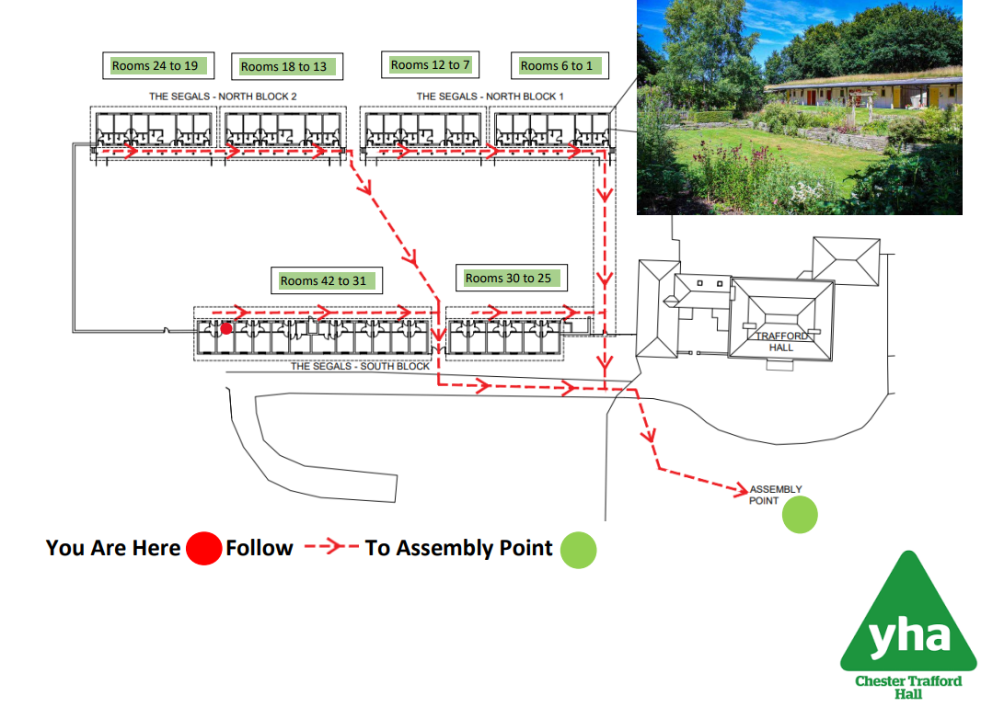
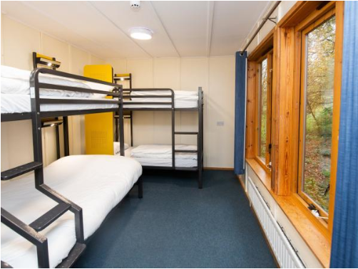
Sleeping Arrangements
About The Site
Boys/girls dorms
Rooms of 4
Teachers dotted around in the corners and middles of the rows
Staff on-hand throughout the night
All rooms are en-suites

Slide 9
Medication
About The Site
All medication needs to be brought into school two weeks prior to the trip (Monday 20th May) alongside a completed 'Administered Medication Form’.

