Slide 1


End of Summer 2 Reflection
Notes:
Entering music: Try everything.

Slide 2

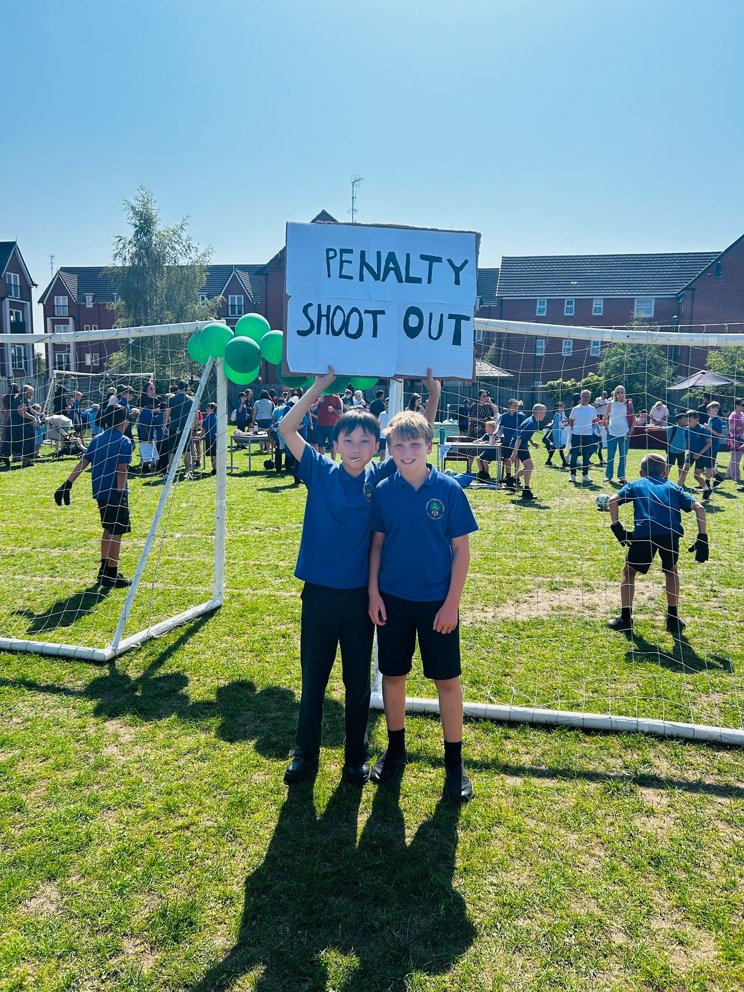
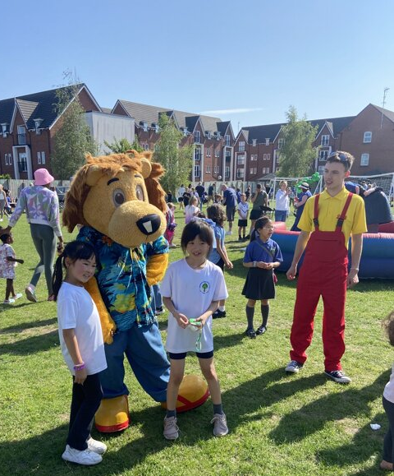
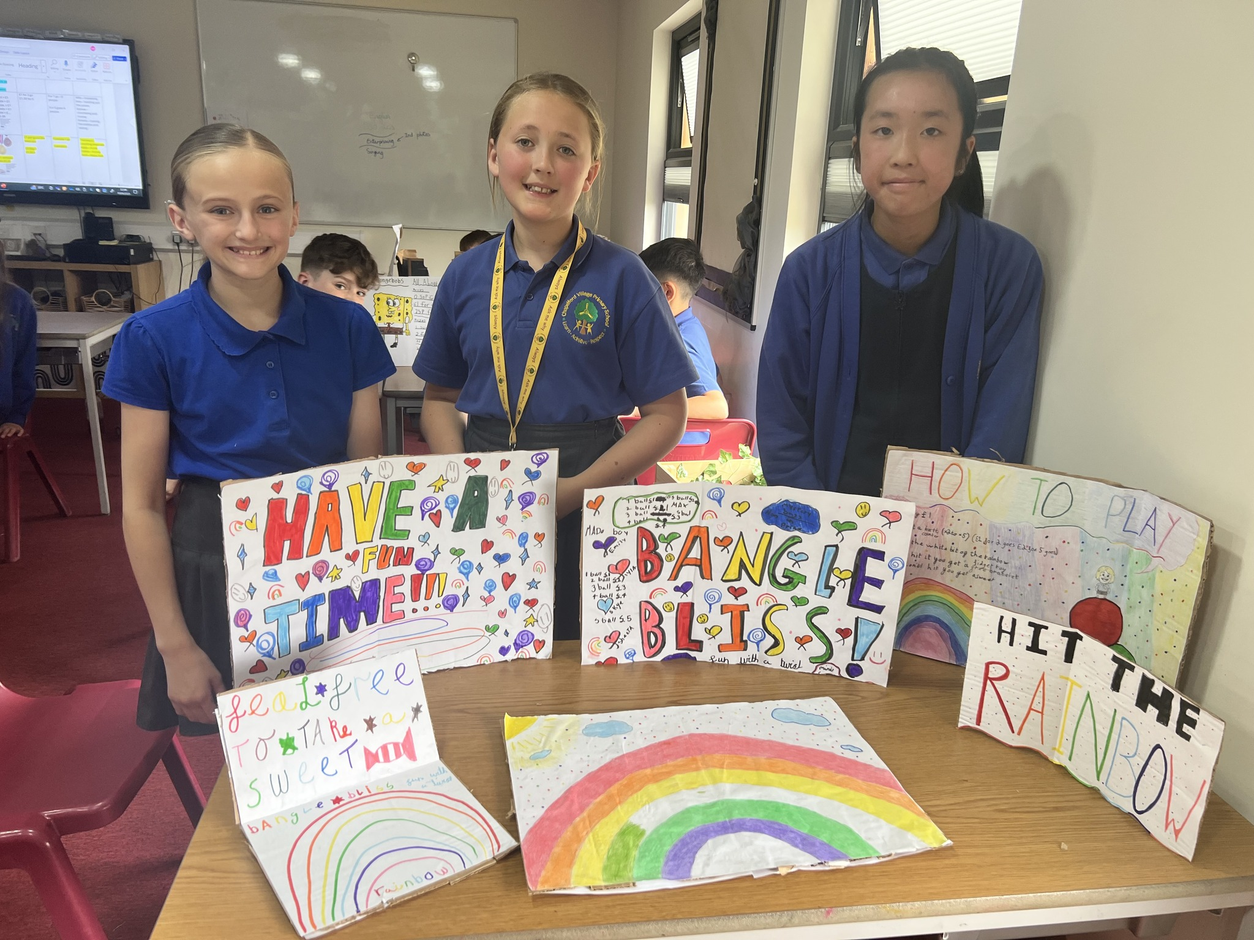

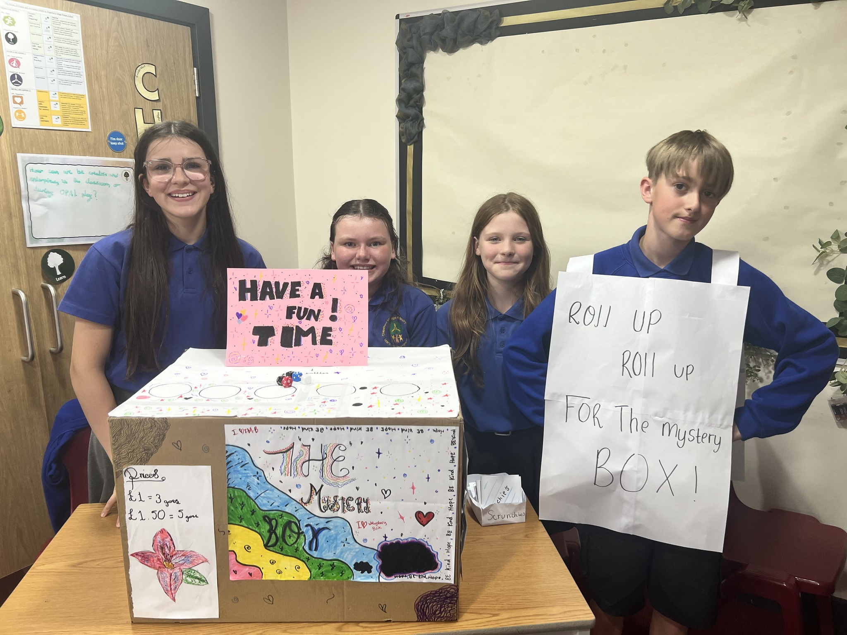
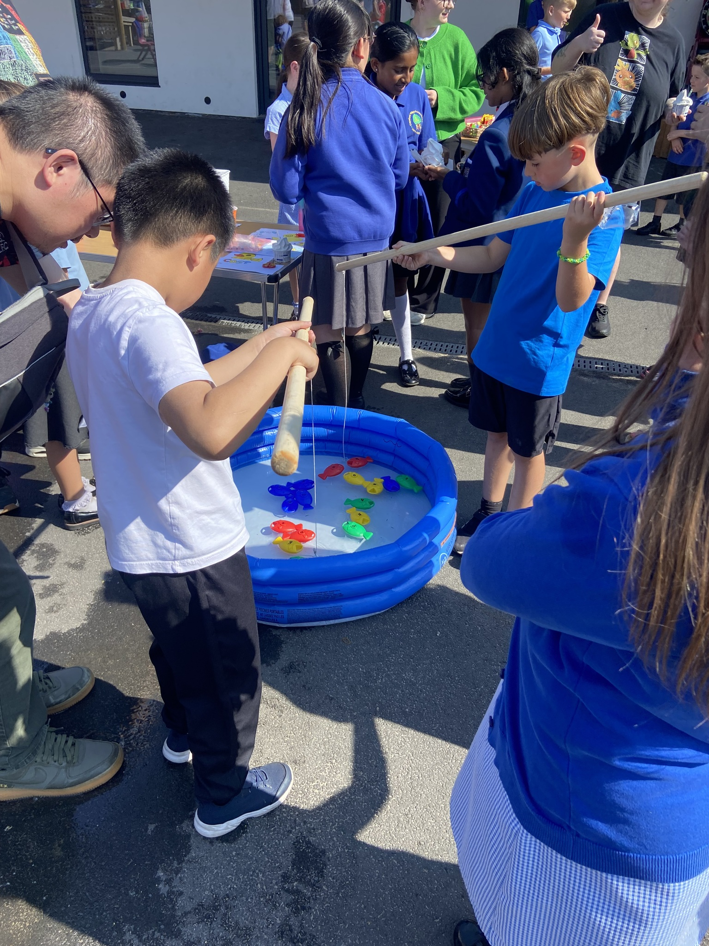

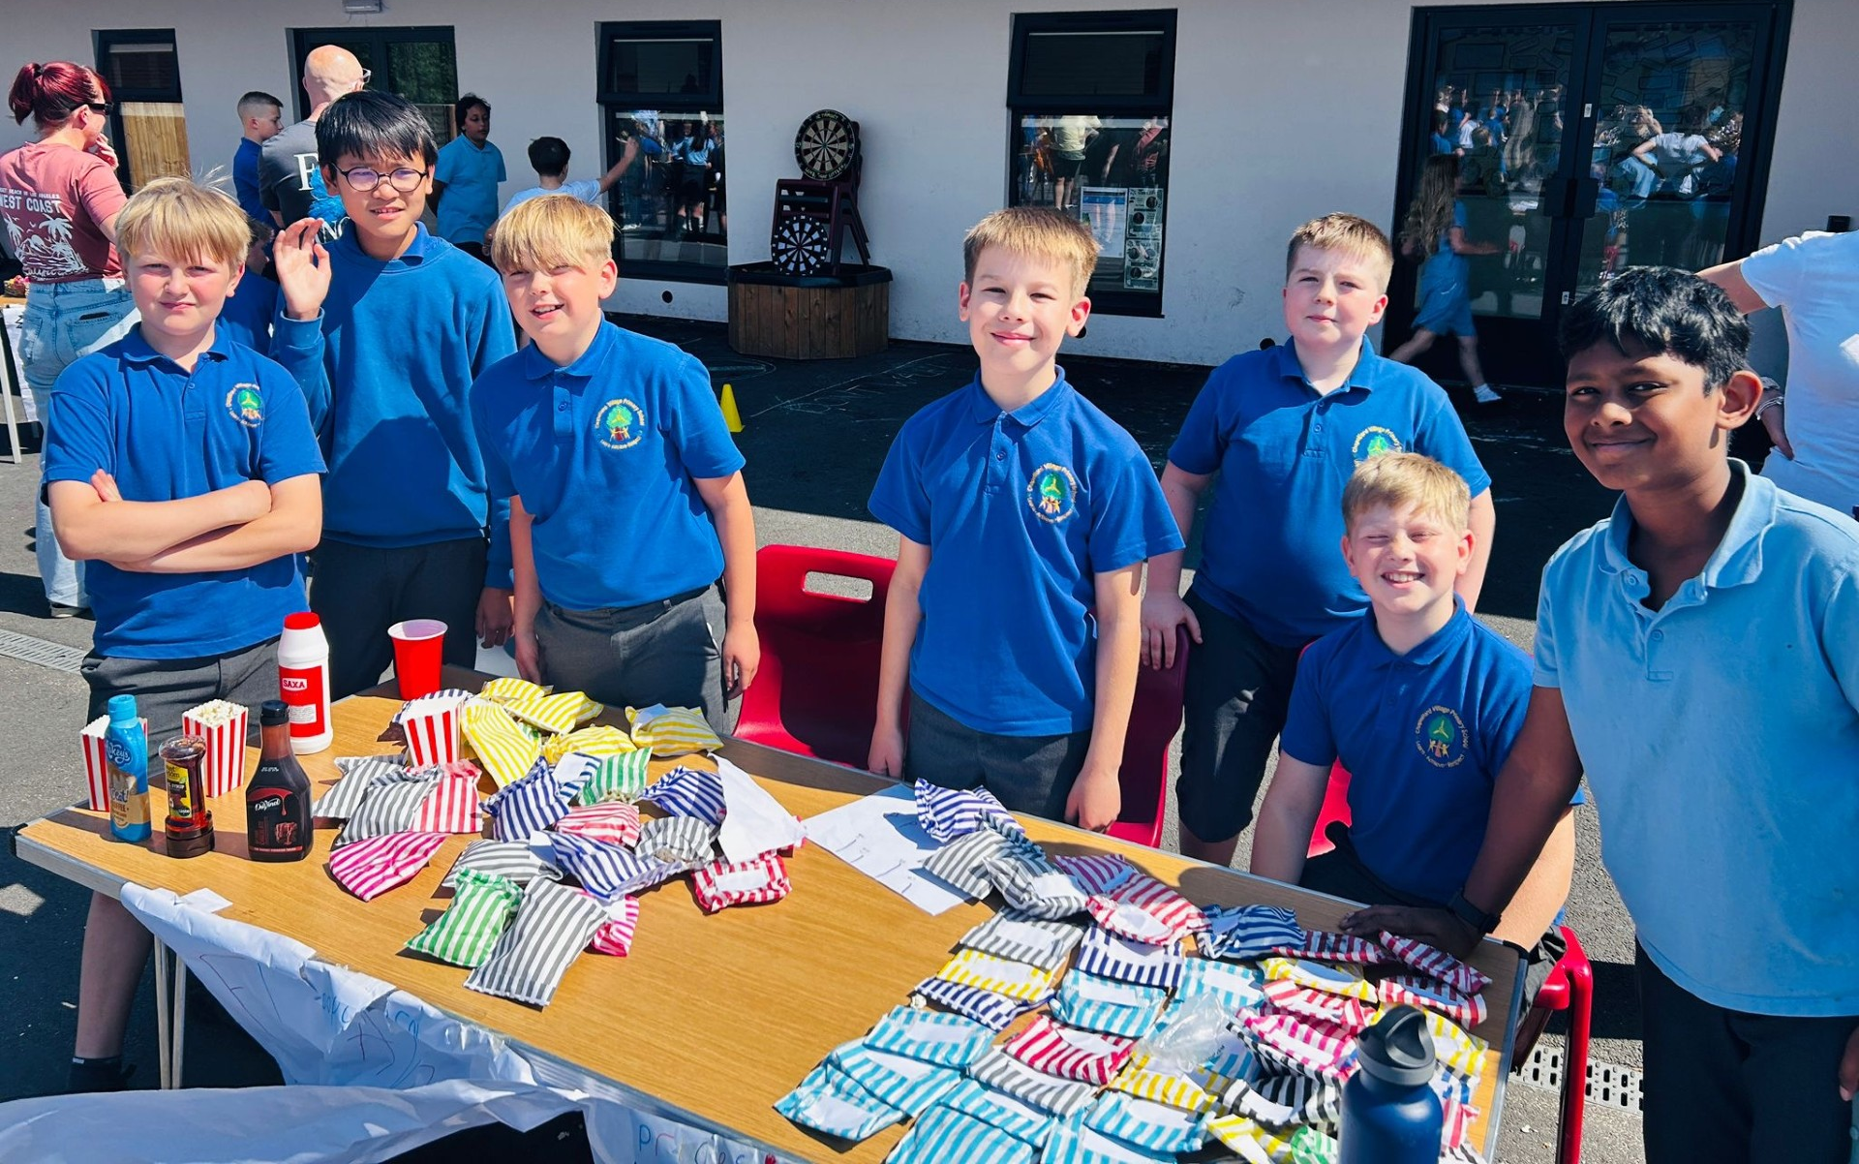
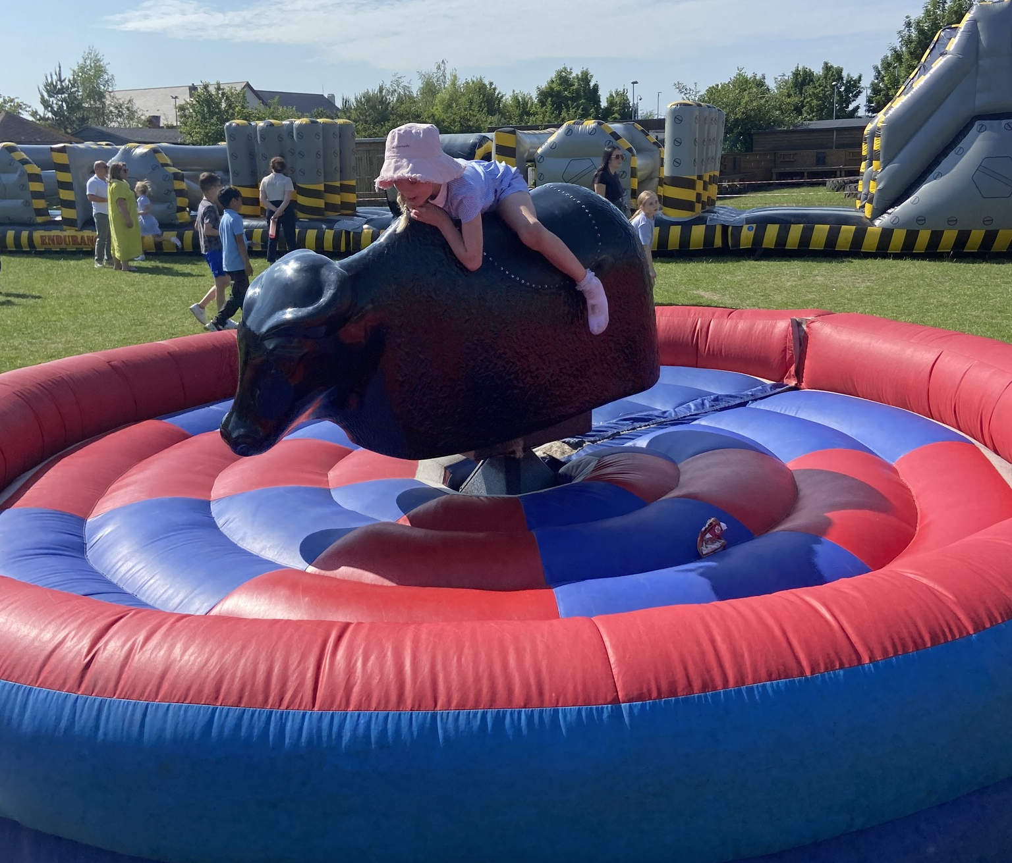
Let’s reflect on this half term…
We further embedded our learning beyond the curriculum.
In Enterprising week with our Summer Fair…
We show Enterprising and Creativity

Slide 3
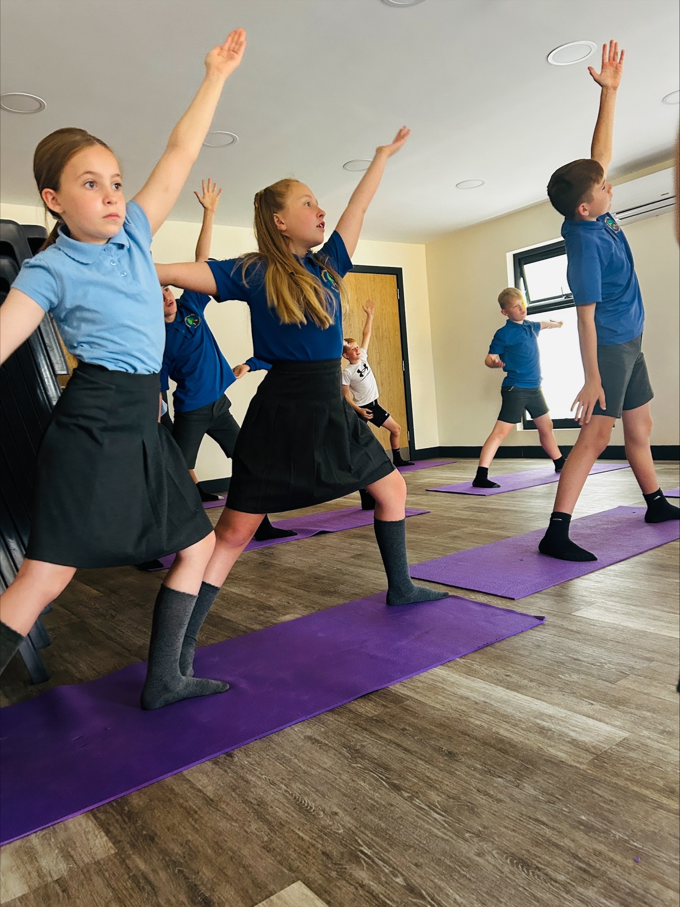
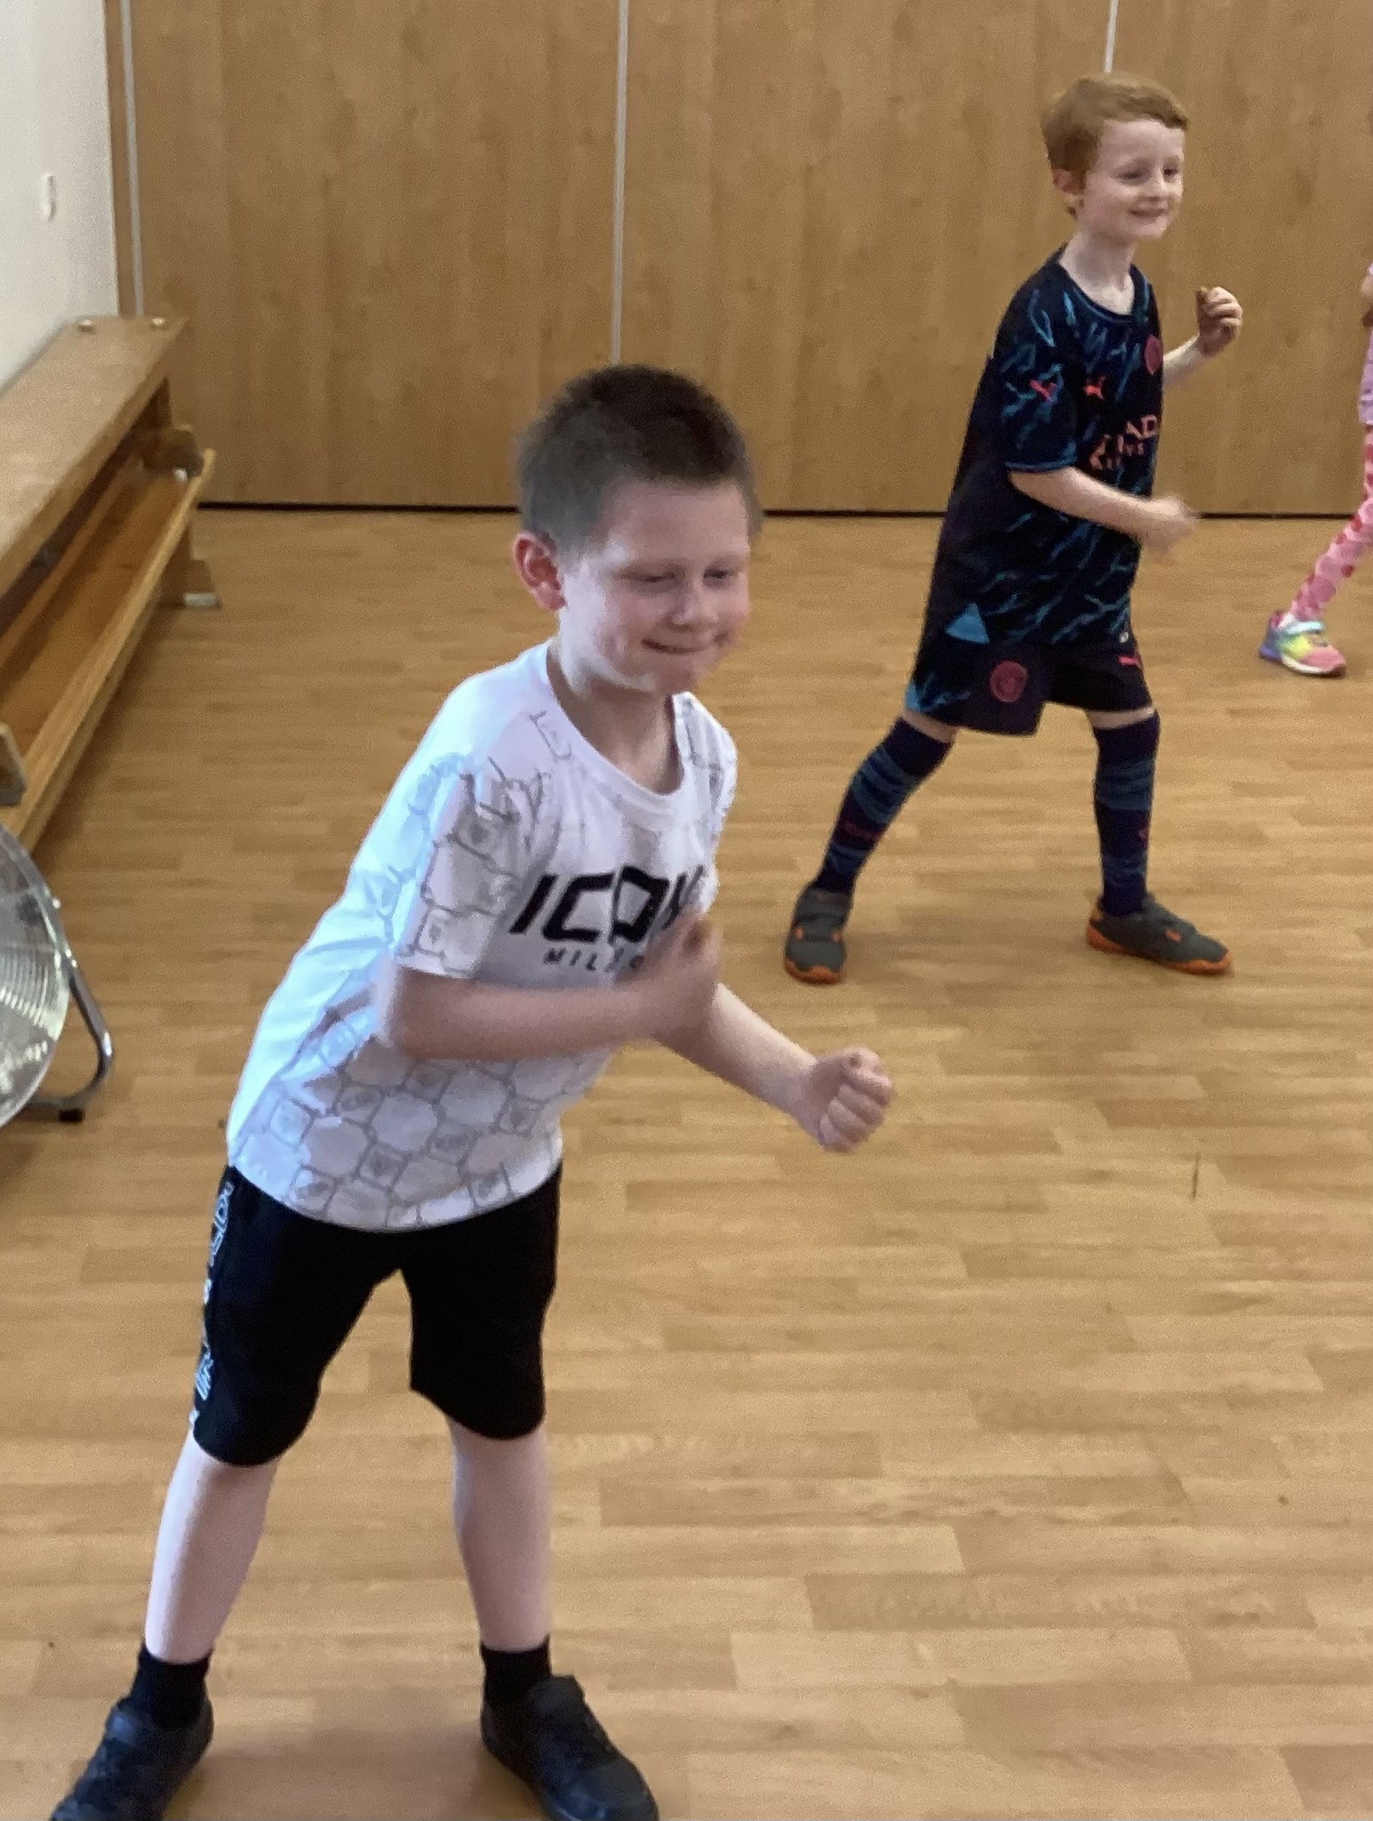
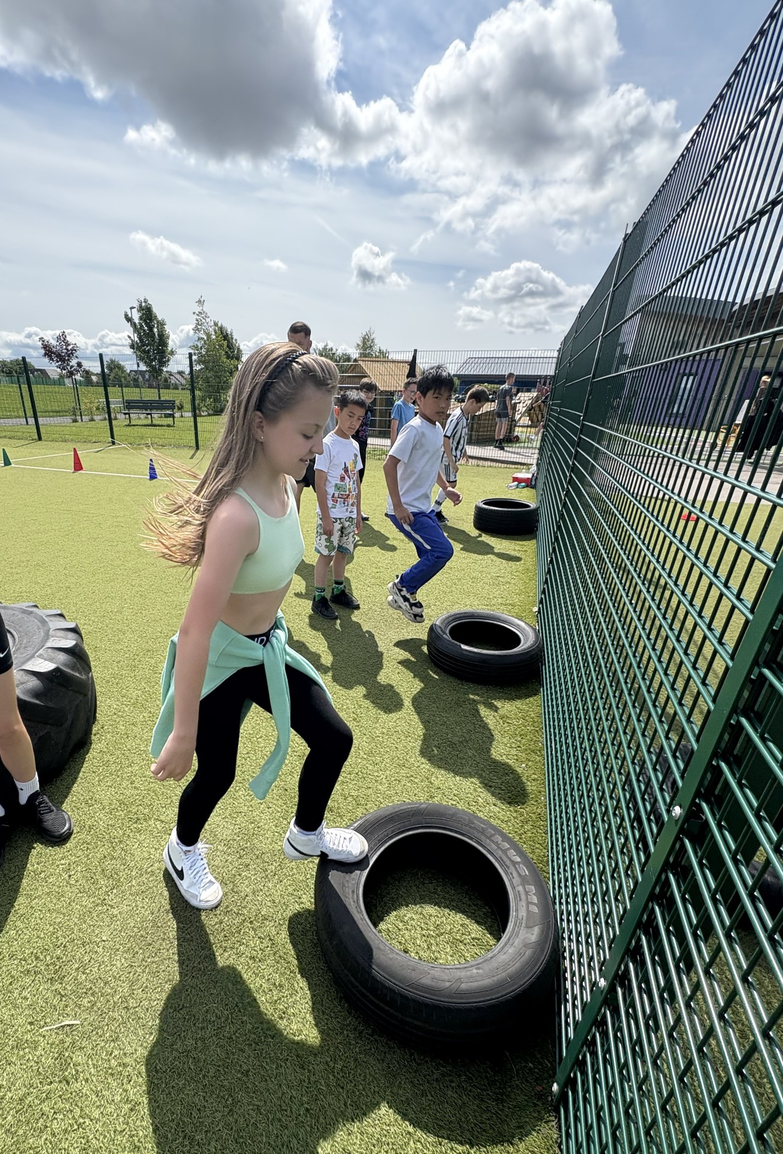

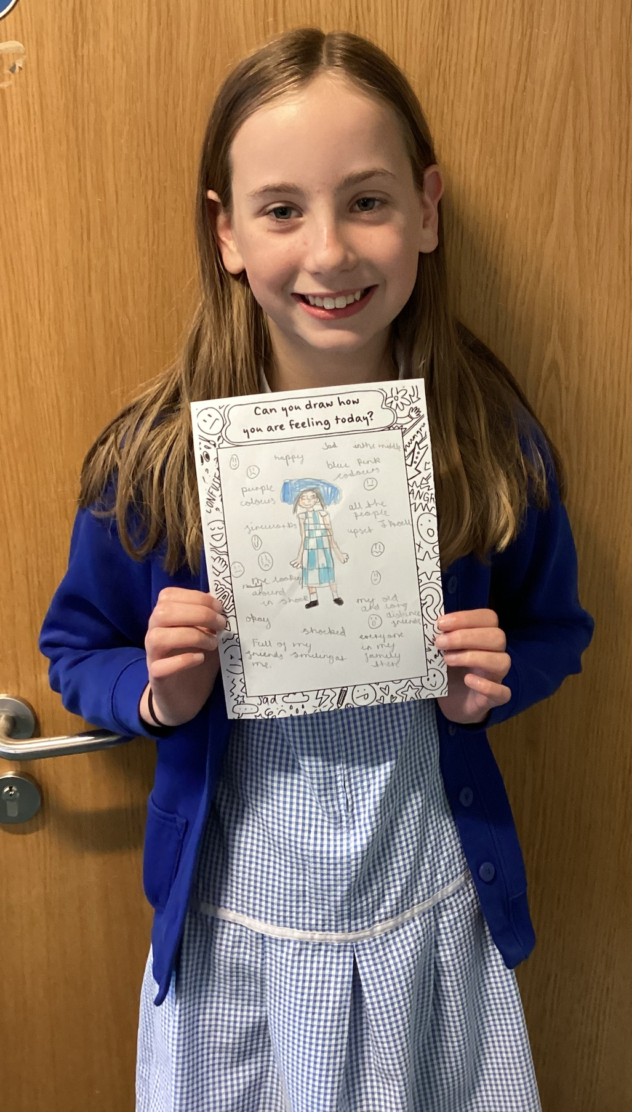
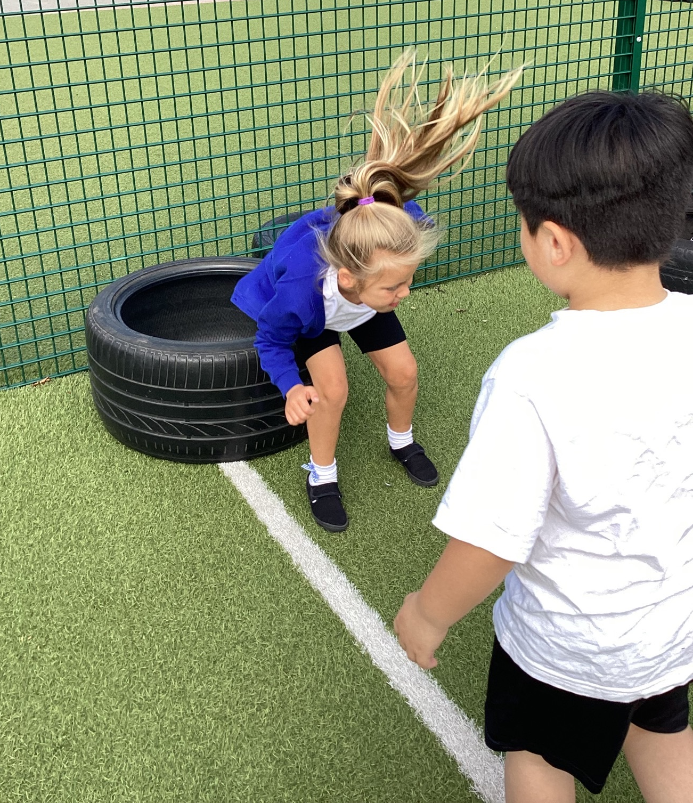
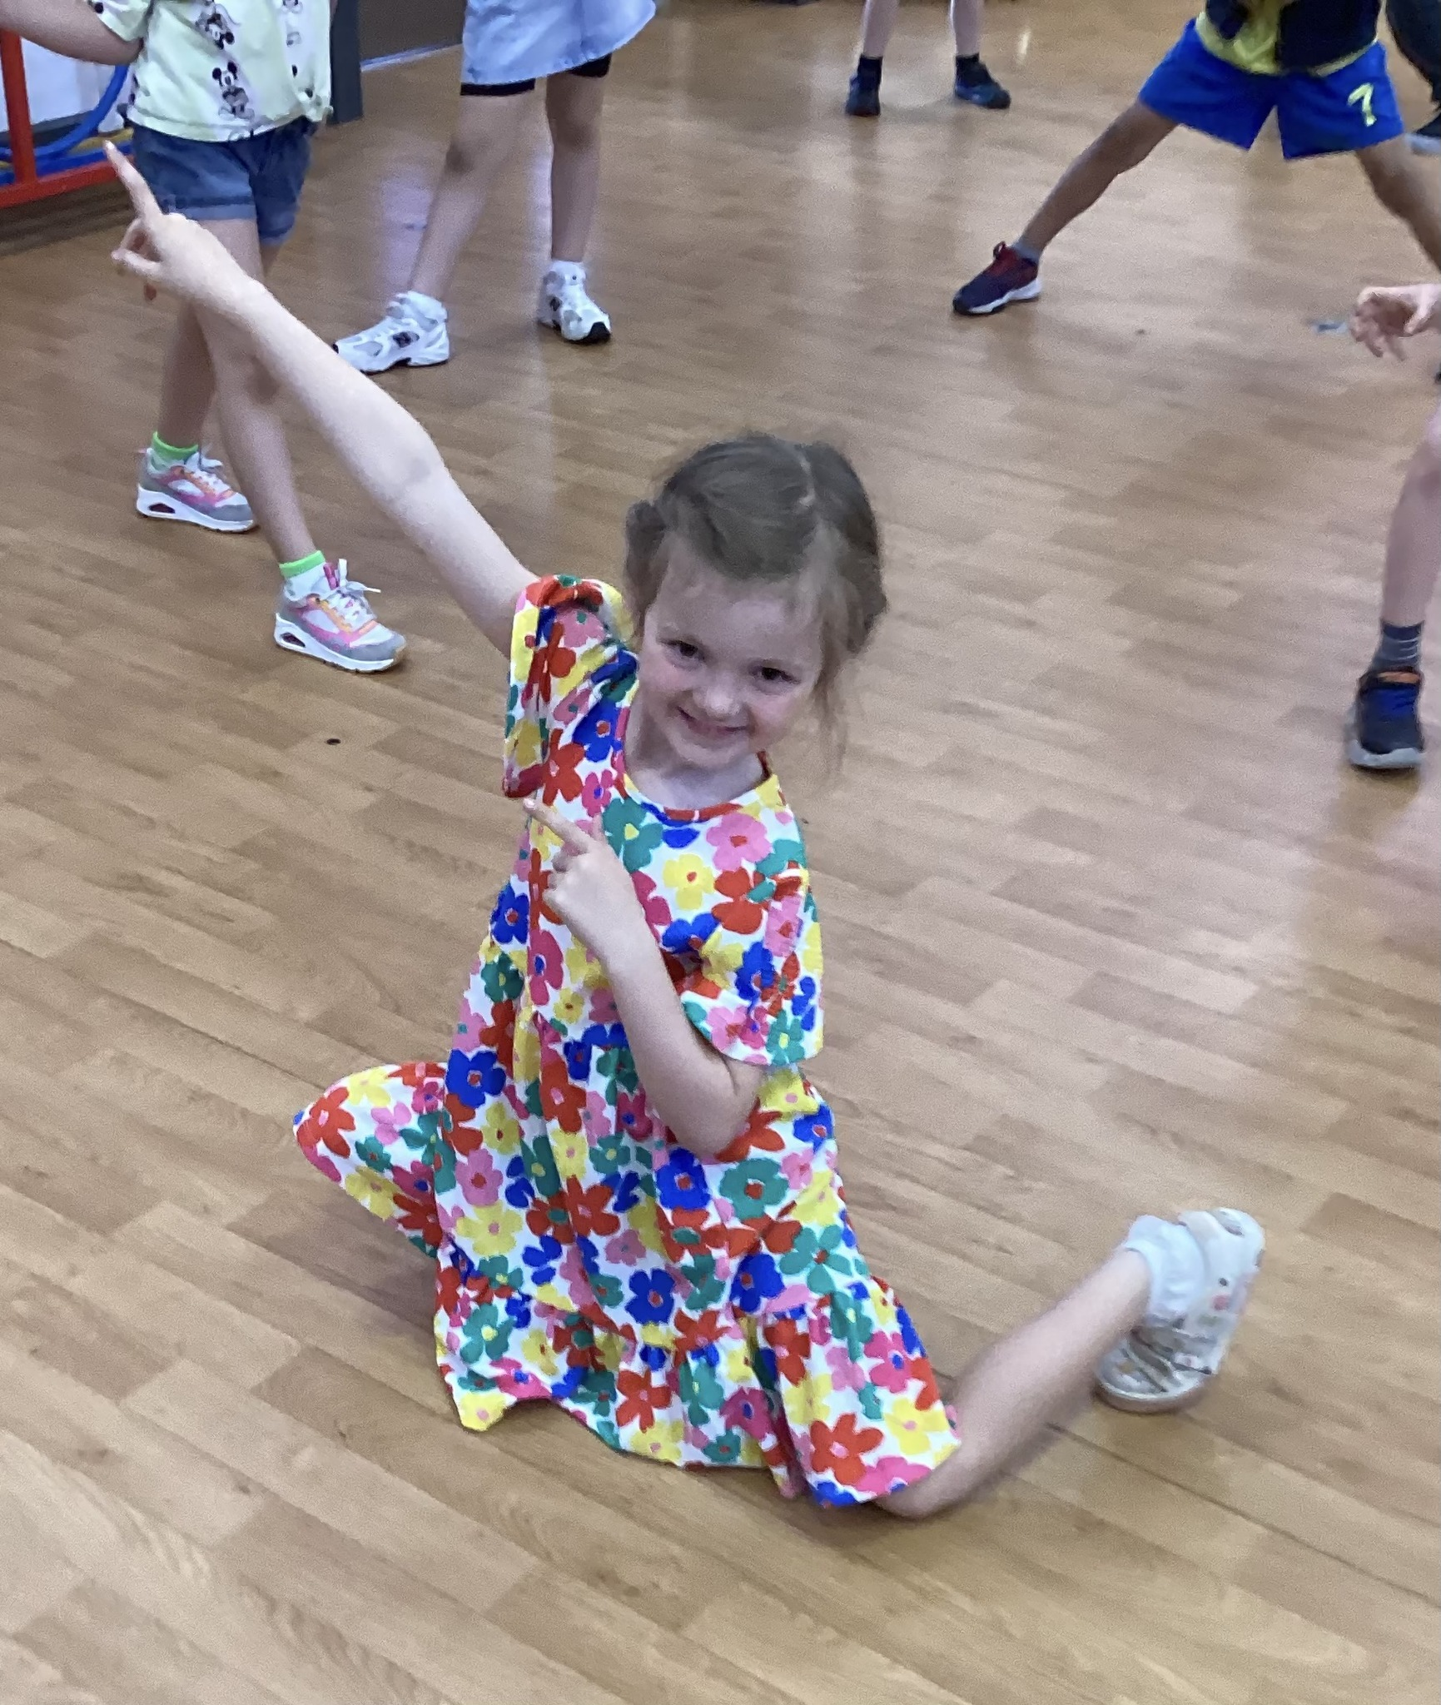
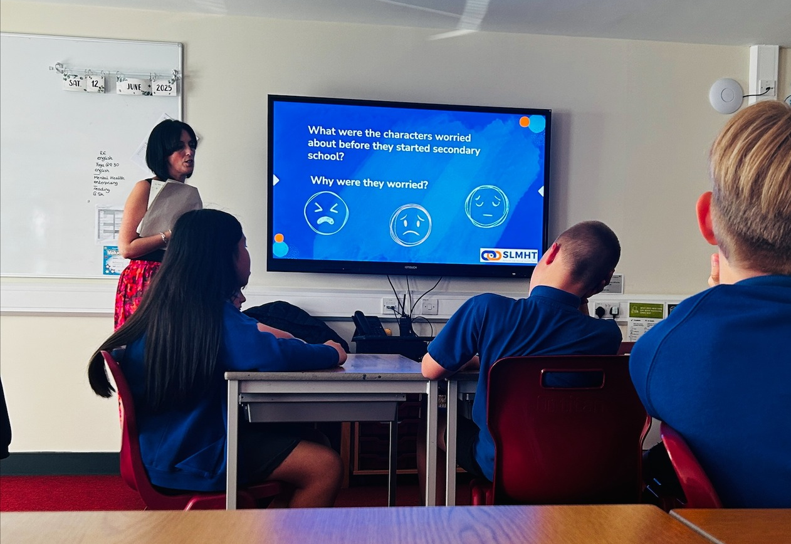
Let’s reflect on this half term…
We focused on our mental and physical wellbeing with Healthy Schools week…
We are Open-Minded

Slide 4
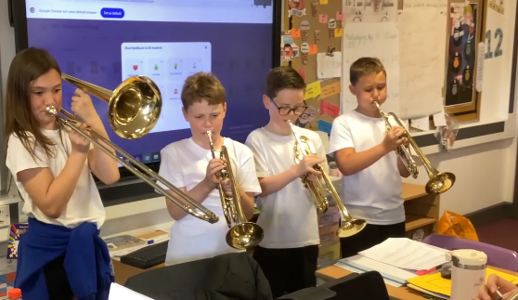
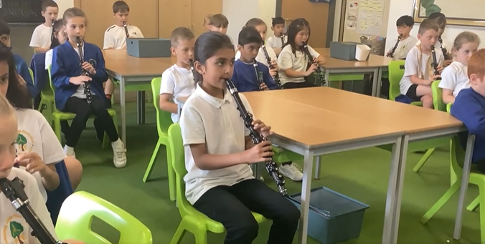
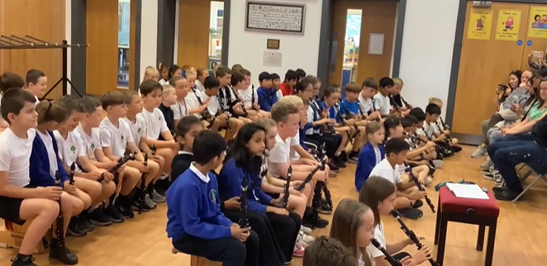
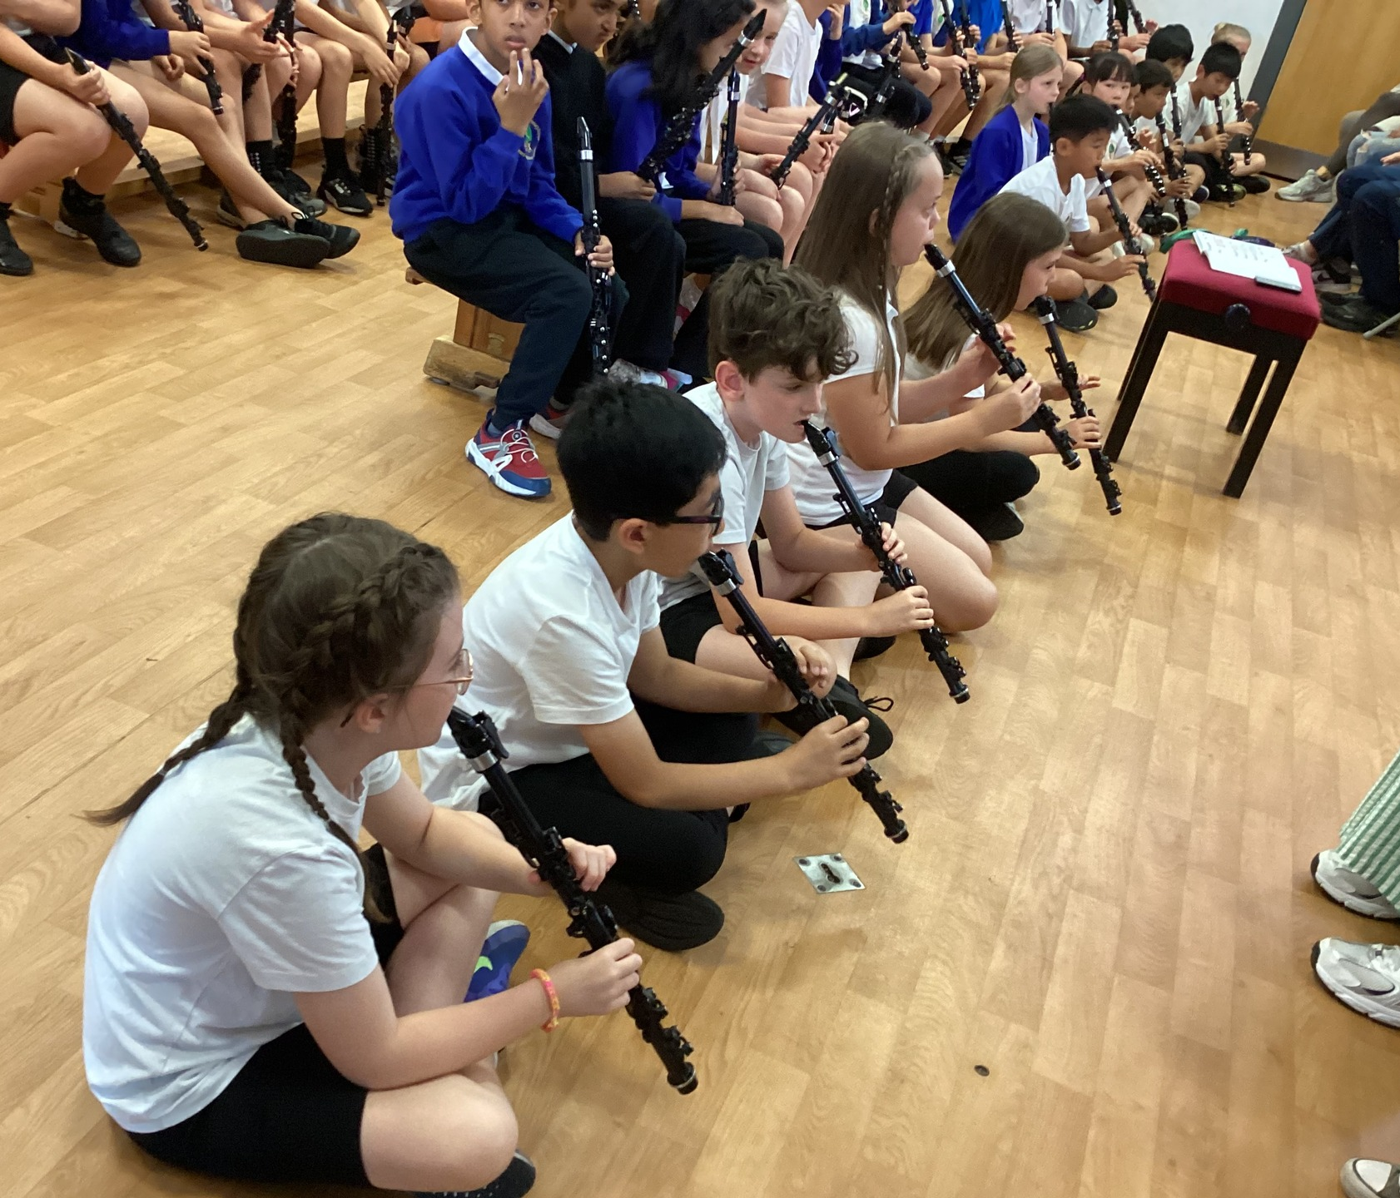
Let’s reflect on this half term…
We further embedded our learning beyond the curriculum.
.. In music.
We are Dynamic

Slide 5
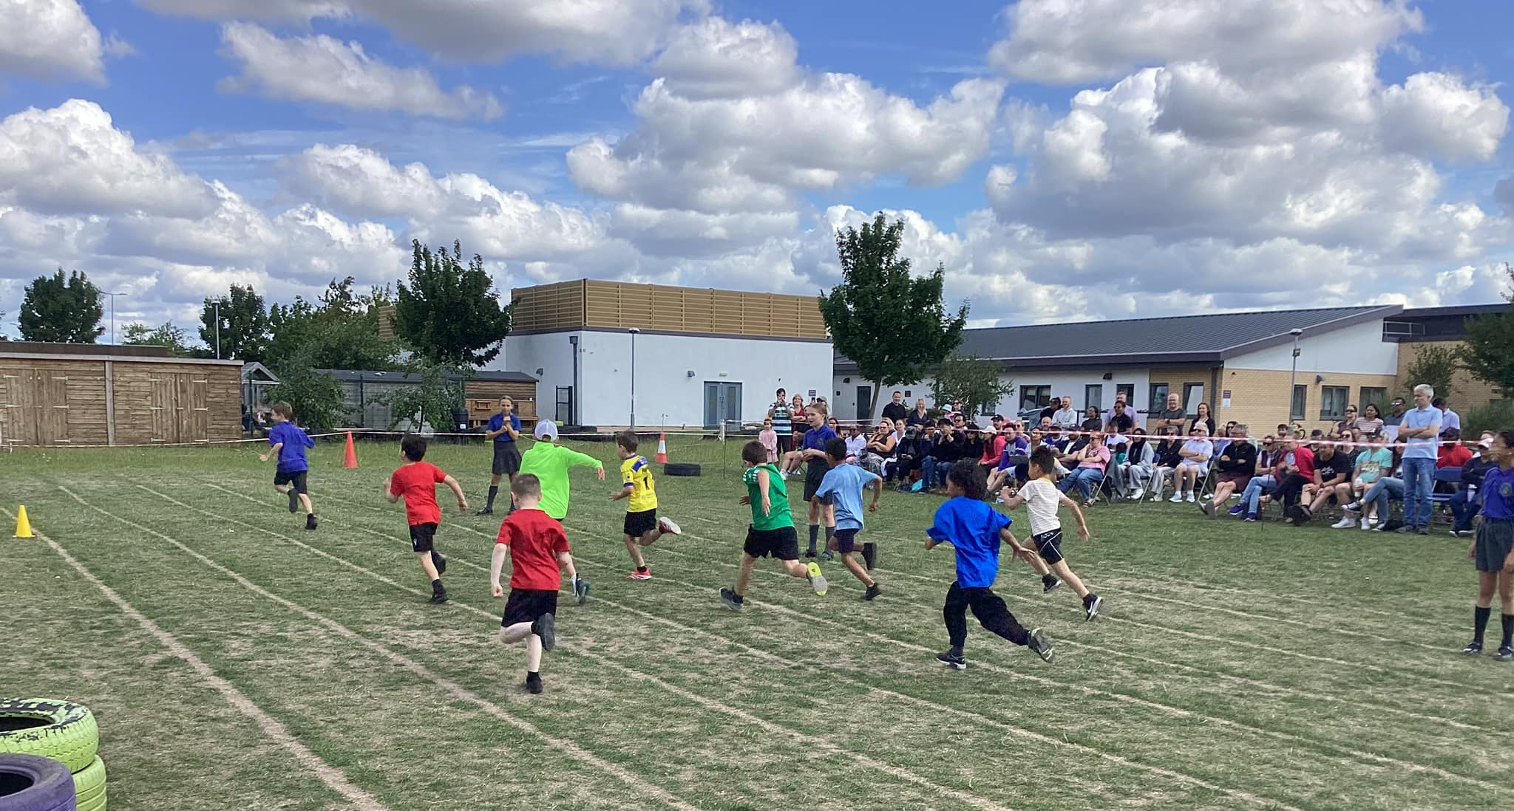
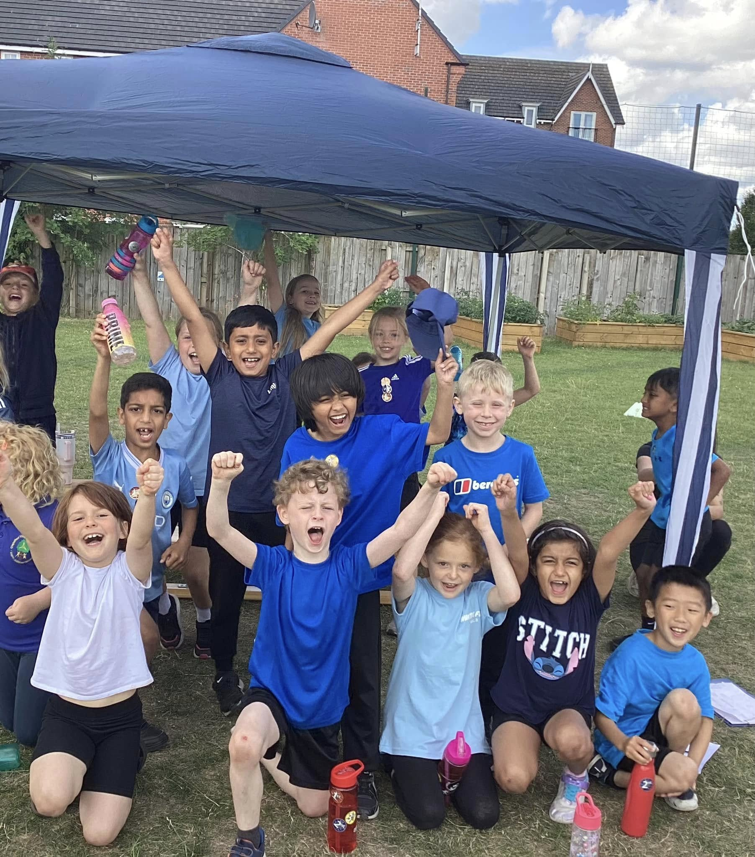
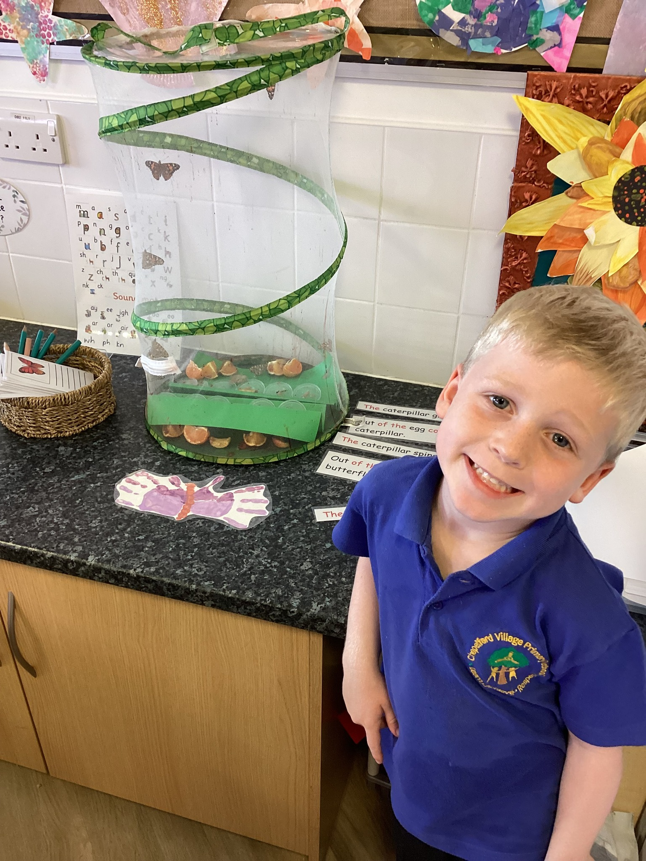
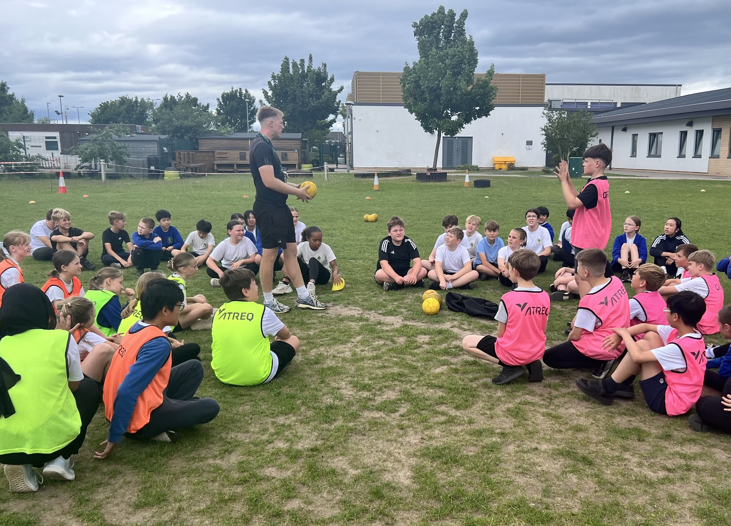
Let’s reflect on this half term…
We further embedded our learning beyond the curriculum.
.. In PE and science.
We are Fearless

Slide 6
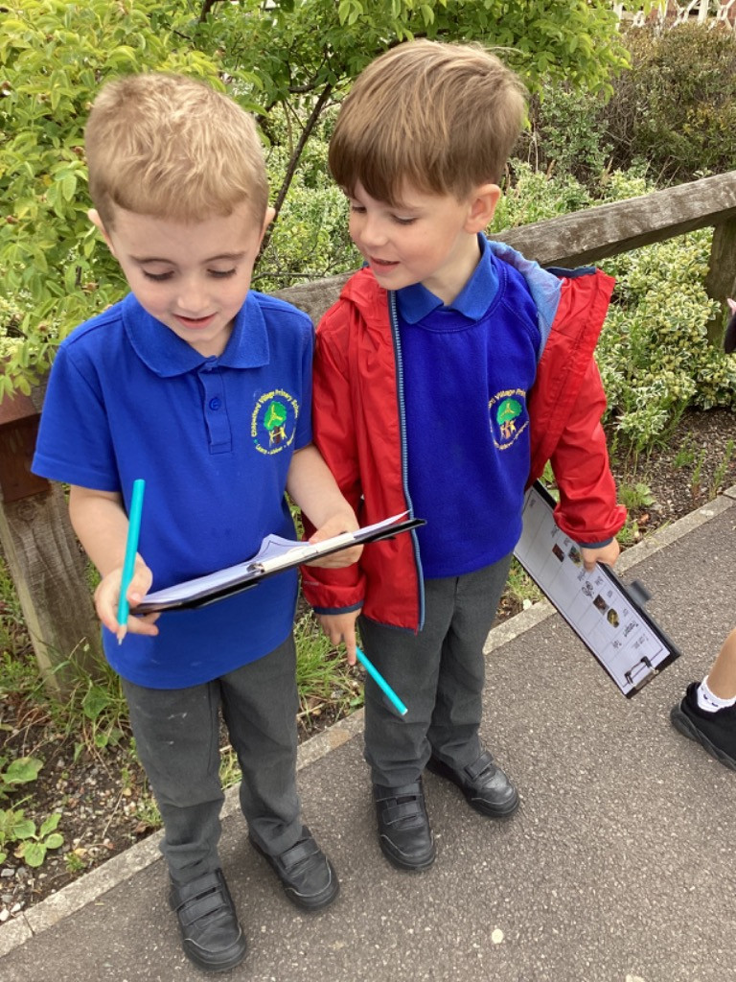
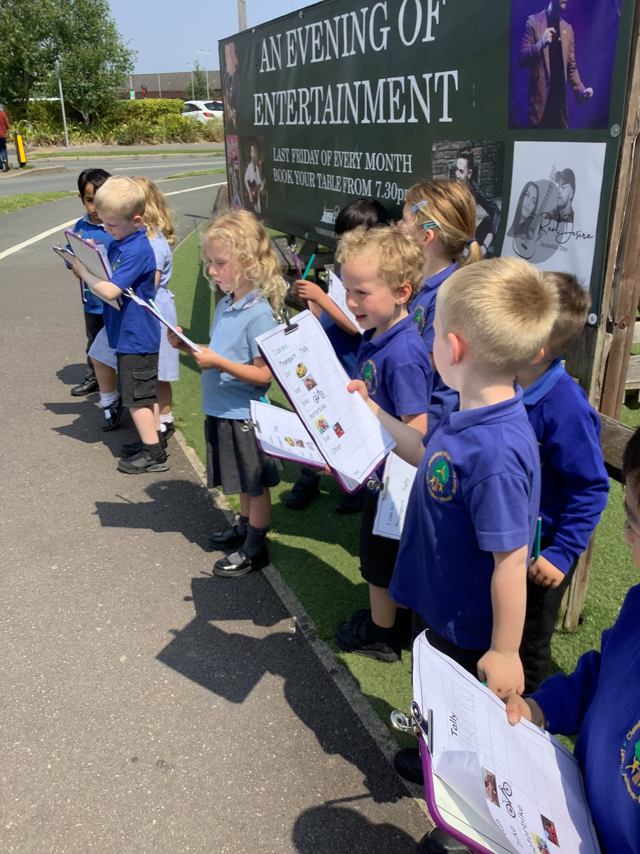
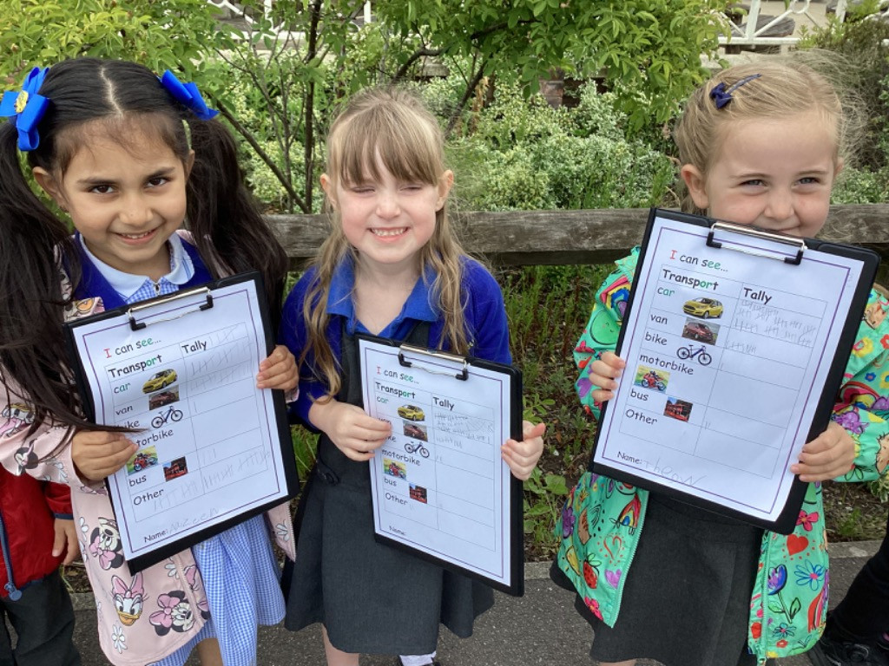
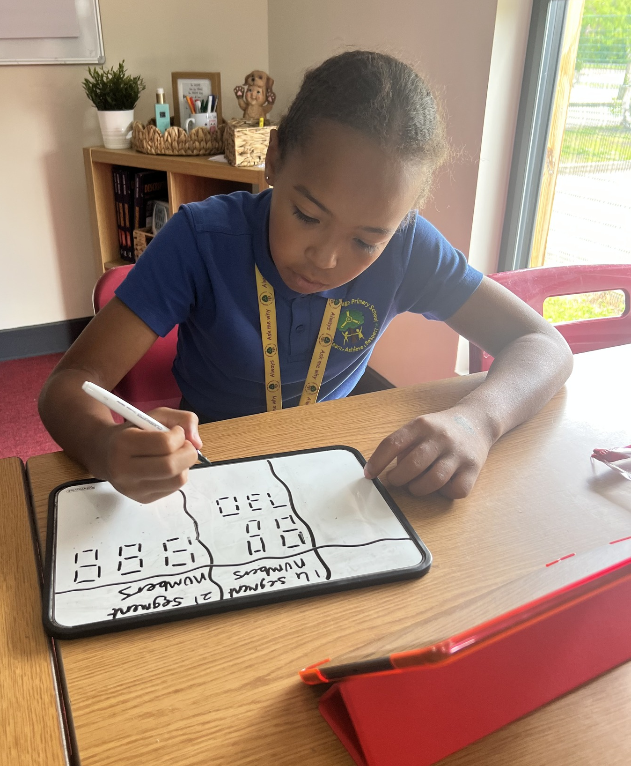
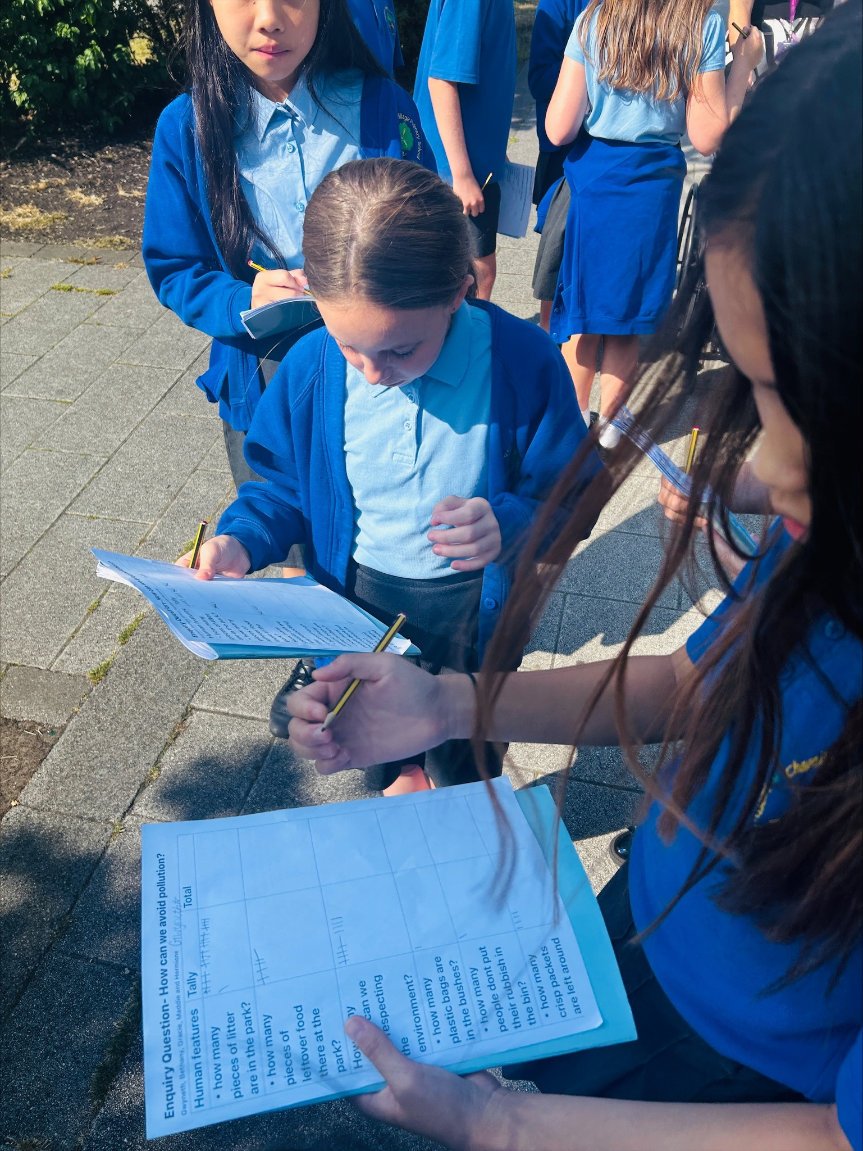
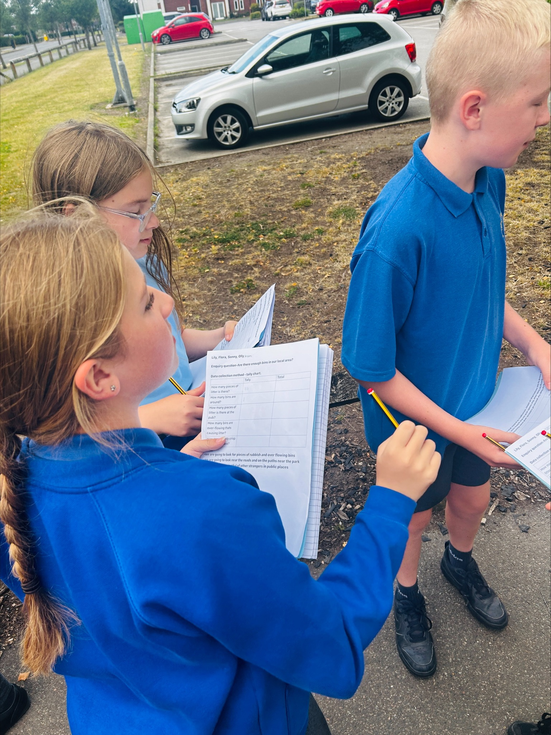
Let’s reflect on this half term…
We further embedded our learning beyond the curriculum.
In Maths (Calculation crunch) and Geography…
We are Dynamic

Slide 7
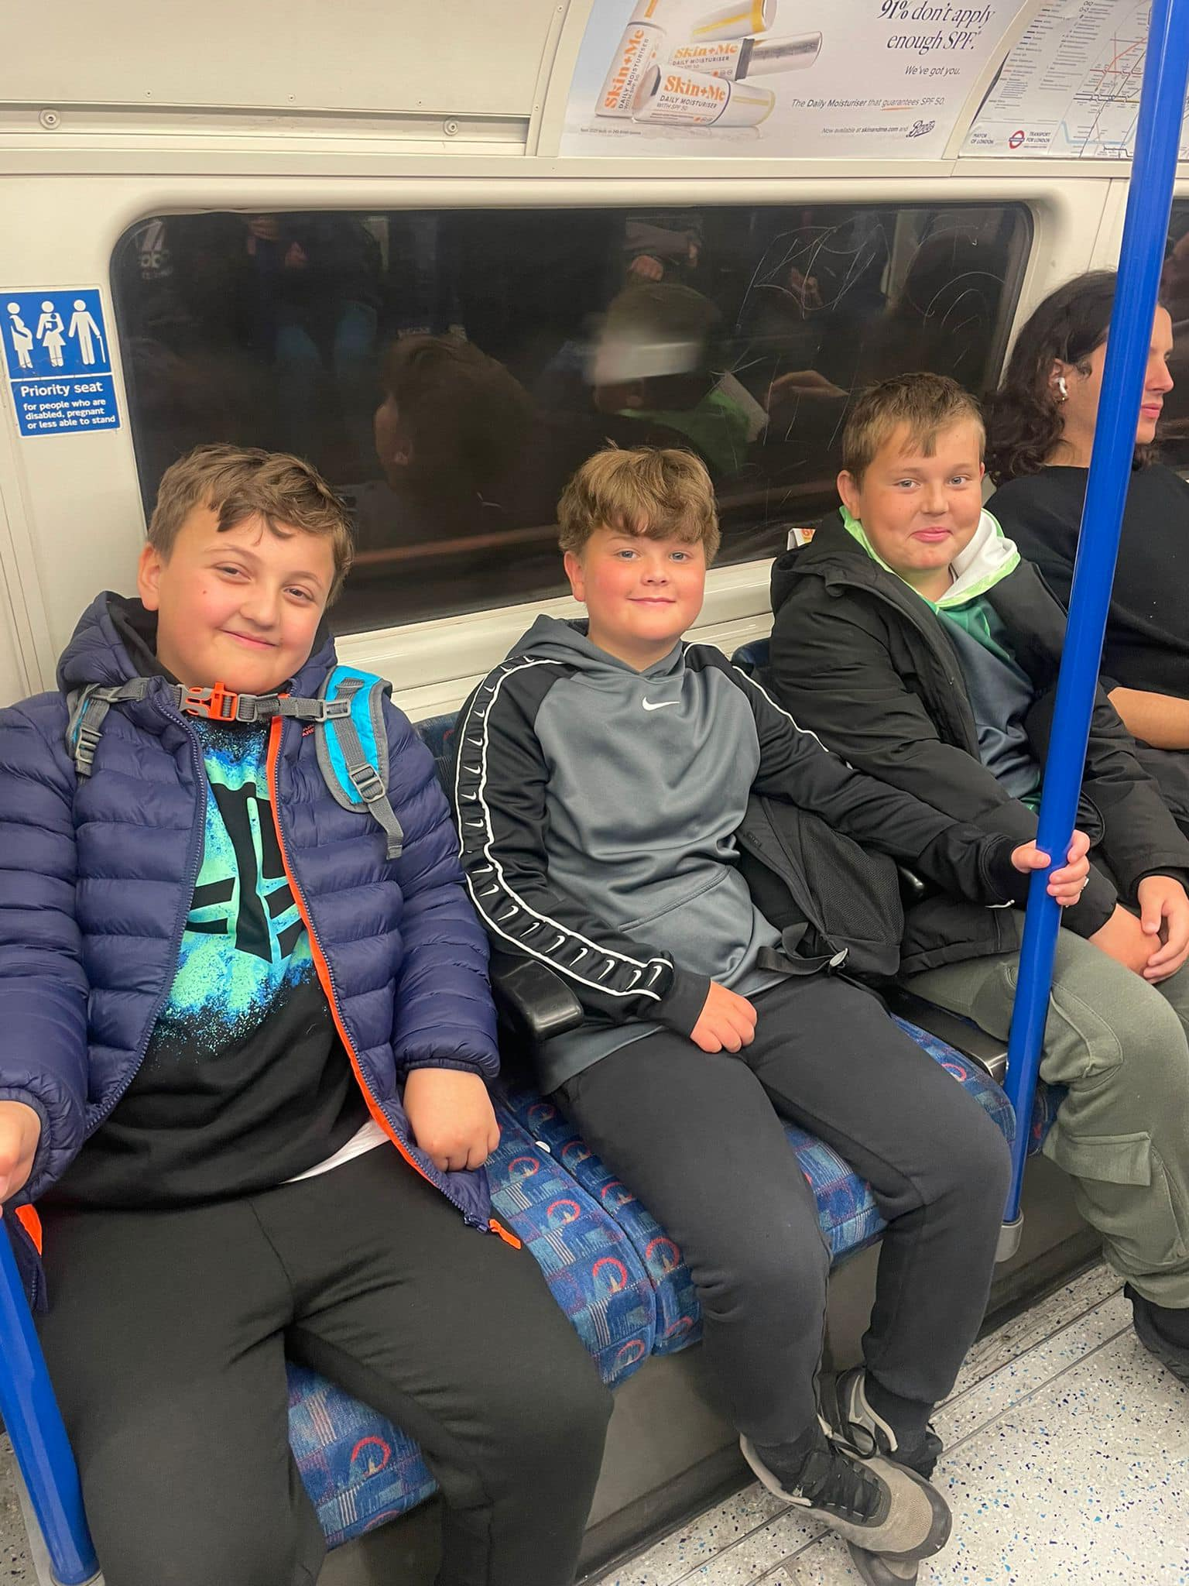
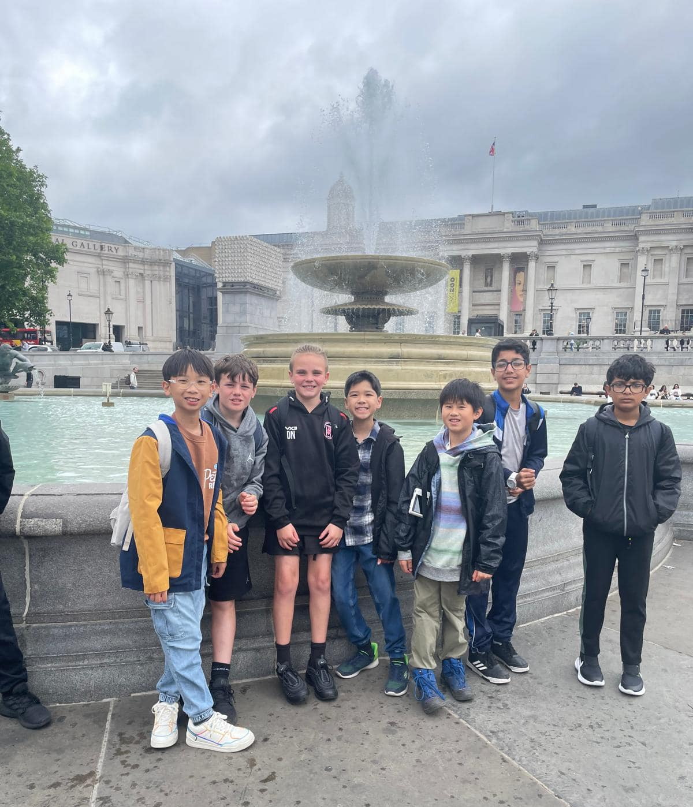
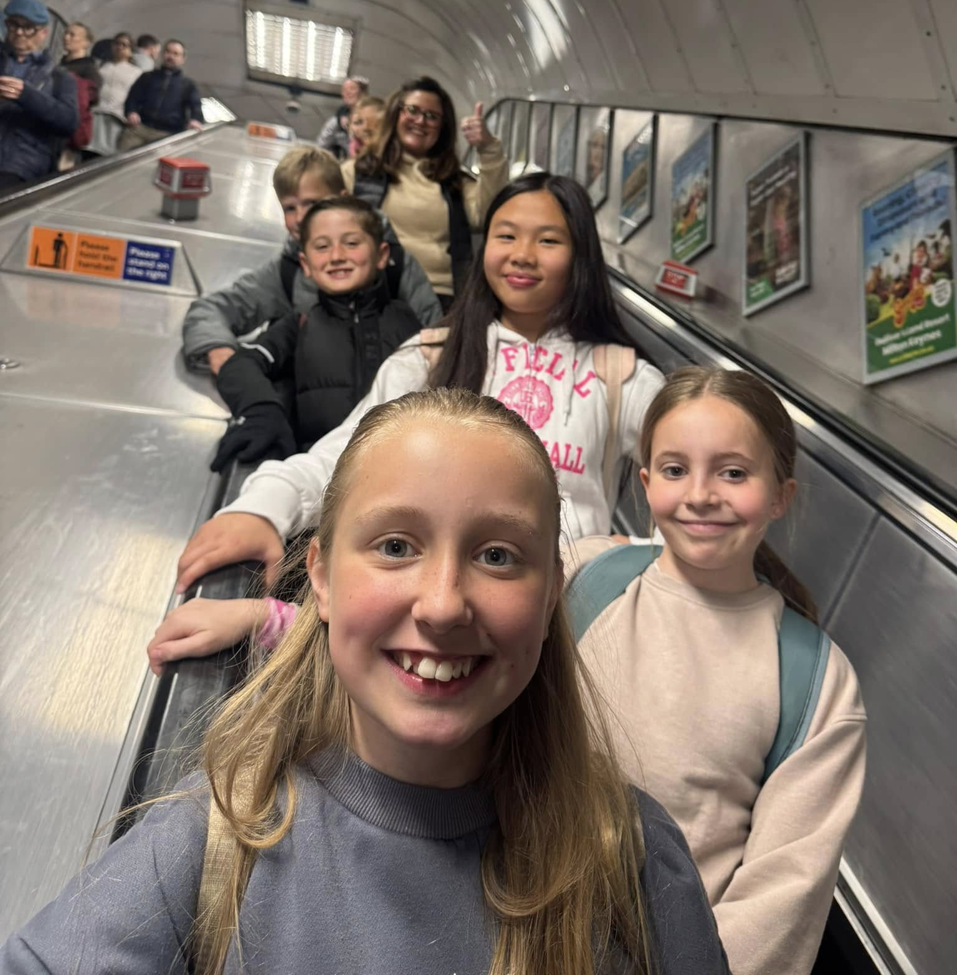

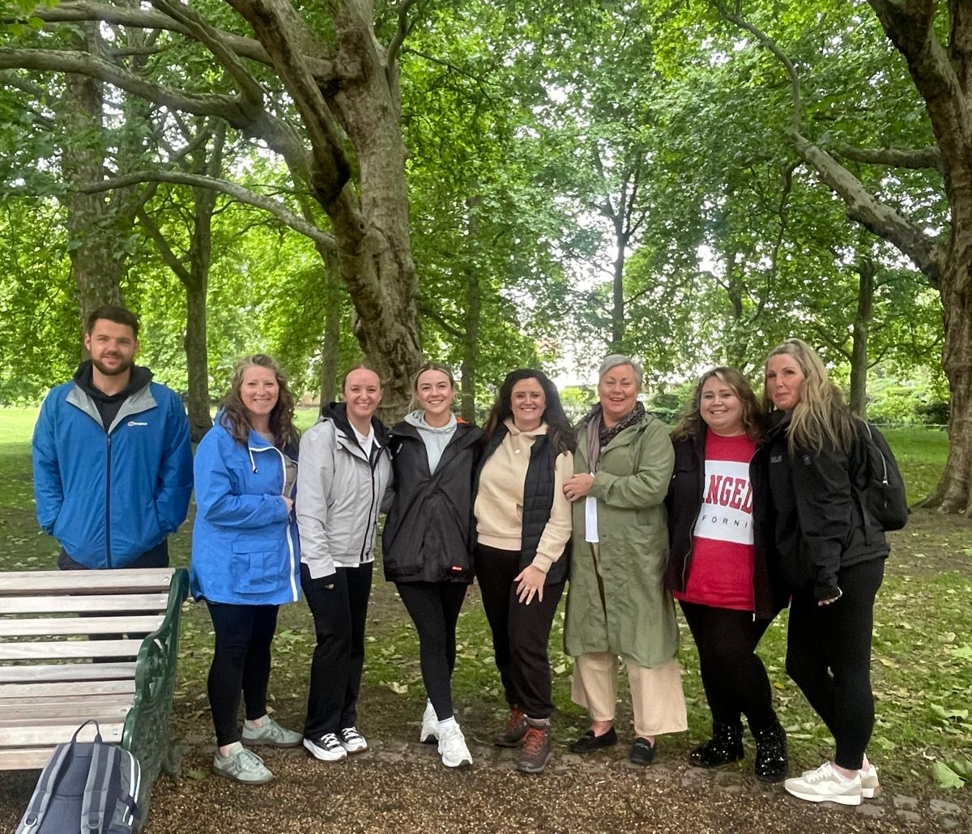
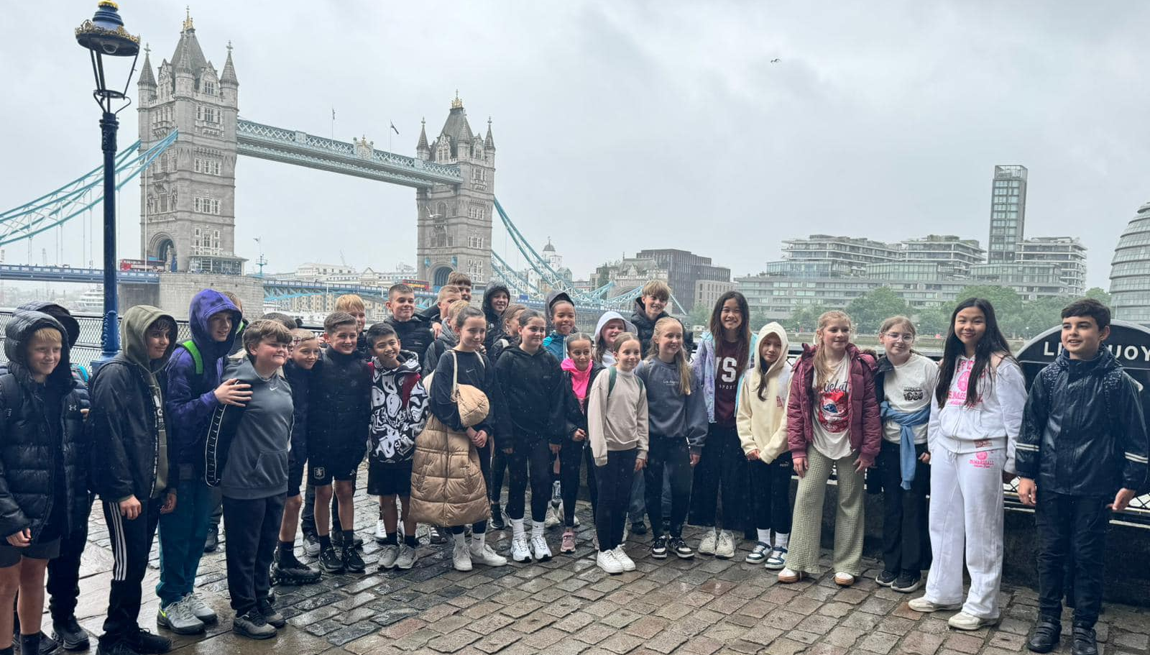
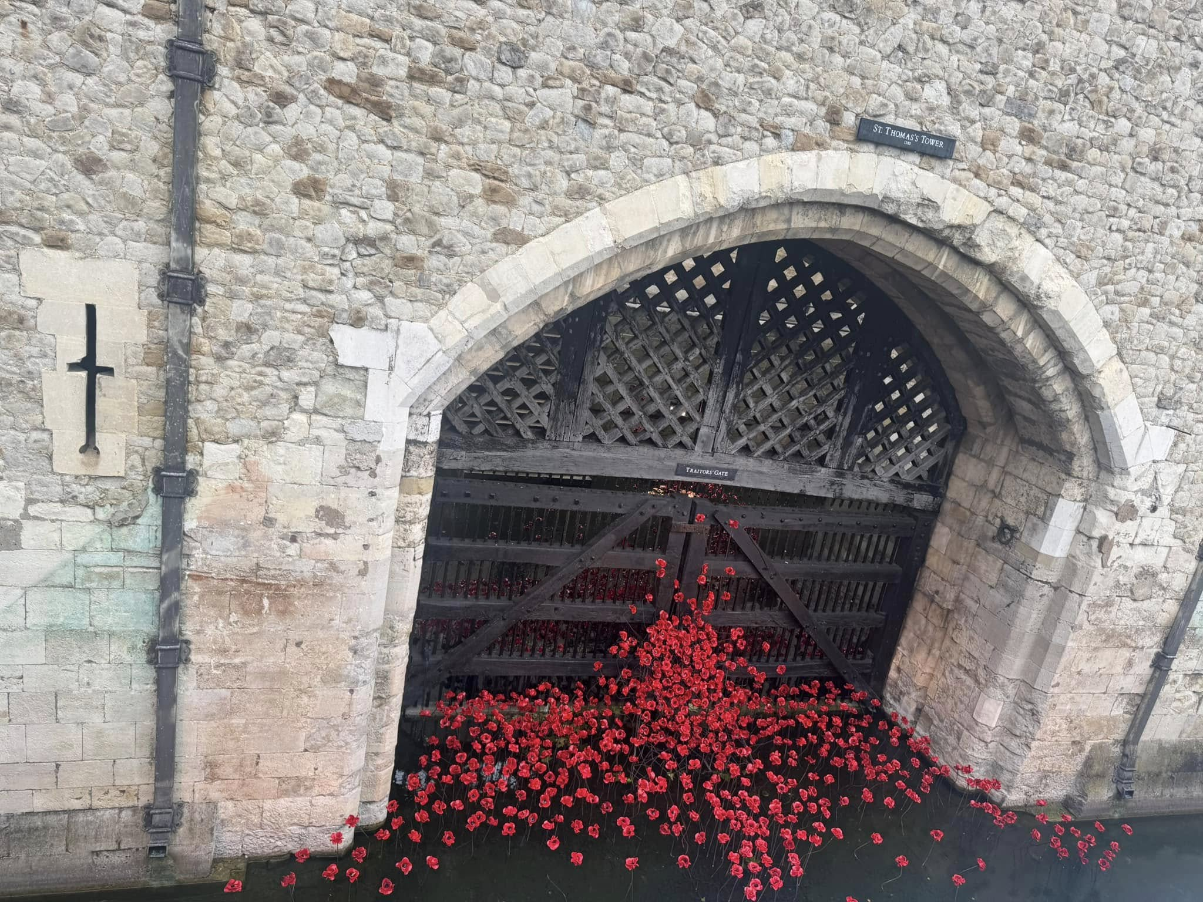
Let’s reflect on this half term…
We further embedded our learning beyond the curriculum.
Year 6’s trip to London linked closely to their History topic of ‘How did the power of the monarchy change over time?’
We show great Listening

Slide 8
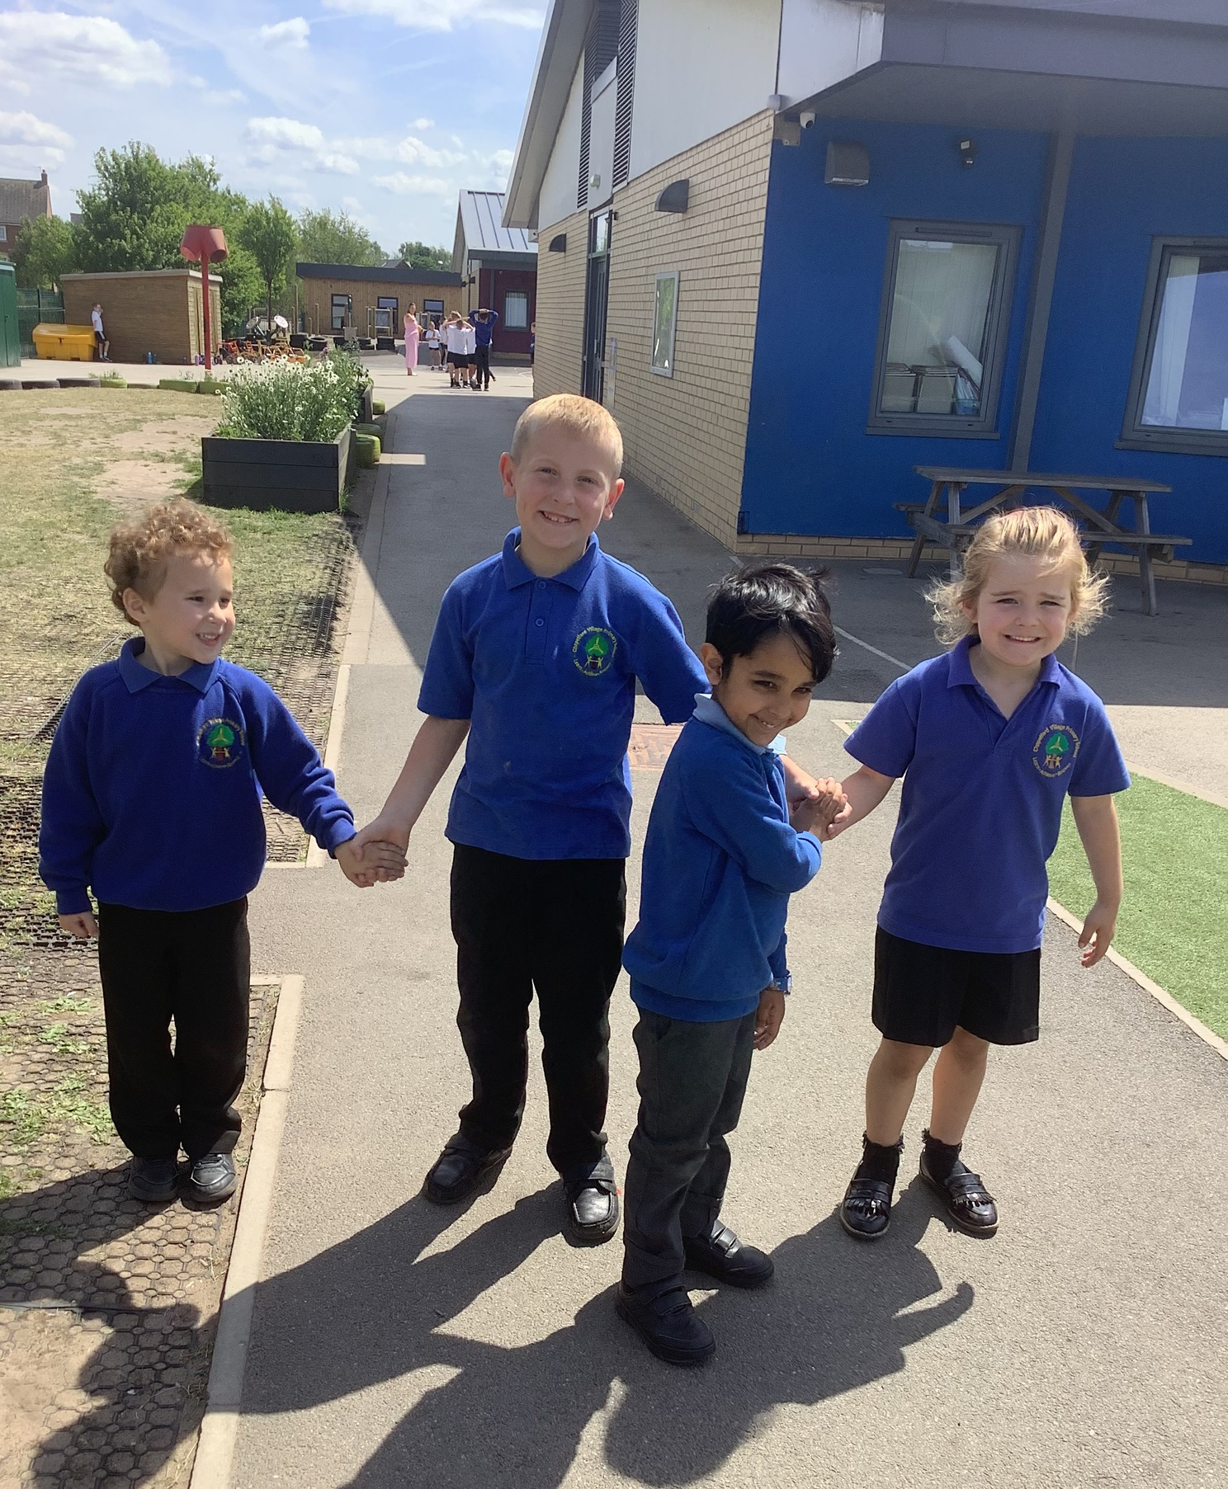
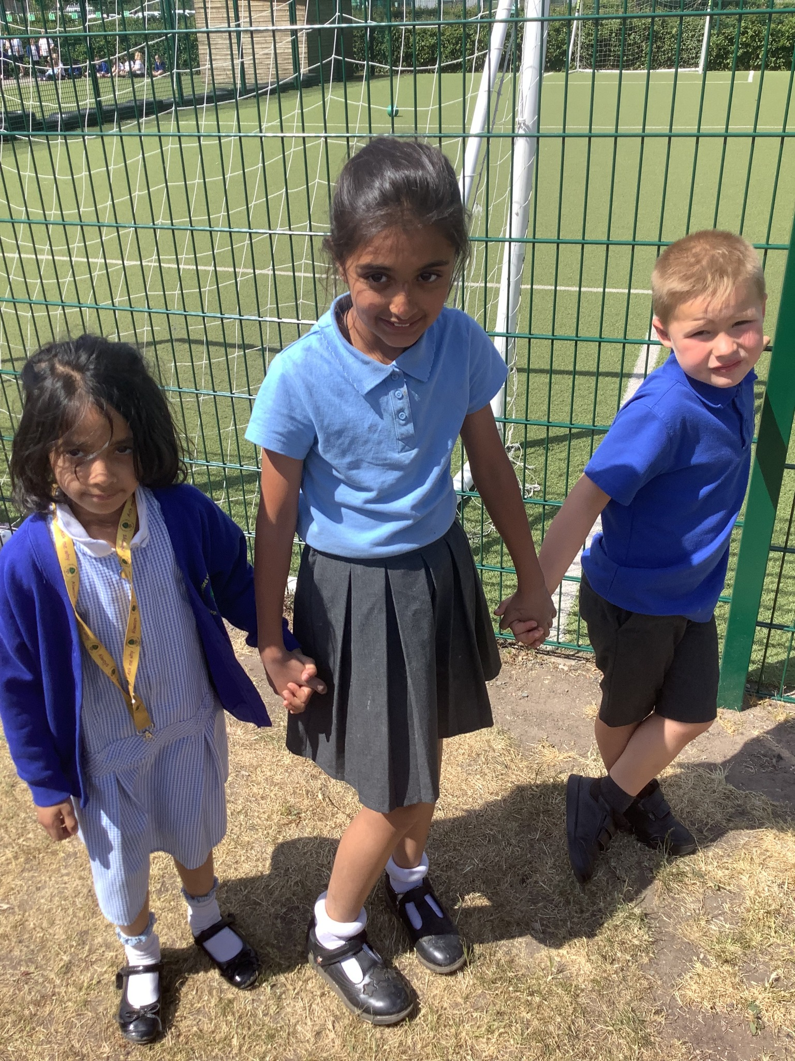
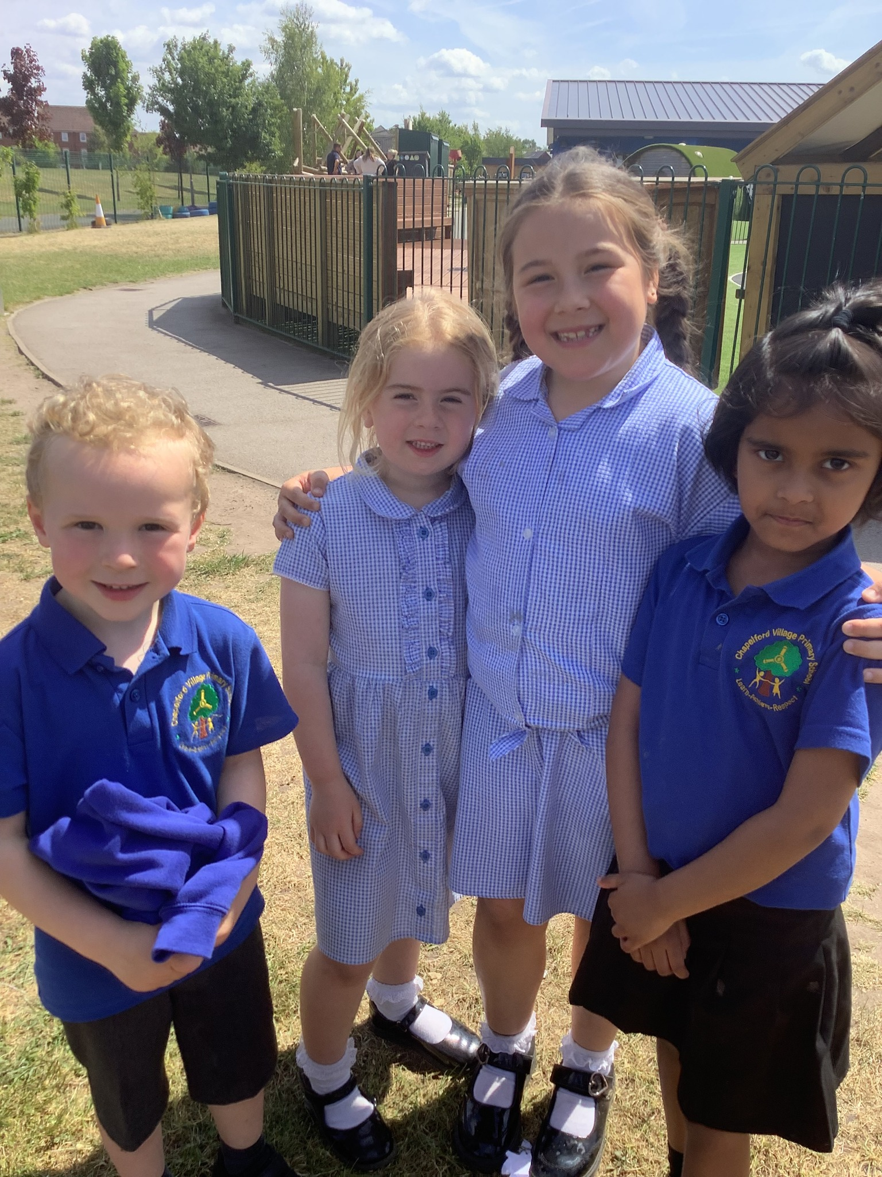

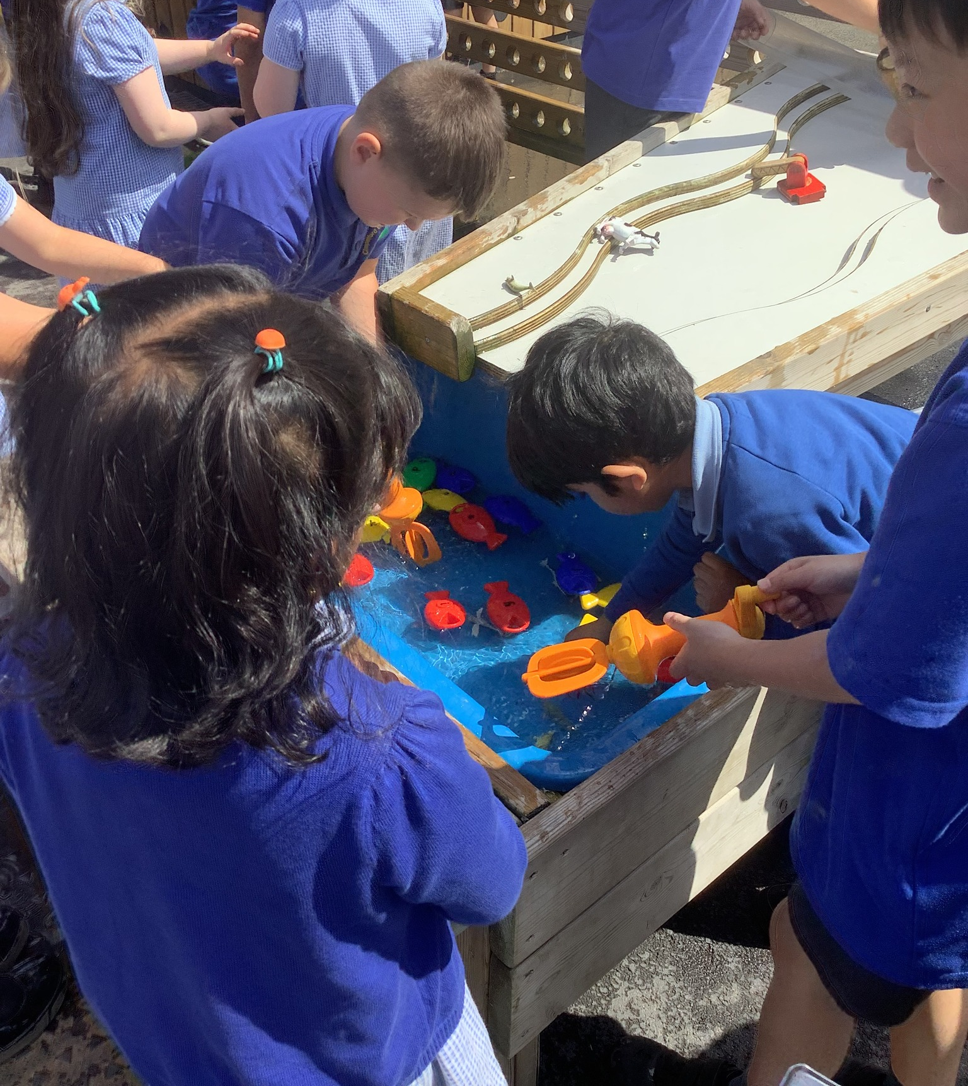
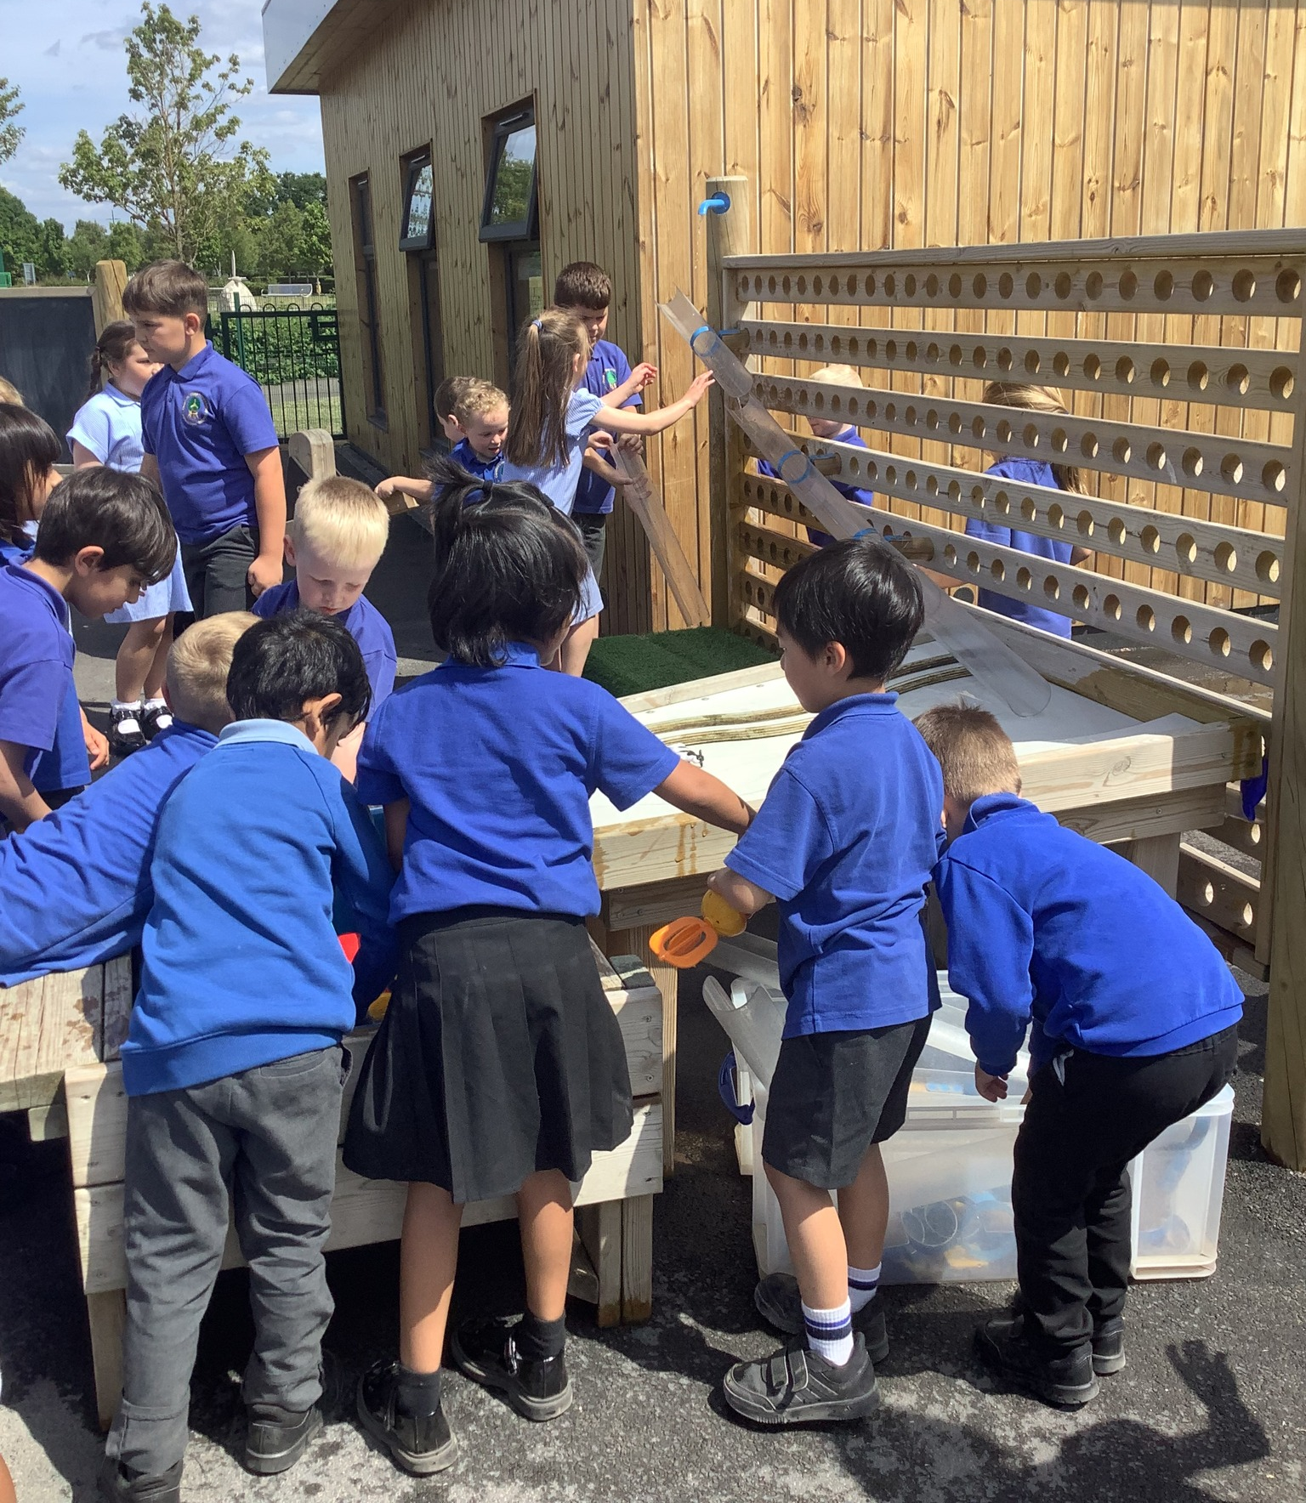
Let’s reflect on this half term…
Our youngest children were supported by our Year 3 children to join in with OPAL and it was a great success!
We work collaboratively

Slide 9
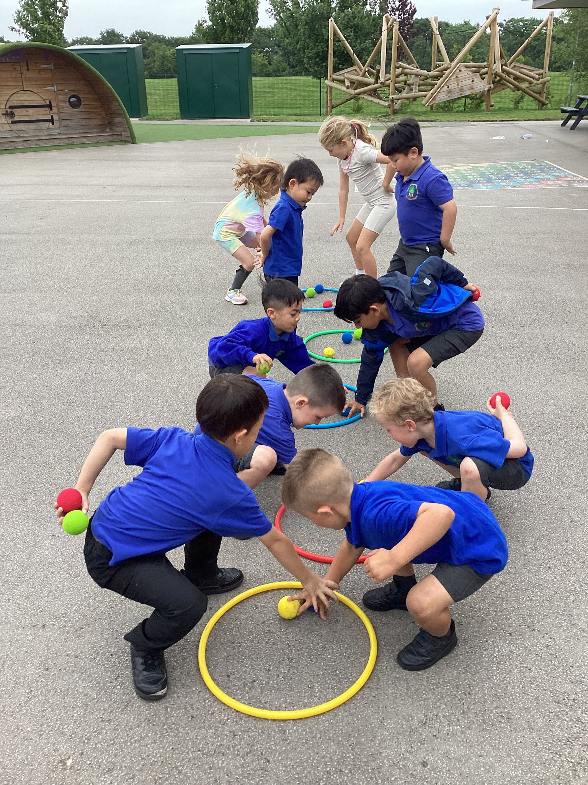
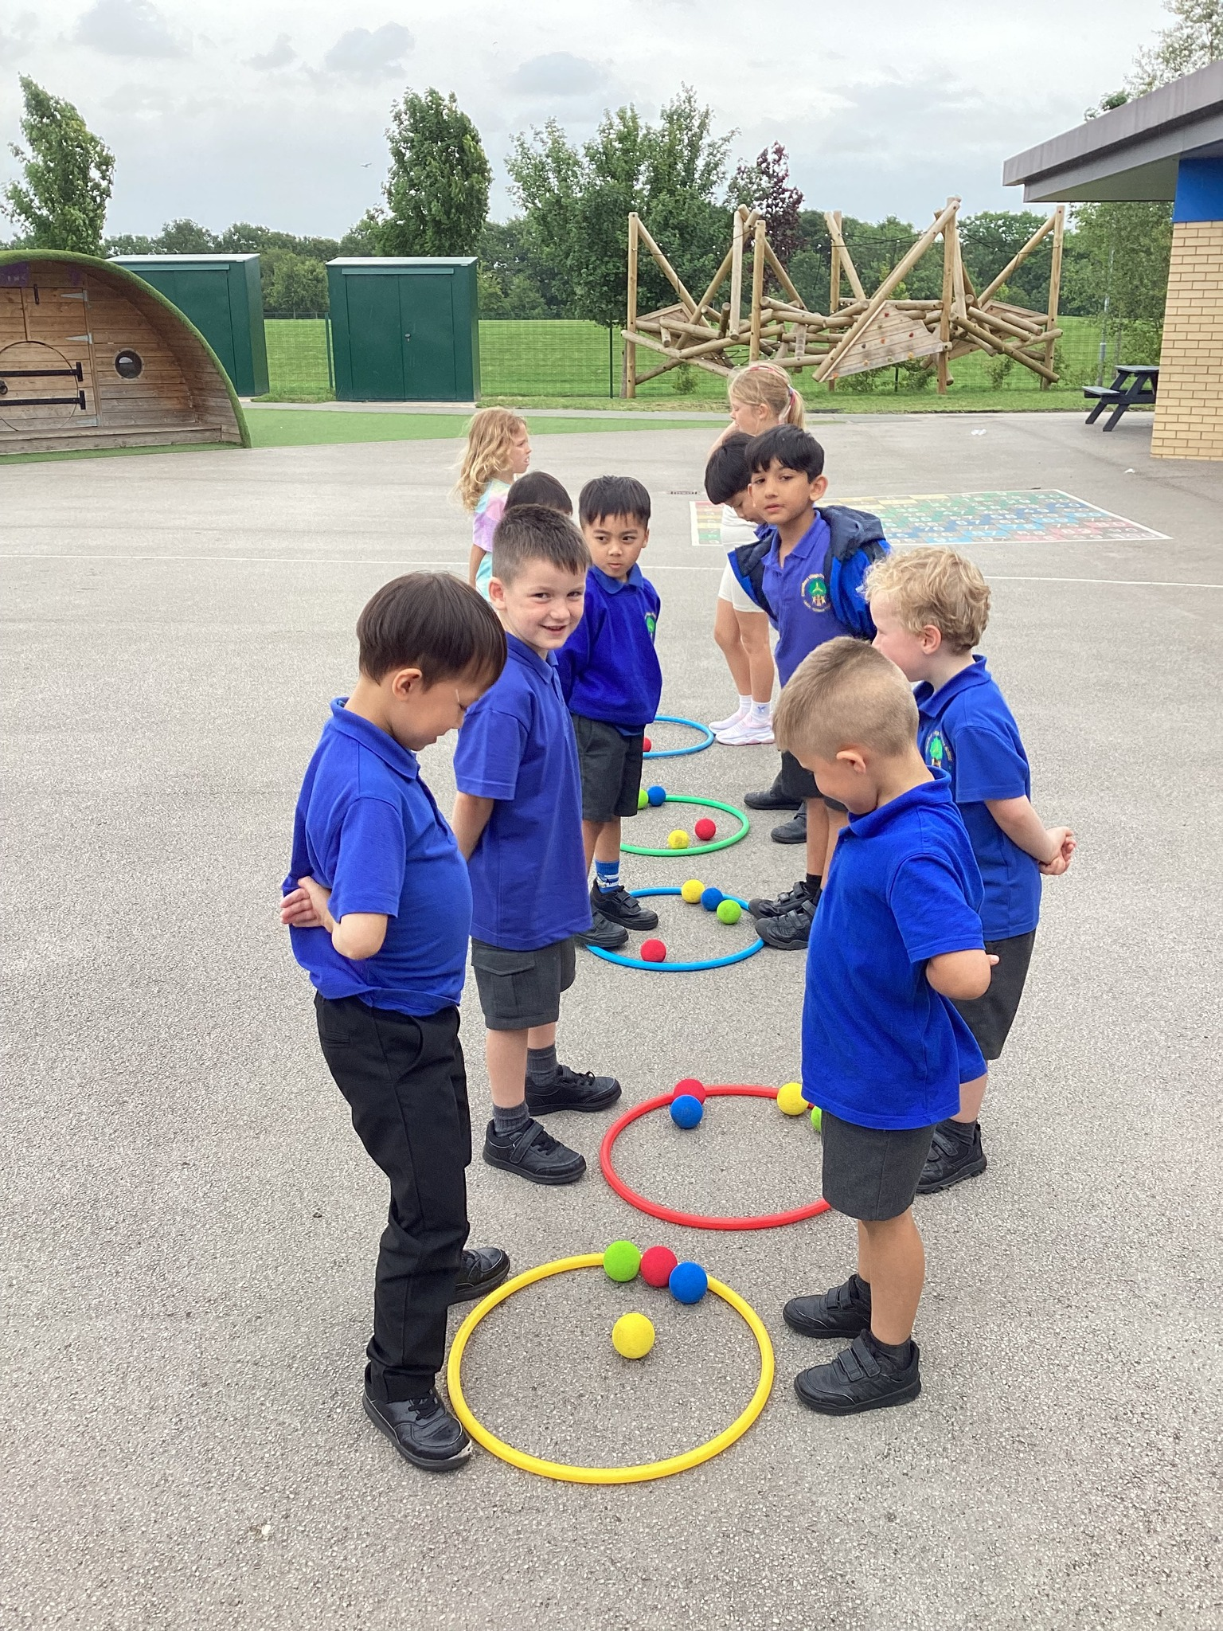
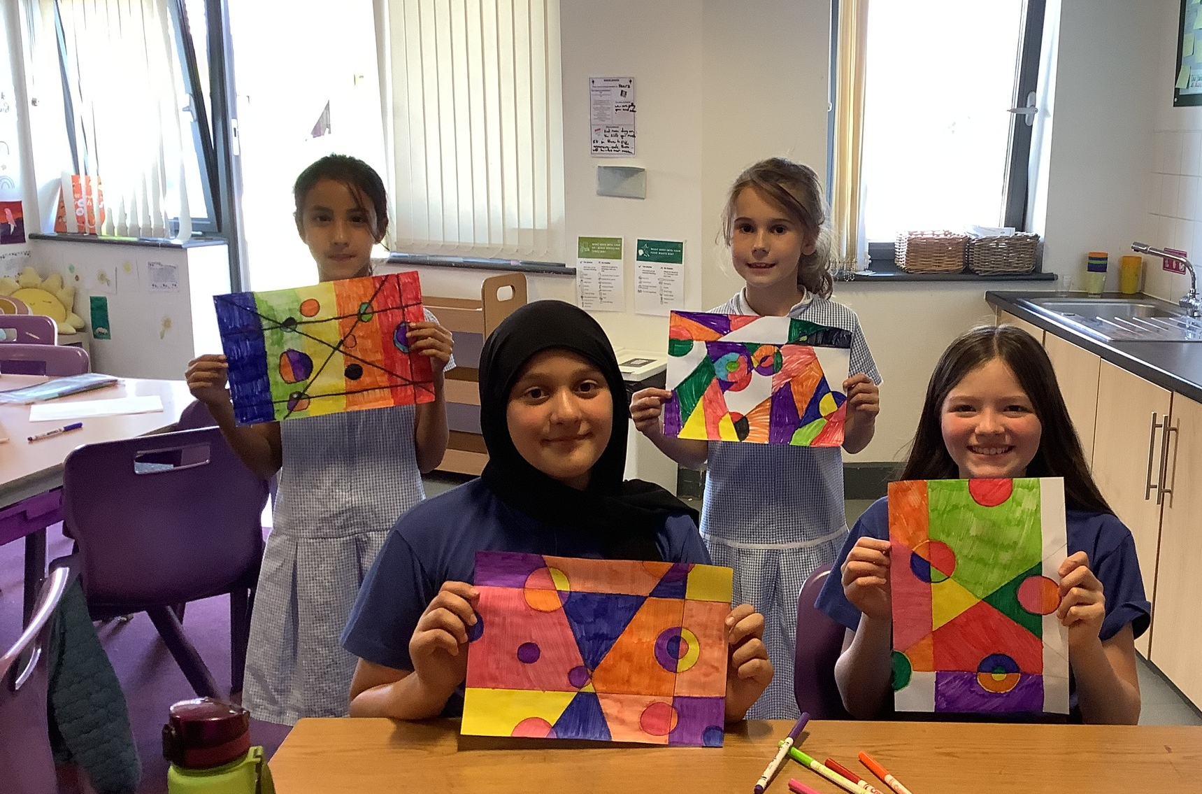
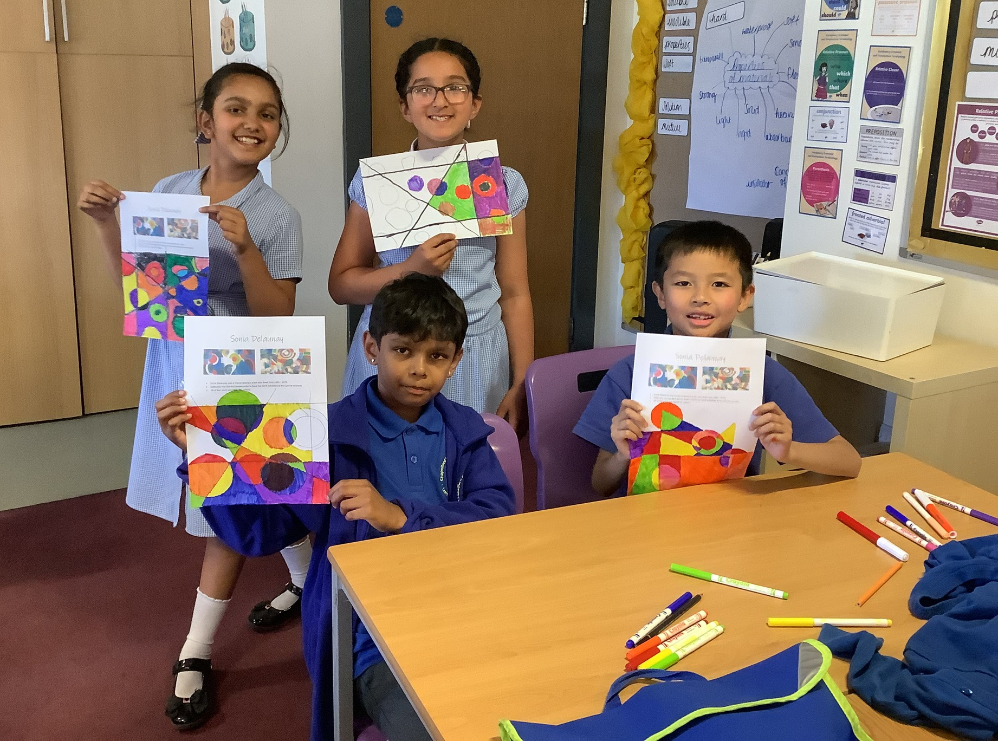
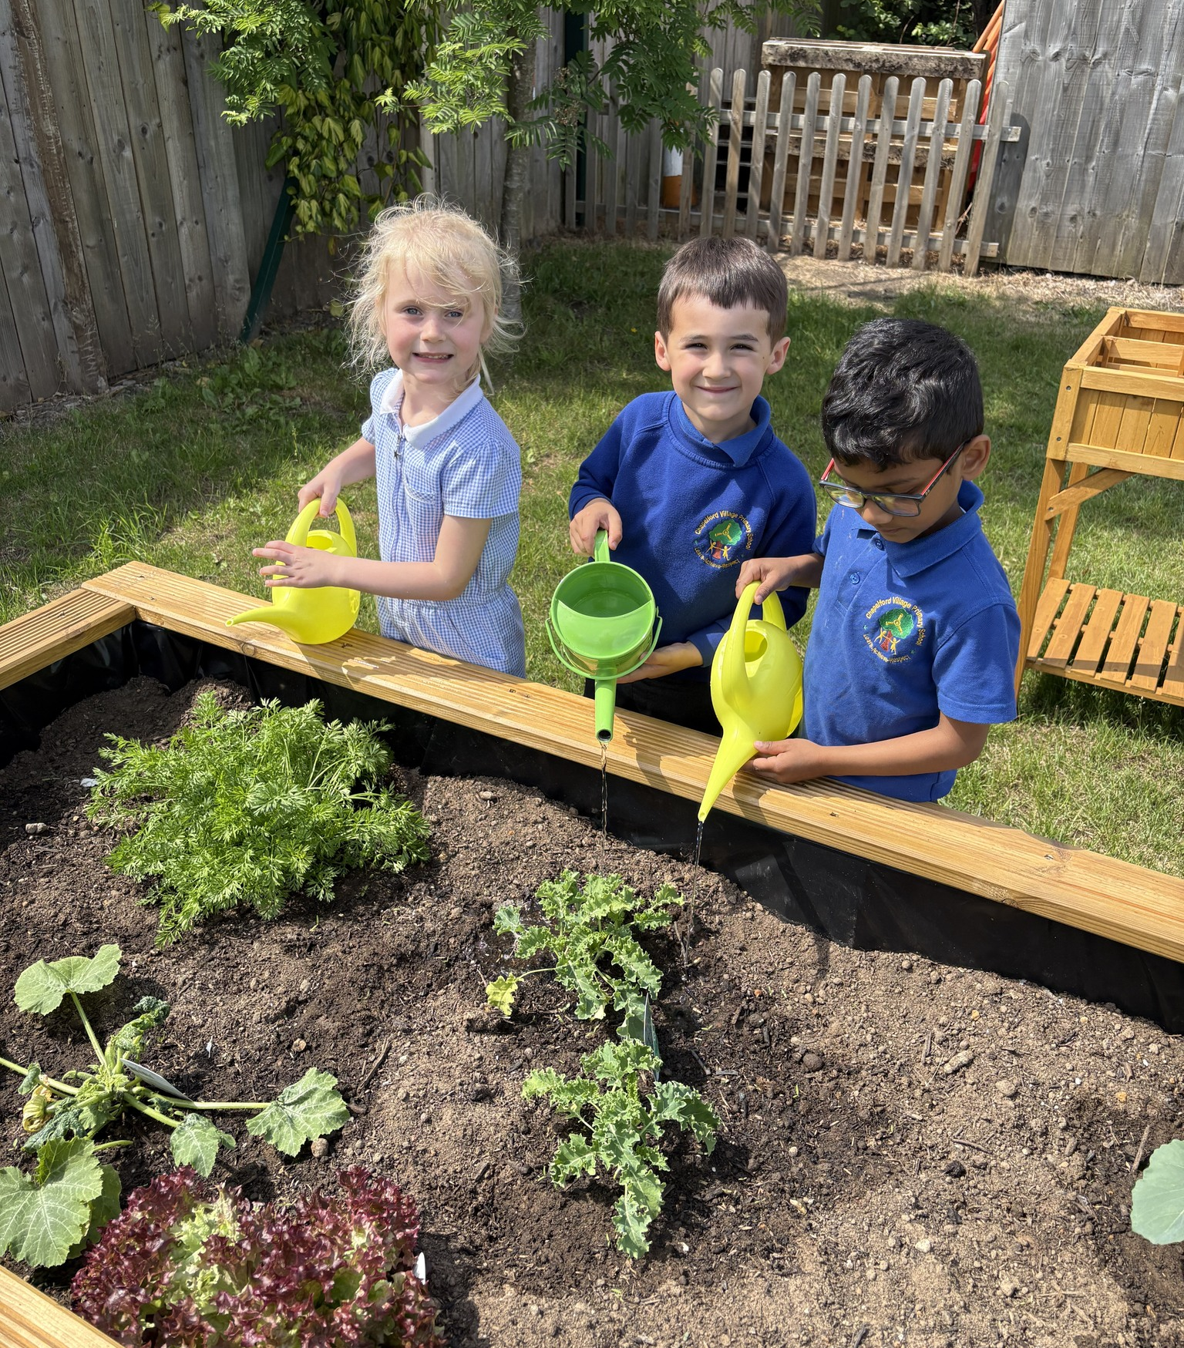
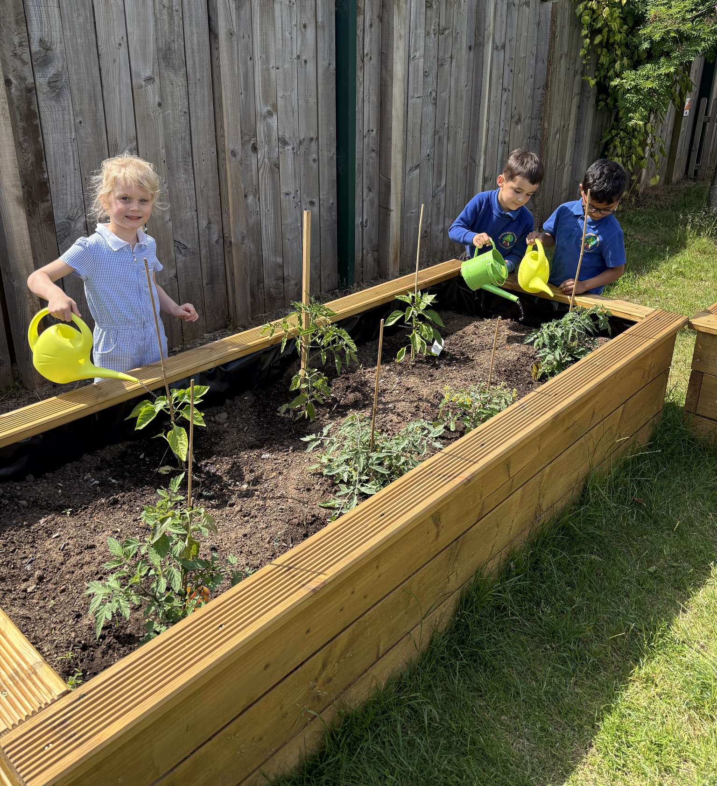
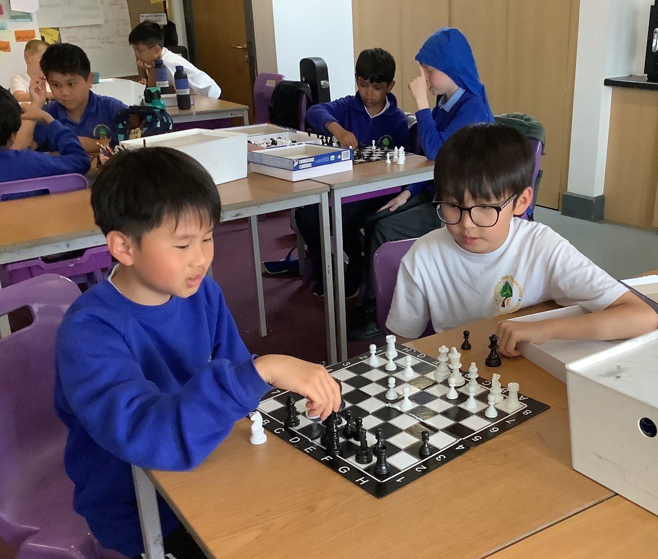
We are Creative
Let’s reflect on this half term…
We participated in extra-curricular activities through our extensive range of after-school clubs including playground games, gardening and artist club.

Slide 10
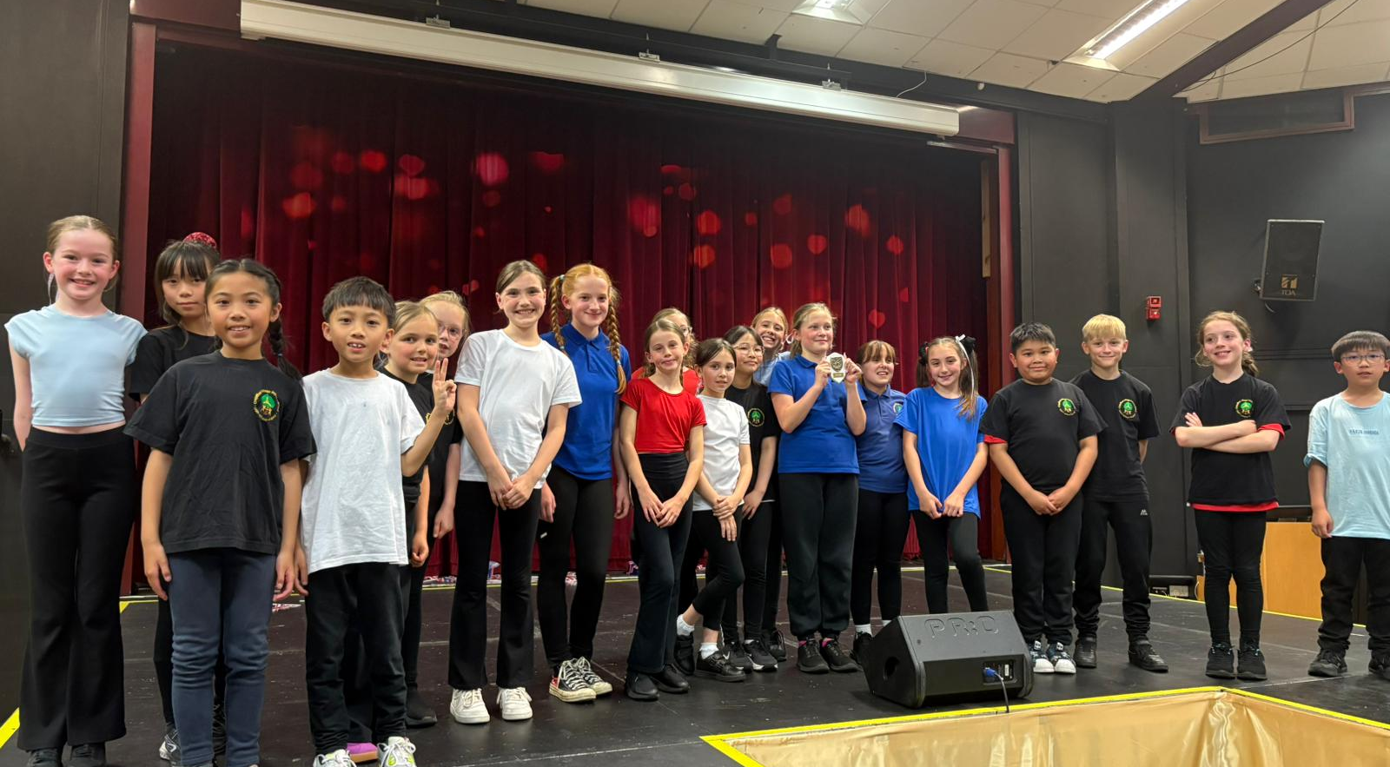
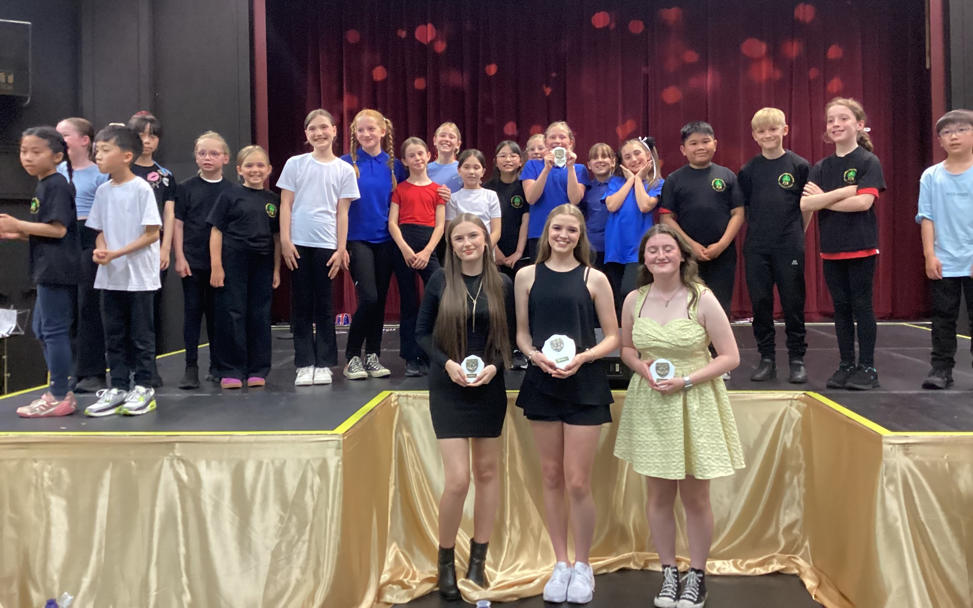

We are Fearless
Let’s reflect on this half term…
We developed our curriculum beyond the curriculum to support our children in becoming confident, resilient and independent individuals.
Our Winners in the primary category at this year’s MAT Factor competition!

Slide 11
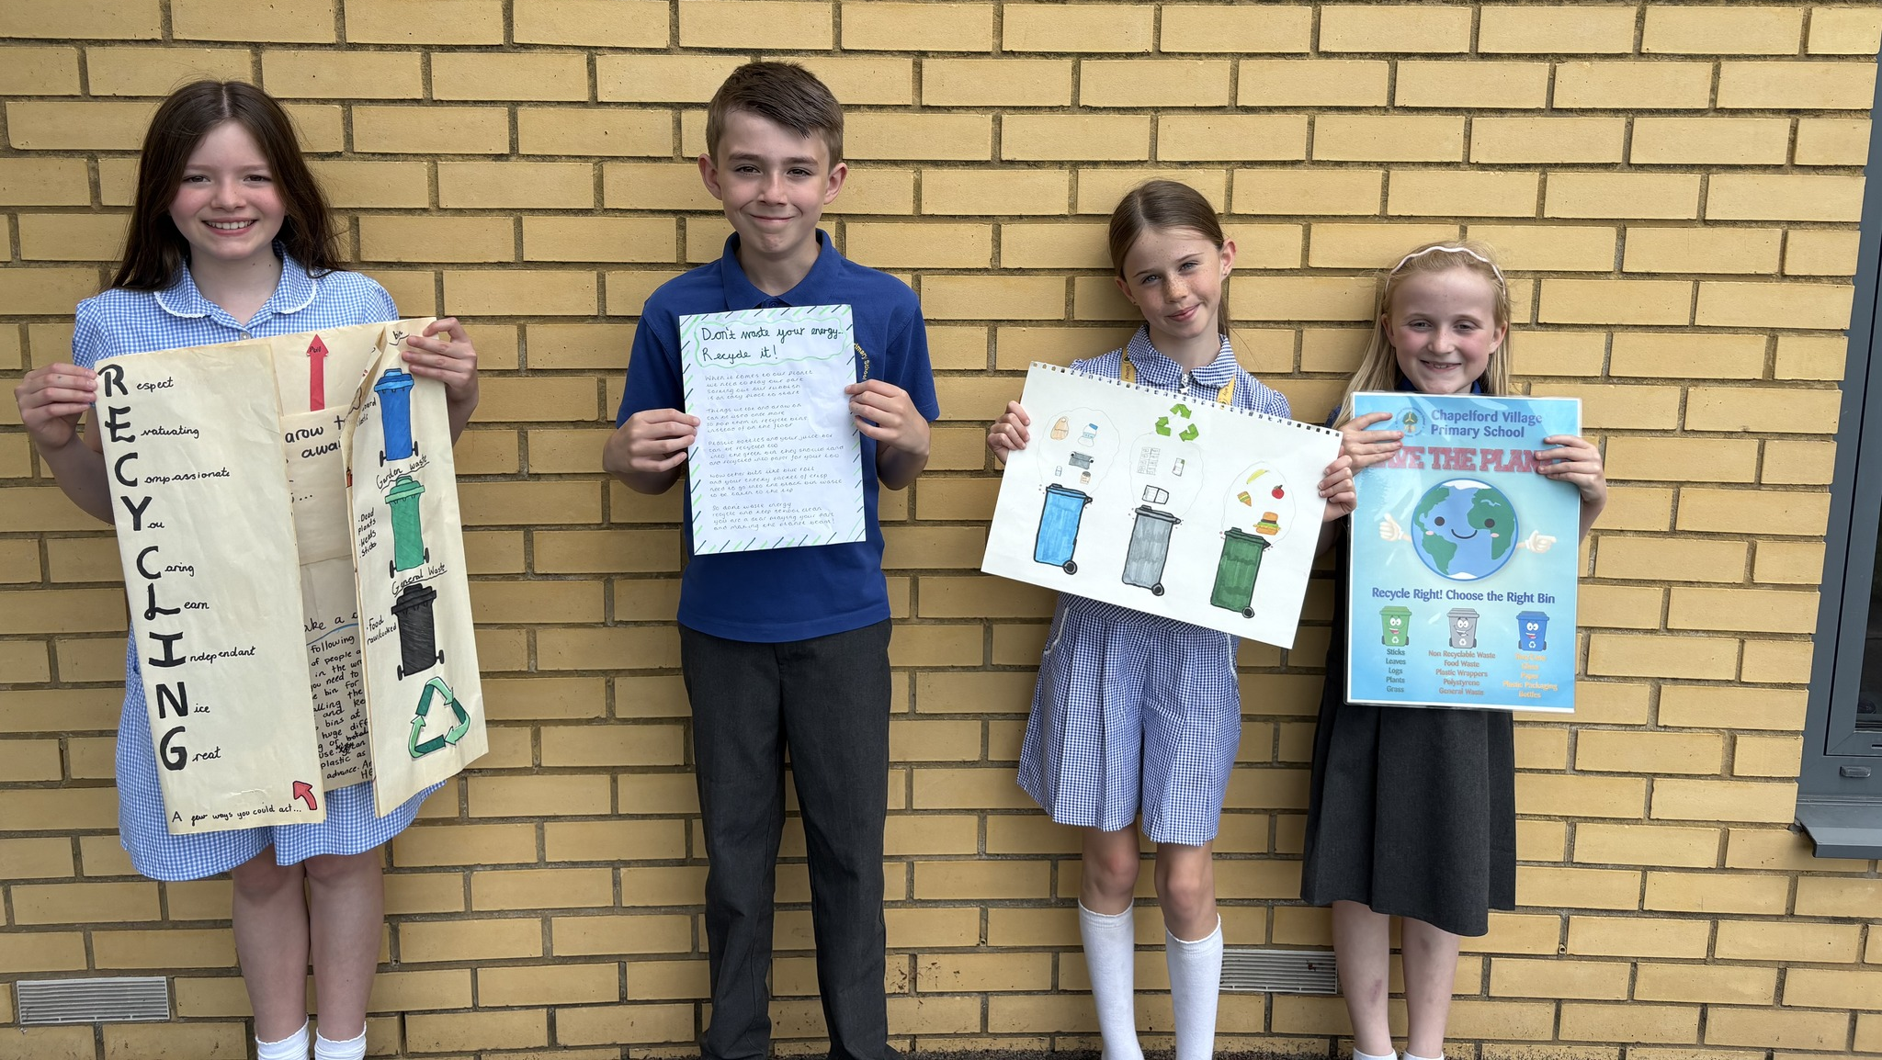
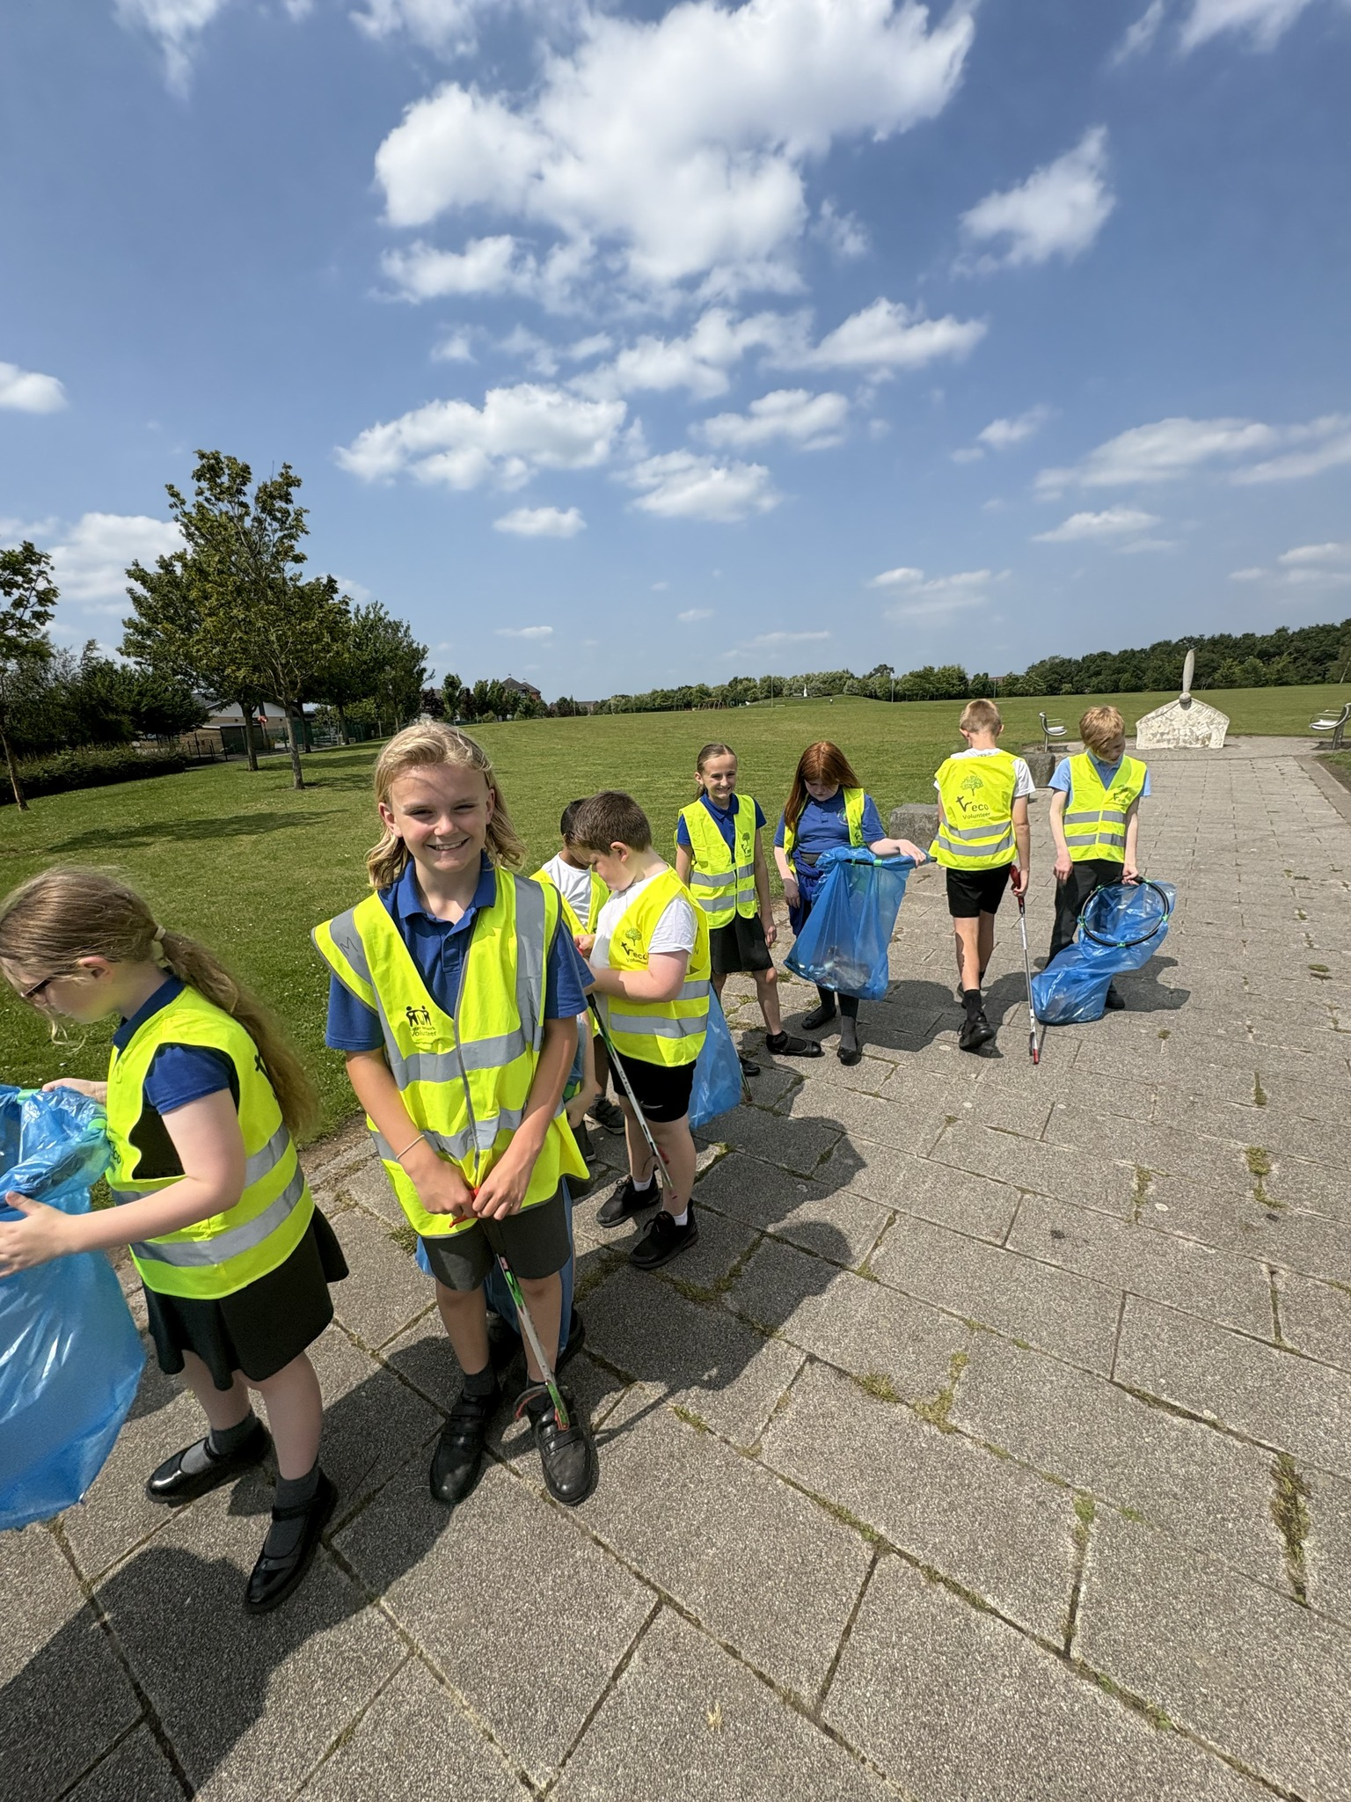


Let’s reflect on this half term…
We participated in extra-curricular activities with our Eco Team..
We are Helpful

Slide 12






Let’s reflect on this half term…
We participated in extra-curricular activities with a range of sporting competitions.
We are Resilient

Slide 13








Let’s reflect on this half term…
We provide our children with lots of rewards.
The end of year House Point treat for the winning house this year was a beach party for St Patricks!
We work collaboratively

Slide 14
Let’s hear from you!
We want to listen to your views, wishes and experiences.
What have you enjoyed most about this year?
Which of our ACPs have you developed?
What have you achieved throughout this final half term?
What would you like to experience next year to further develop your character?

Slide 15


Slide 16





Farewell and good luck to our incredible Year 6 children!

Slide 17






Look out because here I come…

