Slide 1


Year 2 Gulliver’s World Residential: Parent Information

Slide 2

Before the trip, you will be invited in to discuss:
The trip itinerary, including travel arrangements for pick up and drop off
The suggested activity timetable with learning links and sample menu
Hygiene, Health & Safety and Medical
Q&A Session

Slide 3
Suggested Kit List
When packing please check the weather forecast and pack accordingly.
Toiletries (toothbrush, toothpaste, flannel, hand towel)
Rain Jacket
Old Shoes, Trainers or boots (these may get dirty and wet).
The clothes the children wear on the first day will be the clothes they wear for the activities during the day.
A spare set of clothes.
Clothes for bedtime, PJs, Onesie, etc…. and a teddy of course!
A set of clothes for the theme park on Friday
Medication if required (clearly labelled and with the correct form)

Slide 4
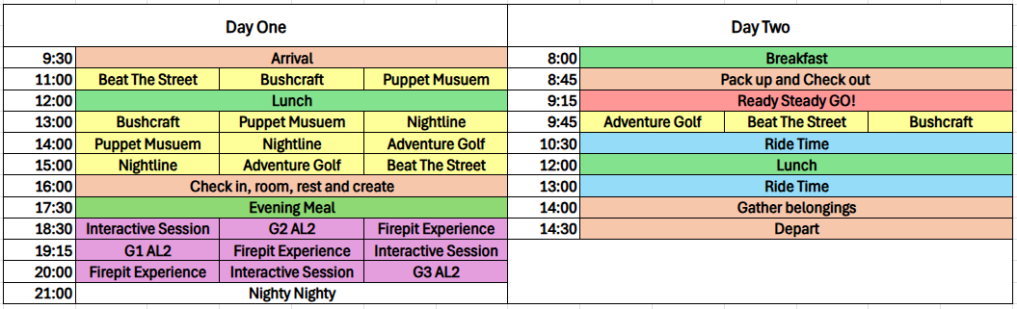
A Sample Itinerary (based on last year’s trip)

Slide 5
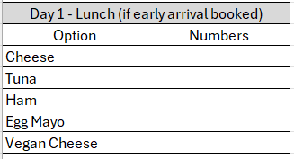
Sample Menu
Evening Meal Reminder
Tuesday & Thursday Dinner
Children's Options :-
Option 1 - Cheese & Tomato Pizza & Fries (V)
Option 2 - Jacket Potato Served with Beans (Vegan, GF)
Adult Options :-
Option 1 - Beef Chilli Rice, Fries and nachos
Option 2 - Jacket Potato Served with Beans (Vegan, GF)
Salad bar - Lettuce, Tomato, Cucumber sticks, sweetcorn & GF plain pasta
Dessert - Strawberry Mousse
Ice Lolly - GF Free & Dairy Free
Water & Cordial,Chance to refill your water bottles if needed
Vegetarian - All menu items suitable
Vegan & Dairy - Tomato & Basil Pasta & ice lolly
Gluten - GF Cheese & Tomato Pizza or Jacket Potato & Ice lolly

Slide 6
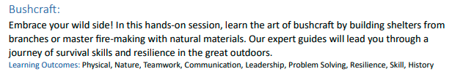
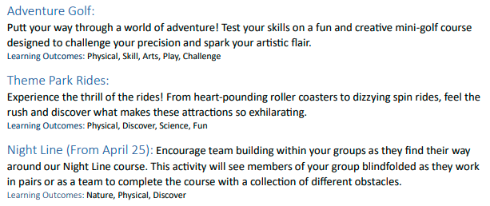
Suggested Activities

Slide 7
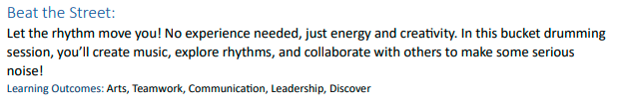

Suggested Activities

Slide 8
Food and Dietary Requirements
All food is provided for your child so please do not send any food, drink or snacks.
Dietary needs will be catered for, but please advise us as soon as possible so that we can let the centre know.
On the arrival day children will get a lunch and an evening meal.
On departure day children will have breakfast of cereal, toast and fruit as well as lunch prior to departure.
All food is home cooked and served in a dining room allocated just to our school.
Children will be responsible for cleaning up after themselves.

Slide 9
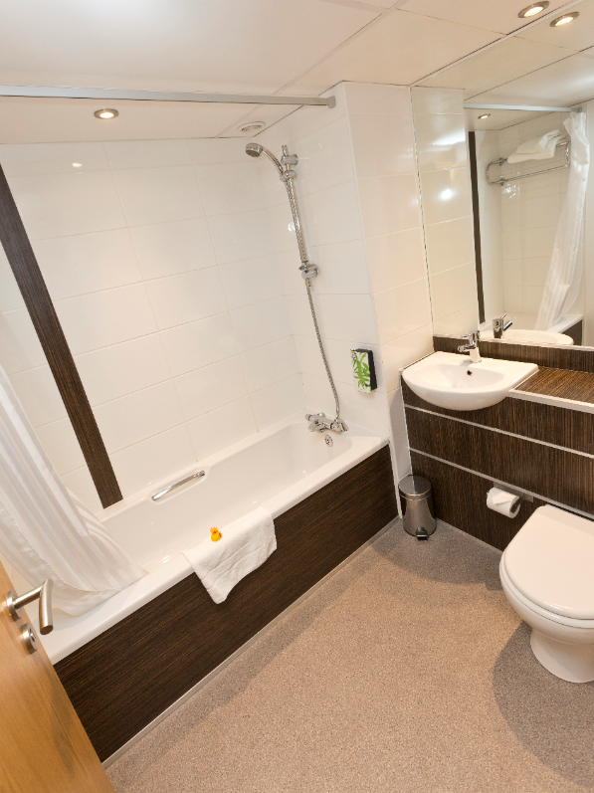
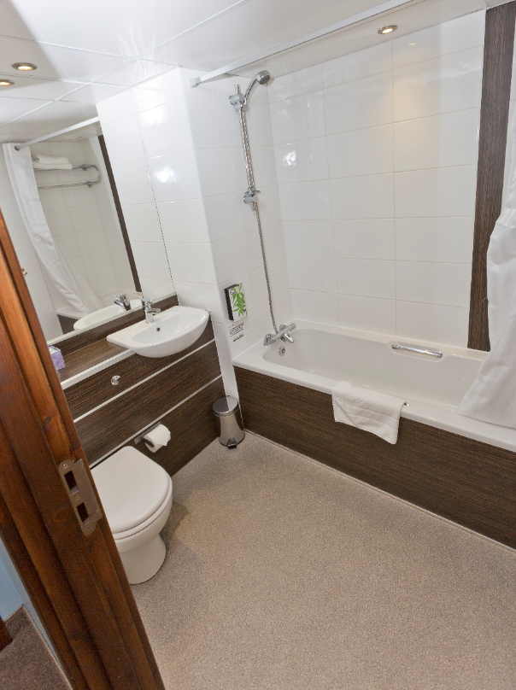
Hygiene
It is recommended that your child brings a small bag labelled with their name to include wash stuff, toothbrush and toothpaste.
It is also useful to send a named bin bag for wet or dirty clothes.
All rooms have a small sink.

Slide 10
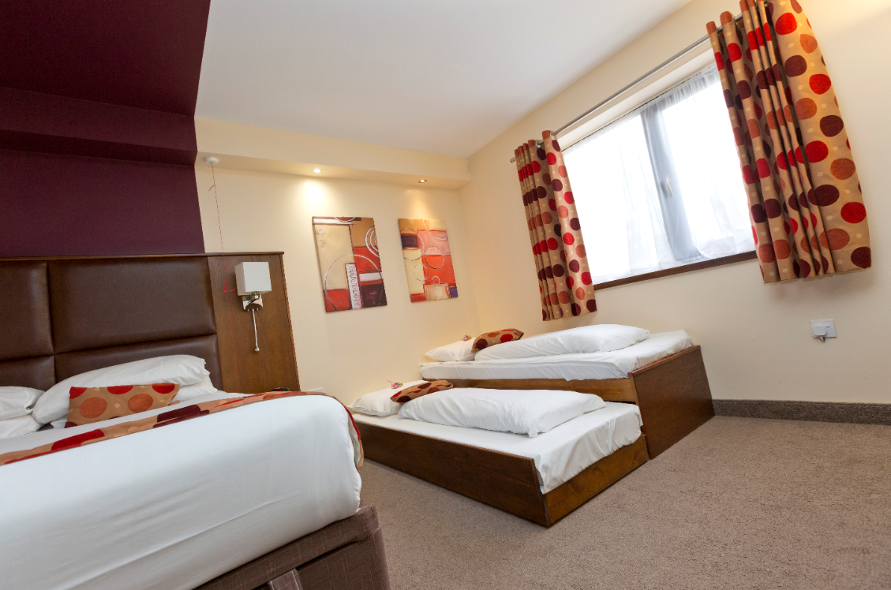
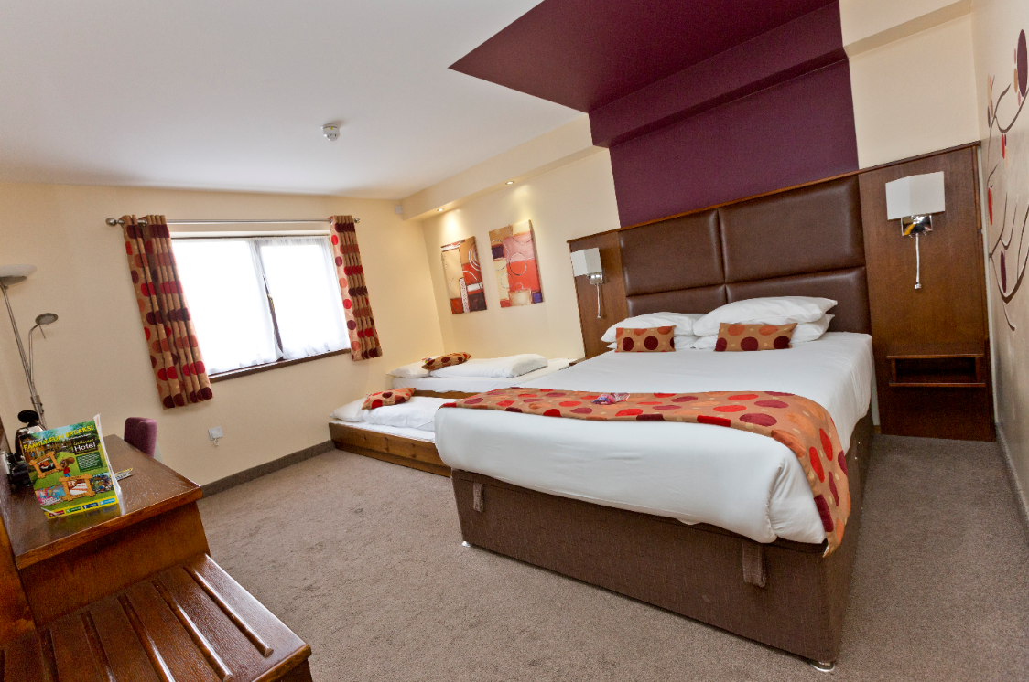
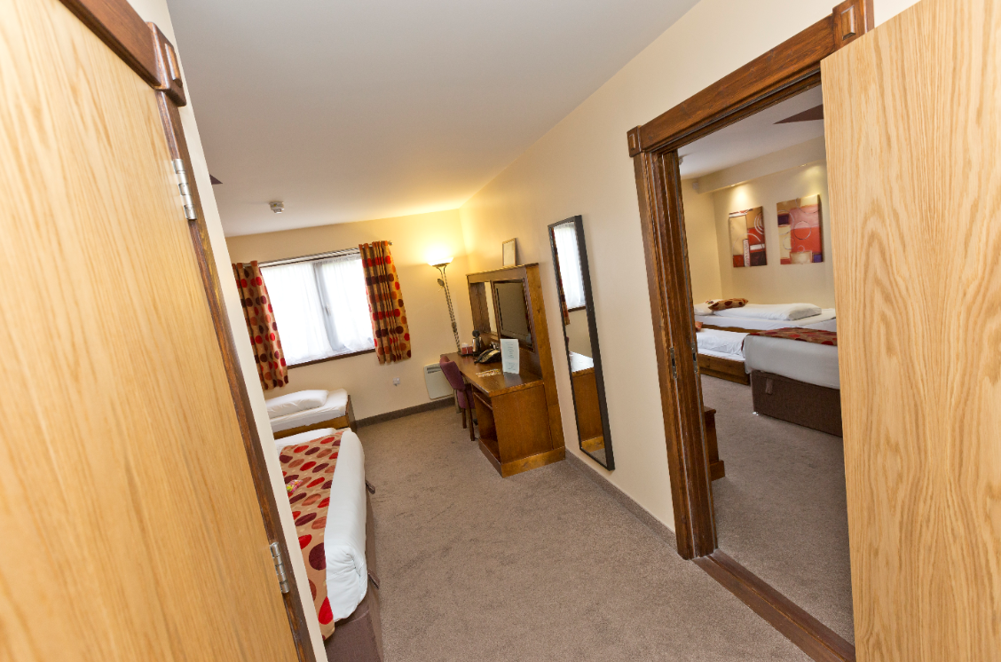
Sleeping Arrangements

Slide 11
Health and Medical
If your child requires medication, or has a medical condition, please make us aware of it in advance of the trip.
All medicines should be prescribed in the original packaging, labelled with the dosage and the child’s name.
All medicines should be handed to staff prior to the trip, not packed in children’s bags.
Please remember inhalers need to be labelled with child’s name and dosage.
Please note that all medicines, along with an administering medicine permission form, should be given to teachers in advance of the trip in order to allow this to be cross referenced against medical forms and the appropriate risk assessment and paperwork to be completed.

Slide 12
Additional Information
All staff are DBS checked
The doors to the centre are locked at night and all adult staff stay in the centre overnight.
Please do not send any toys or games with your child. They may bring a reading book and of course a cuddly toy!
No mobile phones are to be taken. In the event of an emergency, we will contact you. No other technological devices are permitted. This also includes air tags.
If you need to contact your child in an emergency, please contact school during normal office hours in the first instance.
If you have an emergency during the evening, contact via email which will be checked regularly on n.stewart@cvps.omegamat.co.uk. They will contact staff at the centre.
If there is an emergency with your child, please be assured staff will contact you.

