Slide 1
Gulliver’s Information Evening

Slide 2
Welcome
This evening, we will cover:
Trip itinerary including travel arrangements for pick up and drop off.
Suggested activity timetable with learning links and Sample menu.
Hygiene and Health and Medical.
Q&A Session

Slide 3
Pick up and drop off arrangements
Your child needs to be dropped off at Gulliver's world at 9.30am on Thursday 20th June where teaching staff will greet them
On Friday 21st June, your child will need to be picked up from Gulliver's world at 2.30pm.

Slide 4
Suggested Kit List
When packing please check the weather forecast and pack accordingly.
Packing to consider:
• Toiletries.
• Sunscreen.
• Cap or Sun Hat.
• Rain Jacket.
• Old Shoes, Trainers or boots (these may get dirty and wet).
• The clothes you arrive in on Thursday will be the clothes you wear for the activities during the day.
• A spare set of clothes.
• Clothes for bedtime, PJs, Onesie, etc.
• A set of clothes for the theme park on Friday
• Water Bottle (Maybe a spare too).
• Medication – If Required (Clearly labelled with your name)

Slide 5
Trip Itinerary
Day 1
Arrival and Tour.
11.00-12.00 Cycle of activities in groups begins.
12.00-13.00 Lunch
13.00-14.30 Cycle of activities continues.
14.45-16.15 Cycle of activities continues.
16.30-18.00 Cycle of activities continues.
18.00-19.00 Dinner, Room and Rest.
19.00-20.00 Night-Time Activity.
Day 2
Arrival and Tour.
8.15-9.00 Breakfast
9.00-10.30 Cycle of activities continues.
10.30-14.30 Theme Park Rides and Lunch (selection of age-appropriate rides).

Slide 6
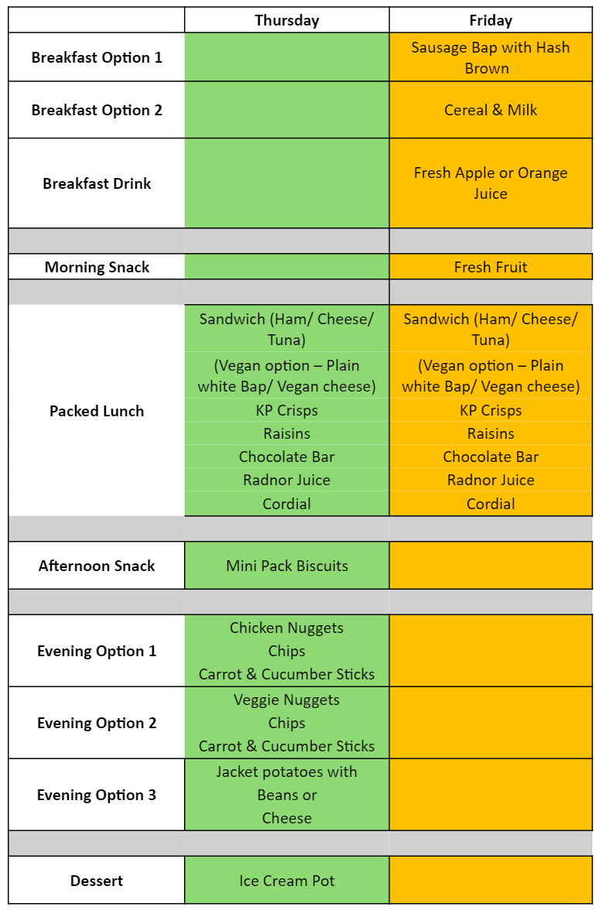
Sample Menu

Slide 7
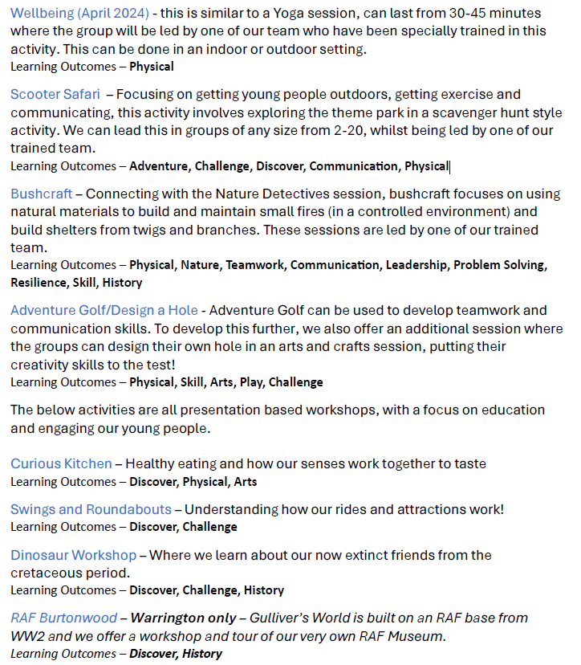
Suggested Activities

Slide 8
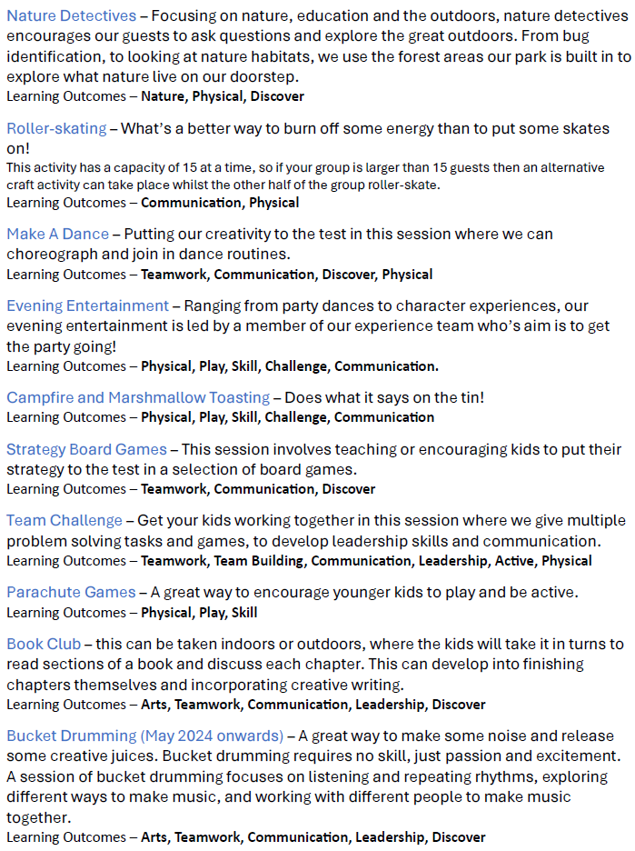
Suggested Activities

Slide 9
Food and Dietary Requirements
All food is provided for your child so please do not send any food, drink or snacks.
Dietary needs will be catered for, but please advise us as soon as possible so that we can let the centre know.
On the arrival day children will get a lunch and evening meal.
On departure day children will have breakfast of cereal, toast and fruit as well as lunch prior to departure.
All food is home cooked and served in a dining room allocated just to our school.
Children will be responsible for cleaning up after themselves.

Slide 10
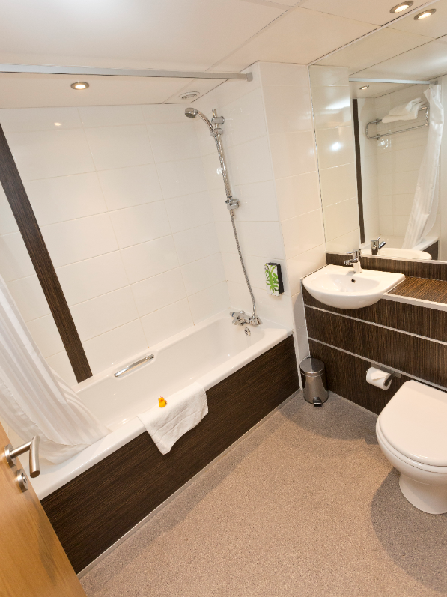
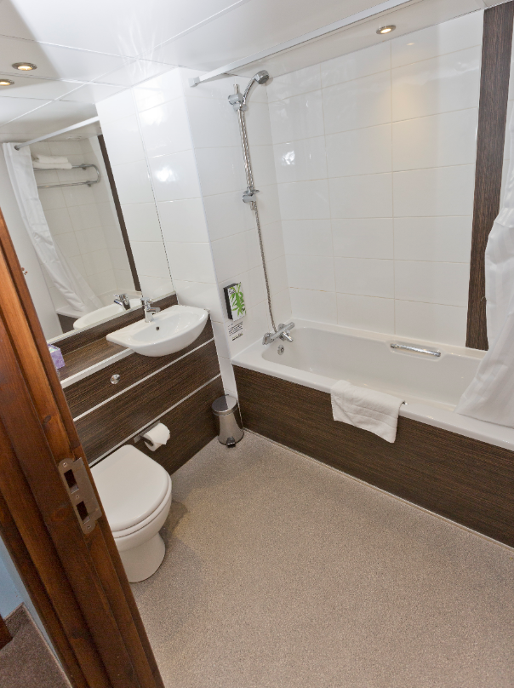
Hygiene
It is recommended that your child brings a small bag labelled with their name to include wash stuff, toothbrush and toothpaste.
It is also useful to send a named bin bag for wet or dirty clothes.
All rooms have a small sink.
There are showers in rooms, but they will not need to use them unless it is essential!

Slide 11
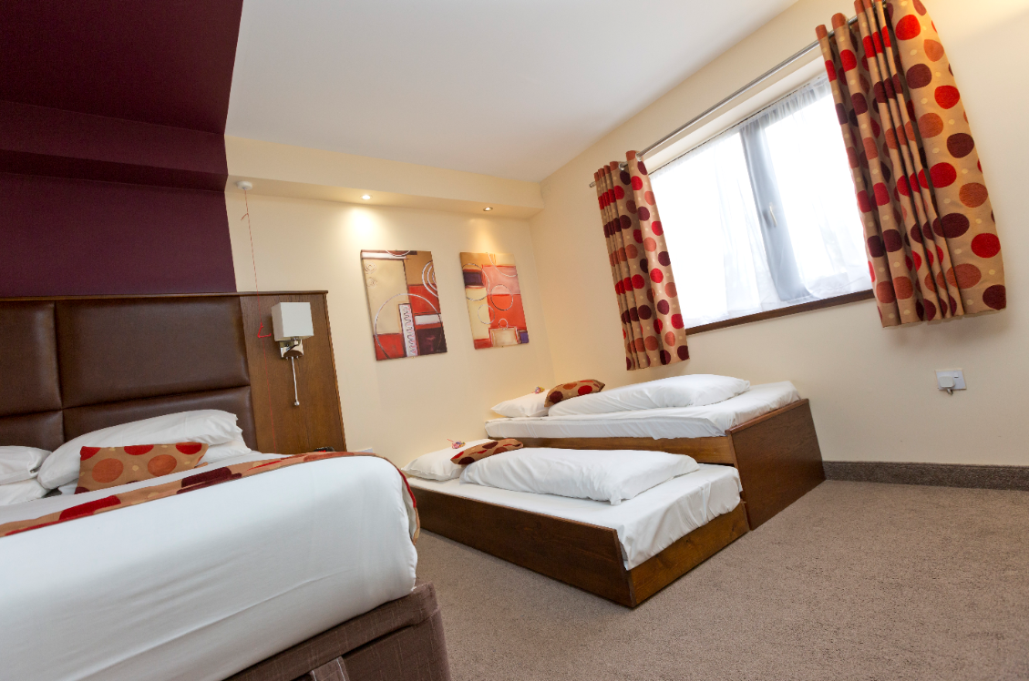
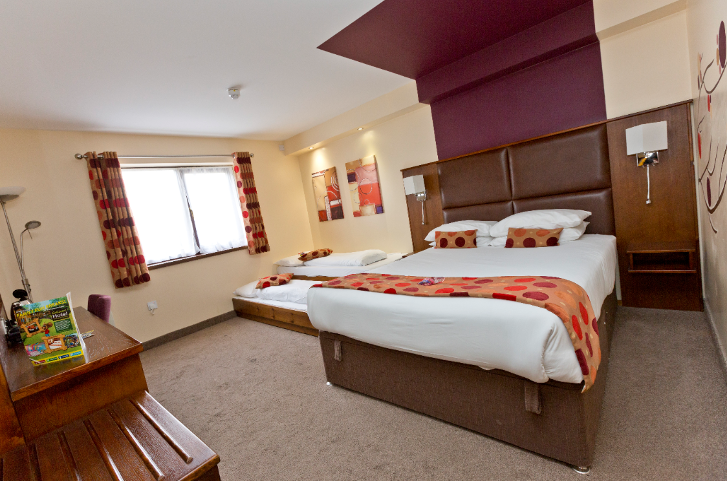
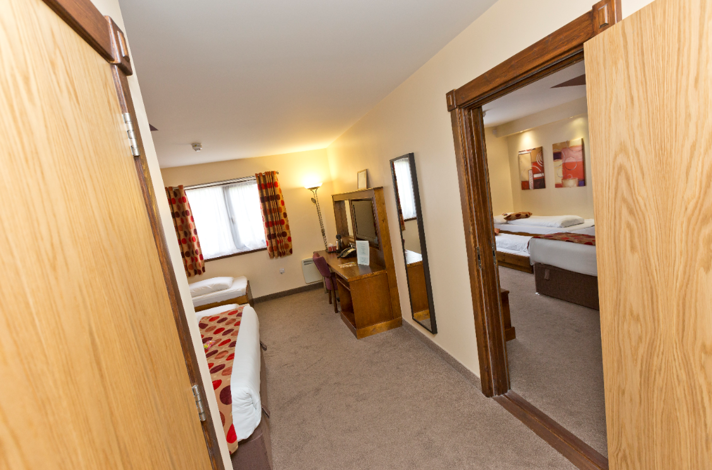
Sleeping Arrangements

Slide 12
Health and Medical
If your child requires medication, or has a medical condition, please make us aware of it in advance of the trip.
All medicines should be prescribed in the original packaging, labelled with the dosage and the child’s name.
All medicines should be handed to staff prior to the trip, not packed in children’s bags.
Please remember inhalers need to be labelled with child’s name and dosage.
Please note that all medicines, along with an administering medicine permission form, should be given to teachers by Monday 10th June in order to allow this to be cross referenced against medical forms and the appropriate risk assessment and paperwork to be completed.

Slide 13
Additional Information
All staff are CRB checked
The doors to the centre are locked at night and all adult staff stay in the centre overnight.
Please do not send any toys or games with your child. They may bring a reading book and of course a cuddly toy!
No mobile phones are to be taken. In the event of an emergency, we will contact you. No other technological devices are permitted.
If you need to contact your child in an emergency, please contact school during normal office hours in the first instance.
If you have an emergency during the evening, contact via email which will be checked regularly on n.stewart@cvps.omegamat.co.uk. They will contact staff at the centre.
If there is an emergency with your child, please be assured staff will contact you.

Slide 14
Q&A Session

