Slide 1
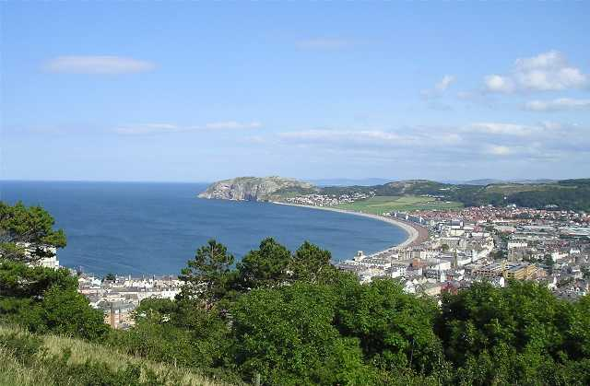
Welcome
Llandudno
Year 5 RESIDENTIAL
june 2024

Slide 2
Where we stay… Llandudno Hostel for Schools
The hostel is reserved just for our school
Dormitory style rooms ranging from 4 to 8 beds
Wash facilities available
Wash hand basins in each room

Slide 3
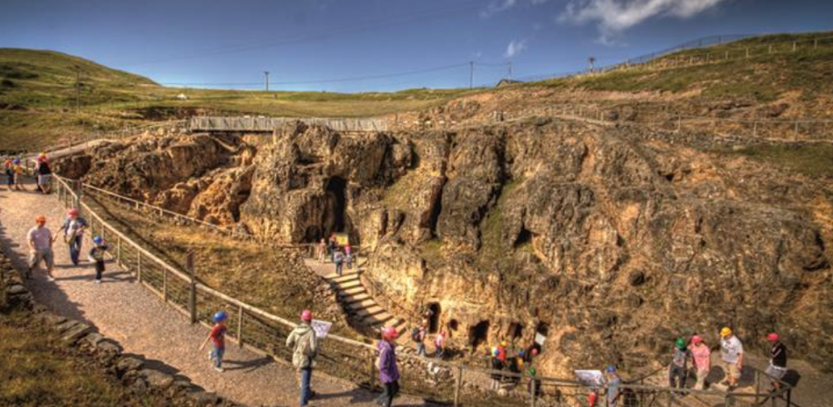
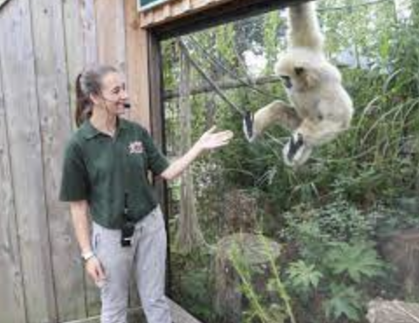
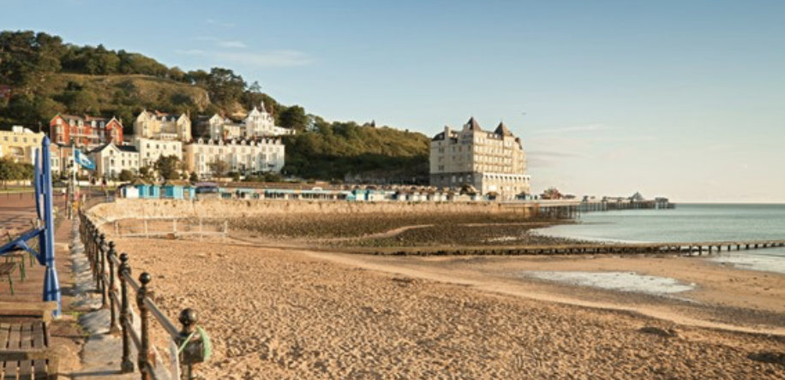
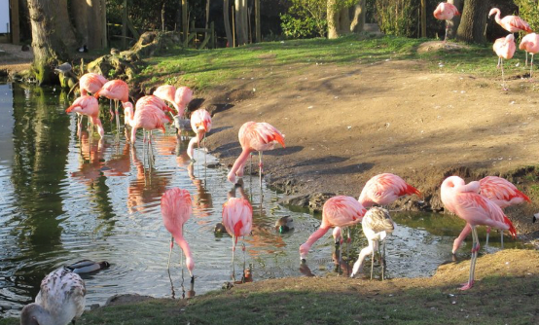
Activities
The outline of planned activities are subject to weather conditions.
Welsh Mountain Zoo
Educational session – Habitats and Adaptations
Games and art activities on the beach
Visit to Great Orme mines
Nature walks on the Great Orme
A ride on the Great Orme tram

Slide 4
What do you need?
All items should be clearly named
Medication if required and given to the teachers with a medical form
Slippers
Outdoor shoes or walking boots – worn to travel
Waterproof coat – worn to travel
Fleece or very warm jumper
Thick socks
Trainers
Suntan cream – labelled
Nightwear
Underwear
T shirts
Tracksuit bottoms or leggings
Towel and face cloth
Wash bag with soap, toothbrush, tooth paste, comb/brush
Teddy bear
Small activity e.g. book, puzzle, magazine, book, cards

Slide 5
Medical forms
Medical forms are to be signed and returned to school 2 weeks prior to the residential along with any medication needed.
We understand that this may be difficult to hand in medication two weeks before, especially if you only have one type of cream. But we please ask that we can take a picture of the medication, so that we can cross reference it with the medical form.
For any more information on this, feel free to contact your child’s class teacher.

Slide 6
Thank you..
Dates to remember:
Class 18 Depart Monday 3rd June and return Tuesday 4th June at 7:00pm
Class 19 Depart Tuesday 4th June and return Wednesday 5th June 7:00pm
Class 20 Depart Wednesday 5th June and return Thursday 6th June at 7:00pm
Class 21 Depart Thursday 6th June and return Friday 7th June at 7:00pm
Any Questions?

