Slide 1
Welcome To Year Six

Slide 2
Overview Tonight you will …​
Understand the structure for Year 6 and the aims for this academic year​
Gain an understanding of the routines and expectations of Year 6 in preparation for transition to high school​
Understand what the school will offer to support maximising progress and attainment over the academic year in preparation for Statutory Assessments and the positive impact that the school can evidence​
Understand the process of transition – application and support for an effective start to secondary school​
Residentials and trips
If you have any questions, please email the Year 6 lead:
r.tickle@cvps.omegamat.co.uk

Slide 3
Introductions
Year 6 teaching staff:
Year 6 Lead/Class 24: Mrs Tickle
Class 22: Mrs King
Class 23: Miss Green
Class 25: Mrs McGoran
Assistant heads: Miss Webb and Mrs Hackett
Maths Specialist: Mrs Skelley

Slide 4
For the Autumn term, children will remain in their classes for all curriculum learning and for Maths, English, Reading, Spelling and SPAG children will be split across two smaller groups to enhance their learning.
Maths lessons cover all maths learning including, mental fluency, times tables, formal written arithmetic, reasoning and problem solving.
English lessons cover spelling, grammar, handwriting, writing, guided reading, comprehension and Pathways reading sessions.
Science, P.E. and the creative learning curriculum are also taught in register classes.
Structure for Year 6 learning

Slide 5
Behaviour
At Chapelford, we pride ourselves on a positive approach to behaviour management. Children can earn dojos throughout the day – in lessons, from written work or during break times.
Dojos can be spent on smaller treats throughout the term in the Dojo shop if a child has enough points or saved towards a bigger treat. Pupil voice is important when rewarding children and we recognise that some children like to earn a material reward whilst others prefer additional break time. Points are safe once earned by the children and they can spend and save as they choose.

Slide 6
Additional Information
We understand that in Year 6, children start making their own way to school in preparation for secondary school. You may wish them to have a mobile phone for emergencies. These must be switched off and handed in at the beginning of the day and will be given out prior to home time. Please support us by providing written parental consent for the mobile phones and if you wish for your child to walk home.
All the children have come back to school looking really smart. In year 6, some children try to adapt the uniform by wearing jewellery, hoodies or trainers – please support us by ensuring your child recognises the importance of following uniform rules in preparation for High school. This includes PE kit too.

Slide 7
We understand that in Year 6, many children are starting to express themselves through media apps such as WhatsApp, TikTok and online games.
At Chapelford, we teach the children how to remain safe online and who to talk to if they are worried about something.
We are members of the Eaware scheme, and these lessons are being taught frequently.
We are also currently in contact with the PCSO who will hopefully be able to arrange an online safety talk for the children.
But we need your help to monitor this at home.
Here is a step by step guides for parents
https://www.internetmatters.org/parental-controls/smartphones-and-other-devices/

Slide 8
Home learning
Homework will be set every Friday and will be due in the following Thursday.
Homework for Year 6:
- Weekly maths home learning task + times tables (alternating between online and physical)
- Weekly spelling home learning task including 5 Common Exception Words.
- Either Grammar and comprehension task (alternating weekly)
- Reading 5 times and recording this in their Homework Diary.

Slide 9
How can parents help?
Whilst SATS tests are unavoidably a focus for Year 6 children across the country, our key focus at Chapelford is to ensure that our children are secondary ready. Parents can help with this in many ways.
Parents can support by:
-Helping children to become more independent and take responsibility for uniform, equipment and the completion of homework and reading.
-Ensuring children have time to do homework but allowing them to work independently as much as possible – supporting only when needed.
-Talking to the children about the importance of education and setting high expectations for behaviour and effort.
-Promoting good attendance and punctuality as learning starts promptly at 8.40.
-Encouraging children to attend booster sessions.

Slide 10
Statutory Assessment Guidance
Dates for your diary:
Monday 13th May – Thursday 16th May
Grammar: 45 minutes + 15 minutes of Spelling
Reading: 1 hour
Maths: Arithmetic (30minutes) Reasoning 1 (40minutes) Reasoning 2 (40minutes)
We will host an evening closer to the time to share preparation

Slide 11
www.muchsmarter.co.uk

Slide 12
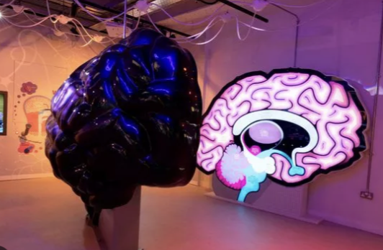
Residentials and trips.
Liverpool trip:
Class 22 – 3rd October 2023
Class 23 – 5th October 2023
Class 24 – 10th October 2023
Class 25 – 12th October 2023
Robin Wood:
All classes – Friday 27th October – Sunday 29th October
London trip:
One day per class.
Dates TBC.

Slide 13
Liverpool
Eureka Science and Discovery
Homes and body section
From Chew to the Poo
Science show
Ferry
World Museum
Children will need to bring a packed lunch.
Warm/waterproof coats
Be in their Chapelford uniform

Slide 14
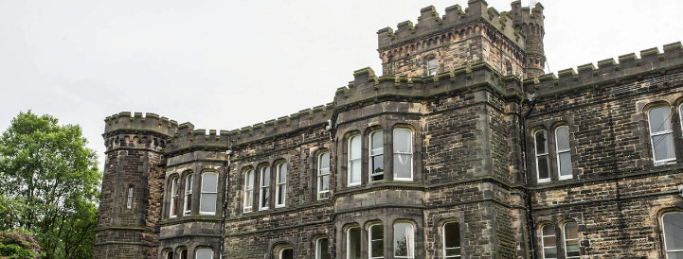
Robinwood Dobroyd Castle, Todmorden, Lancashire
Course leader oversees
15 different activities
Focus of developing specific skills
Ran by groups leaders
Team challenge

Slide 15
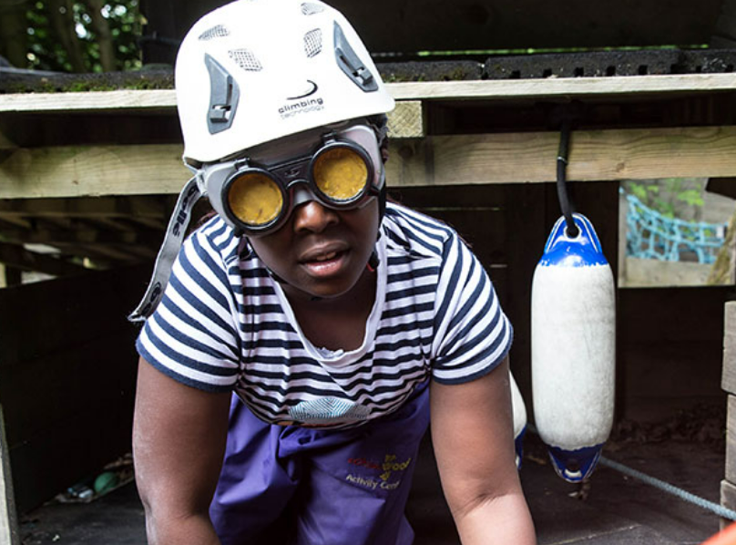
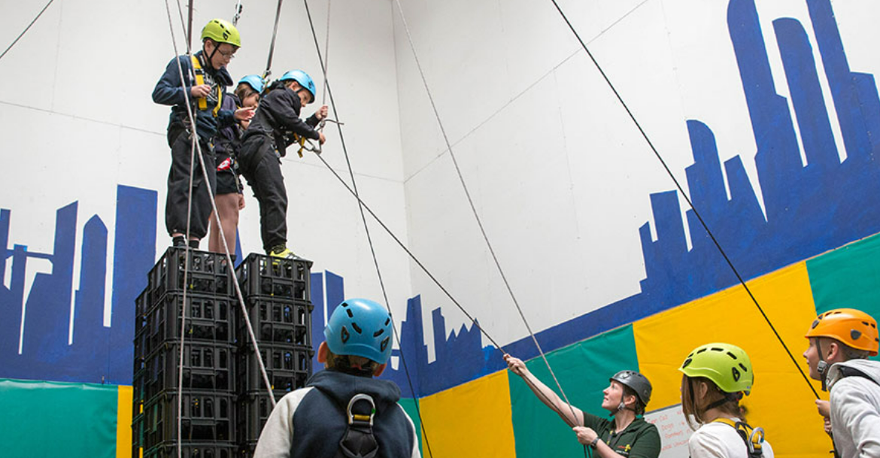
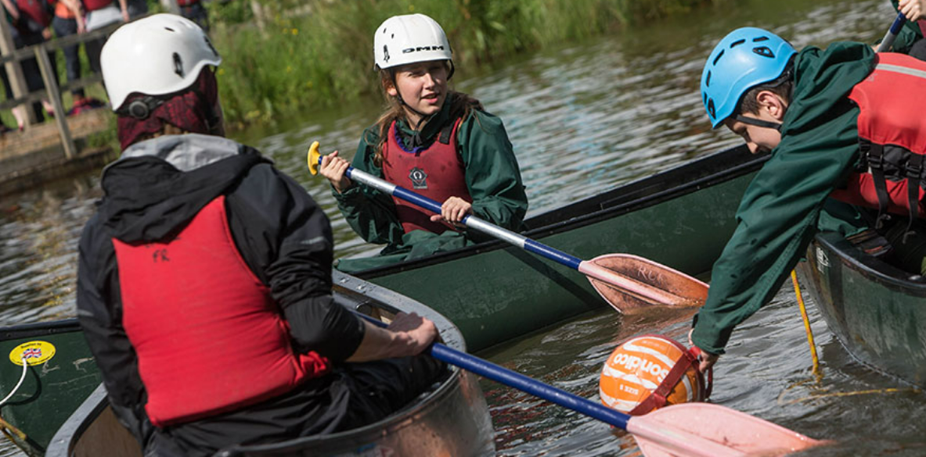
Robinwood Dobroyd Castle, Todmorden, Lancashire

Slide 17
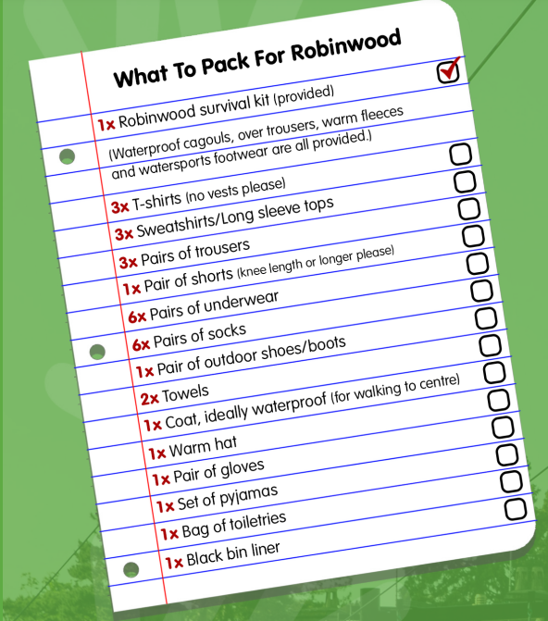
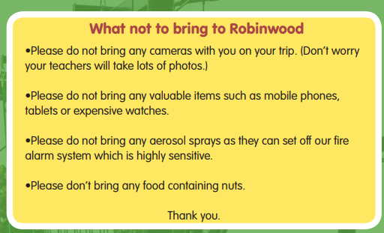
Robinwood What do you need

Slide 18
Robinwood Hoodies
​Hoodies will have all year 6 children’s names on unless you have specified otherwise. If you have already sent your slip back with a name your child prefers, for example; Rebecca, Becky, then that will be the name printed. If you haven’t sent your slip back, it will be their register name printed on the back.
A sample will hopefully be ready soon to share with you.
They will be blue.

Slide 19
Robinwood Medical forms
​Medical forms are to be signed and returned to school 2 weeks (Friday 13th October) prior to the residential along with any medication needed.​
​
We understand that this may be difficult to hand in medication two weeks before, especially if you only have one type of cream. But we please ask that we can take a picture of the medication so that we can cross reference it with the medical form. ​
​
For anymore information on this, feel free to contact your child’s class teacher.

Slide 20
Transition to High school
Deadline:
31st October 2023

Slide 21
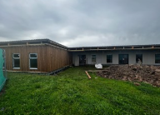
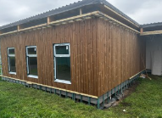
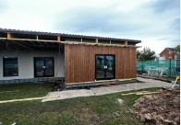
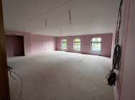
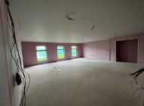
And finally ….

Slide 22
Any questions?
If you have any questions, please email any staff:
Mrs Tickle – Class 24 and Year 6 Lead
r.tickle@cvps.omegamat.co.uk
Mrs King – Class 22
h.Rawcliffe@cvps.omegamat.co.uk
Miss Green – Class 23
s.green@cvps.omegamat.co.uk
Mrs McGoran – Class 25
c.mcgoran@cvps.omegamat.co.uk

