Slide 1


Multiplication Evening 2025

Slide 2

Multiplication – a kind of magic
We try and make times tables as fun and engaging as possible.
They are key to being a confident mathematician in a range of other areas
They are essential for building reasoning and problem solving skills

Slide 3
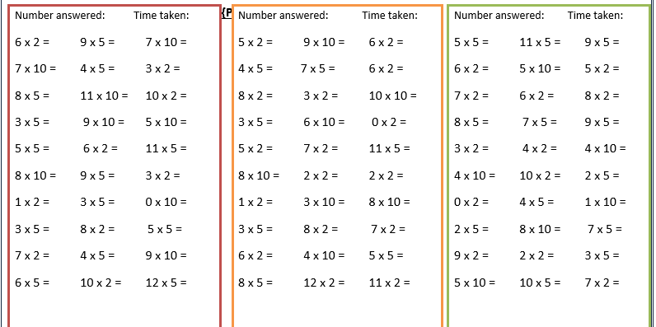
Times tables at Chapelford

Slide 4

Times tables at Chapelford

Slide 5
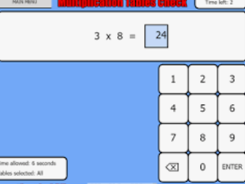
Times tables at Chapelford

Slide 6
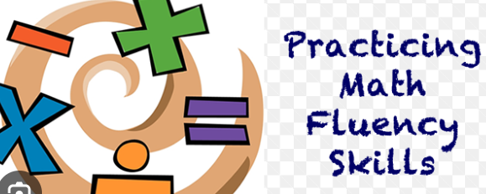
Times tables at Chapelford

Slide 7
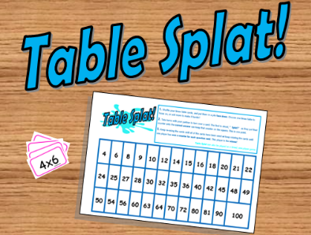
Times tables at Chapelford

Slide 8
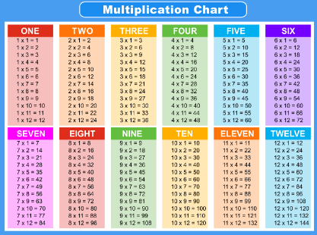
Times tables at Chapelford

Slide 9


National Curriculum
Year 2
Year 3
Year 4

Slide 10
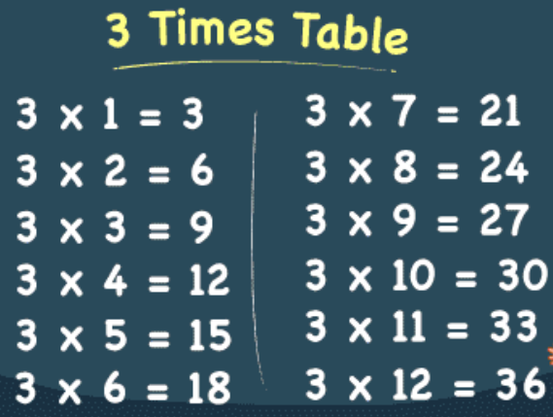
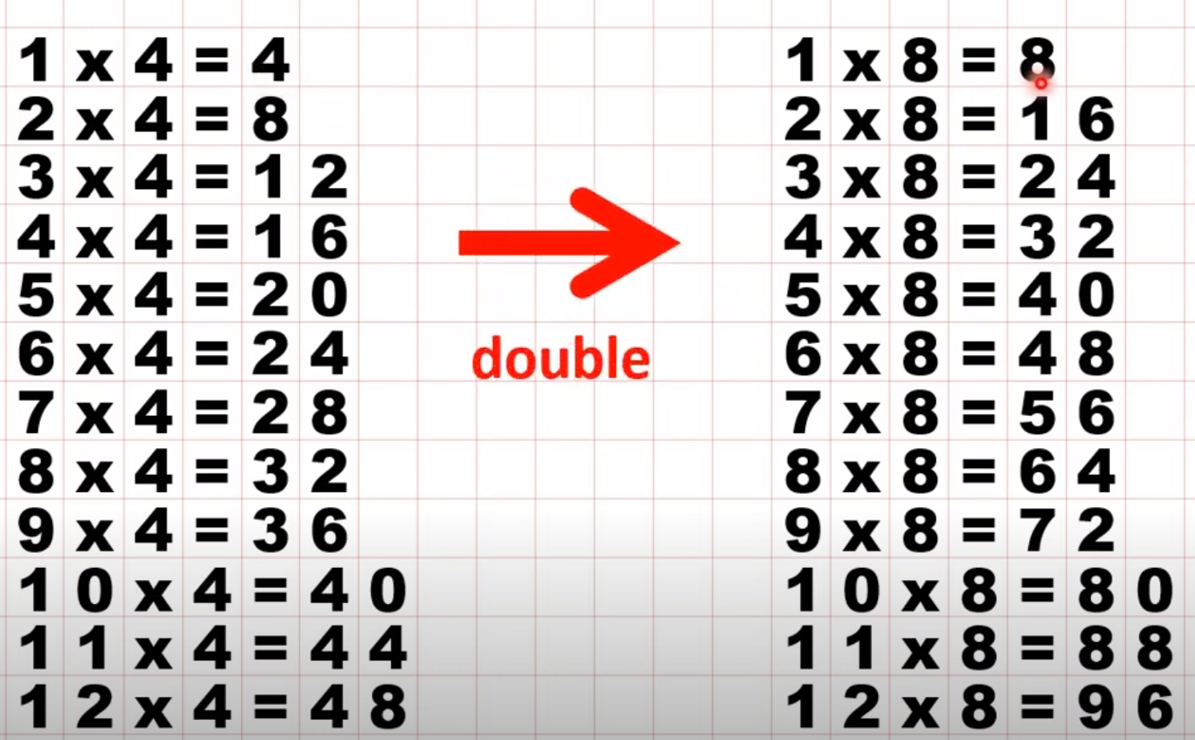
Top Tips! - Year 3
3 x Table
2, 4, 8 x Table

Slide 11
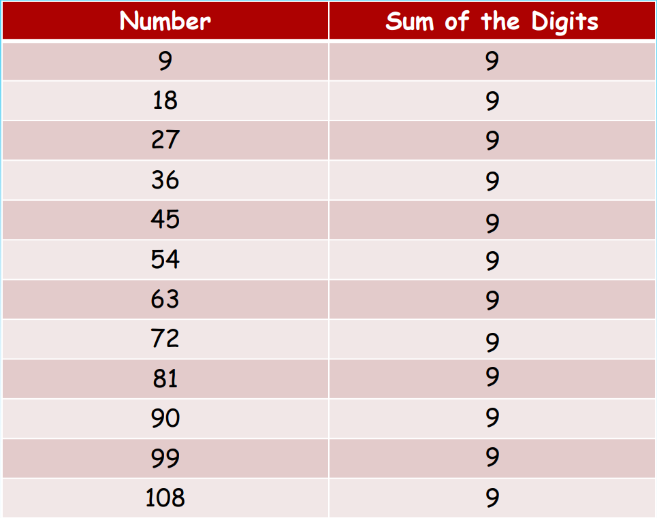
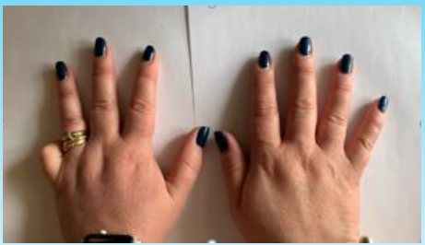
Top Tips! - Year 4
9 x Table

Slide 12
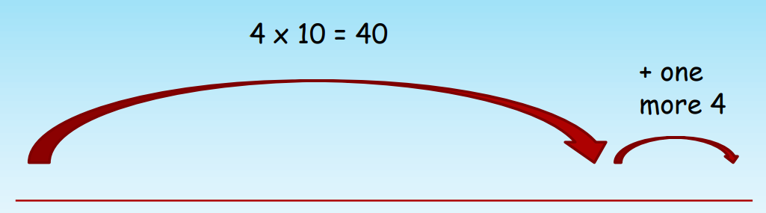
Compensating
Top Tips! - Year 4
If I know what 4 x 10 is, what is 4 x 11?

Slide 13
Top Tips – Year 4! Making Connections

Slide 14
Top Tips – Year 4! Making Connections

Slide 15
Top Tips – Year 4! Making Connections

Slide 16
Top Tips – Year 4! Making Connections

Slide 17
Top Tips – Year 4! Making Connections

Slide 18
Top Tips – Year 4! Making Connections

Slide 19
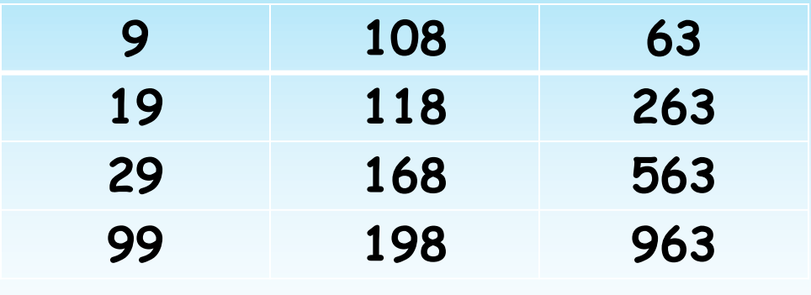
Application
Which of these would be in the 9 times tables?

Slide 20
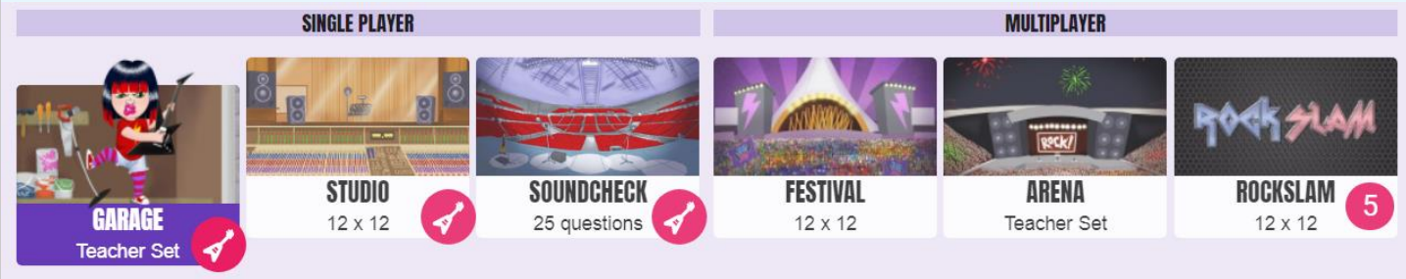
TT Rockstars!
Tests multiplication and division facts together
Children can be grouped and tracked
Some activities use times tables set by the teacher
Children can battle against each other or class v class
Teacher can see who has logged on and for how long
Children win gold coins and can personalise their character
Each week, teachers will look at who has won the most coins, who has got the most correct answers and who has made the most progress, these are then celebrated in the class.
Soundcheck is in the same format as the Year 4 multiplication test

Slide 21
Multiplication Check DfE Guidance
The multiplication tables check (MTC) is statutory for all year 4 pupils registered at state-funded maintained schools, special schools or academies, including free schools, in England.
The purpose of the MTC is to determine whether pupils can recall their times tables fluently, which is essential for future success in mathematics.
It will help schools to identify pupils who have not yet mastered their times tables, so that additional support can be provided.
In 2026, schools must administer the MTC to all eligible year 4 pupils within a 2 week-window from Monday 1st June 2026.
Multiplication tables check: information for parents

Slide 22
Multiplication Check
It is an on-screen check consisting of 25 times table questions.
Your child will be able to answer 3 practice questions before taking the actual check.
They will then have 6 seconds to answer each question.
On average, the check should take no longer than 5 minutes to complete.

Slide 23
Multiplication Check
MTC can be accessed on a PC, Mac, laptop or a tablet.
Children don’t need to press enter on their keypad - This keeps the children calm and relaxed - Avoids typing errors going through on screen keypad is inverse of keypad on laptop keyboard
Teachers can choose how to administer the test E.g. taking 1 child at a time or with a group all using the computers at the same time.
Special arrangements can be made.

Slide 24
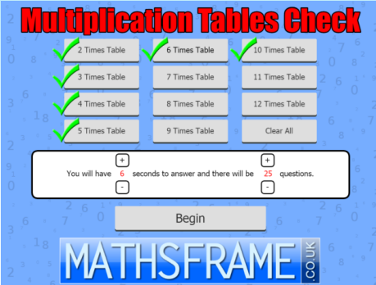
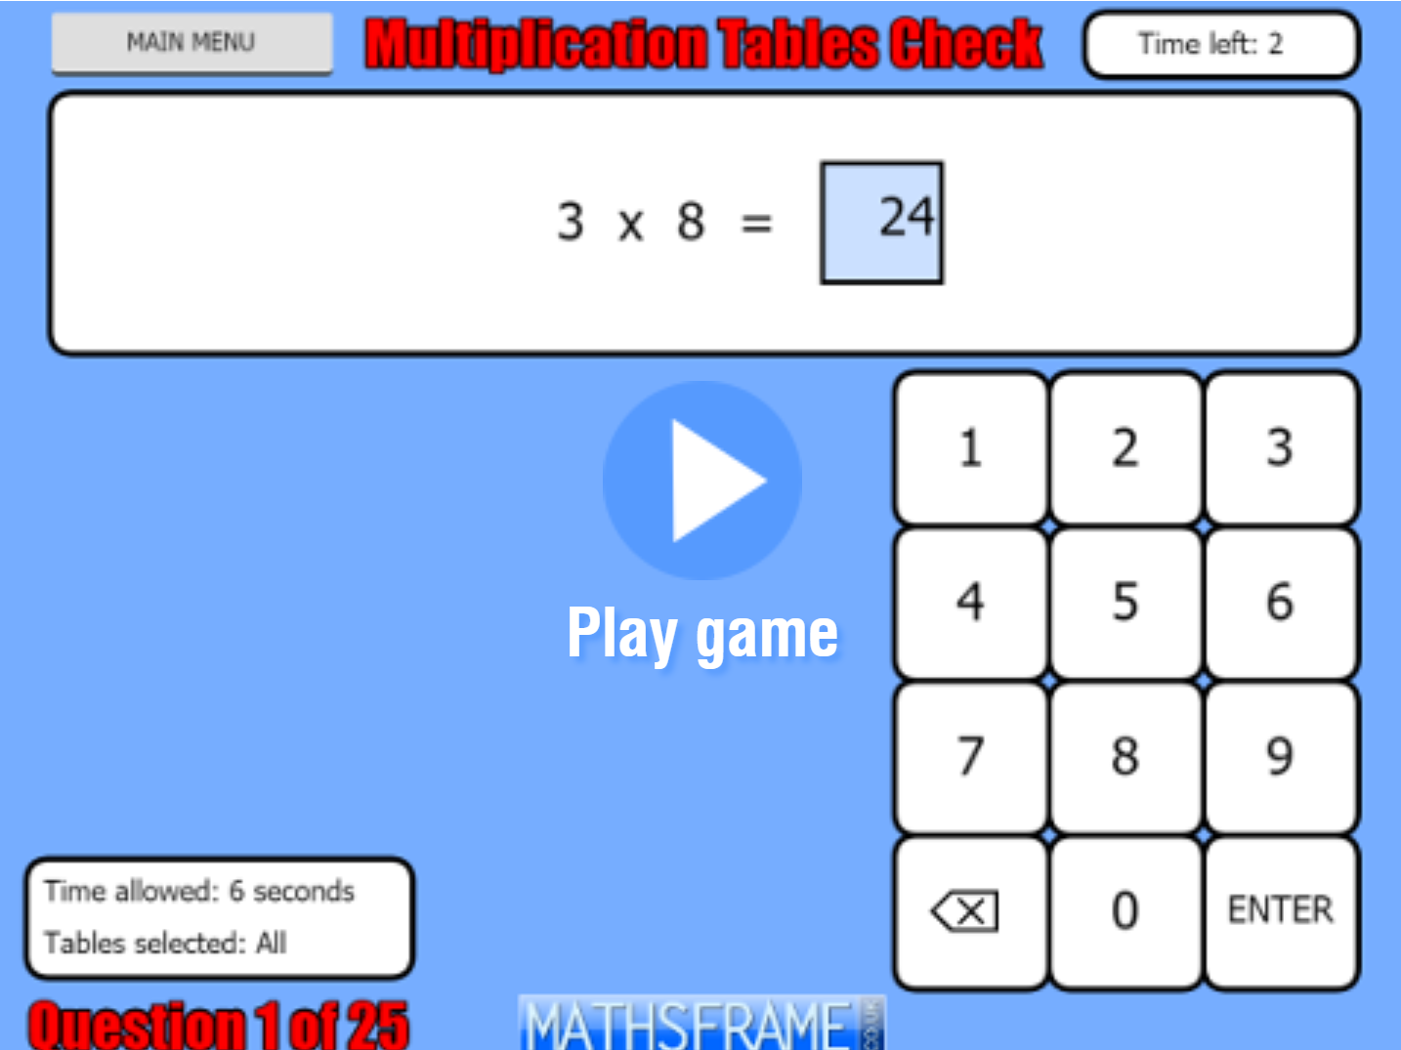
Maths Frame Tables Check
https://mathsframe.co.uk/en/resources/resource/477/Multiplication-Tables-Check
Have a go!

Slide 25
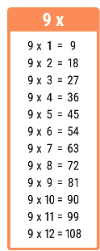

Times Tables Games
Your Turn!

Slide 26


Times Tables Games

