Slide 1


Year 3 Tattenhall Residential:
Parent Information

Slide 2

Before the trip, you will be invited in to discuss:
The trip itinerary, including travel arrangements for pick up and drop off
The suggested activity timetable with learning links and sample menu
Hygiene, Health & Safety and Medical
Q&A Session

Slide 3

Day of Departure
Children arrive at school at the normal time and go to classrooms for register.
The coach will be leaving mid-morning, but we cannot give a definite time at this point.
Day 1 trip to Cheshire Ice Cream Farm on the way to the centre.
The coach journey will last approximately 45 minutes and we will arrive in time for lunch.

Slide 4
What is the centre like?
Secure building with coded access and secure boundary fencing
One floor, each with a dorm of bunkbeds
Toilets allocated for each dorm
A chill out area
Separate dining area
A dance/hall space and art room onsite
An adventure playground onsite
Bedrooms for teachers near each dorm
Boot room

Slide 5

Sample Itinerary (based on last year’s trip)
Day of arrival:
Early morning: Depart from school and travel to Cheshire Ice Cream
Late morning: Activities
12 :00 – 13:30: lunch and outdoor play area
13:30 – 14:00 Leave and arrive at Tattenhall
14:00 – 15:00: Safety briefing, centre orientation, snack
15:00 – 17:00: Free time outside and in dorms
17:00 – 18:00: Tea time
18:00 – 20:00: Evening activities led by school staff
20:00 – 21:30 pyjamas, hot chocolate, story time/dvd and wind down time
21:30: bed, lights out… and hopefully sleep!
Second day
08:00 – 09:00: wake up, get dressed and relax
09:00 – 09:30: breakfast time
09:30 – 10:30: tidy and pack up
10:30 – 12:30: Centre led activities
12:30 – 13:00: lunch time and play time
13:30: depart the centre
14:30: arrival back in school
15:15: home time

Slide 6


Ice Cream Farm Activities
An extra set of clothes may be recommended!

Slide 7
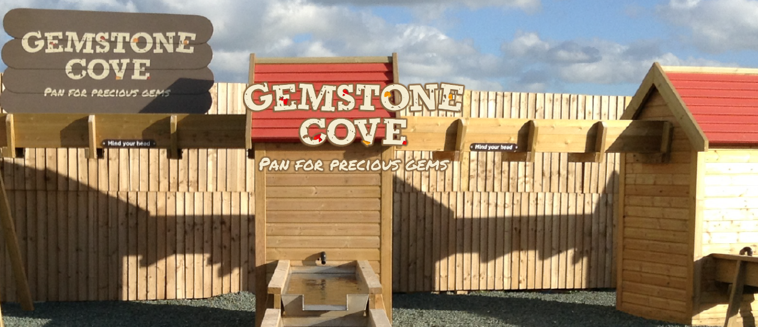

Ice Cream Farm Activities

Slide 8
Lunch and dinner times
Please ensure ALL dietary requirements have been discussed in advance with your child’s class teacher so that we can discuss menu options with you
Please ensure ALL allergies have been discussed in advance with your child’s class teacher
Your child requires a packed lunch, in disposable packaging, for the first day only
They will be served dinner, breakfast and lunch when they are there.
Dinner is a choice of two things with a desert
Breakfast is a choice of cereal, toast and some hot items
Lunch is a choice of sandwiches
Water and juice will be available throughout the day for children to access
Please do not pack any food in your child’s case. Due to allergies and health and safety, it will be confiscated.

Slide 9
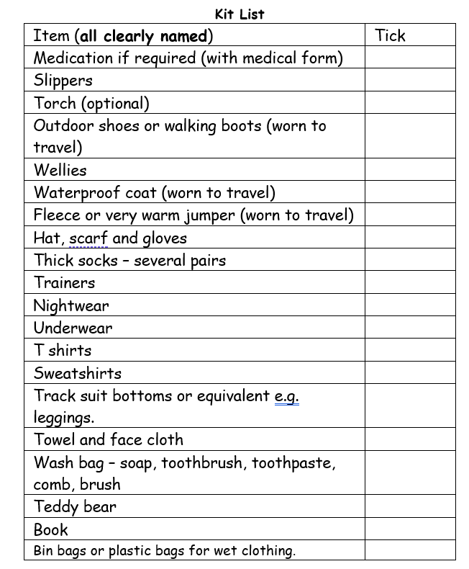
Suggested Kit List

Slide 10
And so to bed …(we hope!)
There are 2 separate dorms.
Girls will sleep in one dorm and boys in another.
Staff will be spread across the centre and children will be made aware of where they are and what they should if they need anything during the night.
Doors will be left ajar
Dimmed lights from hallways will be seen from every bedroom.
If your child sleepwalks or has a history of bed wetting, please let us know as early as possible so that we can discretely meet their needs. This is something our staff regularly deal with on residentials so is not something to put a child off from coming or something you should worry about.

Slide 11
Health and Medical
If your child requires medication, or has a medical condition, you need to make us aware of it.
All medicines should be prescribed in the original packaging, labelled with the dosage and the child’s name.
The medical form must be completed in detail. If your child has allergies, we need to know what symptoms to look for.
All medicines should be handed to staff prior to the trip, not packed in children’s bags. These will be stored in our medical boxes.
Please remember inhalers need to be labelled with child’s name and dosage.
Children with travel sickness should be given the correct dosage in preparation for a 9.30 departure.

Slide 12

How can you help us?
Ensure ALL belongings are named. We find it really hard to reunite odd socks with their owners!
Pack a bin bag for your child to put their wet/muddy clothes in
Ensure your child’s packed lunch, including drinks, are in disposable packaging
Pack sensible clothing – layers are always a good idea and jeans are not the most practical
They will get wet and muddy… please don’t send new/expensive clothing
No electronic items, including smart watches and air tags, are permitted
Go through your child’s suitcase with them so they know what has been packed for them
Ensure all medication has been handed to your child’s class teacher in advance of the trip and there is none in their suitcase
Pack in a bag/suitcase your child is going to be able to carry
Please do not pack any food in your child’s case

Slide 13
“My child feels anxious…”
“They’ve never stayed away from home before…”
“They will get upset…”
“Can you call me and update me?”
Firstly, we want to acknowledge what a huge step it is for both you and your child to agree to coming on the trip. We will do everything we can to make it an enjoyable and fun experience.
We hear these comments all the time and we want to reassure that it is perfectly normal for both you and your child to have these feelings of anxiety.
We are here to support, come and talk to us.
We would always comfort a child who needed it – but, trust us, they are normally so busy having fun and then they are exhausted!
We wouldn’t call unless it was an emergency or unless we absolutely need to talk to you.
Have conversations with your child about the trip and what to expect between now and then and ask us any questions you/they have.

