Slide 1
Anglo Saxon clothing
What kinds of clothes do you think the
Anglo-Saxons wore?

Slide 2
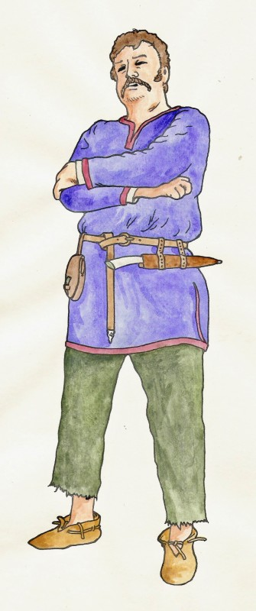
Anglo Saxon Men
Men wore:
wool or linen hip-length undershirts with long sleeves.
Woollen trousers that were held up with a belt threaded through loops.
A tunic was pulled over the head, and reached down to the knees. It was usually decorated at the wrists, neck and hem, and was long-sleeved.
A belt which was worn at the waist, often with a decorated buckle and strap-end.
Pouches, knives and other accessories might be hung from the belt.
Shoes were made usually from a single piece of leather. They were fastened with laces, toggles or loops.
What are the similarities and differences with what we wear today?

Slide 3
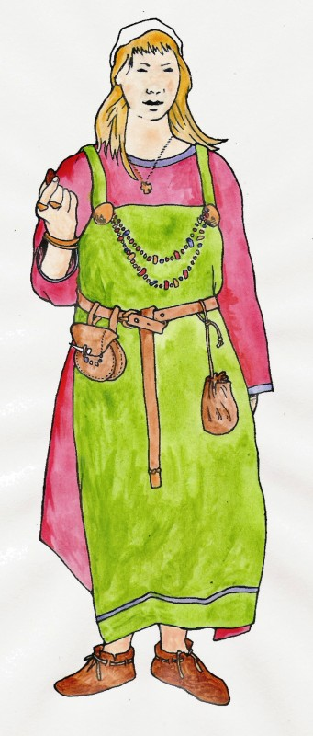
Anglo Saxon Women
Women wore:
An under-dress of linen or wool with long sleeves and a draw-string neck.
The outer dress was a tube of material, rather like a pinafore. A pair of shoulder-brooches or clasps held this onto the under-dress.
A belt was worn, from which various accessories were hung. There is some linguistic evidence that shawls were worn, as well as cloaks, which were fastened either centrally or to the right shoulder with a brooch.
Shoes were as for men, and woollen socks were probably worn.
Rings, bracelets and beaded necklaces were popular.
What are the similarities and differences with what we wear today?

Slide 4
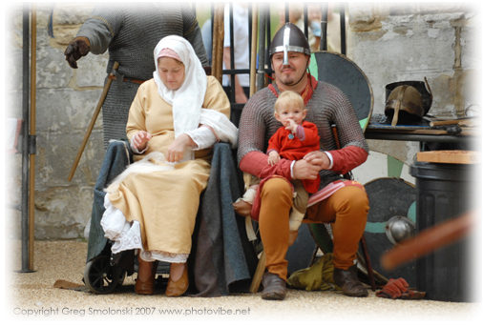
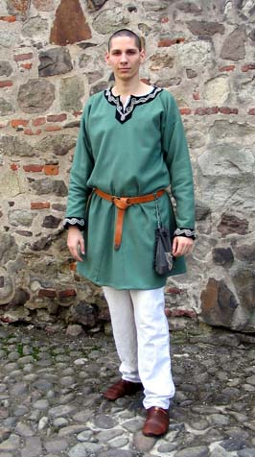
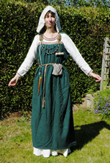
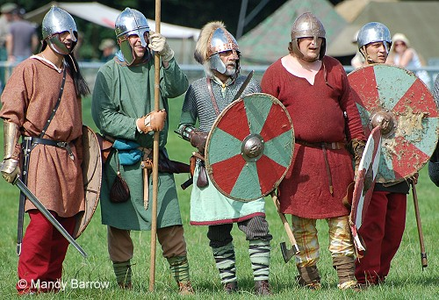
Dress up??
These images show clothes worn by Saxons.

Slide 5
