Slide 1
EYFS Summer Learning
Week2: Diaries

Slide 2
Learning Objectives
I can begin to write words and simple sentences.
I can read words and simple sentences
I can write labels and captions

Slide 3
My Daily Routine
https://www.youtube.com/watch?v=eUXkj6j6Ezw
Can you watch this song about daily routines….
What do you in the day time?
What different things do you like to do on the weekend?
What do you do in the night-time?

Slide 4
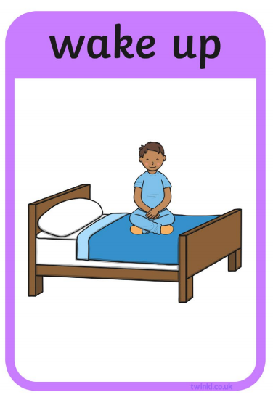
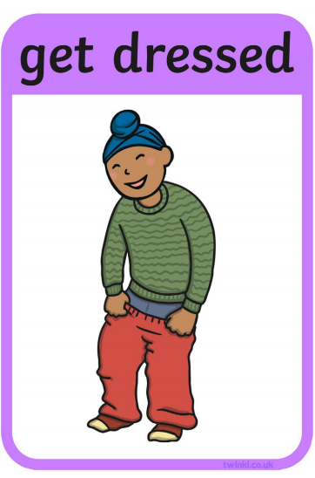
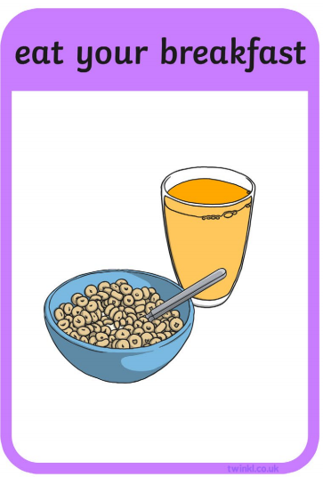
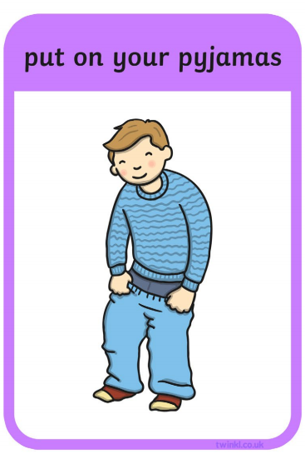
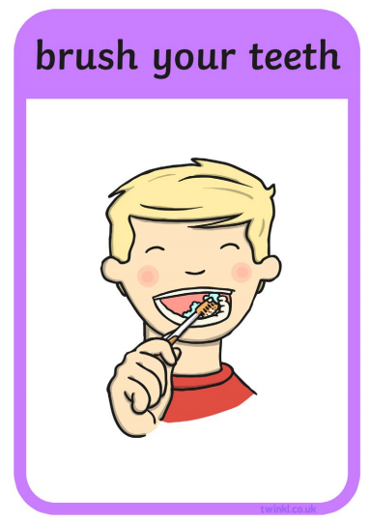
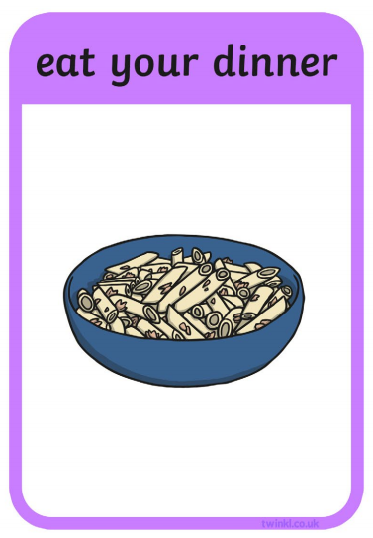
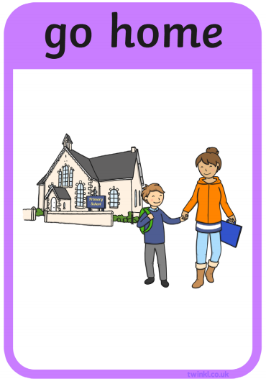
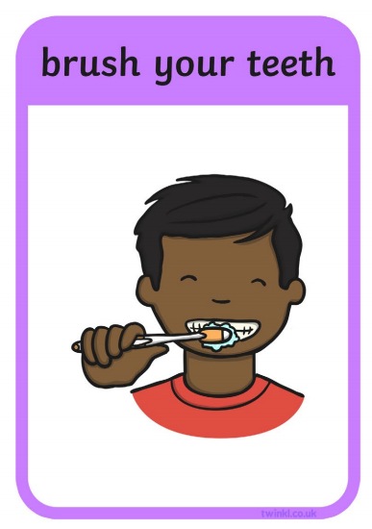
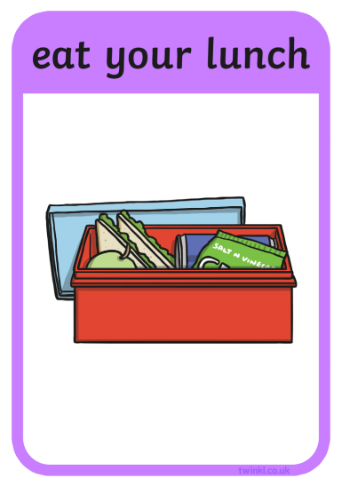
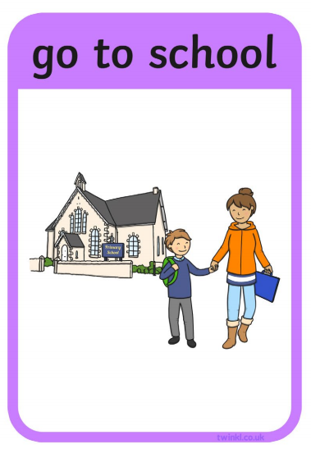
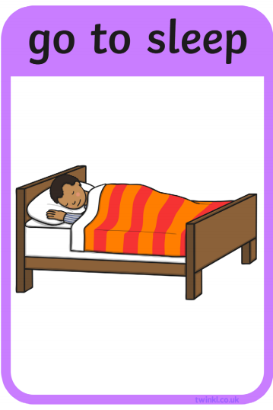
What is your routine?
Can you put these pictures in the correct order? Starting from when we wake up…
What happens next…

Slide 5
Daily Routines-Speaking and Listening
Get your adult to give you three instructions, in any order, using the adverbs, first, next, last.
e.g. Last, put the cowboy hat on.
Next, put the ballet shoes on
First, put your scarf on.
You must sort through the instructions and put the items on in the correct order.
Lets play a game!
You will need:
A variety of clothing items, the sillier the better

Slide 6
Table Talk
Can you talk about your day with your grown up
What time did you wake up?
What did you get up too?
What did you see?
Can you think of three things that you have done today and name them in order using…
first, next and last!
What did your grown ups do today?
Make sure you're using the past tense!

Slide 7
Can you join up the weather words with its picture?
sun
Rainbow
Sun
Cloud
Wind
Thunder
rain
rain
Stormy
windy
Cloudy
Rainbow

Slide 8
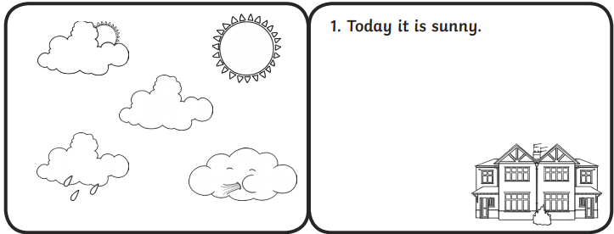
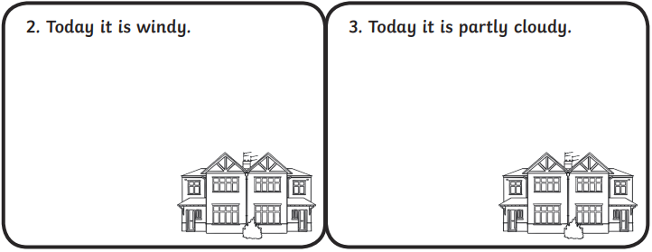
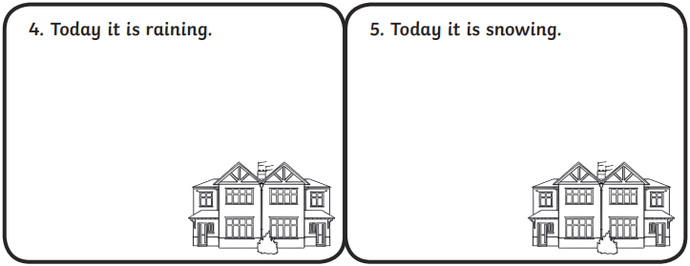
Draw the Weather
In each box, can you draw the weather?
With your adult, discuss what the weather has been like today.
What describing words do you know to describe the weather?

Slide 9
Today I….
Have a go at reading these sentences aloud.
went to the shops
ate my lunch
read a book
What have you done today? Can you write a sentence about it?
rode my bike
played in the park

Slide 10
My Day
Think about your day. It could be today or a special day that you can remember. Can you re-tell your adult using the words below?
First,
Next,
Last,

