Slide 1
Y1 Summer Learning
Diary

Slide 2
Learning Objectives
To use and a conjunction to join two clauses
To use a capital letter
To use a full stop

Slide 3
Ordering Events-Dress Up Fun
This is a game that you can play with your child to help them to improve their speaking and listening skills.
You will need:
A variety of clothing items, the sillier the better
Give your child three instructions, in any order, using the adverbs, first, next, last.
e.g. Last, put the cowboy hat on.
Next, put the ballet shoes on
First, put your scarf on.
Your child must sift through the instructions that you have given and put the items on in the correct order. If your child finds that easy, give them 4 or 5 instructions out of order. Alternatively, add adjectives such as ‘red scarf’ or ‘big hat’ and have more clothing options to choose from.
As your child enjoys dressing up in silly clothes, they will learn to order events and practise following a sequence of instructions.

Slide 4
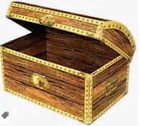
Trash or Treasure
On Post-it notes, write a series of simple statements. Some of these should belong in a diary entry e.g. Today I went to Gran’s house. Others should not, e.g. Elephants can swim. Ask your child to sort the statements into two piles, trash or treasure.

Slide 6
What Diary Entry Should Look Like
You should write as if it has already happened, using words like did, went, had.
It should be written from your point of view. Use words like I, we and our.
Write about the most important events in the order that they happened.
Use time linking words like first, next and then.

Slide 7
Dear Diary,
Today I went to the teddy museum and I travelled on a train. First, I saw the oldest teddy in the world and it was tiny. Next, I saw how teddies are made and I was really excited. Finally, I went to the gift shop and I bought a stuffed blue bear.
Take a look at what a good one looks like. Magpie some ideas for your own.

Slide 8
Write a diary entry
Now it’s your turn to write a diary entry. You can write about a day out that you’ve been on or imagine that you went on an amazing adventure and write about that. You should include:
Where you went
How you got there
How you felt about it
One fun thing that you did.
Challenge yourself to write one sentence for each point.

Slide 9
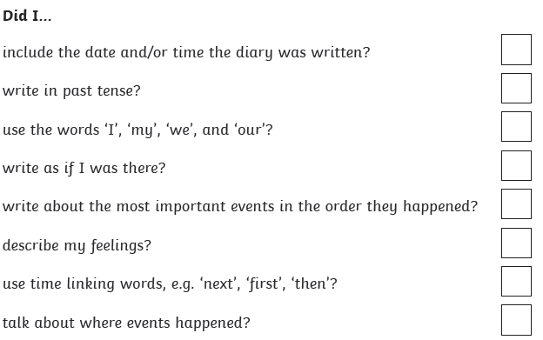
Diary Writing Checklist
Once you’ve written your diary entry, use this checklist to check over your work and edit if you need to improve it.

Slide 10
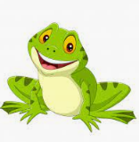
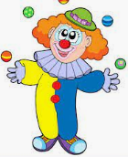
Silly Sentences
Imagine that you are one of the following creatures. Write one sentence about what you have done today, as that creature.
__________________________________________________
__________________________________________________
__________________________________________________
__________________________________________________
__________________________________________________
__________________________________________________

