Slide 1
Poetry
Year 3

Slide 2
Learning objectives
I can recite poetry and show I understand what I have read through intonation, tone, volume and action
I can use a varied and rich vocabulary
I can write a concrete poem
I can read aloud my own writing using appropriate intonation and controlling the tone and volume so that the meaning is clear

Slide 3
What is a Concrete Poem?
Concrete poetry, sometimes also called ‘shape poetry’, is poetry whose visual appearance matches the topic of the poem. The words form shapes which illustrate the poem’s subject as a picture, as well as through their literal meaning.
IT DOESN’T HAVE TO RHYME!

Slide 4
Read these poems. Choose your favourite poem and then have a go at learning it.

Slide 5
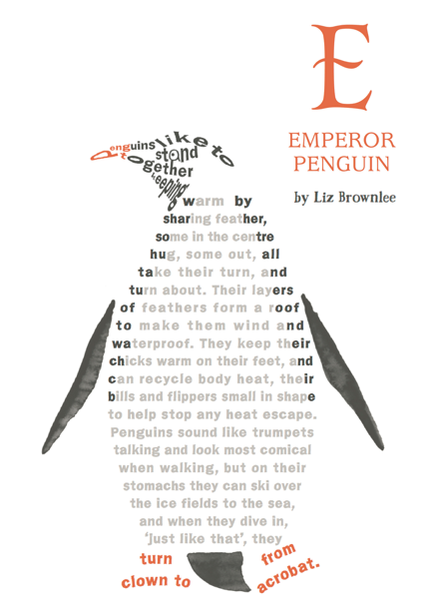
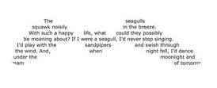
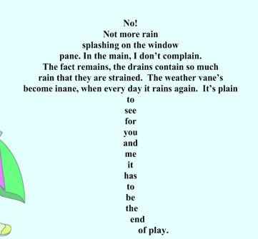

Slide 6
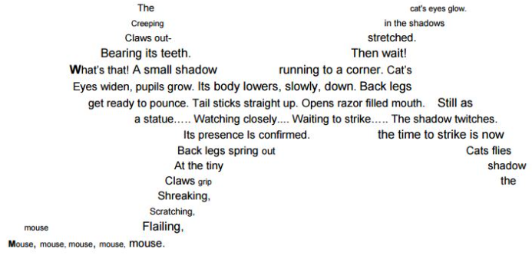

Slide 7
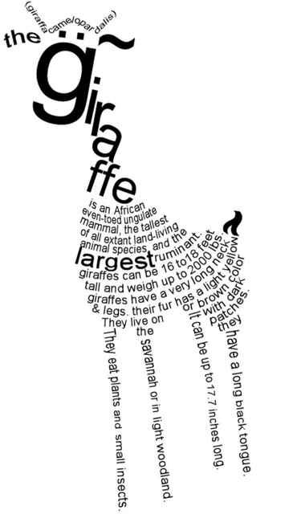
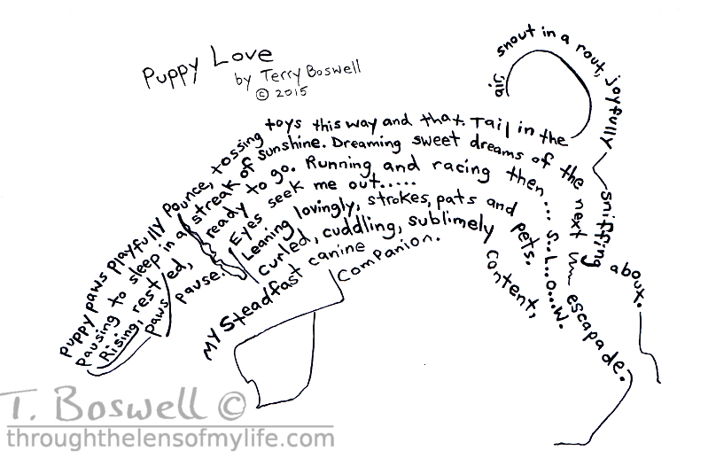

Slide 8
We are going to look in more detail at the following poem Lowland Gorilla.

Slide 9
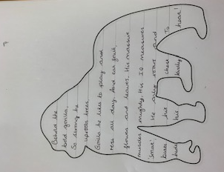
Lowland Gorilla
Behold the bold gorilla,
So strong he uproots trees,
Gorilla he likes to play and rest all day.
And eat fruit, flowers and leaves.
His massive muscles mighty,
His IQ measures ‘smart’,
He only roars and beats his chest,
To hide his kindly heart!

Slide 10
Re-read the poem and then answer these questions. What adjective is used in line 1 to describe the gorilla? Name 3 things that the gorilla does? (behaviour) What does the gorilla eat? Is the gorilla friendly or fierce? How do you know? Can you find any alliteration in the poem? (Clue – words beginning with the same letter)

Slide 11
Each line from the poem has a different purpose

Slide 12
You are going to write your own poem but choose your own animal. Your poem will have 8 lines just like Lowland Gorilla. It doesn’t have to rhyme.

Slide 13
Find out as much as you can about any animal you are interested in.
What does the animal eat?
What does it look like?
What is the animal?
How does the animal behave?
How does the animal move?
Where does the animal live?

Slide 14
Use the same structure to plan your poem
Purpose of the line | Your animal
Introduce your animal with an adjective.
How strong is he? Behaviour.
What does he get up to? Behaviour.
What does he eat? Diet.
What does he look like? Appearance.
Is he intelligent? Personality.
What noise does he make? Behaviour.

Slide 15
Now it’s your turn to write your poem.
Before your write, can you extend your nouns into extended noun phrases? Here is a video to remind you what an expanded noun phrase is.
https://www.bbc.co.uk/bitesize/articles/zhfgcqt?scrlybrkr=ce6e20fb

Slide 16
Publishing Draw the outline shape of the animal that you have written your poem about. Write your poem inside the outline of the animal.

Slide 17
Performance Perform the poem that you have written to a member of your family. Remember to add expression and vary the volume of your voice to add meaning to your poem. If the animal makes a loud noise, then say that line with a loud voice.

