Slide 1
Parent/ Carer Introduction to Phonics and Early Reading

Slide 2
Welcome!
What is phonics?
The alphabetic code
Blending
Reading and books
Reading at home
Spelling
Concerns about progress
Questions and next steps
Notes:
Welcome to our phonics and early reading session.
We are very excited everyone is here to learn about the most amazing journey that their children are starting – learning to read!!!
This will be our structure of the evening. We will aim to give you information about how early reading is taught at our school and how parents can play a vital role in supporting their child’s reading journey.

Slide 3
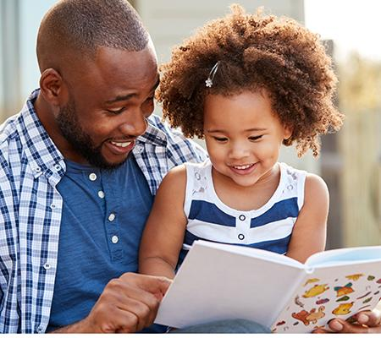
Why is reading important?
Children who are read to daily are significantly more likely to perform well in school – National Literacy Trust (2029)
Over 60% of children who struggle with reading in early years continue to struggle into adulthood – DfE (2015)
Parental engagement in phonics and reading can accelerate children’s reading progress by up to 4 months over a school year – Education Endowment Foundation (2018)
Display of phonics and reading materials in the home leads to better literacy outcomes - Education Endowment Foundation (2021)
Notes:
Why is reading important? Some statistics recently shared from the English Hub. A part of the DfE who work with schools to support and improve Phonics and Early Reading. Explain about my role with English Hub as a Literacy Specialist supporting schools.

Slide 4
We love reading!
Reading for pleasure
Finding out information
Reading the world around them
Understanding forms and official documents
Accessing learning
Notes:
Reading is one of the most important things we can teach our children. We want all our children to be avid readers with a love for all different types of literature.
Think of reading activities you do everyday…. Share some ideas of reading in our everyday environment.
As children start their school life they will very much focus on learning to read. As they move higher up the school and intro secondary education and beyond, they will be reading to learn. So, it is vitally important that we support our youngest pupils to quickly learn to read. We want every child to love reading and to do this we must make sure that it is a pleasurable experience and that they can read with accuracy and fluency so they can access as many opportunities as possible.

Slide 5
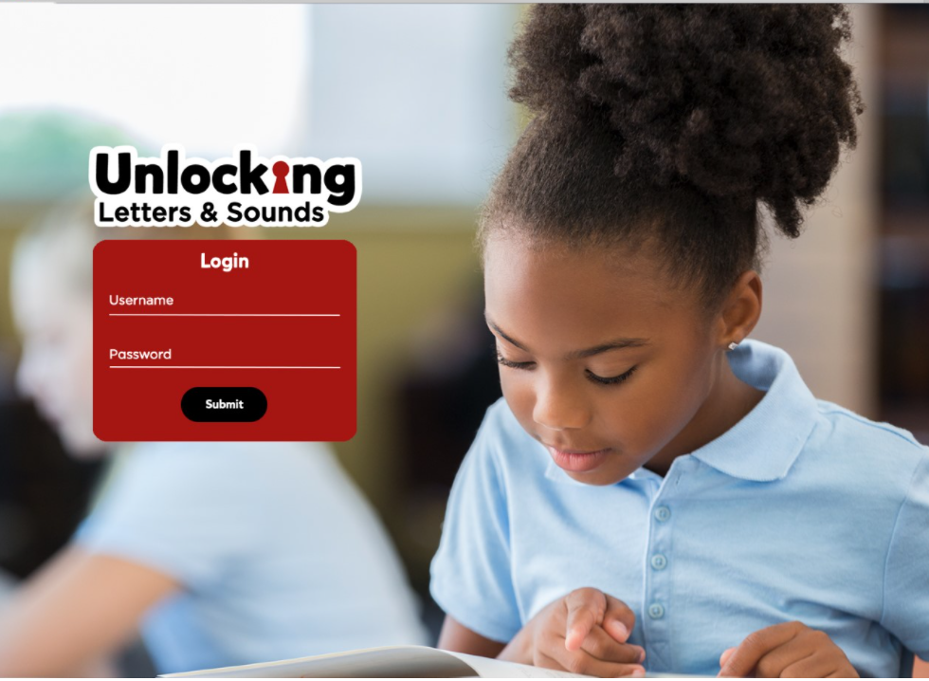

What is Phonics?
Link between the words we say and the letters that represent each sound.
Grapheme – the written letter or groups of letters
Phoneme – the sounds that the grapheme makes.
Notes:
Over the past 50 years schools have taught children to read using lots of different approaches. But, thanks to research we know that phonics is the best way to teach children to read. We know this might be different to how you were taught to read so we hope this session helps you to understand what phonics is, how we will teach phonics at our school and how you can help your child to learn to read.
The national curriculum says that phonics should be the main way that schools teach children to read. The Department of education approved phonics schemes that meet its criteria of a good scheme. Our school has chosen to use a scheme called Unlocking Letters and Sounds. All schemes are slightly differently but , as a school , we think this is the best one for our pupils. All children in the school will use Unlocking Letters and Sounds to teach their phonics and early reading. All staff have had training with this scheme so they are experts at using it.
Phonics teaches the link between the words we read/ say and the words we write on the page. It teaches how the letters in written words represent the sounds we say in spoken words – this is called decoding.
Say the word CAT.
When we say this word we say lots of sounds very quickly – so quickly we hardly notice the sound each letter makes.
Say the sounds in CAT c/a/t
What sounds can we hear? When we write the word cat we represent each sound with a symbol that we call a letter. C A T
This is phonics!
There is some technical vocabulary that we use for phonics and that your children will use.
Grapheme – the written letter or groups of letters
Phoneme – the sounds that the grapheme makes.
With your new vocabulary can you tell me the phonemes that make this word (map)
Can you tell me the graphemes that represent these phonemes?

Slide 6
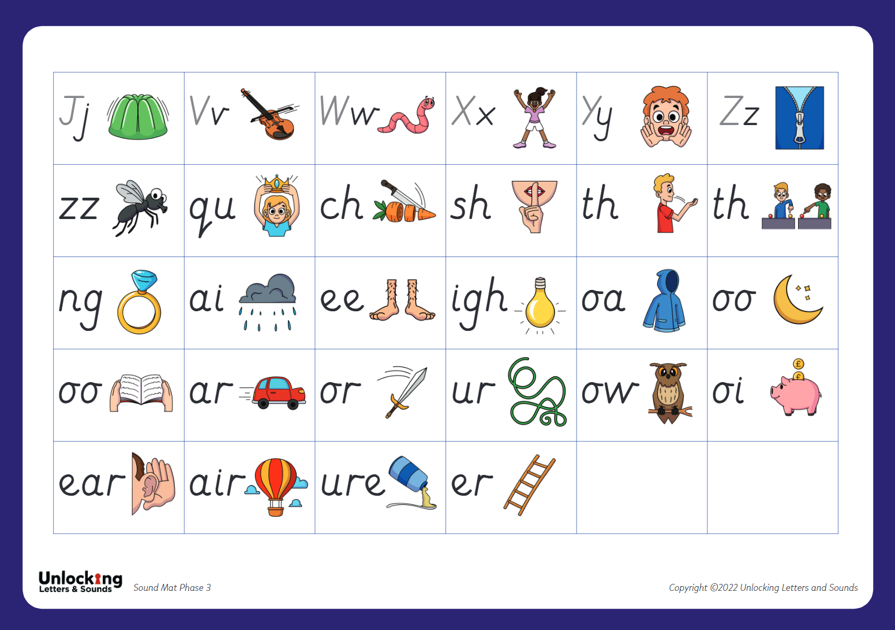
What is Phonics?
Notes:
As children start to learn their grapheme phoneme correspondences (GPCs) it is very important that we pronounce the sounds clearly and purely. Please make sure if you rehearse at home, you do not add an ‘uh’ to the end of the sound. We call this ‘uh’ a swuh. We also help them to learn and remember the GPCs in Reception with an image and action for each phoneme. Your children will be coming home sharing the actions with you so do join them when they are using them!
Model pronunciation and actions for some of the first GPCs children will be learning.

Slide 7
The Alphabetic Code
44 phonemes
Simple Code
Complex Code
Notes:
The English language is made up of about 44 different sounds in different combinations – it is one of the most complicated languages. It will take most children about three years to learn the alphabetic code and to use it to read and it is one of the most important things we teach in Reception and Key Stage 1. We know that children won’t learn to read by themselves so we will be teaching phonics every day to help them learn. Your children will have a daily phonics lesson from Reception until Year 2. They will be taught by their teacher in the whole class and each lesson will last about 20 minutes.
Your child will learn 4 new GPCs each week – we organise them into sets. These sets are then put into phases.
In reception children will be taught Phases 2 – 4. In Phase 2 and 3 the children will learn single letter sounds, digraphs and trigraphs. They will learn to segment and blend to read and spell words. In Phase 4 no new sounds are taught, but children will be taught consonant digraphs and how to chunk polysyllabic words. They will be taught phase 5 in years 1 and 2. Here they learn alternative pronunciations and spellings of previously taught sounds.
When we start this decoding journey, we will keep things very simple. We will teach basic phonemes and their matching graphemes (such as cat and map). This means that children rapidly learn and understand and to build confidence in their reading. This teaching will start straight away in Reception.
We’ve looked at examples where a phoneme is represented by a single letters.
Some sounds are represented by graphemes that have two or more letters.
Eg. Sh o p th i n r i ch
The sounds sh, th and ch are represented by two letters – these are called digraphs.
Some sounds are represented by three letters:
Eg. L igh t
The sound igh is represented by 3 letters - this is called a trigraph.
Your child will be coming home telling you all about phonemes, graphemes, digraphs and trigraphs! They will be fantastic at understanding this vocabulary as they are learning the alphabetic code and you can help by using these words at home.
As you children continue to learn to read, they alphabetic code will become more complex. They will learn about sounds that are represented by lots of different graphemes and how some graphemes can represent different sounds. The complexity of the English alphabetic code is why it takes so long to read. Many children will find different parts challenging – especially at first. But our staff ae skilled at teaching phonics and will be gradually working through the alphabetic code so that every child become an expert reader.

Slide 8
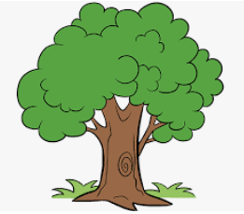
Blending
Pushing the phonemes together to make a word.
Fun – Funny - Funniest
Timorous
Notes:
As well as learning to recognise the graphemes and say the phonemes they represent, we will be teaching children how to use these to read.
When we read a word, we look at each graphemes and match a sound to it (this is segmenting). We push the sounds together to make a word. This is called BLENDING.
Blending is a really important skills that children need lots of practice at – it will take lots of time!
Let’s have a go at blending a word: t / r / ee
We teach the children to work from left to right - identifying each grapheme and saying the phoneme. Once they have done that they go back and push the phonemes together to blend the phonemes together to read the word.
We want to teach children to recognise the grapheme quickly so they can blend it rapidly. Once they can do this their reading will become fluent – and less painful! This really does take practise, so it is really important that children practise this at home with the books we give them.
As children progress in their reading journey, they will begin to read longer words made up of multiple syllables – give the example of fun – funny – funniest
We teach these words by ‘chunking’ them into syllables and blending these chunks together. But we are still identifying the GPCs and blending them together. E.g. hand/bag.
This is what we will do as adults when we come across an unfamiliar word. This is why it’s really important to teach children to read using phonics – without this skills to decode the graphemes we would not be able to read unfamiliar words.

Slide 9
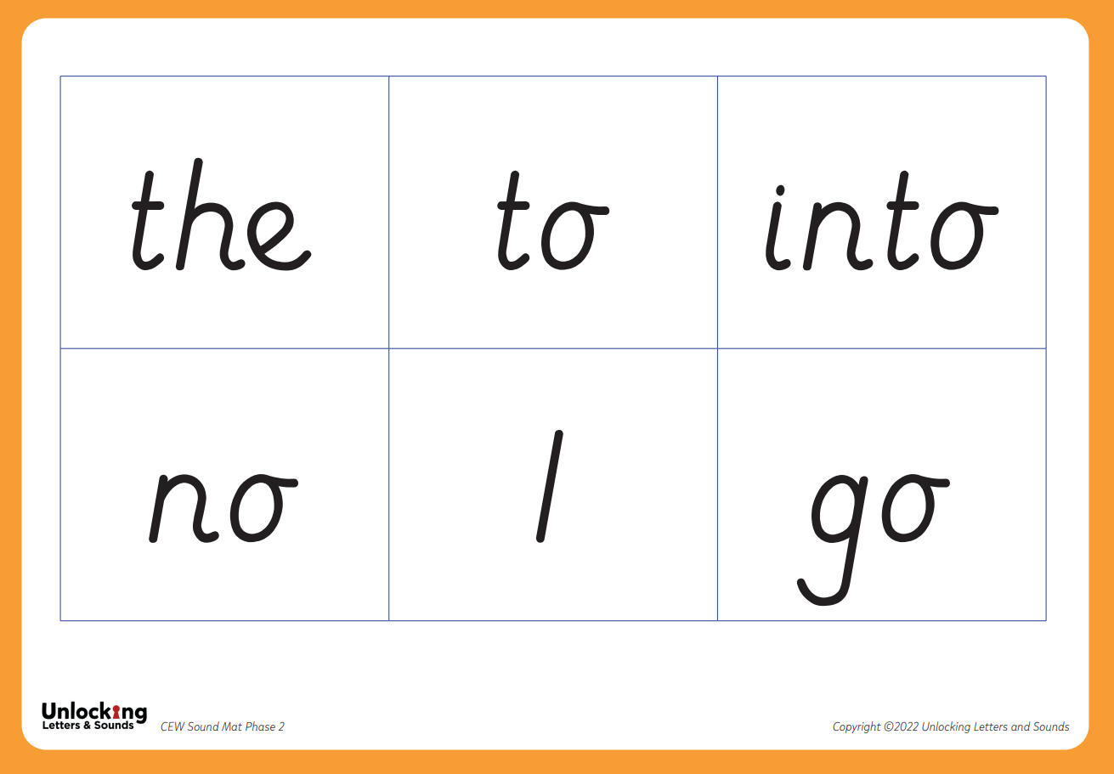
Common Exception Words
Notes:
There are some words that we use a lot in English such as the, like, said, were.
To give children’s reading a boost and so they can access more texts quickly we want children to learn these CEWs early on. Many of them have usual patterns or GPCs that aren’t taught until later on. So, we teach children to recognise them by sight initially. Children will be able to decode some of them later on but , until they have learnt to decode them, we recognise them as CEWs.

Slide 10

Reading and Books
Children will be given books when they can blend – this will be different for every child
Books precisely match children’s phonics attainment
Notes:
As soon as your child can blend some GPCs together to read words, we will be giving them a book. This is incredibly exciting but will be different for every child. Some learn this skills very quickly and others take a bit longer – we will be supporting every child to blend as quickly as possible. Please don’t compare your child with others and contact us if you are worried about anything.
Once your child can read, they will be given a book that precisely matches their phonics attainment so that they can read at least 95% of the words in it. The children are assessed termly to ensure this is done accurately. Please don’t think that this makes the book too easy for them – it’s vitally important that reading is a celebration of children’s reading with you and a chance for them to show their phonics expertise. The focus of the phonic books should always be to use phonics as the first approach and not about guessing or using inference.
In school we will also be reading with children. They will read everyday in their phonics lessons and also every week 1 to 1 or in a guided group. This is when they read with their teacher in a small group. The teacher will listen to every child read as well as teaching for part of the session. This allows us to check every child’s learning.
We will listen to children read on a 1:1 basis and through guided reading sessions later in the year. We share a mixture of phonic decodable books and books for pleasure.
Books are allocated to match the sets and phases that children are secure in. When teachers assess they are ready to move onto the next set we will do so, but we know that this takes a different amount of time for each child – some will need more practice than others.

Slide 11
Reading at home
5 – 10 minutes
Choose a time that works for you
Be positive and celebrate successes
Encourage them to point to the graphemes
Encourage them to say the sounds and blend them together
Be patient and let them try and work it out
Read common exception words by sight.
Notes:
Reading at home is essential as it gives children the opportunity to practice their decoding and blending skills.
We know everyone is busy and children often don’t want to read out of schools. Our top tips are:
5 – 10 minutes every day is often more effective than longer times
Find a time that works for you. Reading at bed time sounds lovely but with a tired child it can often be tricky!
Celebrate what your child can do
Encourage your child to point at the graphemes as they read – this helps them to track the words and know their place
Encourage them to say all the sounds in the words and then blend them together – you can show them how to do this
Be patient and give them time to work it out before stepping in before stepping in If they can’t read a word model how to do it and then ask them to do it
Let them read common exception words by sight
Big gaps between reads will not support fluency. Please read books on consecutive days

Slide 12
What should I write in my child’s Reading Record Book?
Decodable Book – This is closely matched to your child’s reading ability and is checked by using their most recent phonic assessment. Children will only ever be assessed/ given books for phonics that has been taught in school.
Reading for Pleasure Book – A book for you to share with your child. Your child will NOT be expected to read the words themselves. This is a book to develop a love of reading and to share that love of reading together.
Your comments in the Reading Record Book may differ depending on which book you are reading at home.
Notes:
When your child brings a book home from school, they will also have a Reading Record Book. The Reading Record is a place for you to record your reading with your child with a short comment. (This is for both reading for pleasure and decodable books)
One of the most important ways to increase children’s accuracy, fluency and understanding of the book they are reading is to re-read the same books several times. This is why we only give a max of 2 decodable books each week – we would like each book to be read at least three times with a different focus each time. Can keep longer, not a race, it is about building fluency and not rushing through the books. Reading must happen daily, big gaps between reads will result in a step backwards and fluency won’t be achieved. The books should be 95% decodable. It is not about having a challenge of guessing unknown words. They should only have common exception words we have looked at in class and use the skills we have already taught.
Book changes are on a Monday and a Thursday and we won’t change books unless we see 3 clear comments in the reading record book.
This films explains the value of re- reading the same book and what you should focus on each time. https://www.youtube.com/watch?v=Hhu3xeNq3Kg&t=200s

Slide 13
What should I write in my child’s Reading Record Book?
Decodable Books
Read 1 – Comment on the use of Phonics.
Read 2 – Comment on their use of phonics and building fluency. Has it improved since the previous read?
Read 3 – Comment on their fluency, expression and comprehension.
Notes:
This is the book that will be matched to the our Phonics scheme and your child’s reading ability. You will have each book for a minimum of three days and here is a suggestion of how you could comment in your child’s Reading Record Book. The comment doesn’t need to be long but your comments are useful to us. It is your chance to communicate with us and explain how your child is getting on with each book. If you are more specific with your comments then it helps us to ensure the books are well matched and also informs our teaching.
E.g. They read the book almost fluently only stopping to sound out the word time. This comment demonstrates that this child needs further practice with segmenting and blending split diagraphs.

Slide 14
Example comments:
They just stopped to sound out the word…
They read most words fluently.
They struggled to segment and blend…
They identified (Insert a grapheme) independently.
They self corrected when reading the word…
They read the whole book accurately and confidently.
They gave the characters voices.
They paused at full stops.
They read at a faster pace today.
They struggled to concentrate today.
They knew when to pause in the story to add effect.
They knew which words to add expression to because of the exclamation mark.
We had a good discussion about the events in the story.
They retold the story in the correct order.
They were able to predict what might happen next.
They could talk about the characters feelings and why they felt that way.
Notes:
Example comments:
They just stopped to sound out the word…
They read most words fluently.
They struggled to segment and blend…
They identified (Insert a grapheme) independently.
They self corrected when reading the word…
They read the whole book accurately and confidently.
They gave the characters voices.
They paused at full stops.
They read at a faster pace today.
They struggled to concentrate today.
They knew when to pause in the story to add effect.
They knew which words to add expression to because of the exclamation mark.
We had a good discussion about the events in the story.
They retold the story in the correct order.
They were able to predict what might happen next.
They could talk about the characters feelings and why they felt that way.

Slide 15
Reading for pleasure books:
Any of the previous comments and you could write something like the below.
We looked up other books the author had written.
We shared this book at bedtime.
They noticed this story was similar to…
They predicted what might happen next by looking at the front cover.
They wanted to retell the story by looking at the pictures.
We discussed the title, cover and blurb.
Their favourite part was…
Notes:
This is the book that the adult shares with the child and the child isn’t expected to read. This is a great opportunity to show your love of reading and to share in a magical adventure together. It’s a time to model expression, pausing for effect and it is a great time to focus more on the comprehension side of reading. (Using the comments from the previous slide are great here) Children will focus when reading decodable books (especially at the start of the year) on the decoding, so the reading for pleasure books are a great opportunity for lots of book and vocabulary talk. These books do not have to be changed daily, but we offer the children the opportunity to change these books every morning.

Slide 16
Reading at home
Continue to read to your child.
Model how to read a book – left to right, turning pages
Ask questions about what has happened and characters’ feelings
Support vocabulary
Predict what will happen next
Make connections
Model your love of reading!
Notes:
Whilst learning to decode and reading books that allow children to do this is important there is so much more to reading! We know that decodable books are not the most exciting to read and alone, won’t give our early readers all the skills they need to develop a love of reading.
It is therefore important that you continue to read to your child and share a wide range of books with them – these should be books that children cannot decode themselves. Reading books to children is a precious and lovely thing to do – we are sure you and your child already have favourite books that you share together! By modelling reading and show how much you love reading you will be setting a fantastic example to your child.
When you read to your child you will want to:
Model how to read a book inc voices
Ask questions about what has happened to support your child’s comprehension or understanding of the text
Ask questions about characters’ feelings
Discuss the meaning of words and vocabulary
Ask children to predict what they think will happen next
Make connections with things your child has experienced or other books or films they have seen
Most importantly – show that you love reading! By modelling this you will support your child to develop their love of reading.

Slide 17
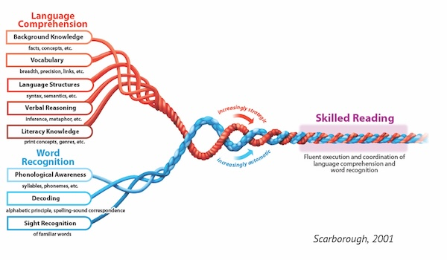
Notes:
This is Scarborough’s Reading Rope.
It is a diagram depicting the need for both word reading (Phonics) and language comprehension (reading for pleasure) in order for children to become skilled readers. This research explains why we send home reading for pleasure books and encourage you to read stories you have at home alongside the teaching of phonics and rehearsal of taught skills E.g. segmenting, blending and recognition of CEWs through the reading and re-reading of phonic texts.
The two skills intertwine to create skilled readers.

Slide 18
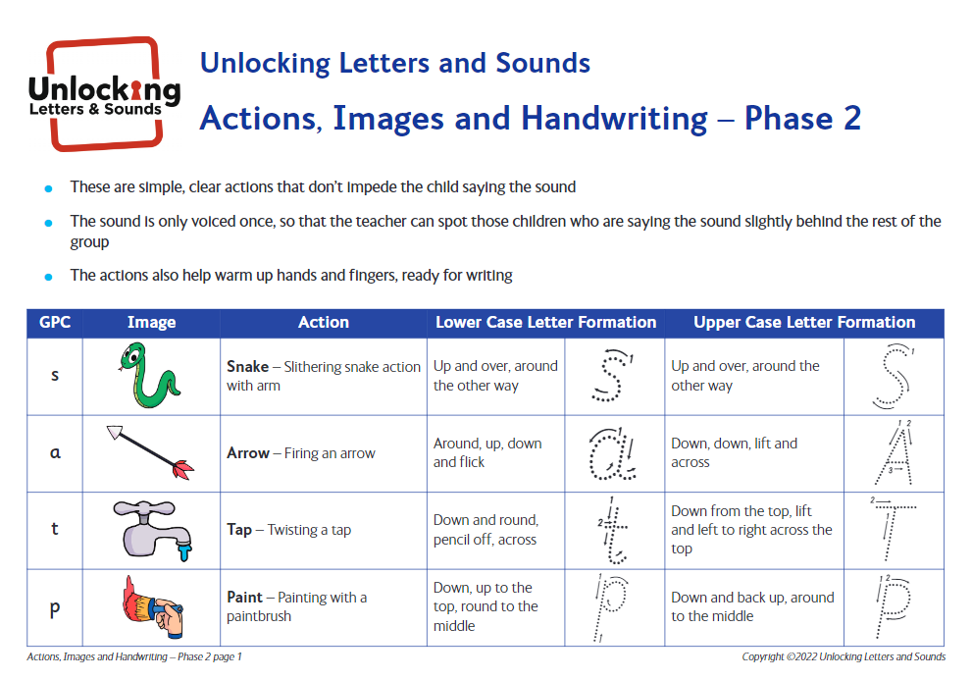

Spelling
Segmenting words
Daily writing as part of phonics lessons
Notes:
We know that when children are reading, they are decoding the GPCs they know and blending them together to read a word or group of words. We teach children to use their phonics to spell in the opposite way. Instead of blending the phonemes together to spell a words we seperate the phonemes so we can hear each sound to be able to spell the word. This is called segmenting.
Let’s try segmenting this word to write it: sh i p
Your child will write words, captions and sentences as part of their phonics lesson each day. As with reading, we will only ask them to write words contacting GPCs they have been taught. As part of their daily lesson we will also teach them how to write and form the letters they are writing.

Slide 19
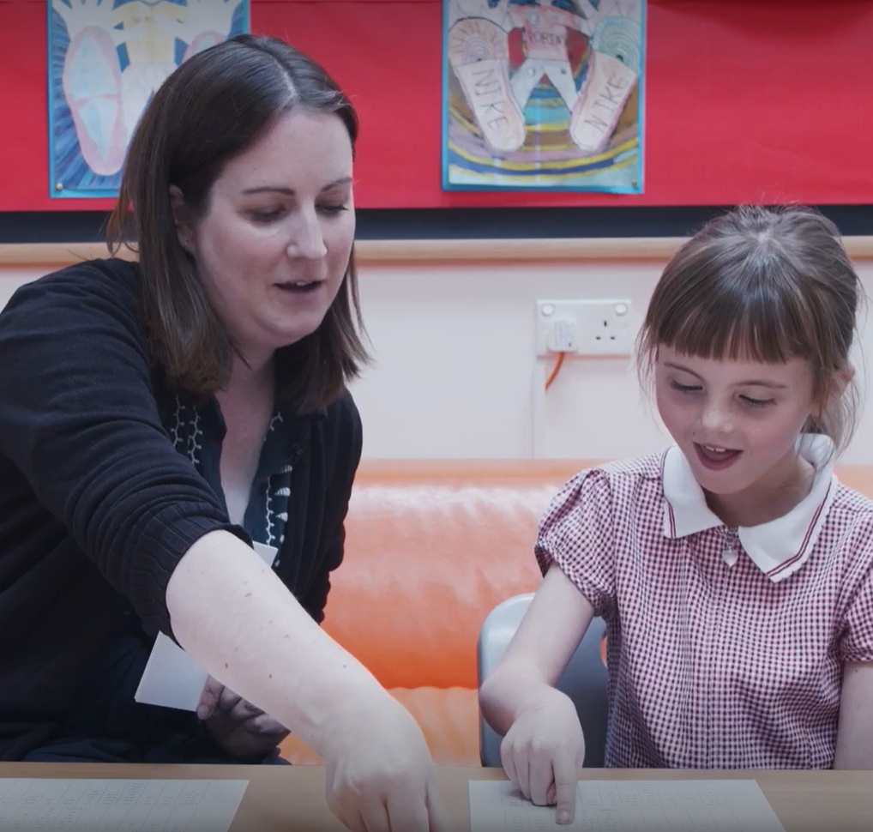
Concerns about progress
All children are different
Discuss any concerns with teachers
Teachers will assess your child reguarly
Interventions to support child in the specific skill they are struggling with
Adaptions for children with SEND
Notes:
All children are different and, at different points in their learning, will find things more difficult or challenging. Staff at our school have all had training to identify what children are finding difficult and to help them overcome this. We know if is very tempting to compare you child to others – especially with reading and what books they are on etc but we would suggest you speak to teachers if you have any concerns. If we have any concerns we will discuss them with you – and we might ask you to do some extra practice at home.
Teachers and TAs will assess your child termly to check their learning. We quickly identify any child who might be at risk of falling behind and will support them with extra phonics- usually by giving them ‘interventions’ to support the specific skill they are struggling with – some children may struggle to identify the GPC; others might not be able to blend yet. We send home termly letters identifying graphemes children are not able to match with the correct phoneme and whether they need some additional segmenting and blending practice at home. We send home tag cards each week, showing which phonemes we have learnt. You will never be sent cards we have not taught and would recommend rehearsing the recognition of graphemes and their phonemes regularly and they can be taken off to make little words. Start with 2 and then 3 phoneme words. These cards do not need to come into school and can be kept at home once you receive them. Less chance of losing them!
If a child has SEND we may need to make adaptions to their phonics eg. additional time to practice, more visuals . Again, we will discuss these with you but research has shown that phonics is still the most effective way of teaching children with SEND to read.

Slide 20
Questions and next steps
Notes:
Learning to read is such an exciting journey for children and we are incredibly excited to be starting it with your child. We hope today’s session has given you an understanding of how we teach phonics at our school.
Ask for questions
Give information about next steps specific to your school eg. more workshops, coming in to read with their child etc.

