Slide 1


Year One
Phonics Screening Check
A Guide for Parents

Slide 2
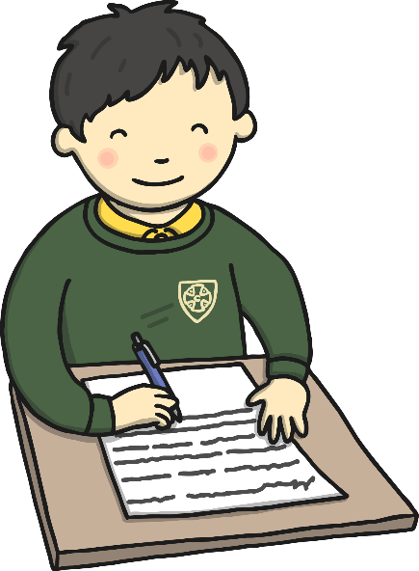
What is the Phonics Screening Check?
Children in Year 1 throughout the country will all be taking part in a phonics screening check during the same week in June. Children in Year 2 will also take the check if they did not achieve the required result when in Year 1 or they have not taken the test before.
Headteachers decide whether it is appropriate for each of their pupils to take the phonics screening check. The phonics screening check is designed to confirm whether individual children have learnt phonic decoding and blending skills to an appropriate standard. It is important to note EVERY child is expected to take part. Breaks and amendments can be made to make the test more accessible. Your child’s class teacher will consider if any access arrangements need to be made.
chapter
menu
next page

Slide 3

What Happens During the Test?
The test contains 40 words. Each child will sit one-to-one and read each word aloud to a teacher. The test will take approximately 10 minutes per child, although all children are different and will complete the check at their own pace. The list of words the children read is a combination of 20 real words and 20 pseudo words (nonsense words).
chapter
menu
next page

Slide 4

Pseudo Words (Nonsense Words)
The pseudo words will be shown to your child with a picture of an alien. This provides the children with a context for the pseudo word which is independent from any existing vocabulary they may have. Pseudo words are included because they will be new to all pupils; they do not favour children with a good vocabulary knowledge or visual memory of words.
chapter
menu
next page

Slide 5
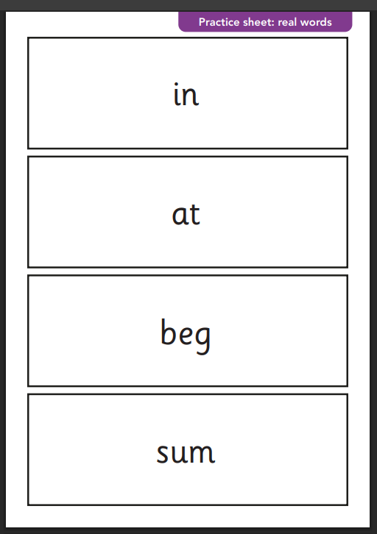
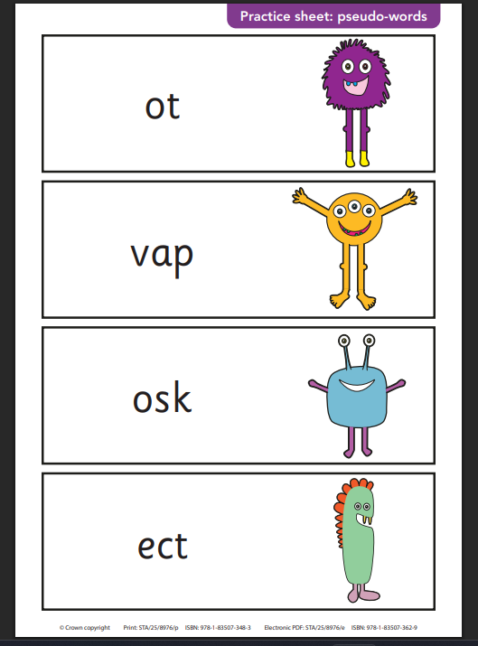
Example Test

Slide 6
Phonics Screening Check Week
If a pupil is absent during the check week, the check can be administered to them until Friday 20 June.
If a pupil does not take the check during this period and returns to school after Friday 20 June, they must be recorded as absent and they will re-take the test in Year 2.
The test will be administered in a quiet space by Mr Hewett. The children take part in mock tests to familiarise them with the format of the test, what to expect and to feel comfortable in the environment they will take the test in.
The results of the mock screening test will be shared with you at parent’s evening and your class teacher can give you a break down of specific areas to rehearse and tasks you can carry out to help your child further.
The results of the mock tests are also used by your child’s class teacher to review children’s next steps, to support pupils using intervention, practice throughout the school day and if necessary, re-teach any lessons.

Slide 7

Reporting to Parents
By the end of the summer term all schools must report each child's results to their parents. They will also confirm if the child has met the standard threshold. Children who do not achieve the expected level will retake the test when they are in Year 2. The pass mark in previous years has been 32, but we will not know if this remains the same until the results are released.
chapter
menu
next page

Slide 8

How Are the Results Used?
Results from the check will be used by schools to analyse their own performance and for Ofsted to use in inspections.
chapter
menu
next page

Slide 9
How Can I Help My Child at Home?
Miss Evans will send home activities for you to complete at home to support your child in the Phonics Screening Check.
Play lots of sound and listening games with your child. Phonics play has a lot of real and nonsense segmenting and blending word games which are helpful. Some are free and others incur a small fee (Approx £7 for the year)
Complete activities which particularly rehearse split digraphs, adjacent consonants and multi-syllabic words.
Keep reading as much as possible to and with your child.
Encourage and praise. Remind children some words will not make sense, just segment and blend what you hear. DON’T GUESS!
If your child is struggling to decode a word, help them by encouraging them to say each sound in the word from left to right, repeat this process speeding up each time to hear the phonemes making it easier to blend to read.
Blend the sounds by pointing to word as you say it.
chapter
menu
next page

