Slide 1
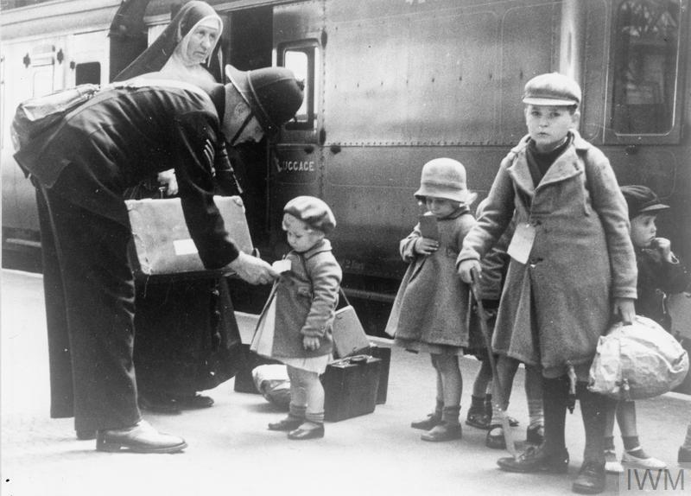
World War 2
History:
What started the war
Evacuees
Rationing
Anne Frank
Maths
Decimals
Negative Numbers
Converting Units of Measure
Timetables
Science:Forces
Air Resistance
Pulleys and Levers
Newton
Water resistance
PE
Rounders
Tennis
Athletics
Literacy: Letters from the Lighthouse
Diary Entries
Recounts
Drama
Narrative
PSHE: Changing ME
Body Image
Puberty
Conception
DT/Art:
D Day Art
Stop Motion Animation

