Slide 1

Welcome LKS2 Parents

Slide 2

School gates open at 8:45am.
We use the time between then and 9 o clock to do accelerated reading and help the children to settle into the day.
The official teaching of the day starts at 9 o clock.

Slide 3
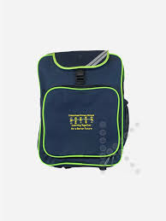

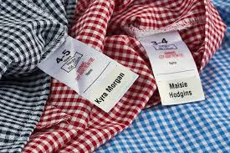
Book bags and Water Bottles
Your child needs to bring their bag and water bottle to school every day.
Please check their bag daily for important letters or information.
Please label all your child’s personal property.

Slide 4



Accelerated Reader
We wanted to remind you about the home-school reading system at Chisenhale - Accelerated Reader. This supports children in choosing appropriate books for their independent home-school reading and it is the same system that they used last year.
Every class reads first thing in the morning so it is imperative that your child is on time so they don’t miss out.

Slide 5

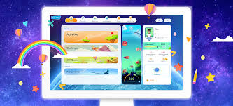
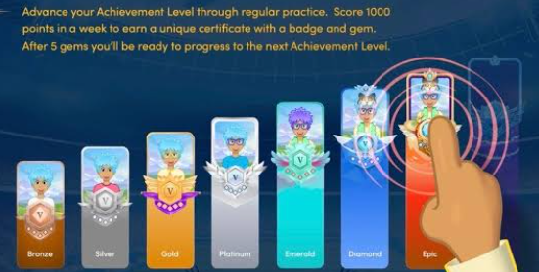

Mathletics
Each week, the teachers will set some relevant maths activities for children to complete at home.
Sometimes we complete some tasks together at school so that children can become more familiar with how to use the program.
It really helps children with mastering and consolidating their skills in Maths in a fun way.

Slide 6
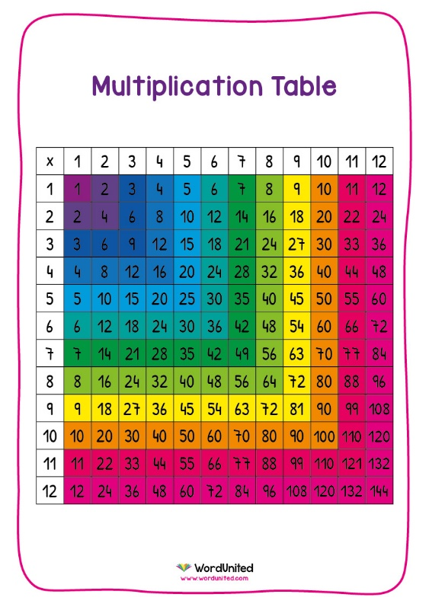
Times Tables
In primary school, times tables knowledge is vital for quick mental maths calculations and problem solving, as well as for many of the topics children learn in Years 5 and 6 (division, fractions, percentages).
Under the National Curriculum primary school children are expected to know all their times tables up to 12x12, by the end of Year 4.
How you can support your child: As maths is such a big subject, and we will of course continue to teach the full curriculum, we will need your continued support to help practice the times tables with your children.
Some easy ways to do this include:
- Asking questions such as “what’s 7 x 8?”
- Reciting times tables by rote (4 times 1 is 4, 4 times 2 is 8, etc)
- Using apps and games
- Singing times tables songs (there are loads online)

Slide 7

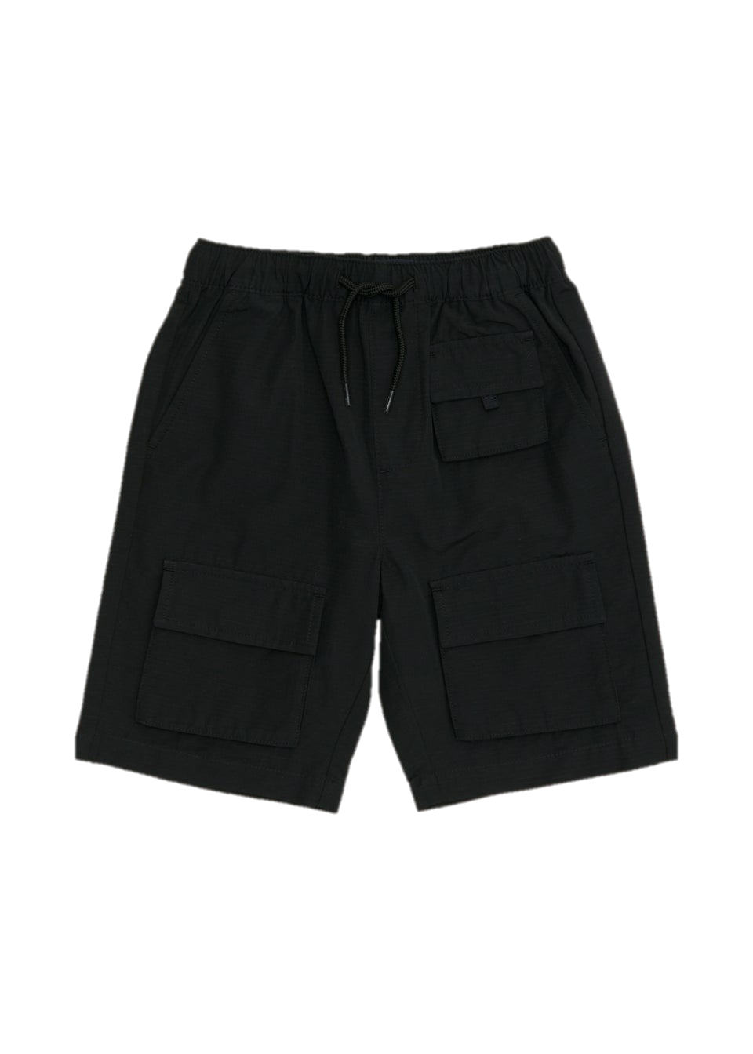
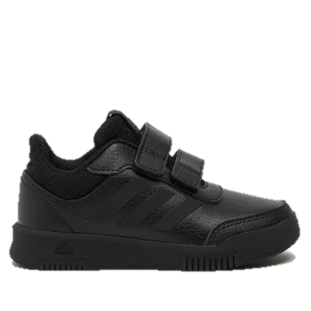
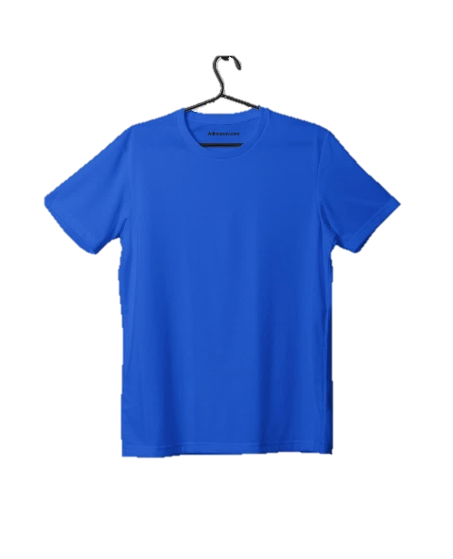

PE
Year 3’s PE days are Thursday and Friday.
Year 4’s PE days are Tuesday and Friday.
Please come in PE kit on these days which includes navy/black joggers with a blue T-Shirt. For safety reasons, it is important that they wear suitable footwear such as trainers or plimsolls. Long hair needs to be tied up for PE and earrings need to be removed or covered
Children should not wear any jewellery to school, unless it is for religious reasons.
Your child may wear earrings as long as they are small, plain studs. Your child needs to be confident to remove these independently on their PE days (or just not wear them on their PE days.)

Slide 8
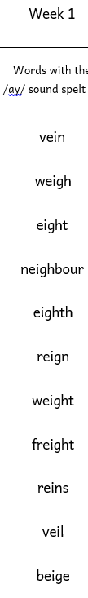

Spelling
Children will have new focus spellings every week to practise. The spelling focus will be mentioned in the Family learning.
Y3 will have their spelling quiz every Thursday.

Slide 9
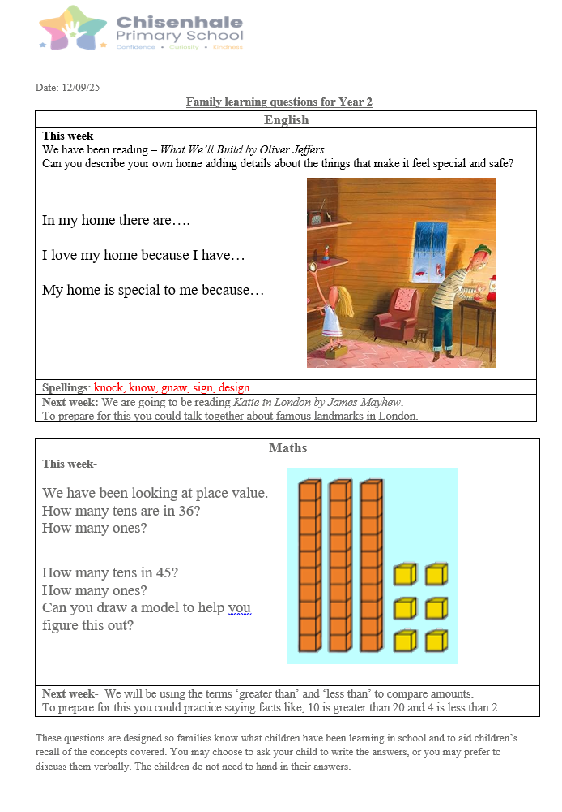
Family learning
Family learning is emailed out to parents every Friday.
It includes information about what your child has learnt at school that week, and what they will be learning next week.
There are some fun activities for your child to complete with your support.
These activities aim to consolidate your child’s learning and help them to feel more prepared for the learning next week.
Your child does not need to hand in their work.

Slide 10
Now lets meet the team!
Each adult in LKS2 will now introduce themselves.
If you have a question you would like to ask us we will be here until around 3:30 to help answer your queries if we can.

Slide 11
Websites
Mathletics - https://login.mathletics.com/
Maths Factor times tables practice - https://www.themathsfactor.com/times-tables-check/pinpoint/#/
Maths skills practise - https://www.topmarks.co.uk/maths-games/hit-the-button
https://www.topmarks.co.uk/maths-games/daily10
Spelling game - https://spelliegame.com/#easy
https://ictgames.com/mobilePage/spookySpellings/index.html

Slide 12
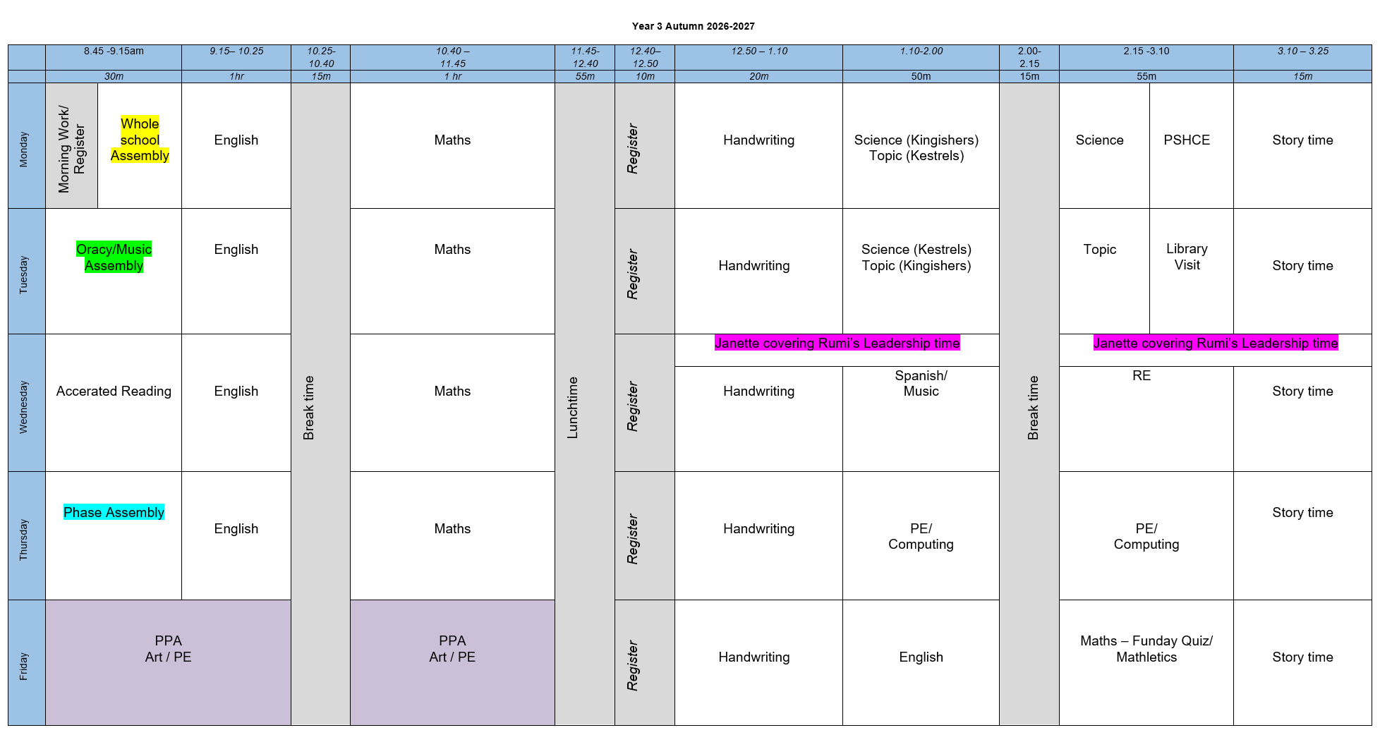
Y3 Timetable

Slide 13
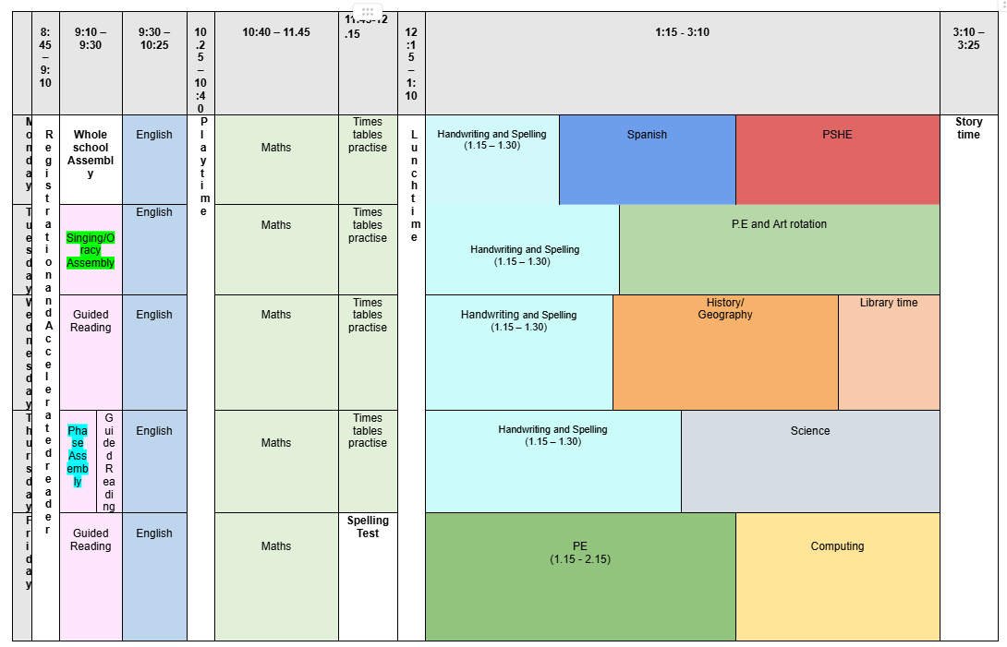
Y4 Timetable

