Slide 1

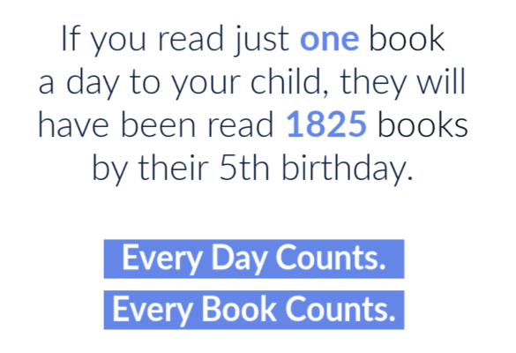
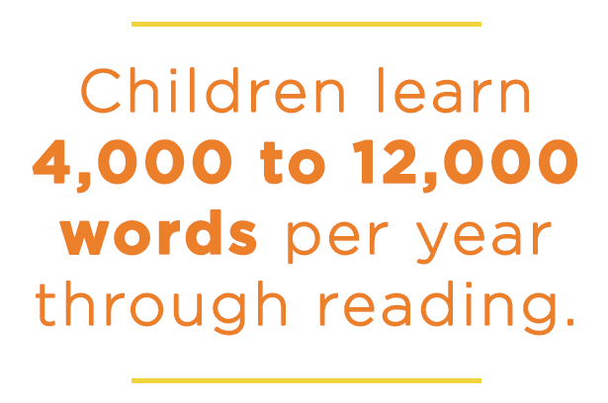
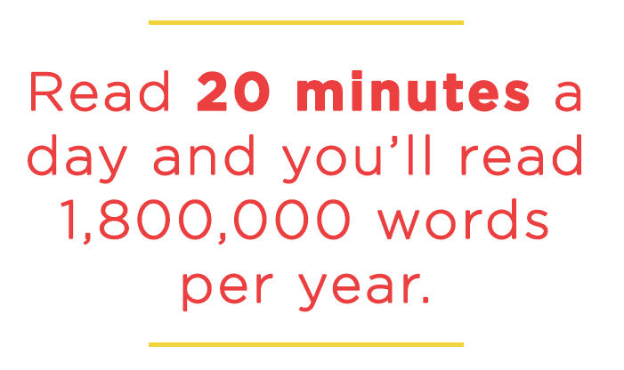
THE Partnership Phonics Programme
Reading with your child at home

Slide 2
Helping your child to read is one of the most useful things you can do for them.
It will help them gain confidence in learning in many other subjects and gives a great step-up into life beyond school.

Slide 3
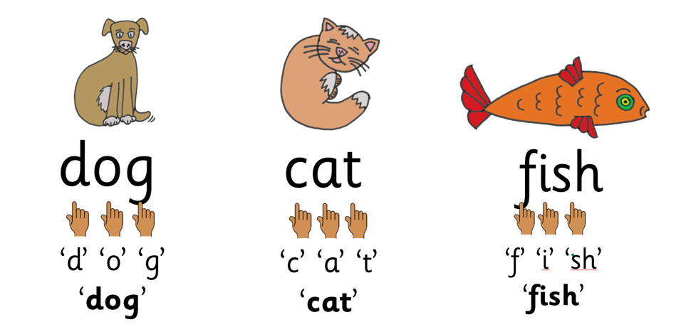
We teach learning to read through phonics.
Phonics is the matching of sounds to letters and groups of letters and then blending the sounds together to read words.

Slide 4
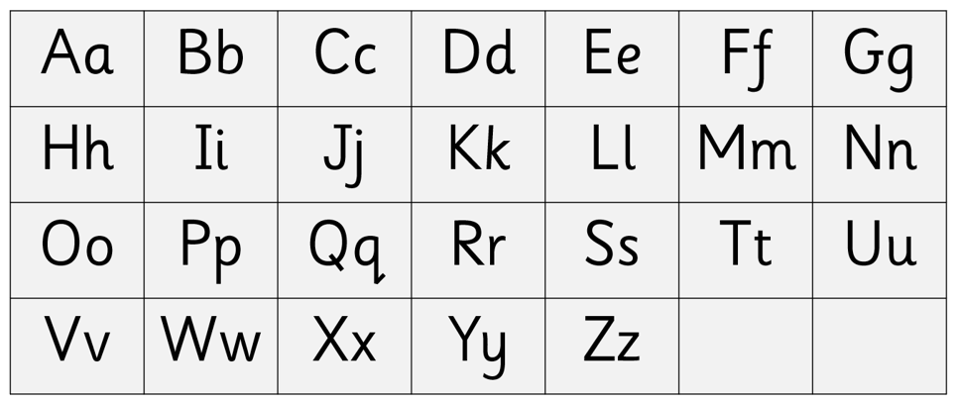
There are 26 letters in the alphabet.

Slide 5
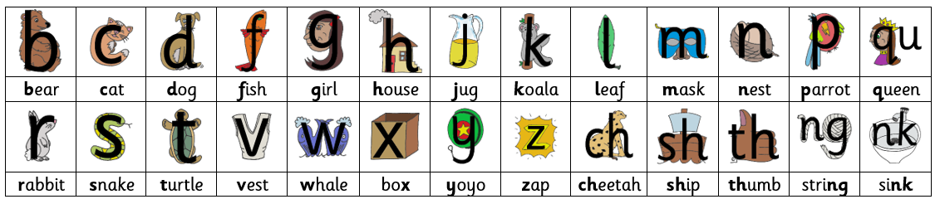
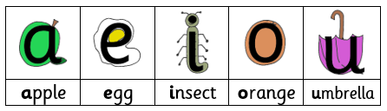
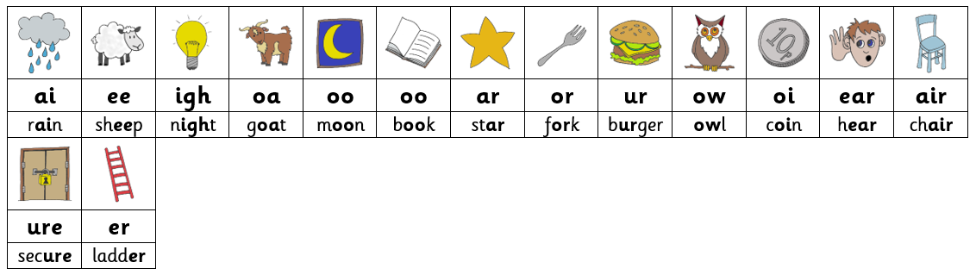
There are 44 English speech sounds.

Slide 6
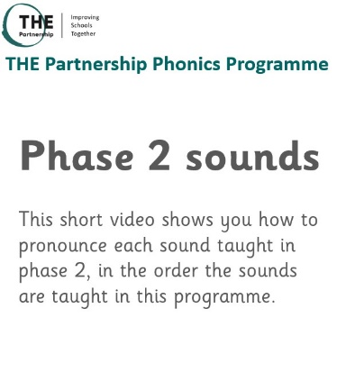
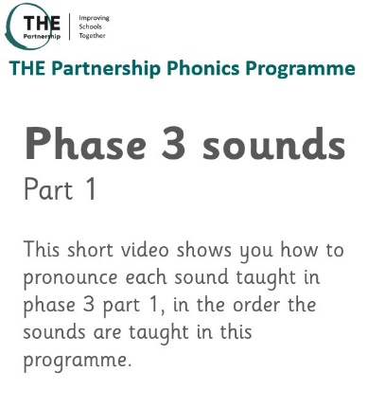
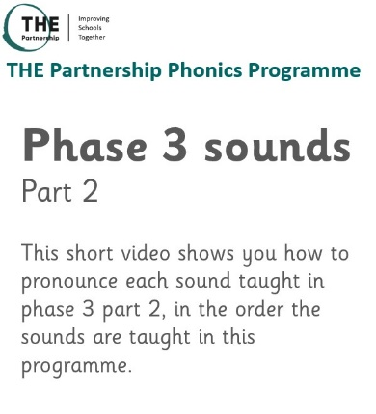
https://youtu.be/6DE37N5LE_8
https://youtu.be/oxVUGHj2MuM
https://youtu.be/fSPGOjZq2Dc

Slide 7
There are four key concepts that we teach to all pupils, these are:
Letters are symbols (spellings) that represent sounds.
A sound may be spelled by one, two, three or four letters:
E.g. dog street night eight
The same sound can be spelled in more than one way:
E.g. rain acorn cake day
Many spellings can represent more than one sound:
E.g. head seat break

Slide 8
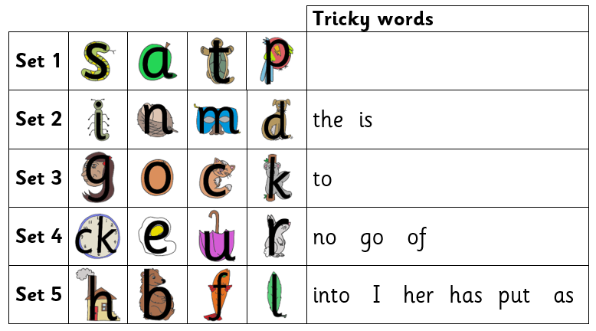
The phonics programme progresses from simple to more complex phonic knowledge and skills.
The programme begins with:

Slide 9
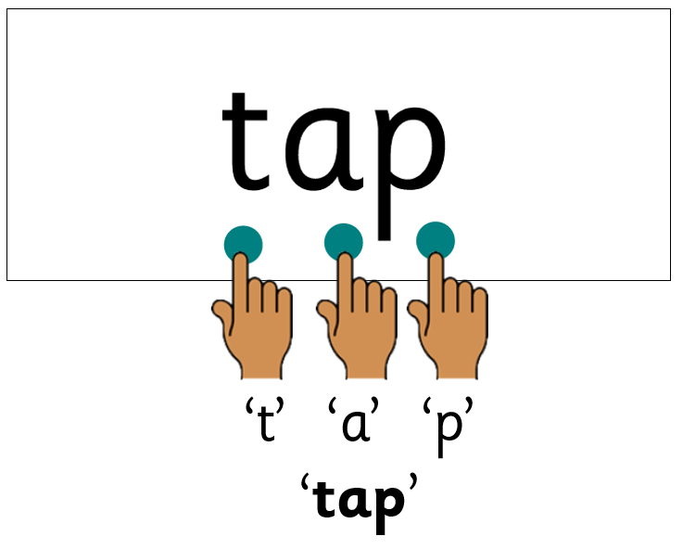

Reading words
Sometimes the word has the sound buttons added to help your child see each sound.
The aim for your child to read words without the sound buttons.

Slide 10

There are also some words which contain sound combinations your child has not yet learned.
These are called tricky words.
Your child is told why they are tricky with the letter/sound combination explained in school.
In the word ‘is’, the ‘s’ makes a /z/ sound.

Slide 11
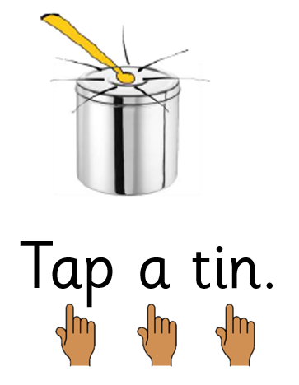
Your child will learn to read sentences.
“If you sound out a word, re-read the word and start the sentence again.”

Slide 12
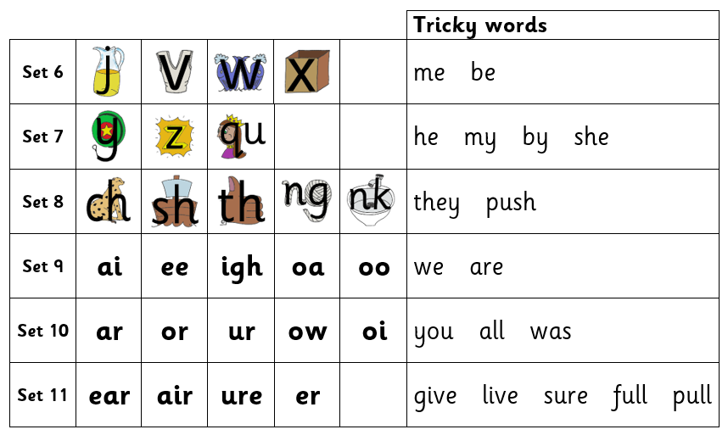
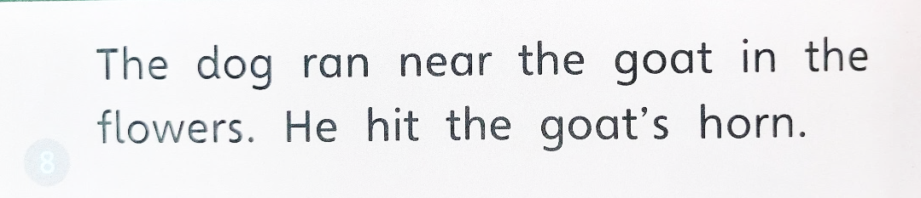

Slide 13
Spelling words
As your child is learning phonics, they will be learning how to use their growing phonic knowledge to spell words.
When your child wants to spell a word, they will think about all the sounds in the word, one by one.
Then, they will match a sound-spelling to each sound to write the word.

Slide 14
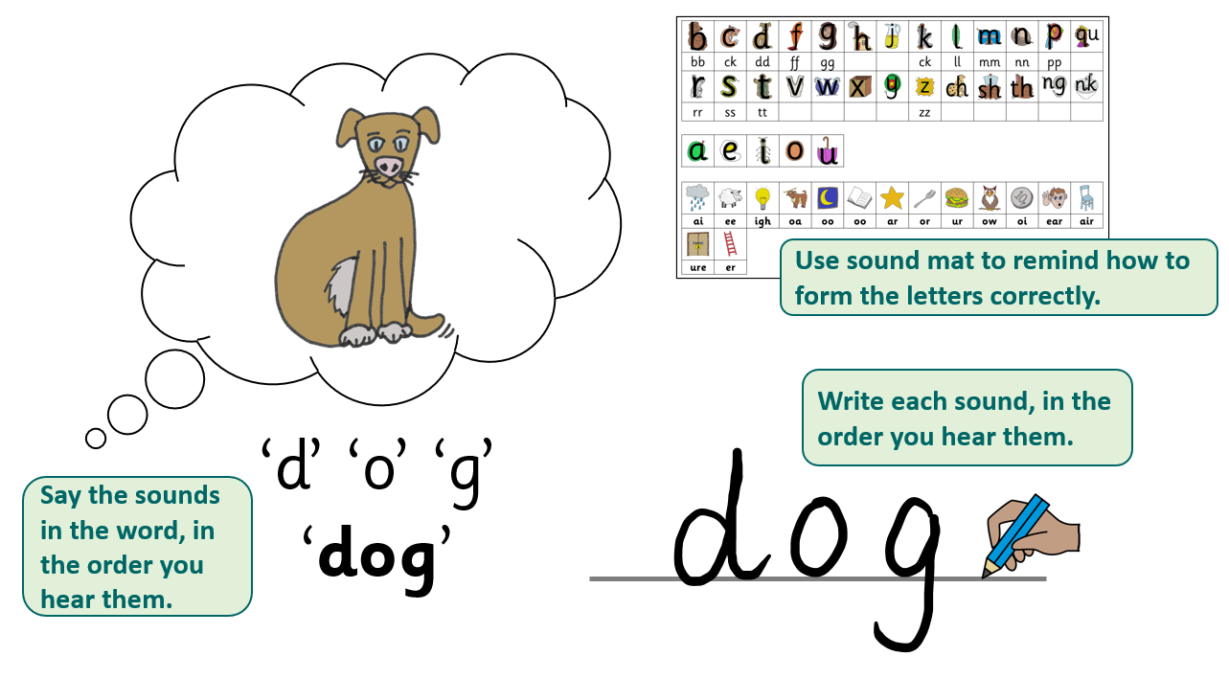

Slide 15
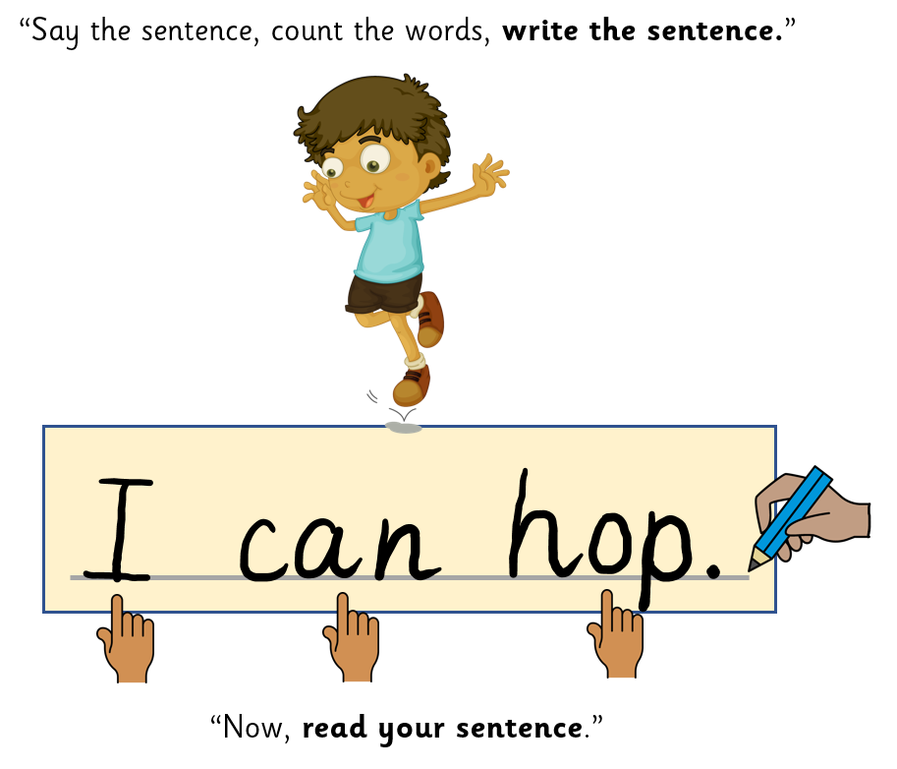

Slide 16
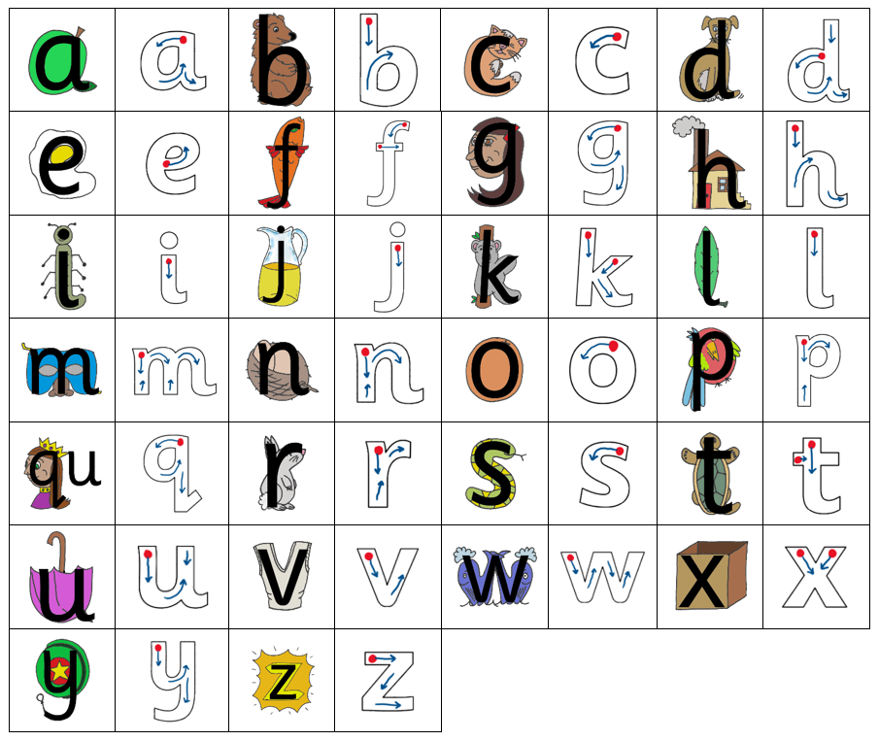
Letter formation
The pictures used to teach your child letter sounds, also help to teach letter formation.

Slide 17
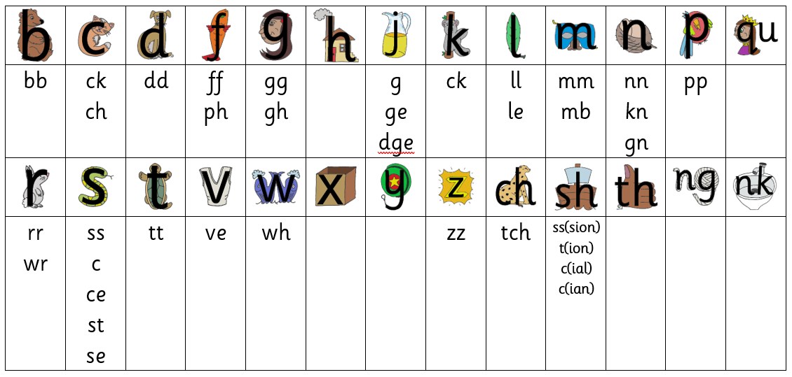
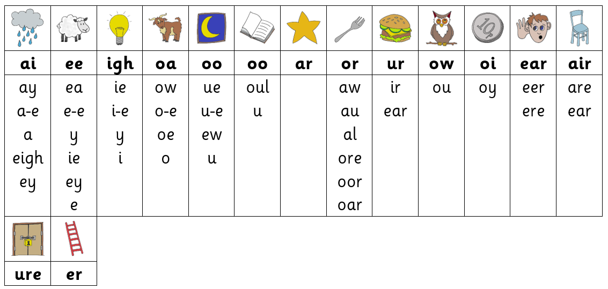
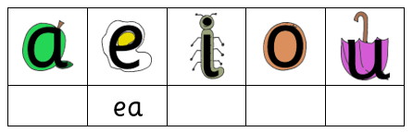

Slide 18
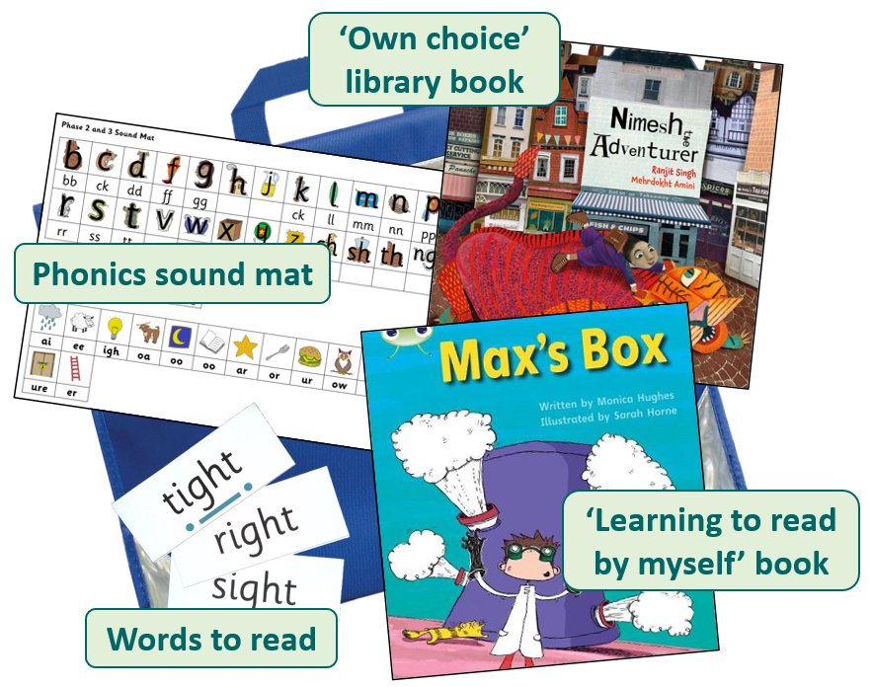

Slide 19
‘Learning to read by myself’ physical book
Due to a lot of hard work and fundraising, the school has been able to purchase a small number of bug club books that we are now able to hand out.
These will be allocated once a week which means the same book needs to be read every night until it is changed. This is to support your child’s fluency and understanding.
Of course it is vital that these are returned promptly and in the same condition they were sent home in. If these books are lost or damaged we will be asking for a £5 donation towards the cost of a new book.

Slide 20
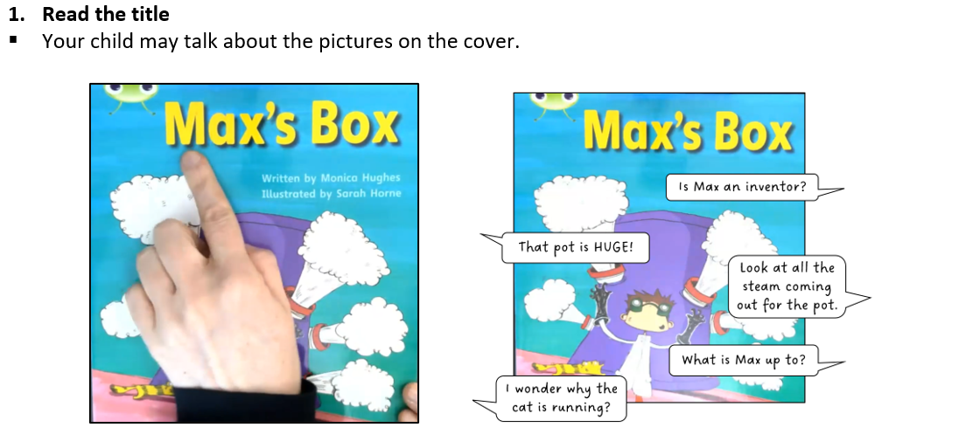

Slide 21
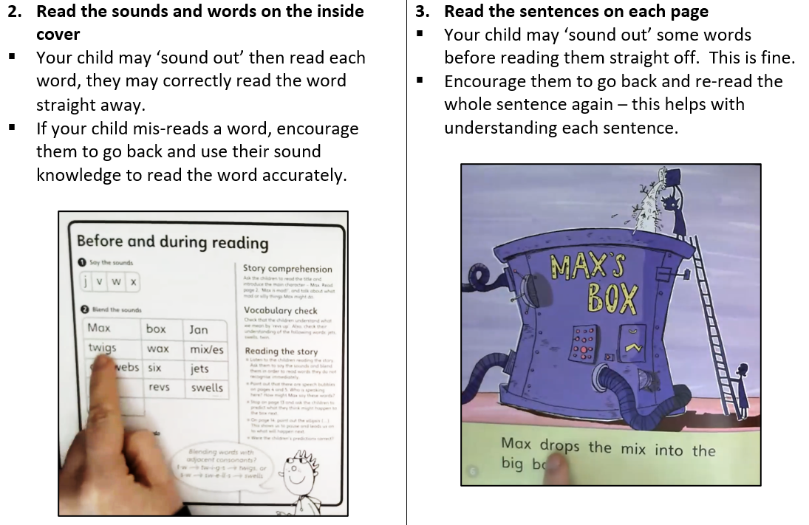

Slide 22
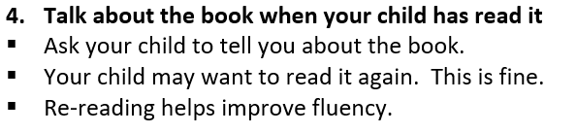

Slide 23
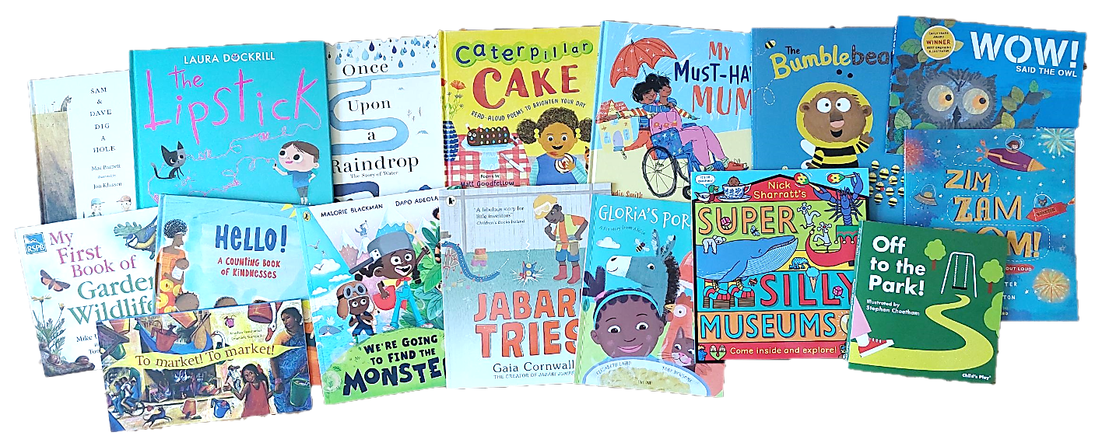
‘Own choice’ library book

Slide 24
If you want to find out more about the phonics programme we use, please visit:
https://www.the-partnership.org.uk/school-improvement/the-partnership-phonics-programme

Slide 25


