Slide 1
Chorlton High School Microsoft Office: MS teams
September 2020 - Student lesson

Slide 2
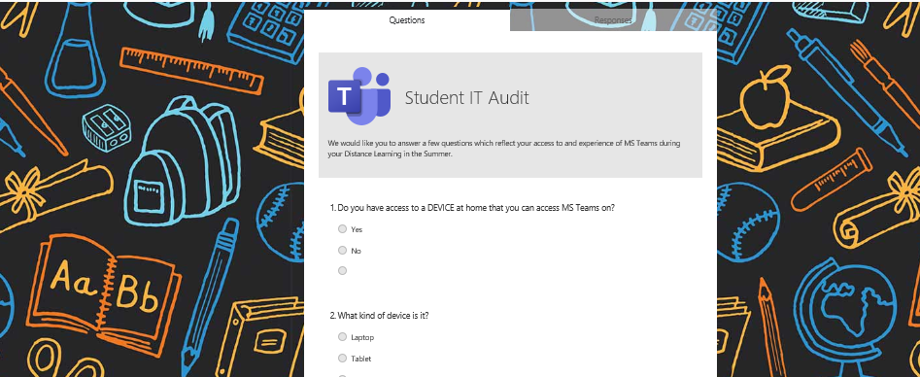
Auditing your TEAMS experience
Audit:
Go to your MS Teams page and click into your form team.
https://forms.office.com/Pages/ResponsePage.aspx?id=yIDyozGCLEWuxbl4I6sUrQDz2mx3e6JBt1cZosseswlUNlpJREFMUFVYMFkyMllVMFFQTU4yU0JSMS4u
Hook and Connect
Notes:
In here you will find a post which will link you to a survey we want you to complete.
Do this now before we continue the session.

Slide 3
Your Distanced Learning Experience
What did you like the most about remote learning?
What new skills did you develop?
Describe your typical day of remote learning – how did you use TEAMS? E.g. what did you do first?
What challenges did you face?
What do you find difficult about TEAMS?
How were your lessons similar to your lessons in school?
How were they different?

Slide 4
WHAT
Learn how to use some of the key features in Microsoft Teams really well- including – routines, class notebook, assignments and communication.
HOW
By navigating each part of TEAMS and exploring it’s function
By practising some tasks on TEAMS to make sure we can use it effectively.
WHY
We will use MS Teams to complete our Home Learning and Home Study and we want you to be successful
When you are absent, we will deliver lessons via MS Teams again and we want you to feel confident

Slide 5
Successful Routines
Notes:
We want you to be successful both in school and at home should the need arise where school has to work remotely.
We are going to support you through how to be successful on MS Teams whilst at home by talking through the expectations of you step by step!
Routines
Remember that routines are really important!
Make sure you keep a regular routine so that you can continue to learn and make progress!

Slide 6
Daily Routine in MS Teams
YEAR TEAMS have important messages from your HOY and Form Tutor
1. VISIT YOUR YEAR and FORM PAGE
2. CHECK YOUR DAILY TIMETABLE
3. GO TO EACH SUBJECT TEAM
POSTS contain important messages from your teachers
4. CHECK POSTS.
REPEAT FOR EACH SUBJECT YOU HAVE THAT DAY
FILES have all of your lesson resources
5. GO TO FILES AND COMPLETE YOUR LESSON
ASSIGNMENTS are tasks you need to complete and submit for feedback
6. COMPLETE ANY ASSIGNMENTS
Notes:
Talk through the process students should follow at home when working through MS Teams. Some students may be familiar with this from Summer Term 2020, however they should be reminded to ensure they are checking across their subjects on their timetables.

Slide 7
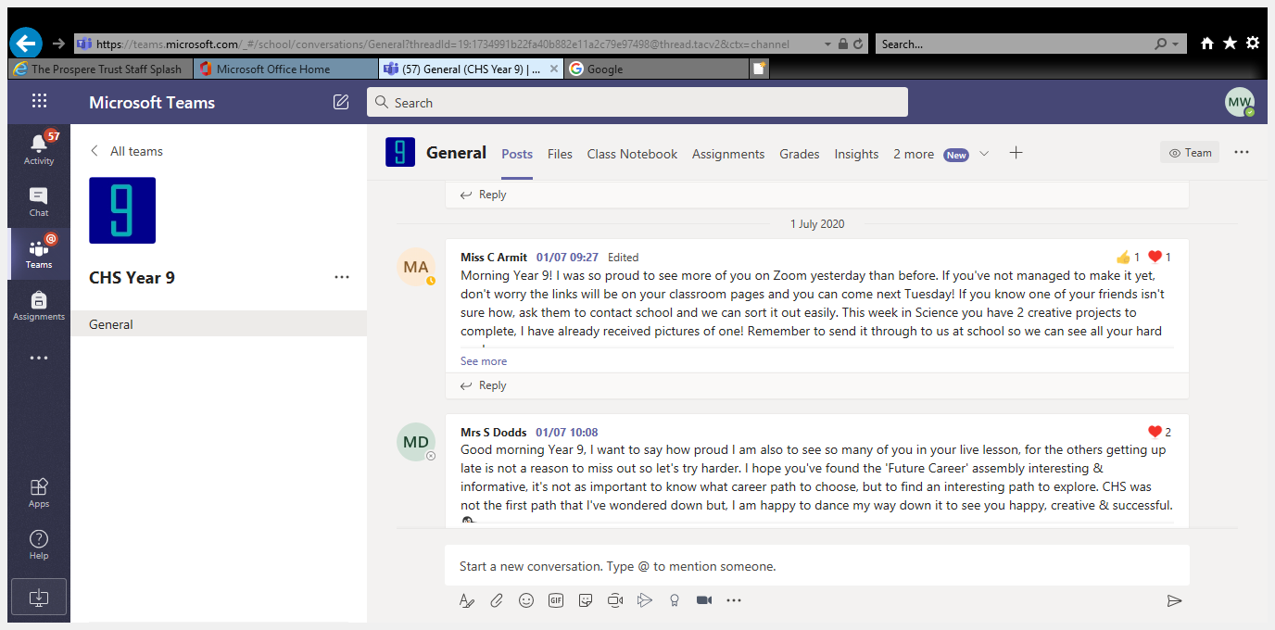
Year and Form Teams
Year Group and Form Teams
These are important teams for you to regularly check as they will have lots of key messages and pieces of information for you!
MESSAGES FROM HOY AND FORM TUTOR
BE READY, BE SAFE, BE RESPECTFUL
ASSEMBLIES
WELL BEING AND SAFEFUARDING MESSAGES
COMPETITIONS
PERSONAL DEVELOPMENT CURRICULUM
Notes:
This is an important space for students to hear communal messages for their Year Team/Form Team. Students should be encouraged to check hear for information to support them with school information and routines.
Students should be reminded that checking this space is as important to review as well as their subject/curriculum area.

Slide 8
Timetable
This will be provided to you.
It may be flexible or structured and will usually involve English and Maths everyday, Science most days and then your other subjects on assigned days.
LIVE LESSONS
Live Lessons will be offered through MS Teams.
We will share further info on this later. These will be part of your timetable.
You should also notice you have a calendar in MS Teams, this will also have key information for you, such as your timetable!
Notes:
Remind students that in the event of a school closure or isolated closures, they will need to check their calendar and review their timetable issued by school.
The calendar area will also have links to live lessons for students to join if these are being delivered by their teachers.

Slide 9
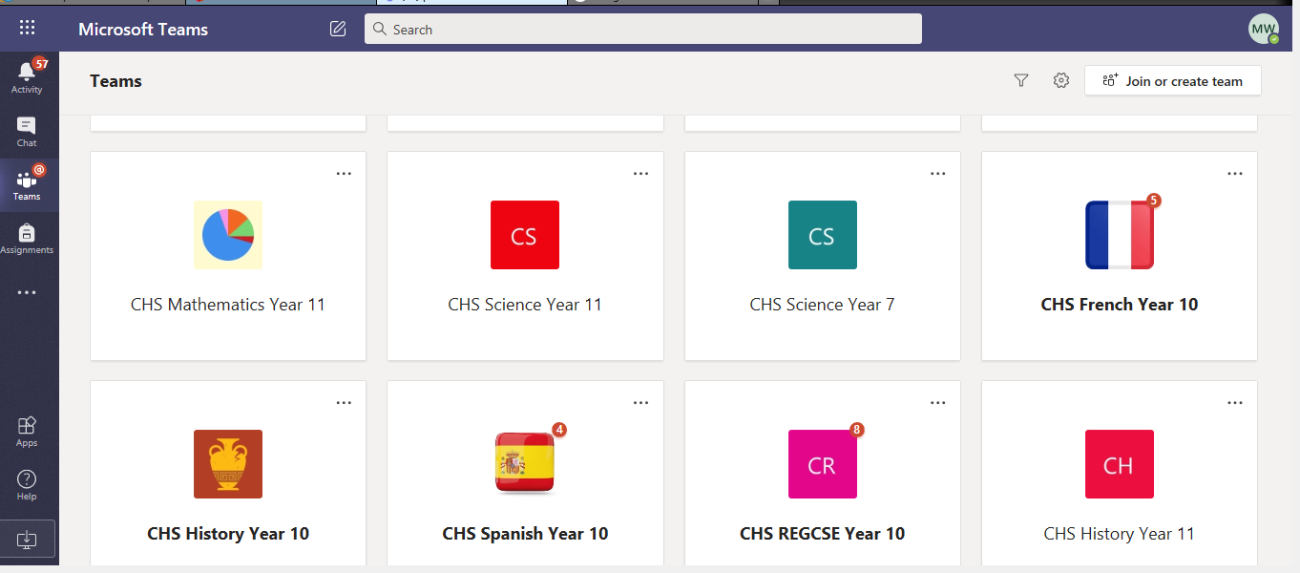
Subject Teams and POSTS
Subject Team
You have a team for every subject you have.
Posts
ALWAYS CHECK POSTS
POSTS have really important teacher messages, there may also be included shared messages from your teachers, examples of work that has been submitted, praise postcards for students and Teacher videos to help you with your learning

Slide 10
Files (Class Materials)
Files and Class Materials
Check the folder names which will direct you to the lessons for the day/week.
All your previous lessons are stored on there for your home study
Most lessons have a PowerPoint to guide you through each part. There might also be videos and worksheets in the folders for you to access.
Make sure you follow the path to the correct week.
New Information

Slide 11
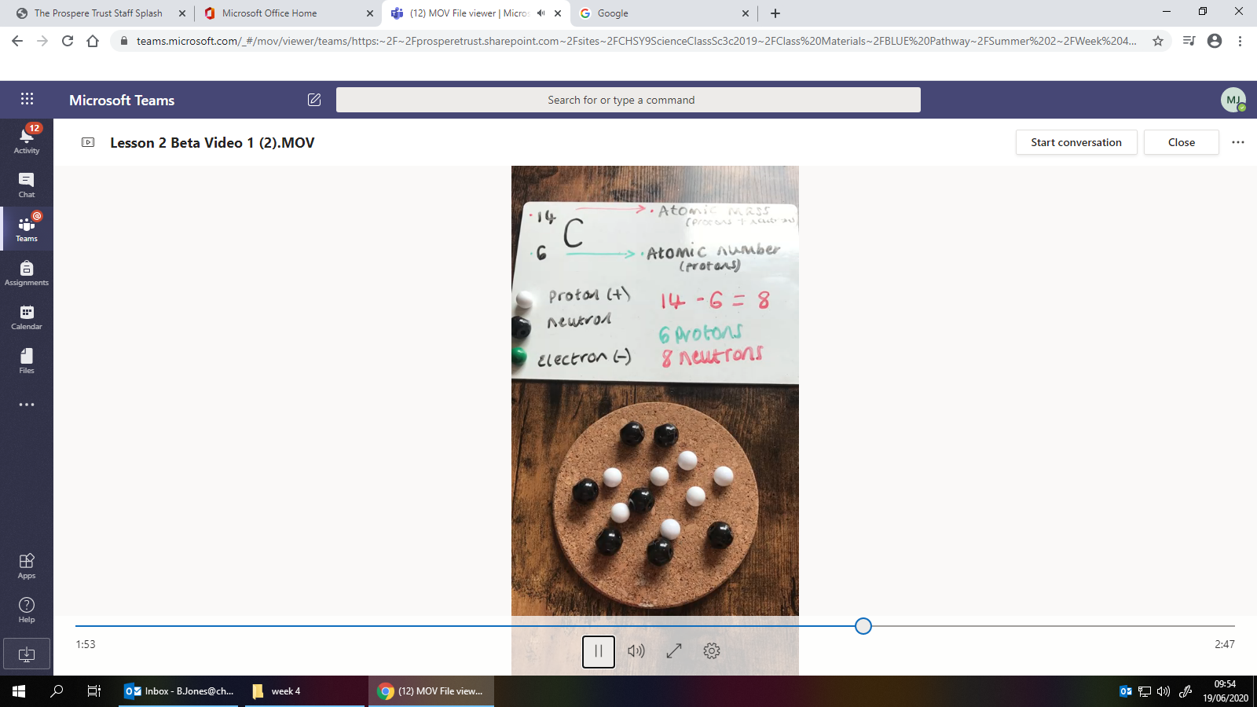
Daily Routine in MS Teams: Lessons
They might start with a review of your previous learning
The WHAT, HOW, WHY will give you clear instructions on what the lesson is about, including instructions for completing it online. This might be a teacher video, narration or just a slide with text. You might have a pre-recorded video lesson
Your teacher will present new information in small steps and may use video, narration, text to help with this explanation. Look out for this!
You will be given some tasks to do, which you can complete in an exercise book at home or on the CLASS NOTEBOOK.
To demonstrate understanding and review your learning – you may complete a QUIZ or an ASSIGNMENT on TEAMS.

Slide 12
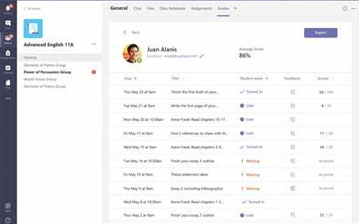
Assignments
The ASSIGNMENTS tab has all of the assignments that have been set for you by your teacher.
Read your instructions carefully. You may have to:
Complete the work in your book or electronically and submit it. If you complete it in your book, take a picture and hand it in
Complete a task that has been set up already for you – e.g. quiz or a task sheet
We will talk about assignments in more detail soon!
The GRADES tab has all of your marks so you can monitor your progress

Slide 13
Accessing lessons in MS Teams
Go to your MS Teams page and click into your form team.
In class materials you will find a PowerPoint for this lessons. Open it up so you can follow along as we work through MS Teams.
Demonstrate your Learning

Slide 14
Class Notebook

Slide 15
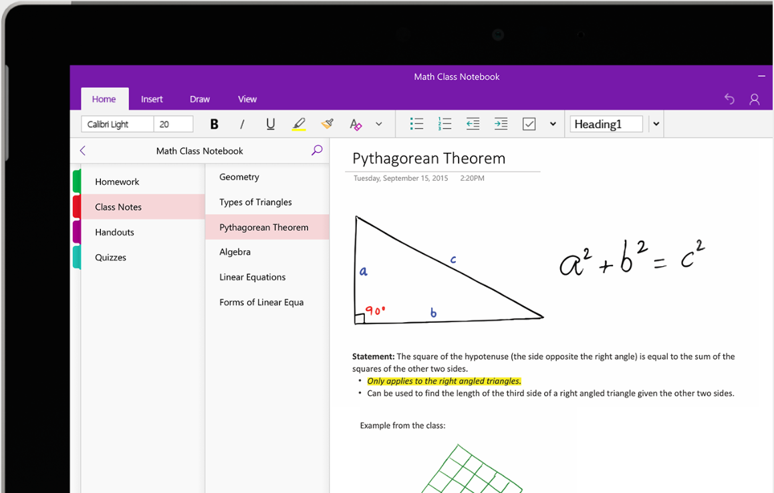
Using the Class Notebook: Microsoft Teams
Using the Class Notebook: Microsoft Teams
One Note is a notebook app that is part of Microsoft Office that creates a class notebook for you.
Think of this like an exercise book. A space where you can make notes and complete your work.
Class notebooks can be used in a range of ways.
New Information

Slide 16
Using the Class Notebook: Microsoft Teams
Using the Class Notebook: Microsoft Teams
Each of your Teams will have a separate Class Notebook, just like you would have a separate exercise book for each subject!
Once you click into a Team, the Class Notebook can be found in the “Class Notebook” section in the Tab at the top.
New Information
Notes:
Remind students that some subjects might not have activated a class notebook.
This will mean they should work in their school exercise book, or work on the linked documents that have been attached tot heir assignments/posts.

Slide 17
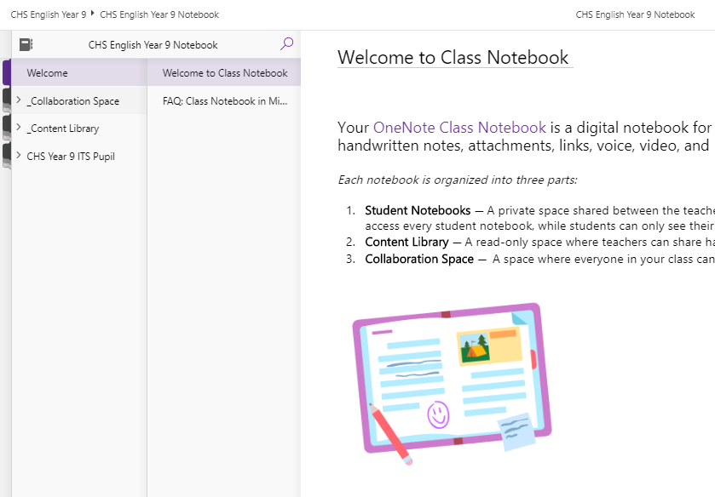
Using the Class Notebook: Microsoft Teams
Your Class Notebook is split into three parts.
Collaboration Space
Content Library
Your own personal student notebook
The collaboration space is open to everyone in the class, all class members can read or write on anything in this part of the notebook.
Imagine it like one big exercise book that everyone in the class can write in!
Q: What class tasks or activities could the Collaboration Space be useful for?
New Information

Slide 18
Using the Class Notebook: Microsoft Teams
The Content Library is a place for Teachers to upload materials like worksheets. You can read or copy anything from here into you own student notebooks, but can’t modify or delete anything!
Imagine it’s like one BIG digital filing cabinet for all of your classroom documents and materials.
The student notebook is your own personal space to make notes and complete worksheets.
Think of it in the exact same way as exercise books we use in school, apart from it’s digital!
New Information
Notes:
Content Library:
Q: What would you find helpful for Teachers to put in the Content Library?
Students notebook:
This part of the Notebook is shared between you and the teacher. Teachers have access to every student notebook so they can see what work you are completing!

Slide 19
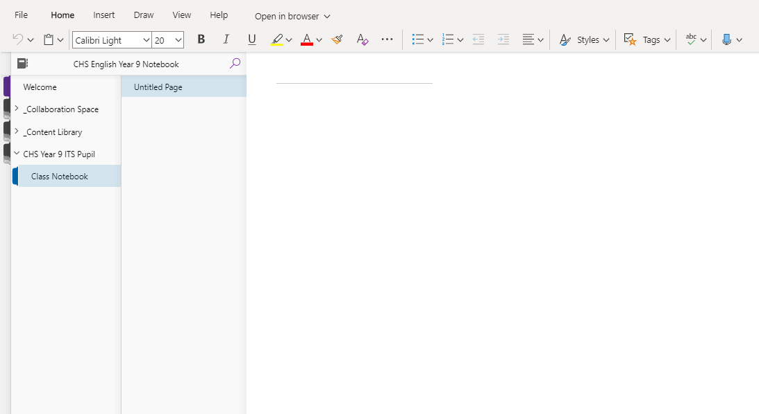
Using the Class Notebook: Microsoft Teams
In each section, there are pages.
In your Student Notebook, you can create pages yourself and give them a title or your teacher may sometimes send you a page that they want you to complete or work on.
When you click into your private Student Notebook, it will be organised by sections.
In this student’s notebook they have a section called “Class Notebook”.
Your Teacher may create sections for you and hand them out to you throughout the year.
So you may end up with many sections in your Personal Notebook!
New Information
Notes:
Remind Students:
You will notice that when you click into a page, you are presented with a ribbon at the top of the screen, very similar to Microsoft Word & PowerPoint.
These tools and features let you edit the page and allow you to make notes and complete School work, just the same way you would in your exercise book.

Slide 20
Using the Class Notebook: Microsoft Teams
New Information
Notes:
Talk students through the main areas of the class notebook:
The ‘Home’ Tab in the Ribbon has everything you would usually find in Microsoft Word (Use this tab to format your work). You can change font type and size, use bullet points and highlight text. You can even use the ‘Tags’ to create ‘To Do’ lists, or tag a piece of content as important.
The ‘Insert’ Tab in the Ribbon let’s you create tables, insert a File (such as a Word Document), a link to a website or video, as well as audio!
The Draw Tab in the Ribbon let’s you draw or sketch with your mouse. There’s even a digital highlighter, so once you have completed some work, you could highlight sections that are of key importance!
The View Tab in the Ribbon let’s you explore a range of accessibility options. For example, you could use the Immersive reader to have any text on screen read out to you in a number of different languages. The Reading view helps you to focus on text on screen. You could change the page colour of your notebook to help with contrast!

Slide 21
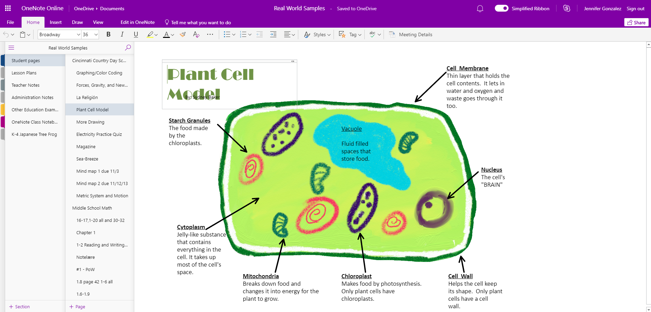
Using the Class Notebook: Microsoft Teams
Q: What tools and features has this student used to create this piece of work in their Class Notebook?
This student has a number of Sections in their Student Notebook
They also have a number of pages in each section. This student looks to have arranged their pages by different topics.
New Information
You can create new pages easily by clicking the ‘+ Page’ button
Notes:
WAGOLL:
Show students an example of what a class notebook might look like.
Remind students this can be viewed by themselves and their teacher.

Slide 22
Using the Class Notebook: Microsoft Teams
Go to your MS Teams page and click into your form team.
Access the Class Notebook
Click into your Student Notebook
Give your first page a Title – “Class Notebook”
Use the Ribbon we’ve looked at and create a mind-map about the Class Notebook, imagine you are explaining to someone what it is and how it can be used! Use the following tools we have looked at:
Use the ‘Home’ tab to format your page
Use the ‘Insert’ tab to include websites or files that will further explain about Class Notebook
Use the ‘Draw’ tab in a creative way! (Arrows for the mind map?)
After completing your mind-map, experiment with the ‘View’ tab and look at immersive reader
Demonstrate your Learning
Notes:
Practice:
This task will need to be set up and distributed prior to the lesson. Students should follow the practice task to enable them to engage with their class notebook.
This will also give them an opportunity to ask questions relating to class notebooks.
Be mindful of time for the session

Slide 23
Assignments

Slide 24
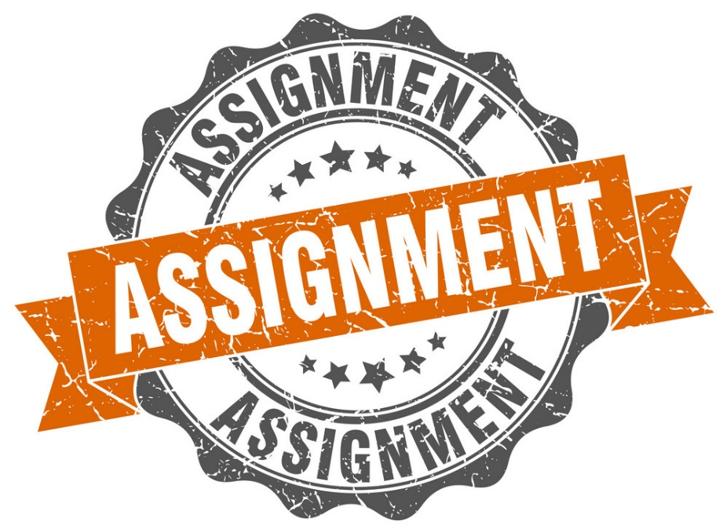
Submitting Assignments: Microsoft Teams
Assignments
This is your assignment tab. In this area you will find tasks to complete to assess your understanding. You might also find quizzes and surveys that you should complete.
This Year we will be using Assignments for Home Learning and Home Study tasks too. This means all you school work and home learning can be accessed in one space with one log on!
New Information

Slide 25
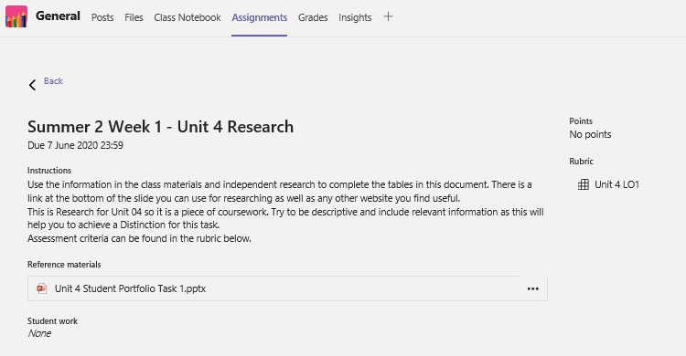
Submitting Assignments: Microsoft Teams
Assignments
Your assignment will have a clear title. This may be linked to your lesson or Topic.
There is a clear due date, this is when the work should be submitted to your teacher.
Instructions are given to support you (what is expected).
Reference materials
Rubric
New Information
Notes:
Additional guidance:
Reference materials might be added, these are resources to help support you in completing your work.
Rubric: If you are completing an assessment piece your teacher might give your some criteria

Slide 26
Submitting Assignments: Microsoft Teams
When you have completed your work click on the ‘Turn in’ button.
This will submit your work to your teacher!
Open the attached file.
This will then open in the file format (Word/PowerPoint etc. You can work directly on to this file, it will save automatically for you!
New Information
Notes:
Turning in work:
Be clear with students that they should work directly on any linked documents, and click ‘Turn in’ when this has been completed. If they don’t Turn In work this will not be submitted or visible to their teachers.
If students do submit work they can undo the action using the same button to recall their work.

Slide 27
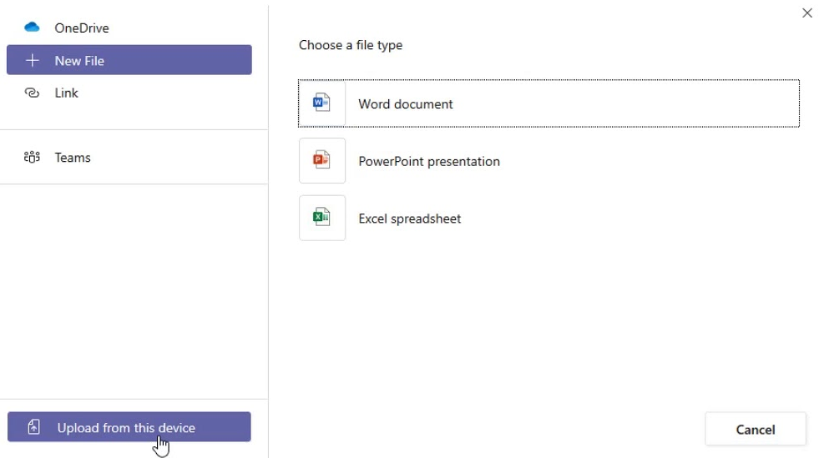
Submitting Assignments: Microsoft Teams
What if you are asked to upload your own work? Maybe this is a picture or a design task you have completed…..
You can do that too!
Click ‘Upload from this device’ if your work is on your personal device.
From here you will need to select the file you want to upload before clicking ‘Turn in’
Click ‘Add work’ to attach your own document.
Notes:
This information related to linking work or a document to their assignments. This might be to submit drawings, designs, photographs, audio clips etc. depending on the subject. This process might look a little different on a phone/tablet but it should be completed the same way.

Slide 28
Submitting Assignments: Microsoft Teams
Go to your MS Teams page and click into your form team.
In assignments you will find a short assignment for you to complete.
This will allow you to complete a practice assignment for this session so you know how to complete one or add new work to present to your teachers.
Demonstrate your Learning
Notes:
Practice:
This task will need to be set up and distributed prior to the lesson. Students should follow the practice task to enable them to engage with their assignment.
This will also give them an opportunity to ask questions relating to assignments.
Be mindful of time for the session
Remind students this is also where they will need to access their home learning and home study tasks this year (NOT DODDLE)

Slide 29
Communication

Slide 30
Communicating with your Teacher: Microsoft Teams
There may be a time when school needs to close again for a period of time.
In this situation you will be working from home on your lessons.
We have been doing this in the last year but sometimes this has been harder because you need your teachers support.
We want to be able to offer you this support so we can help you continue to be successful!
New Information

Slide 31
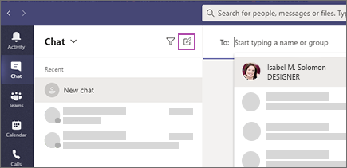
Communicating with your Teacher: Microsoft Teams
We understand the importance of being able to ask a teacher question when you might be stuck or need clarification.
We have opened up the chat function in MS Teams for September, however this must be used in a professional manner or the function will be removed for individuals and groups, if not all students!
All chat areas will be moderated
New Information
Notes:
Express to students the following:
The chat function is to be used between a teacher and a student, not between students.
This allows you to get support to your specific concerns with work.
All chat areas will be moderated.

Slide 32
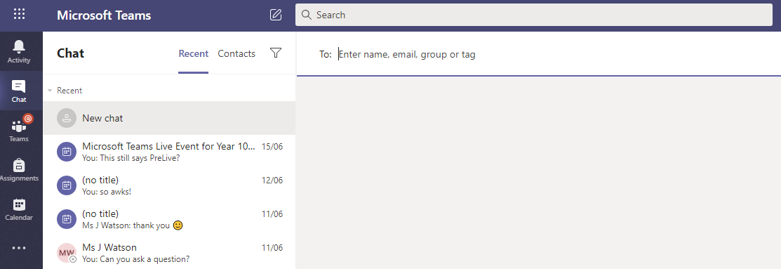
Communicating with your Teacher: Microsoft Teams
2. You will then need to click on to the pen icon in the first column.
1. When in MS Teams, click on the Chat tab on the left bar.
3. A new chat box will open.
Here you will need to type in the teacher you want to ask a question to.
Names should start to appear as you start typing.
Notes:
Show students how to access the chat feature and how to send a message to their teacher.
Teachers names will begin with ‘Mr’ ‘Mrs’ ‘Ms’ for example ‘Mr Rayworth’
When students start to type this will bring up their teachers names. Students should be clear they are sending to the correct teacher.

Slide 33
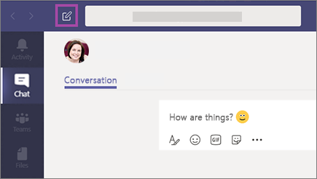
Communicating with your Teacher: Microsoft Teams
How should I communicate when sending a message?
Remember, this function is here to support you with your learning. You should keep this dialogue professional and ask only questions relating to your work.

Slide 34
Communicating with your Teacher: Microsoft Teams
Lets look at some examples of questions you might ask?
Good afternoon, I need to some extra support for my assignment. Where can I access more information?
Good morning, I am not sure how to calculate the answer on Slide 4 of this weeks lesson, how should I do this?
Good afternoon, I am working on my designs but am not sure how to draw 3D. What technique should I use?
Good morning, I am working on my written task but need to add more examples, where can I find these?
Notes:
Reminder for Students:
Once you have asked a question, be patient when waiting for a response. Your teacher will respond as soon as they are available to do so.
Chat features should be used predominantly when school is closed or students are distanced learning. Not necessarily between lessons.

Slide 35
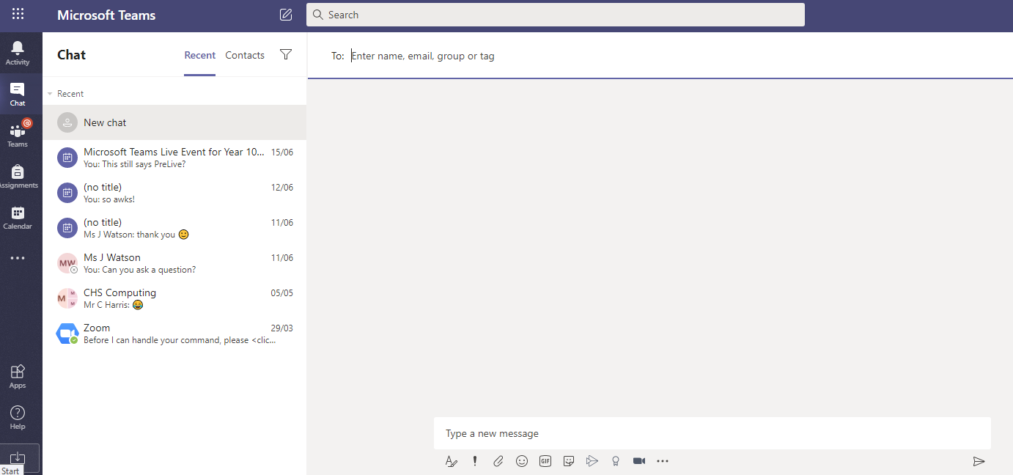
Communicating with your Teacher: Microsoft Teams
Go to your MS Teams page and click into the ‘Chat’ tab.
Type a message to your teacher for this session and tell them one thing new that you have learnt in todays session.
Demonstrate your Learning

Slide 36
Review

Slide 37
REVIEW: Microsoft Teams
High
How Confident do you now feel using Microsoft Teams independently?
Do you have any specific questions we can support you with today?
Low
Review – Summary of Learning

