Slide 1


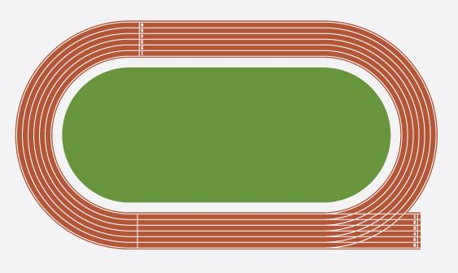

GCSE PE
Independent study
Assessment criteria (H.O.P.E.S)
Developing- Students will identify the role they play within sport
Securing- Students will be able to perform in sport and within different roles within sport
Mastering- Students will be able to reflect on the role they play within sport and make informed decisions within sports performance
Boys- Football
Girls- netball
Boys- Handball
Girls- Football
Boys- Basketball
Girls- Fitness
Boys- Rugby
Girls- Gymnastics
Boys- fitness
Girls netball
Boys- Badminton
Girls-softball
Boys- Cricket
Girls- Rounders
Boys- Trampolining
Girls- Basketball
YEAR
11
Final Sports Day
Assessment criteria (H.O.P.E.S)
Developing- Students will identify the role they play within sport
Securing- Students will be able to perform in sport and within different roles within sport
Mastering- Students will be able to reflect on the role they play within sport and make informed decisions within sports performance
All-
Athletics
All-
cross country
Boys- Rugby
Girls- Gymnastics
Boys- Handball
Girls- Football
Boys- Football
Girls- netball
Boys- Basketball
Girls- Fitness
Boys- fitness
Girls netball
Sports Day
Sports Day
YEAR
10
All-
cross country
All-
Athletics
Assessment criteria (H.O.P.E.S)
Developing- Students will identify the role they play within sport
Securing- Students will be able to perform in sport and within different roles within sport
Mastering- Students will be able to reflect on the role they play within sport and make informed decisions within sports performance
Boys-Dance
Girls- Basketball
Boys- Tennis Girls- badminton
Boys-Gymnastics
Girls- Football
Boys-Handball
Girls- Fitness
Boys-Rugby
Girls- Gymnastics
Boys-Basketball
Girls- Dance
Boys-Football
Girls- Netball
9
YEAR
Core PE

Slide 2


GCSE PE
Core PE
sports Day
BTEC PE
GCSE PE
Boys- Cricket
Girls- Rounders
Boys-Gymnastics
Girls- Football
Assessment criteria
Developing- Student will understand all core and advanced skills in all sports
Securing- Students will be able to perform a range of core and advanced skills Mastering- Students will be able to apply core and advanced skills while implanting correct decision
Boys- Rounders Girls- Tennis
Boys-Fitness
Girls- Basketball
Boys- softball
Girls- Rounders
All-
cross country
Boys-Handball
Girls- Fitness
Boys-Basketball
Girls- Dance
Boys-Rugby
Girls- Gymnastics
Boys-Football
Girls- Netball
Boys- Tennis Girls- badminton
All-
Athletics
YEAR
8
Sports Day
Boys- Cricket
Girls- Rounders
Boys- Rounders Girls- Tennis
Boys- softball
Girls- Rounders
Boys-Fitness
Girls- Basketball
Assessment criteria
Developing- Students will be able to identify key skills in all sports
Securing- Students will be able to perform key skills in all sports
Mastering- Students will be able to apply keys skills to outwit an opponent in all sports
Boys-Gymnastics
Girls- Football
All-
cross country
Boys-Handball
Girls- Fitness
Baseline testing
Boys-Rugby
Girls- Gymnastics
Boys-Basketball
Girls- Dance
Boys-Football
Girls- Netball
YEAR
7
Core PE

