Slide 1


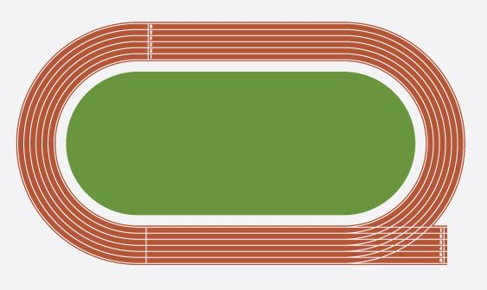

GCSE PE
Btec Tech Award
Component 1 course work Final submission
Exam preparation phase
Component 3 exam
Assessment Criteria
L2P- Adequate application of knowledge within written and examination units.
L2M- Good application of knowledge within written and examination units.
L2D- Comprehensive
application of knowledge within written and examination units.
Component 1 acting on feedback
Revisiting teaching for component 3
Component 1 hand in first submission
Component 1 course work start
Year 11
Assessment Criteria
L2P- Adequate application within written and practical assessment including leading and coaching others
L2M- Good
application within written and practical assessment including leading and coaching others
L2D- Comprehensive
application within written and practical assessment including leading and coaching others
Course work released
Component 2 course work Final submission
Component 2 acting on feedback
Component 2 hand in first submission
Component 2 course work start
Course work released
Importance of fitness
Training methods
YEAR
10
Role and responsibilities of officials
Improving techniques
Fitness testing
Fitness programming
L1P-limited
Knowledge displayed in units 1 and 2
L1M-Adequate
Knowledge displayed in units 1 and 2
L2D- Good
Knowledge displayed for all topics in unit 1 and 2
Preparing for sport
Equipment and technology in sport
Types of provision for performers
Components of fitness
Introduction to course
Year 9
KS4 BTEC

Slide 2


GCSE PE
GCSE
Completion of AEP
Practical moderation
Revision paper 2
Paper 2 exam
Assessment criteria
AO1- Demonstrate knowledge and understanding of the factors effecting performance
A02- Apply knowledge and understanding of these factors using sporting examples.
A03- Analyse and evaluate the factors underpinning performance
Revision paper 1
Paper 1 exam
Introduction to AEP
Addressing misconceptions paper 2
Types of feedback
Mental preparation
Diet and nutrition
Health fitness and wellbeing
Paper 2
PPE
Types of guidance
Goal setting
Year
11
Sociocultural issues and sports psychology
Section a-
Worth 30% overall grade.
20 questions
Question focus- sociocultural influences, sports psychology, health fitness and wellbeing
Section b-
Worth 30% overall grade
20 Questions
One 6 mark question which will link to synoptic knowledge
Classification of skill
Violence in sport
Ethics in sport
Characteristics of skillful movement
Drugs in sport
Commercialisation in sport
Knowledge displayed in units 1 and 2
Participation in physical activity and sport
Physical activity and sport in the UK
YEAR
10
Components of fitness
Addressing misconceptions paper 1
Physical factors effecting performance
Section a-
Worth 30% overall grade.
20 questions
Question focus- applied anatomy and physiology and physical training
Section b-
Worth 30% overall grade
20 Questions
One 6 mark question which will link to synoptic knowledge
Prevention of injury
Optimising training
Effects of exercise
PPE
Paper 1
Movement analysis
Cardiorespiratory system
Muscular system
Introduction to course
Skeletal system
Year9
KS4
GCSE

Slide 3
GCSE PE
GCSE
Moderation sample request
Moderation day
Assessment criteria
AO1- Demonstrate knowledge and understanding of the factors effecting performance
A02- Apply knowledge and understanding of these factors using sporting examples.
A03- Analyse and evaluate the factors underpinning performance
Moderation prep
Students work on individual sport
Video evidence capture
Gymnastics and dance
Video
evidence capture
Athletics
Badminton
Year
11
Sociocultural issues and sports psychology
Section a-
Worth 30% overall grade.
20 questions
Question focus- sociocultural influences, sports psychology, health fitness and wellbeing
Section b-
Worth 30% overall grade
20 Questions
One 6 mark question which will link to synoptic knowledge
Tennis
Rugby
Volleyball
Trampolining
Handball
Netball
football
YEAR
10
Video evidence capture
Physical factors effecting performance
Section a-
Worth 30% overall grade.
20 questions
Question focus- applied anatomy and physiology and physical training
Section b-
Worth 30% overall grade
20 Questions
One 6 mark question which will link to synoptic knowledge
Volleyball
Tennis
Trampolining
Athletics
Video evidence capture
Gymnastics and dance
Rugby
Badminton
Handball
Netball
football
Year9
KS4
GCSE

