Slide 1

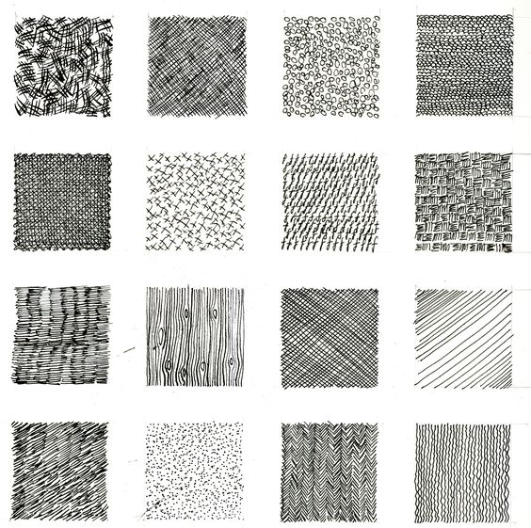
Lesson 3 & 4
Key Terminology
Mark making describes the different lines, dots, marks, patterns, and textures we create in an artwork. It can be loose and gestural or controlled and neat. It can apply to any material used on any surface: paint on canvas, ink or pencil on paper, a scratched mark on plaster, a digital paint tool on a screen, a tattooed mark on skin…even a sound can be a form of mark making
Task 3
By filling the squares of the paper, create 4 different marks in biro.
Example

Slide 2
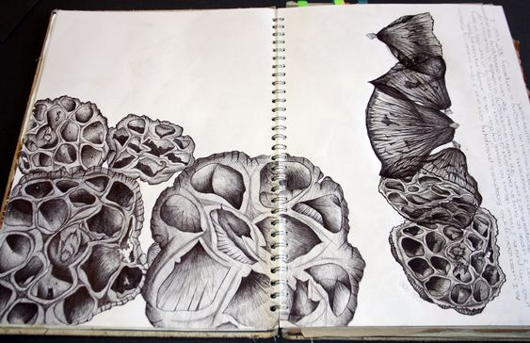
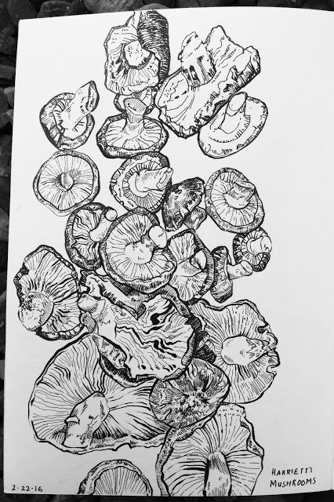
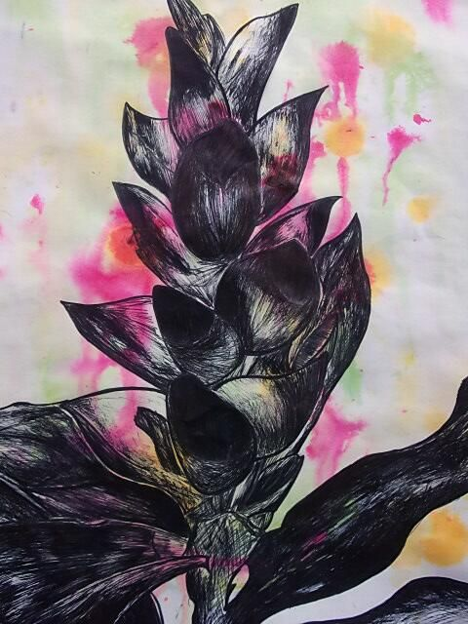
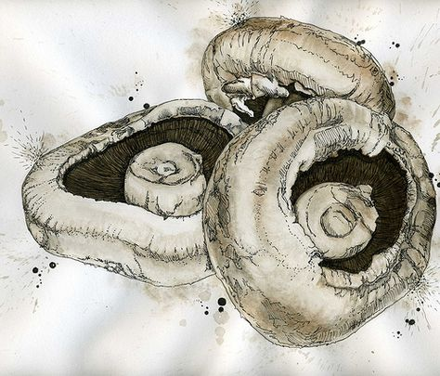
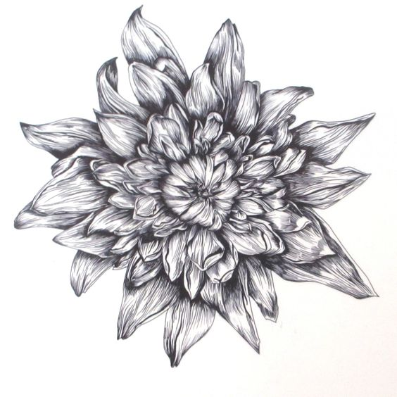
Task 4
To create an A5 pen observational study of a woodland natural form. Use your own secondary or primary image source.

