Slide 1

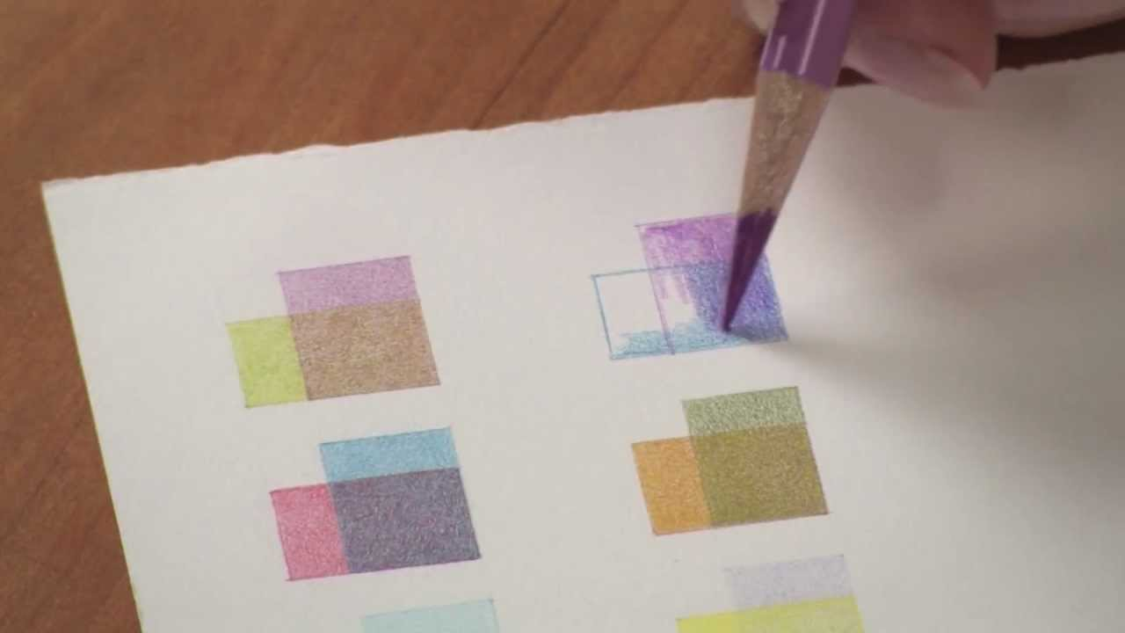
Lesson 5 & 6
Exploring Colouring Pencil
Task 5
On paper draw the following slide square templates and use colouring pencils to colour in the squares using the colour combinations
Blue + Red
Orange + Green
Yellow + Red

Slide 2


Slide 3
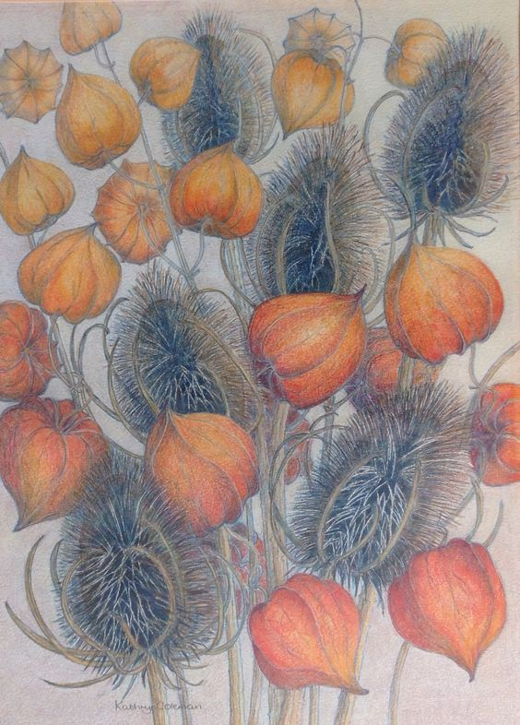
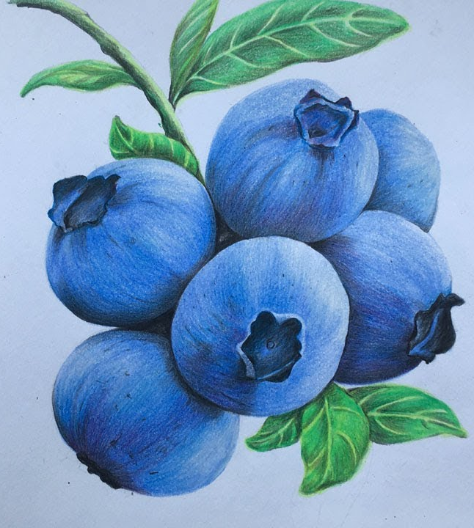
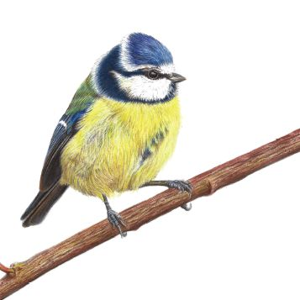
Lesson 5 & 6
Task 6
To create an A4 colouring pencil observational study of a woodland natural form. Use your own secondary or primary image source.

