Slide 1
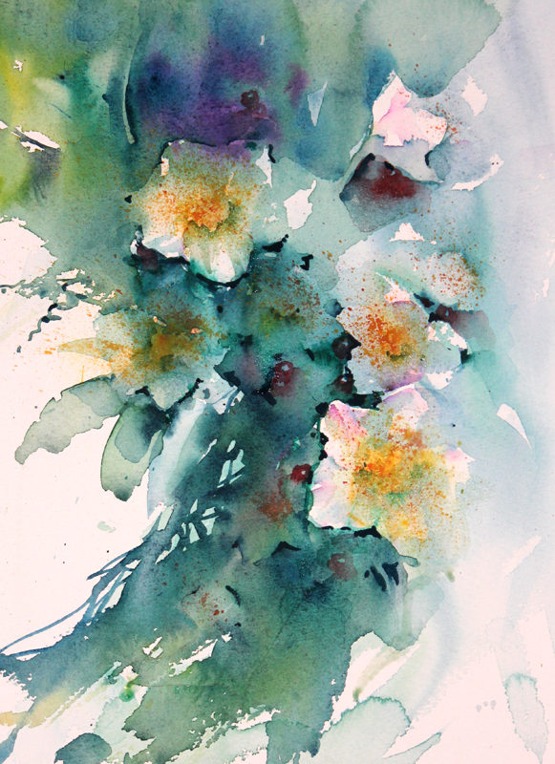
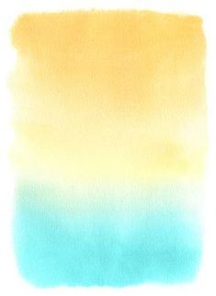
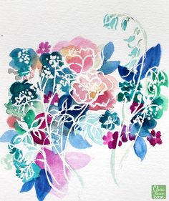
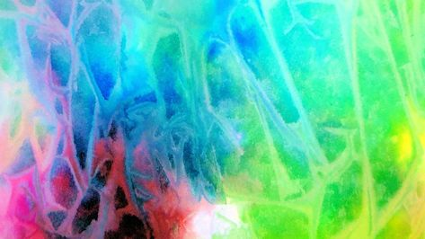
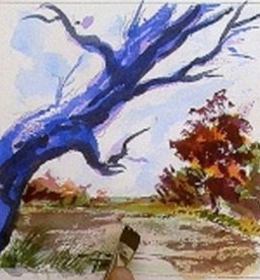
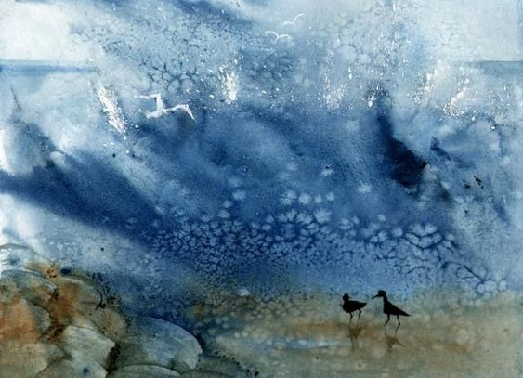
Lesson 7 & 8
Exploring Watercolour
Watercolour is a painting method in which the paints are made of pigments suspended in a water-based solution.
Task 7
On the paper provided, explore the 6 different watercolour techniques
Gradient
Wet on Wet
Masking Fluid
Salt
Plastic Wrap
Dry Brush

Slide 2
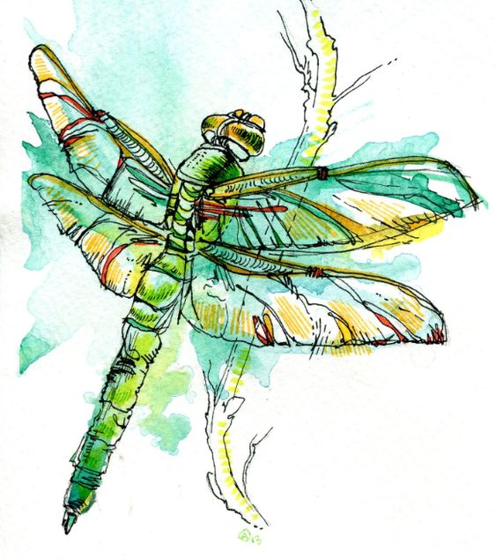
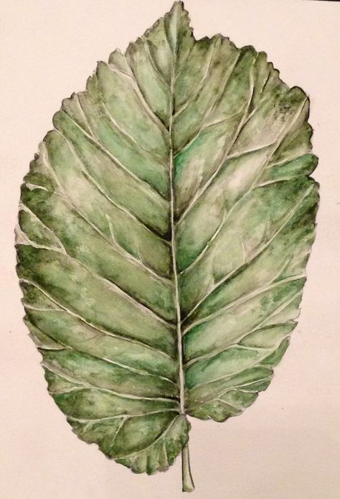
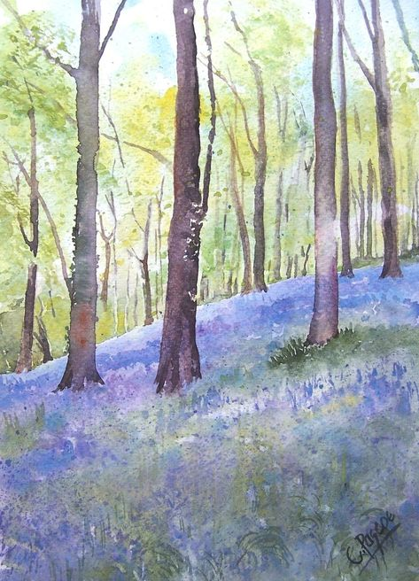
Task 8
To create an A4 watercolour observational study of a woodland natural form. Use your own secondary or primary image source.

Slide 3
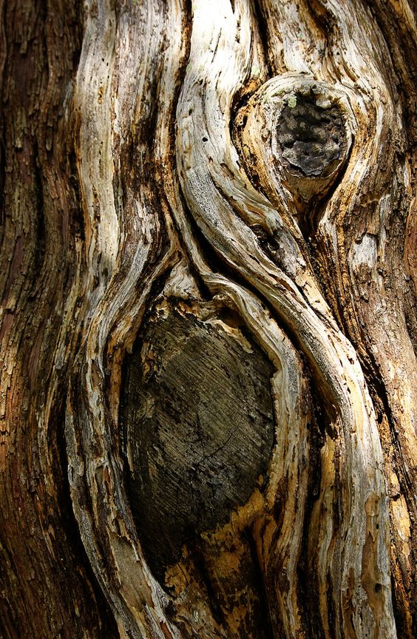
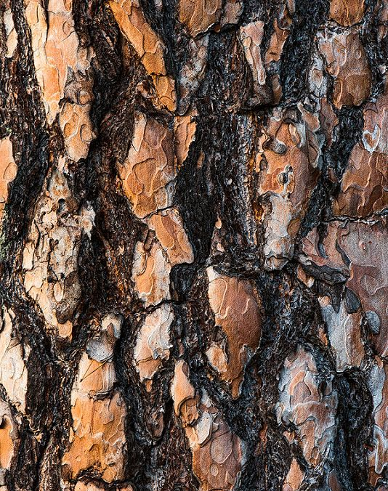
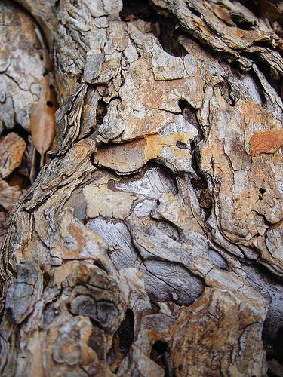
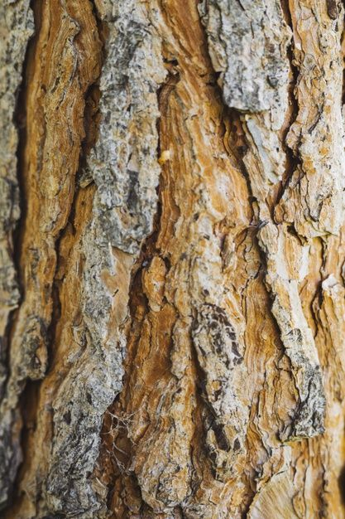
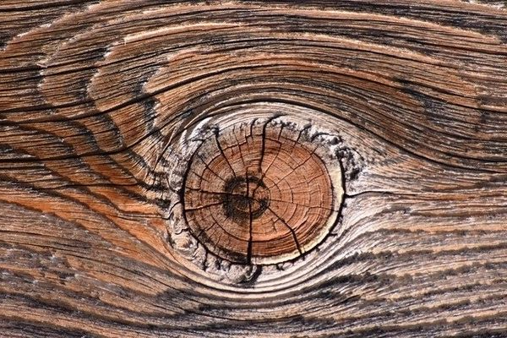
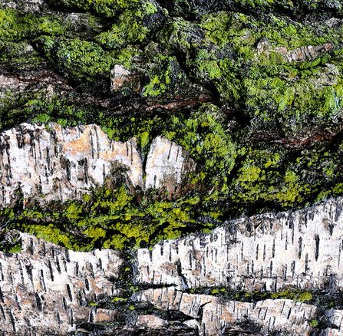

Slide 4
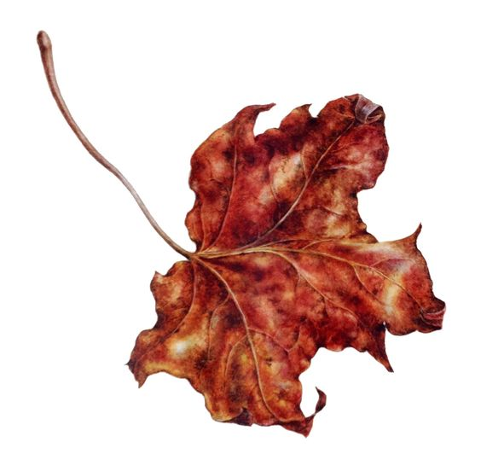
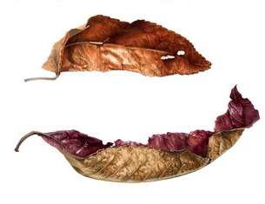
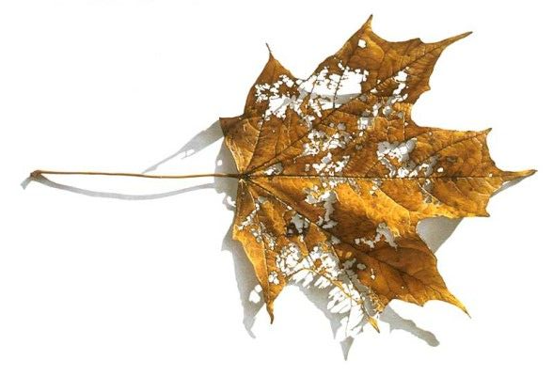
Success Criteria
Drawing is accurate of the 3 dimensional leaf
Colours are mixed exact and tones to show depth and texture
Application of graduated colours is with a high level of control
Incorporate blemishes
Evaluation of watercolour leaf study
WWW
EBI
How did you resolve problems?
What would you do differently next time?
Variety of tones to show crispy texture
Raised vein to show depth
Organic blemishes
Curved ends to create a 3 dimensional form

