Slide 1
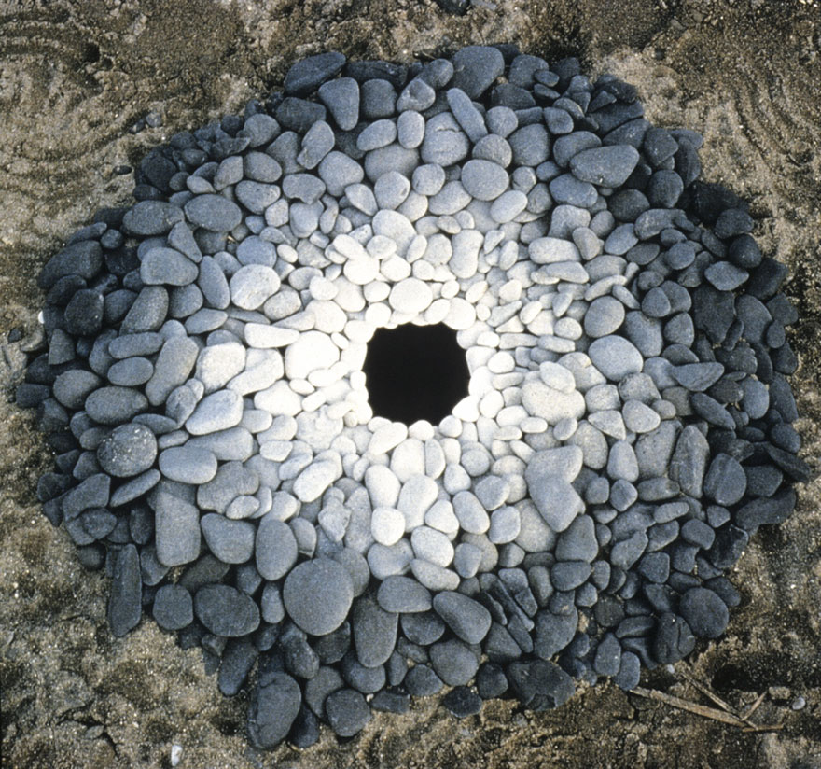
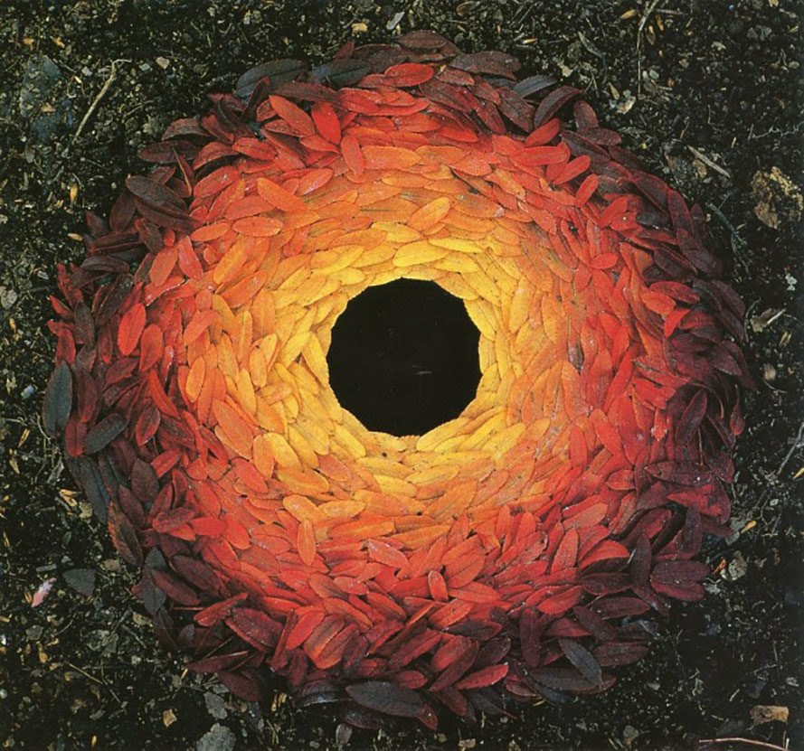
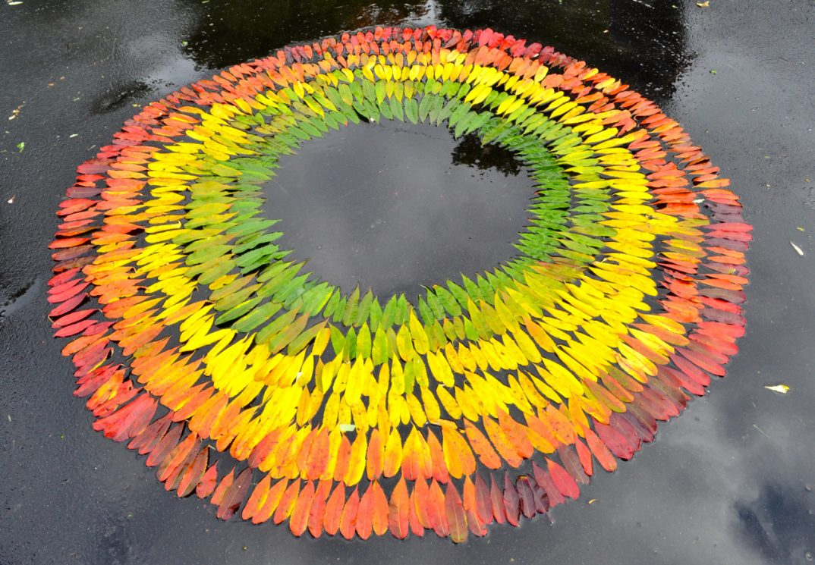
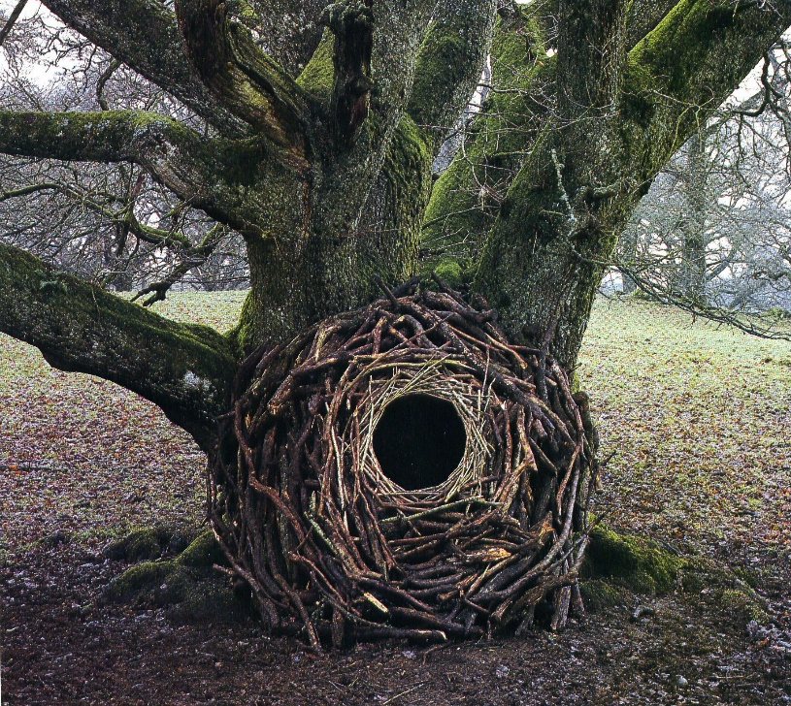
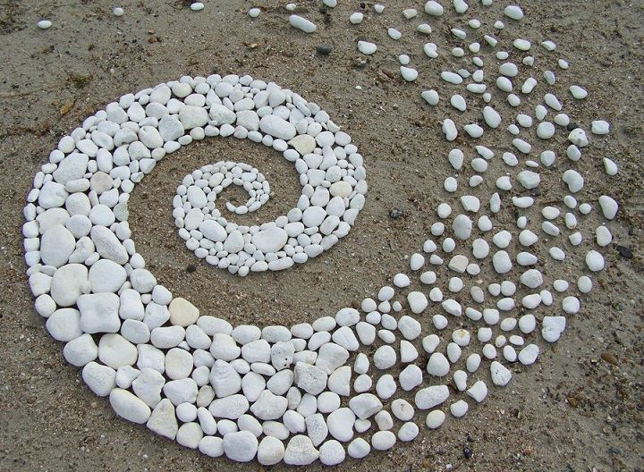
Outdoor Art Inspired by Andy Goldsworthy
Andy Goldsworthy is a British artist known for his site-specific installations involving natural materials and the passage of time.
Andy Goldsworthy is a naturalist, meaning that all of his art is derived from or related to nature. Goldsworthy is inspired by all aspects of the natural world, including snowflakes, twigs, icicles, reeds, tree roots, and rocks.

Slide 2
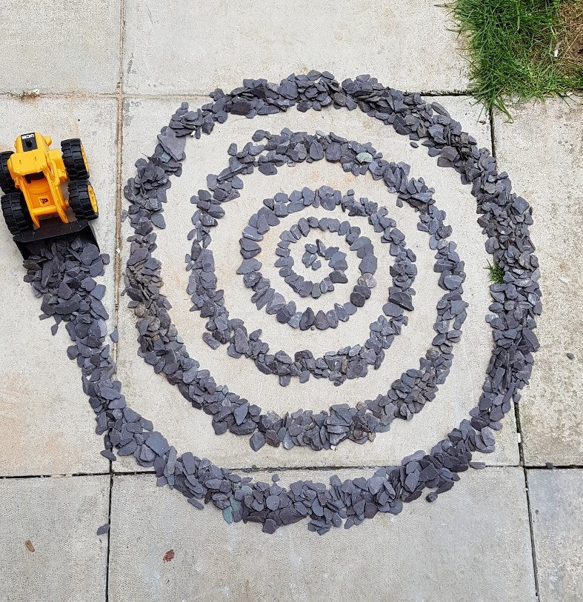
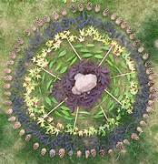
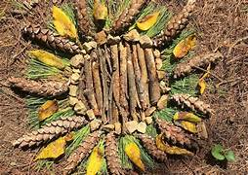
Lesson Task 1
Have a go at creating your own Art inspired by the work of Andy Goldsworthy.
Here is an example…
Make sure to photograph your work
If you do not have any access to the natural world see what you can create with man-made objects inside.

Slide 3
Lesson Task 2
Create an Artist research page on Andy Goldsworthy
Must include:
Facts about him and his life (brief). Include a lot of facts about his artwork.
Images – 6 images of his work. Include the name and date.
Select one of his most impressive artworks and explain why you like it.
What do you think about their work and why? Give your opinion.

