Slide 1
LINE
Continuous Line Drawing Techniques

Slide 2
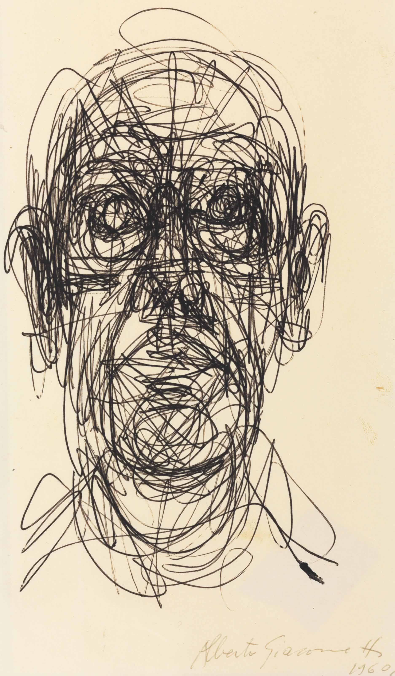
DO NOW​
You have 5 minutes to list as many adjectives to describe Alberto Giacometti’s portrait.

Slide 3
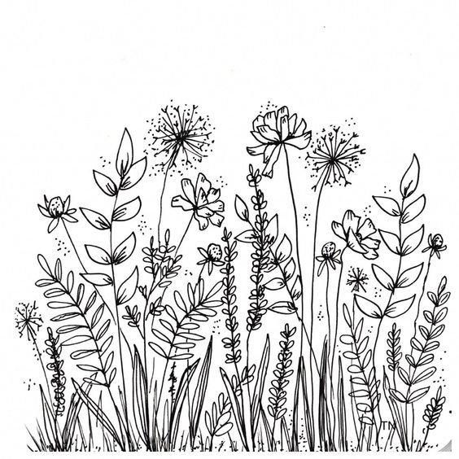
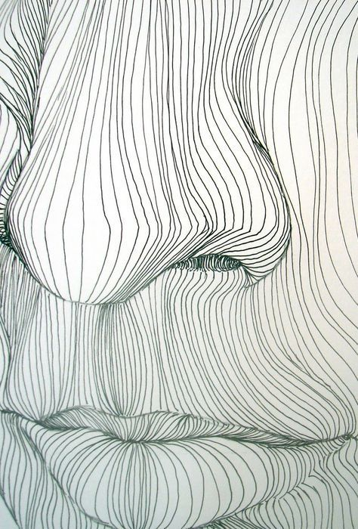
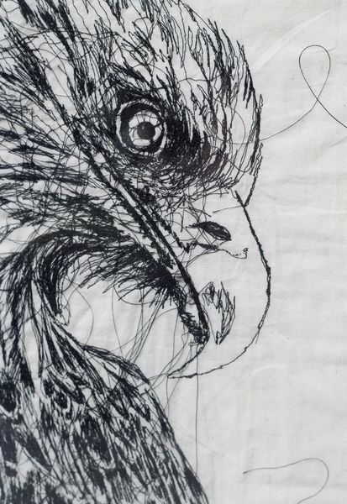
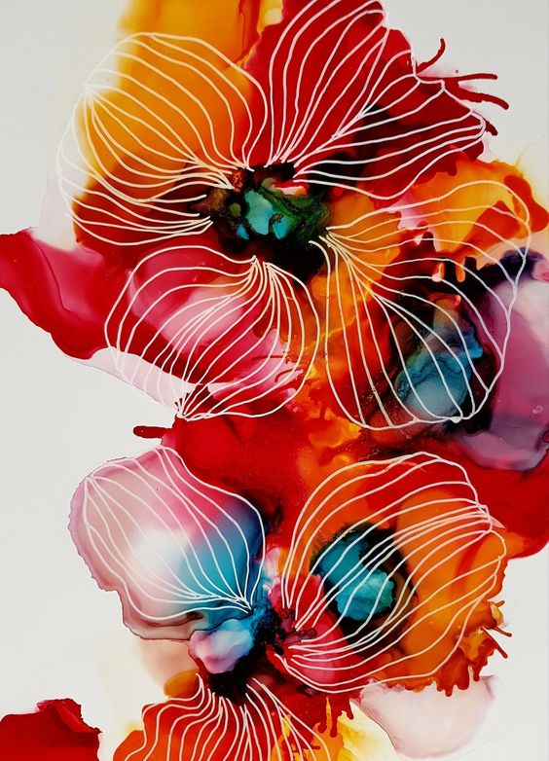
Copy the paragraph below
LINE
A narrow, continuous mark made by pencil, pen or paintbrush. Line is very important because we usually start with a line (outline) when we make a drawing.

Slide 4
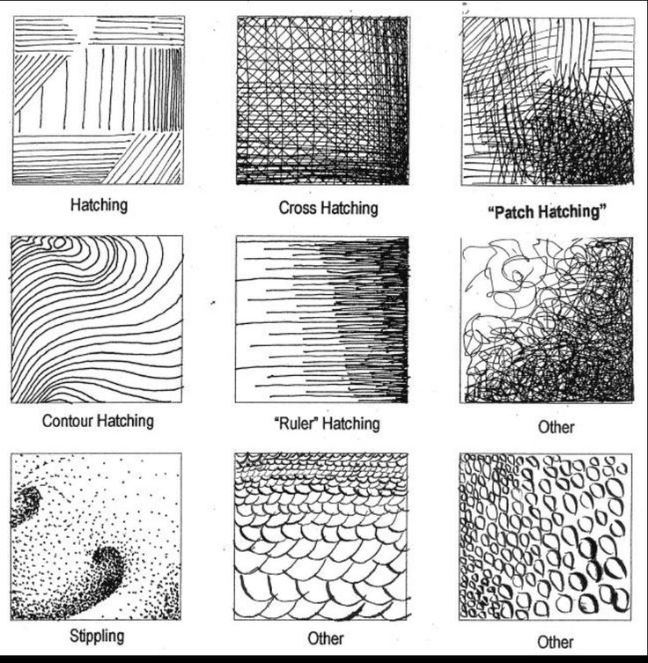
Task 1 – Draw in Pencil the box below
3cm
3cm
15cm
Task 1
To fill boxes with a variety of line
Name the lines underneath

Slide 5
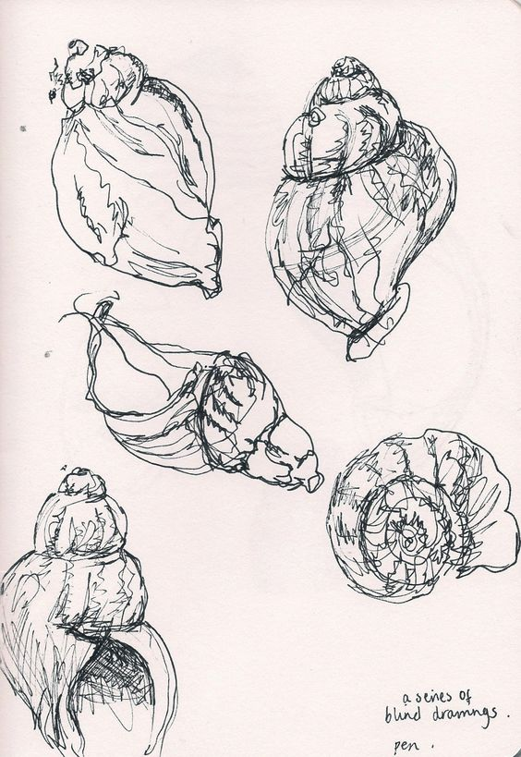
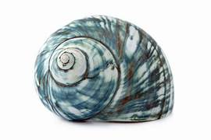
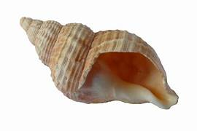
Continuous Line Drawing
Task 2
To create line observational studies of the shells using different drawing techniques.
Continuous
Blind
Wrong hand
Stretch and Challenge
Evaluate outcome
Explain how you created the study
How did you feel when creating the study?
What did you learn by making the study?

