Slide 1
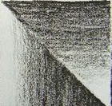
Mushroom Observational Drawing
DO NOW
In pencil on paper practice the graduated tonal range example

Slide 2
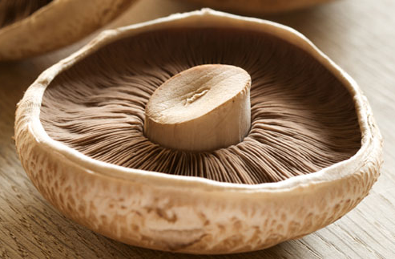
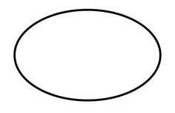
Mushroom Observational Drawing
Task 1
Work from one of the mushroom pictures to make a careful observational Drawing onto A5 paper working in pencil.
Keyword
An ellipse is an oval shape similar to a circle but longer and flatter

Slide 3
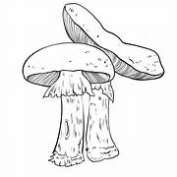
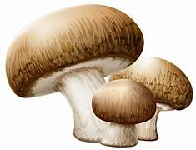
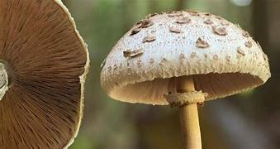
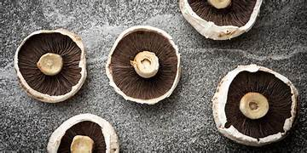
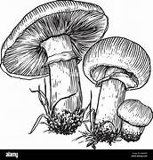

Slide 4
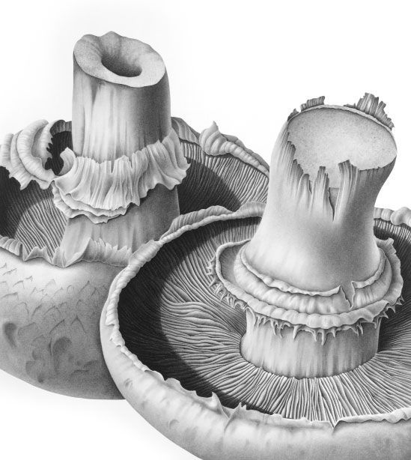
Developing mushroom study by applying tone
Success Criteria
· I can apply gradual mark making tones to the light and dark tones of the mushroom.
· I can apply graduated marks to show full tonal range within details
· I can apply a full range of tones to create a realistic sense of depth
Art Terminology
Depth - to making objects appear closer or further away and making a two-dimensional image seem three-dimensional
Gradation in art - is a visual technique of gradually transitioning from one colour hue to another, or from one shade to another.
Tonal Range – The different tones between light and dark (refer to tonal boxes in sketchbook)

Slide 5
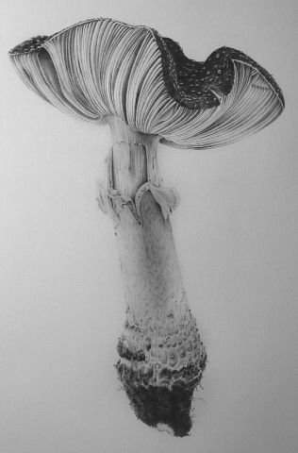
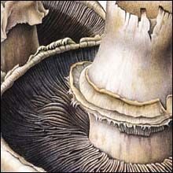

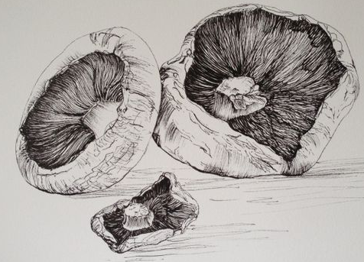
Exceptional drawing studies of mushrooms

