Slide 1
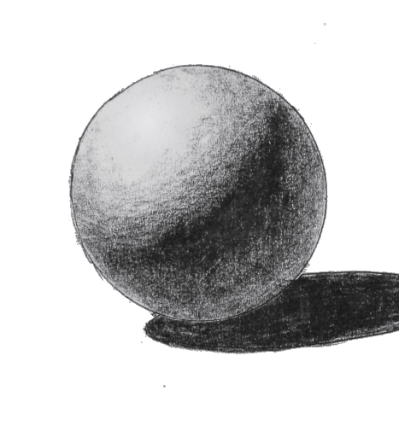
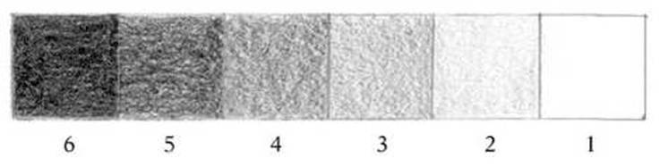
Still Life
Do Now: 10 minutes
1. Copy the sphere drawing using tonal graduation to show where the light hits the surface.

Slide 2
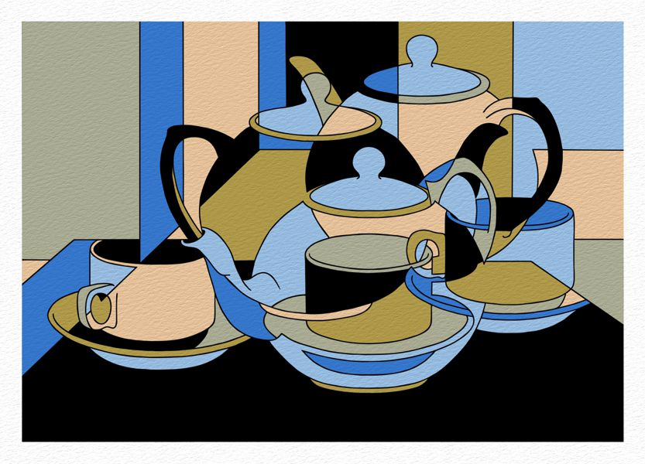
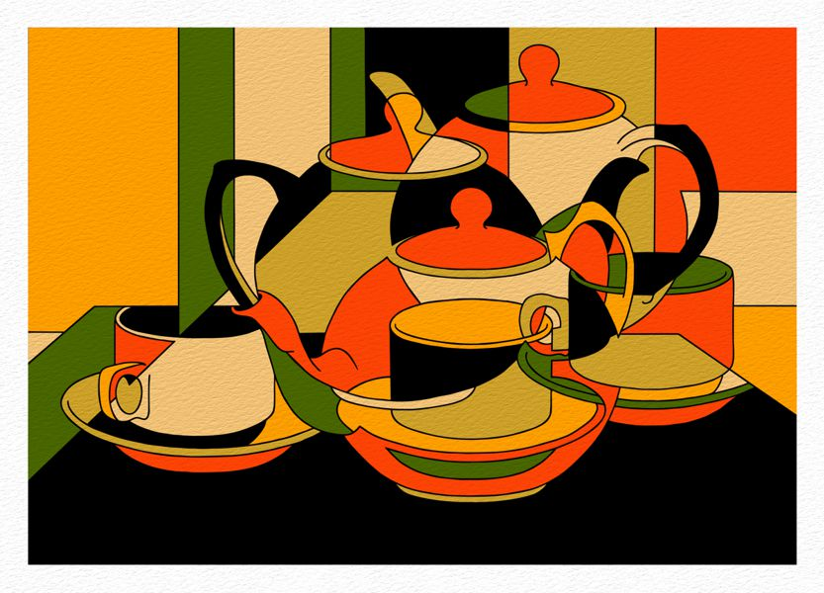
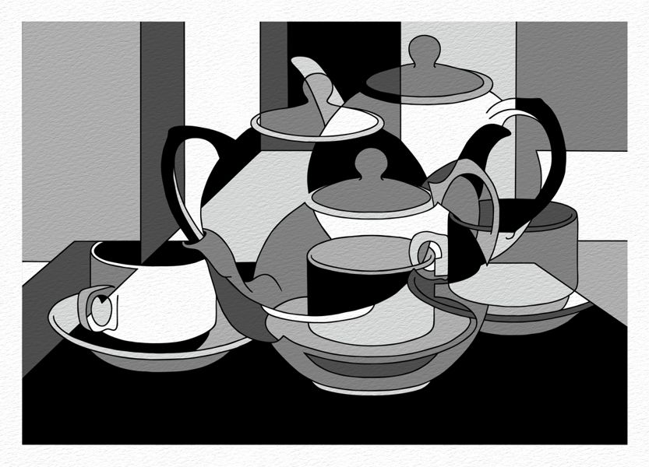
Task: Cubist colour still life
Choose a colour scheme of warm or cool colours.
Choose no more than 5 colours to work with.
Add colour or pencil tone & shade to the still life outline to create an abstract still life.
Apply colour carefully using a circular blending technique.
Challenge: How can you apply colour to still give a sense of the direction of light?

Slide 3
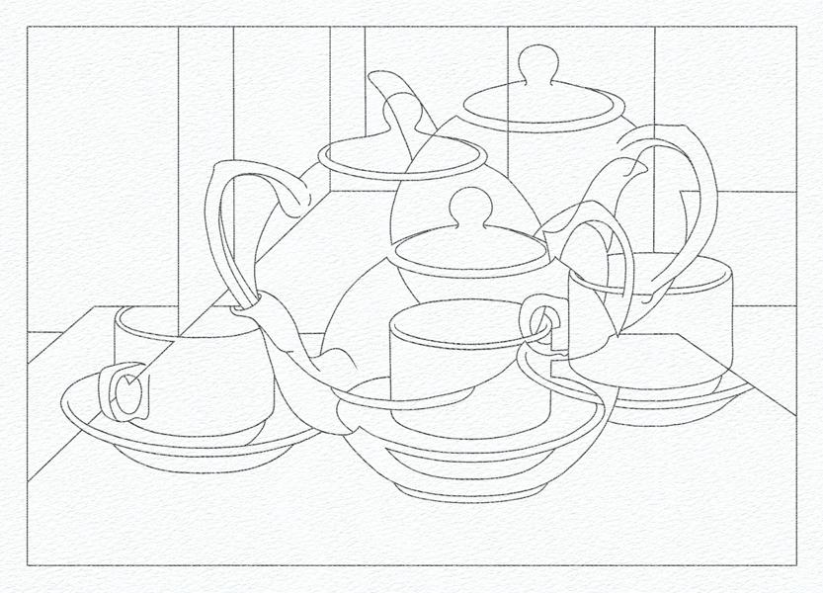
Cut along line

