Slide 1
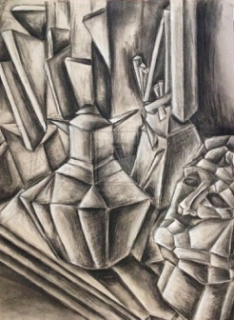
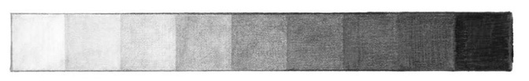
Lesson 3 Cubist Observational Drawing
Looking at a piece of Cubism work, recreate the work as a drawing!
Try and use tone, shade, detail and proportion!
Make sure you label your piece with the name of the artist and the name of the piece of work!

Slide 2
Lesson 4: Cubist Artist Research Tasks
Either on PowerPoint, a word document or by hand complete a research task about the art movement Cubism.
Within your research you should include the following:
Written information about Cubism. This must be done in your own words.
You must name 2 artists that were part of the Cubism movement and explain why.
You must also collect and add 4-5 images of Cubistic work. – include its name, who painted it and when.
You must include your own personal opinion on the Cubism movement.
You can present this however you want! Colourful, exciting, creative! It is up to you!

Slide 3
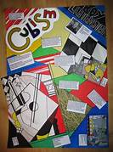
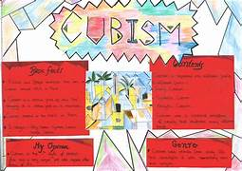
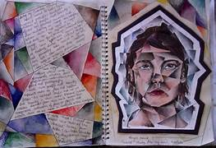
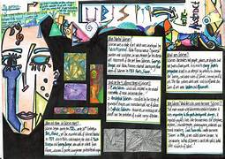
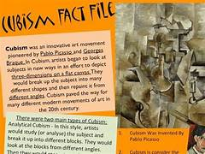
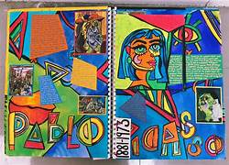
Example Cubist Research Pages

