Slide 1
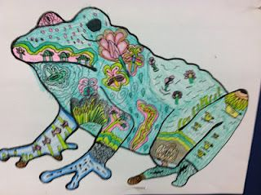
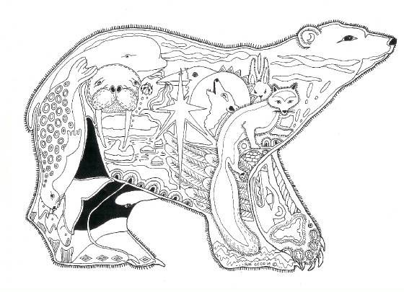
Habitat Animal
Trace your animal onto A4 paper.
Use a pencil to plan and draw items from their habitat inside the drawing. Ensure to draw lots of detail.
Use colour pencils to carefully add colour.
Extension: Use pencil to design an unsuitable environment for your animal.
Go over this in black and white to create contrast in your work.

Slide 2
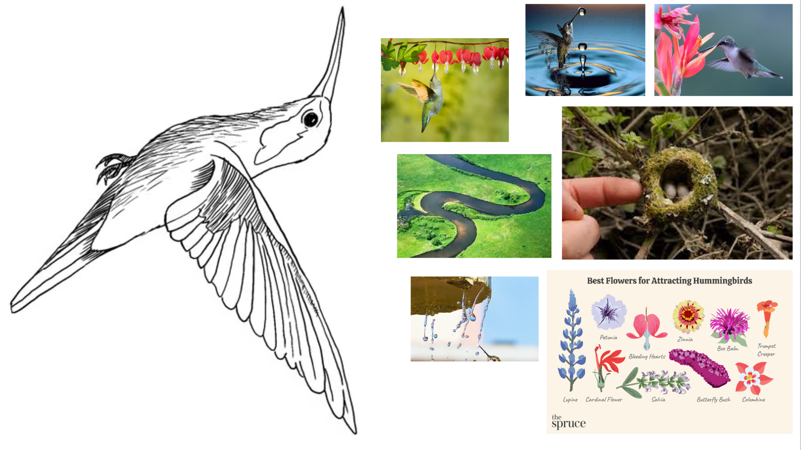

Slide 3


Slide 4
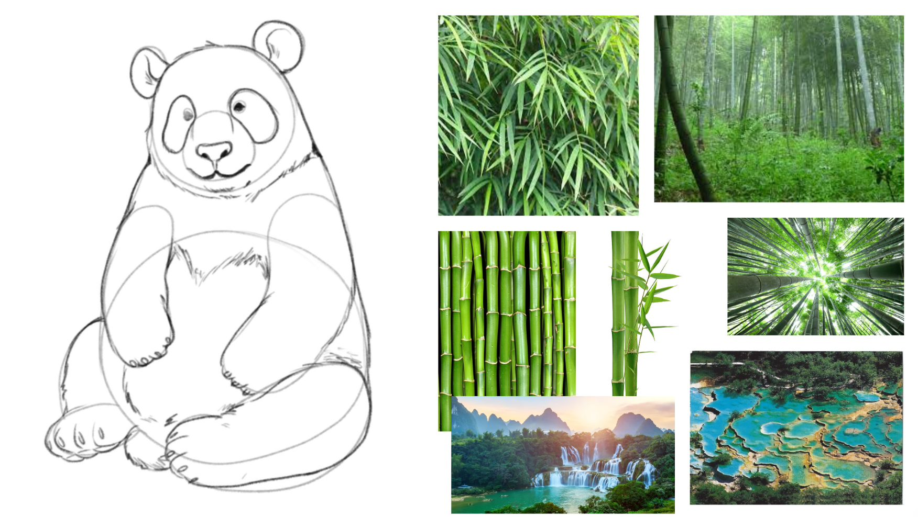

Slide 5
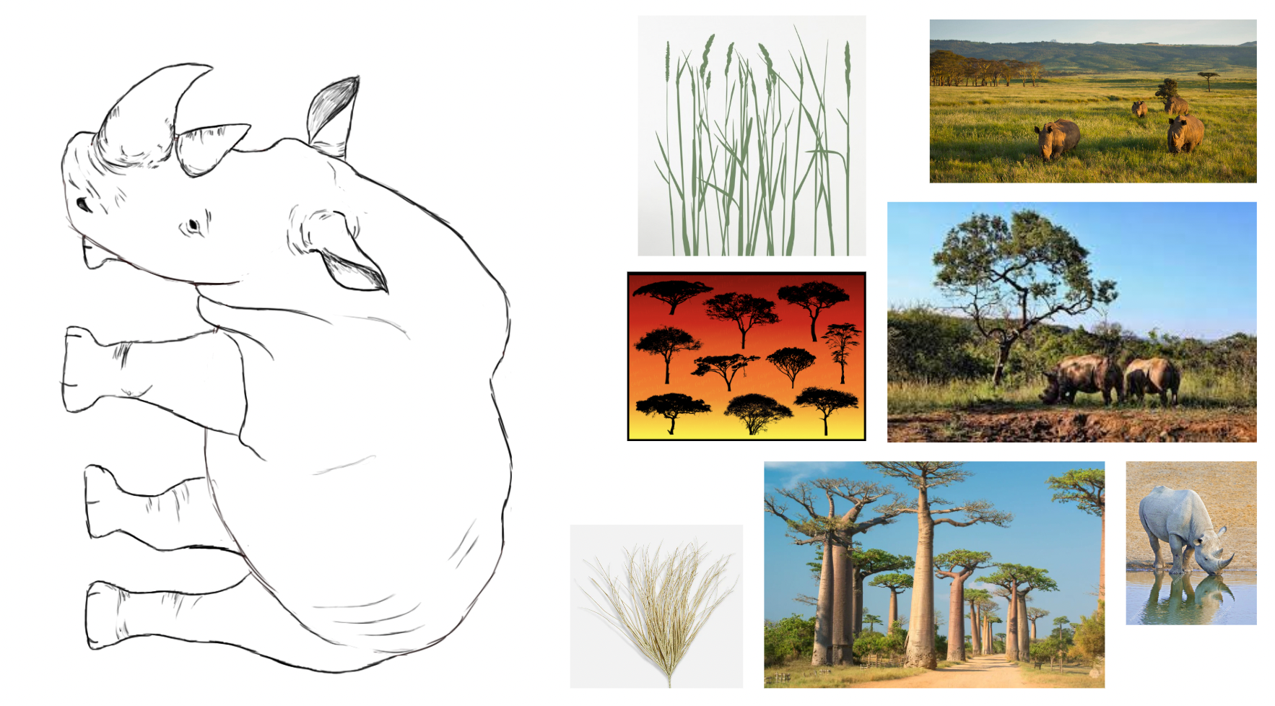

Slide 6
