Slide 1
Typography
Lettering Design Drawing
1. Create an original design using different types of lettering into a visually interesting composition.
2. Create a focal point using size variation and color contrast.
3. Vary the size and angle of the letters or numbers
4. Use black and white design in the background.

Slide 2
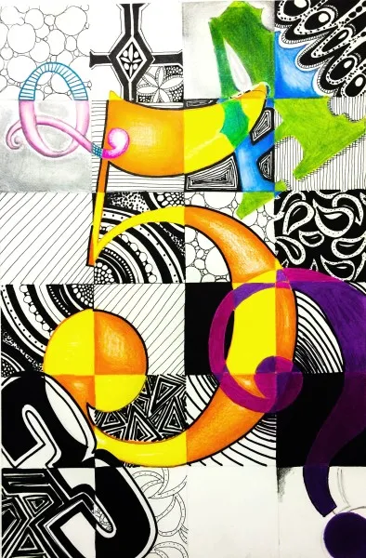
Lesson 1, 2 & 3
Your own Typography Artwork which uses mixed media and new typography techniques.
Mixed media means to use more than one material. In this case, different papers and pencils and pens.
Notes:
Photocopy these for next lesson on a range of paper - colour, graph etc.

Slide 3
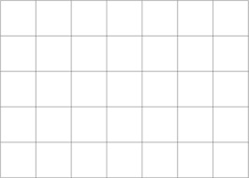
Task 1
You have 15 minutes to neatly draw a grid 7 x 5 (4cm squared) onto your A4 page.
Success criteria:
Use a ruler for straight lines
Correct measurements (4cm x 4cm) squares
A row of 5 squares across the top of your page (portrait)
A row of 7 squares down the side of your page (landscape)

Slide 4
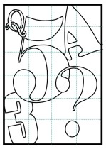
  Task 2
  Over the next 2/3 lessons you will have time to complete your typography design, so please consider the following list for ideas that you can use to develop your work
  Useful design tips / ideas
  Vary the sizes and angles of the letters/numbers.
  Choose your own selection of numbers and letters to make it personal to you
  Overlap some of the letters/numbers
  Have some designs go off the page
  You can repeat the same numbers / letters
  Rotate or twist – use tracing paper for accuracy
  Contrast your colours using colour opposites or adding black and white areas.

Slide 5
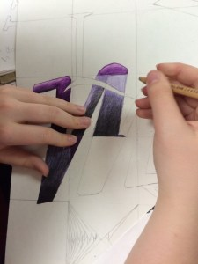
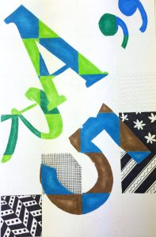
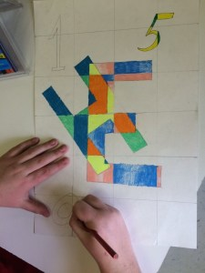
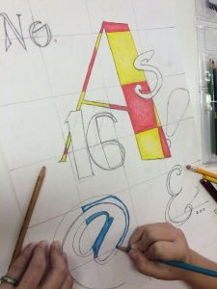
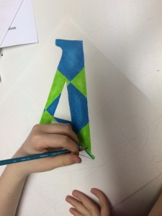
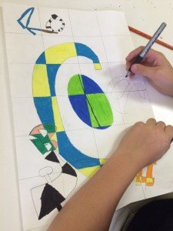
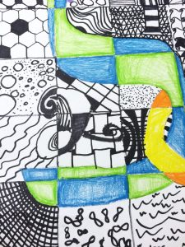
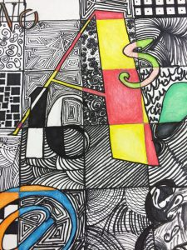
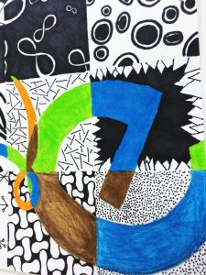
Artwork Example Stages

Slide 6
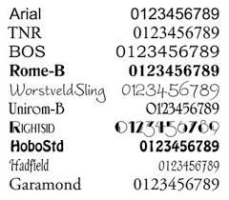
Checklist - Make sure you have
Chosen numbers and letters that are relevant to you - personalized
Vary the size of some of the letters / numbers
Try and vary fonts so they are different font styles.
Your fonts are not just outlines, but have tone, texture, colour or pattern.
Refined your font with pen.
Rubbed out any excess pencil lines.
Notes:
Photocopy these for next lesson on a range of paper - colour, graph etc.

