Slide 1


Year 7 Parents Information Evening

Slide 2


Slide 3


Slide 4
“The main word I have chosen to describe my time over the years would be, “Confidence”.
My journey throughout Churchmead has been incredible. If any student is struggling, Churchmead is here to provide you with all the support and guidance you need.”
Gold tie prefect

Slide 5
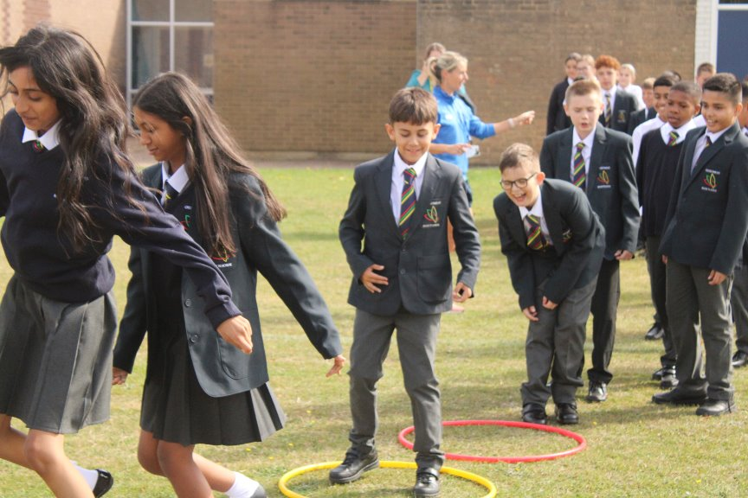
It's the experiences and adventures that will make their time at Churchmead.
Exploration
Determination
Support

Slide 6
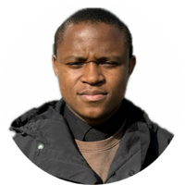
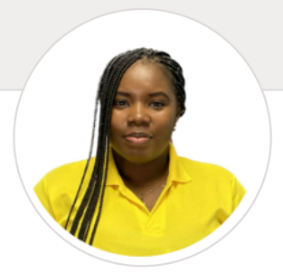
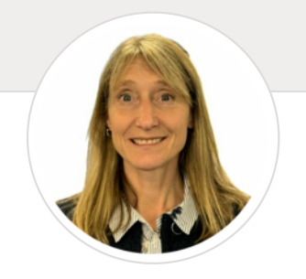
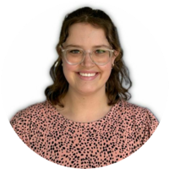
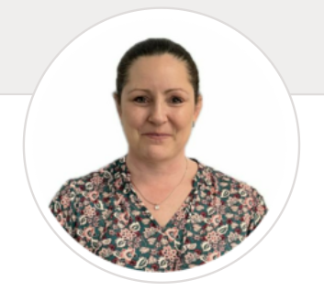
Form Tutors
7 St. Teresa
Mr Vilanculos
7 St. Becket
7 St. Faith
7 St. Victor
Mrs Brown
Miss Ault
H Garner
Mrs Allen
Notes:
As a HOY I will be supporting students with their wellbeing, resilience, and behaviour. We are extremely proud of the systems and resources we have in place to help support our students. These focus on developing skills that will increasingly enable your child to manage their relationships and feelings and build their personal resilience.
Of course, student success not only depends on what the school provides, but also on the quality of the relationships formed between parents and carers and the school. We strive to be open in our communications and to work well together to make this school a purposeful and happy community

Slide 7
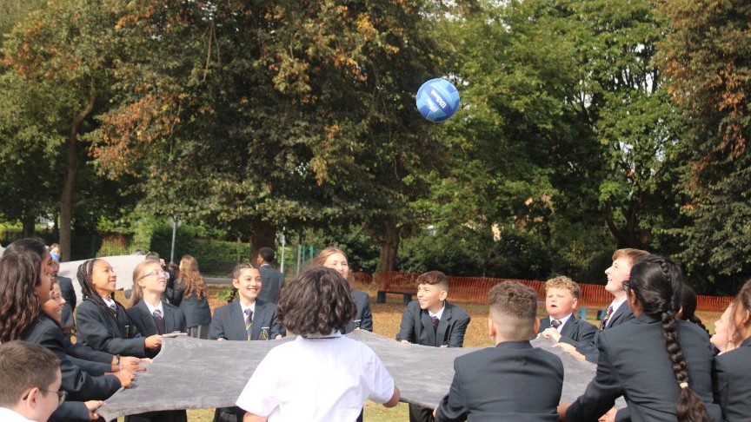
How can I help my child succeed in Year 7?
Promote....
Positivity
Leadership
Care
Resilience
Dedication

Slide 8
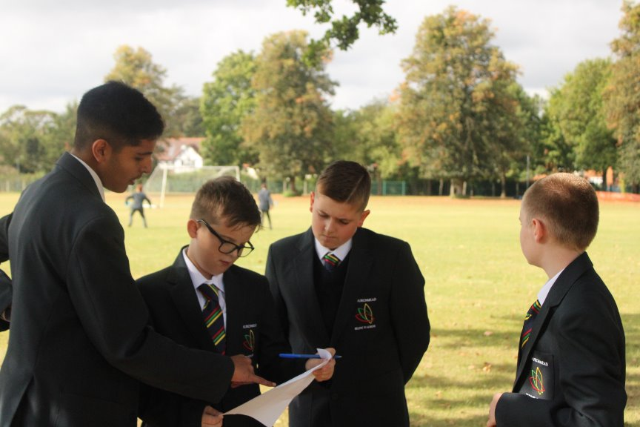
Our expectations ….
Uniform
Mobile phones
Equipment
Homework

Slide 9
Our approach
We will track pupils using rigorous assessments standardised across each subject, matched to GCSE criteria across all five years.
Through this we can then provide timely (early) intervention where required.

Slide 10
Assessment within Grades 9 - 1
In Years 7 and 8, your child’s report will give you a number and a grading within these numbers to show where they are within it. These will be:
  Mastery
  Secure
  Developing
Within these thresholds key skills and knowledge will be differentiated in order for the students to make progress at a pace which suits them.
For example, if your son/daughter is working at a 2S, this means that they are securely working at a grade 2 level within GCSE criteria.

Slide 11
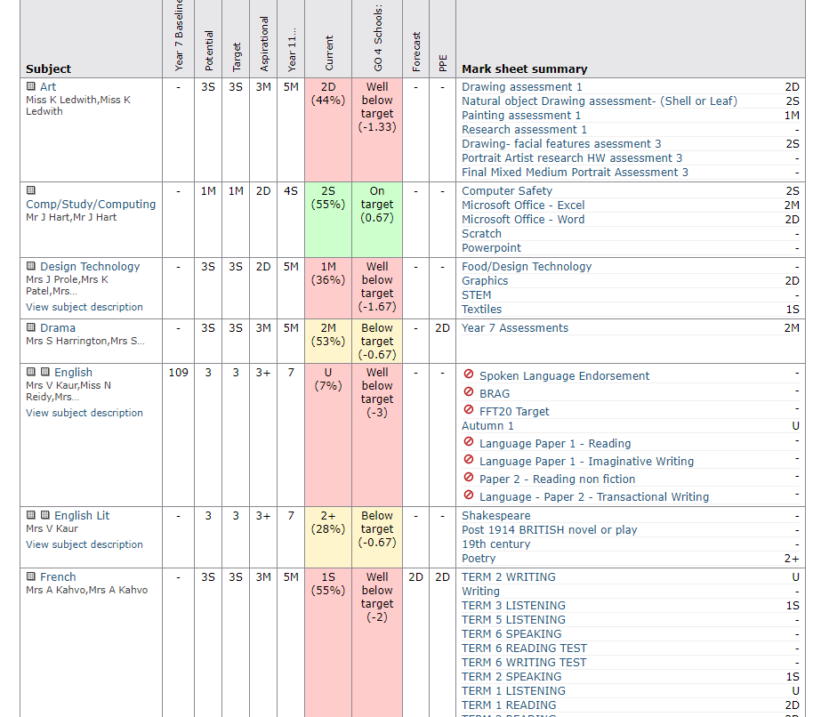
Go 4 Schools
Potential – What they should achieve by the end of the academic year.
Aspirational – A target the pupils have aim for once they reach their potential target.
Year 11 Target – What they are expected to achieve in Year 11.
Current – The current performance in the subject based upon the GCSE grading.

Slide 12
Reporting to Pupils
Students will receive feedback in their assessments which will give them clear guidance on what they are doing well and what they need to improve on.
They will also have to fill out their own self-reflection sheet highlighting what skills and knowledge they have and what areas they feel they need to work on.
Pupils will generally have to undertake independent review/ improvement activities following the assessment.

Slide 13
Reporting to Parents
You will receive three progress reports per academic year, one at the end of each full term.
You will receive, per subject, an assessment of how your child is working. Depending on the threshold your child is in you will be given the letter and a number.
Report Key
Commitment to Learning | Student's Commitment to their Learning
Classwork | Quality of Classwork produced
Homework | Quality of Homework produced
Commitment to Learning
Outstanding | Student is well motivated and is able to work effectively in a wide variety of situations
Good | Student is usually well motivated and works effectively with support and guidance
Needs improvement | Student is sometimes well motivated, but sometimes needs refocusing
Classwork
Outstanding | Classwork produced is consistently outstanding
Good | Classwork is of a good standard and completed on time
Needs improvement | Classwork often inconsistent and regularly needs redirecting
Homework
Outstanding | Homework produced is consistently outstanding and is always handed in on time
Good | Homework is of a good standard and handed in regularly on time
Needs improvement | Homework is inconsistent

Slide 14
Homework
All homework is to be written in the planner by the pupil during the lesson.
Key pieces of homework will be set on Go 4 Schools and can be viewed by parents and pupils.

Slide 15

Year 7 English

Slide 16




Churchmead School Y7 English
We want to continue building on the strong foundations of the work done in primary school.
We aim to provide a rigorous and comprehensive programme of study - ensuring a clear progressive route to GCSE.
Students will have multiple opportunities to develop reading, writing and spoken language in their lessons.

Slide 17

An overview of the Year 7 curriculum

Slide 18
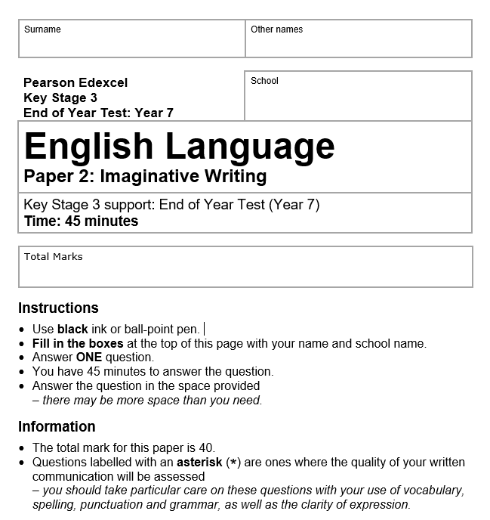
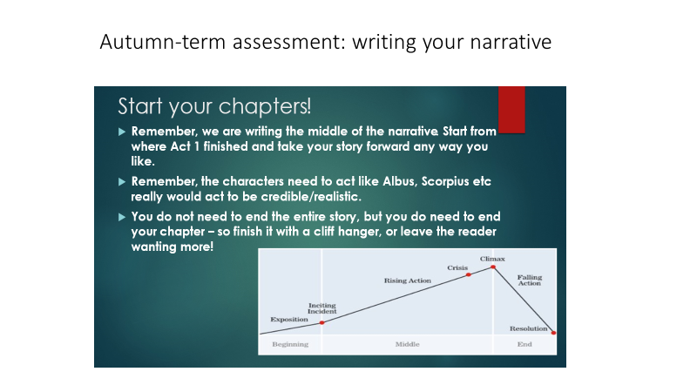
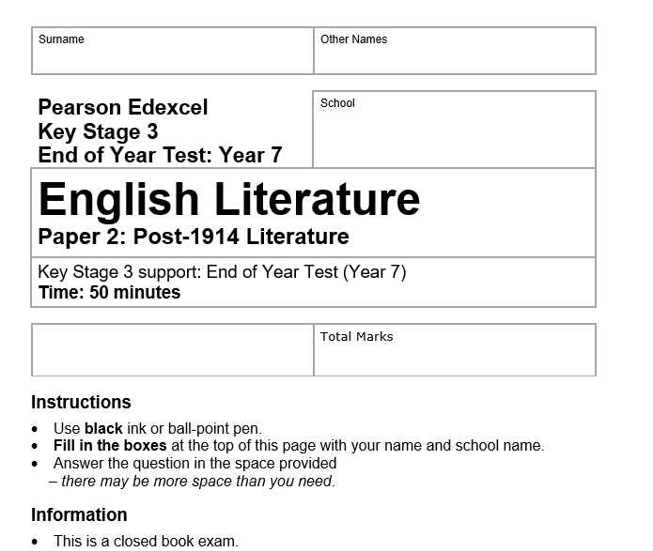
Assessment in English
WWW/EBI/NTIW
Half-termly assessments
Clearly linked to GCSE skills

Slide 19
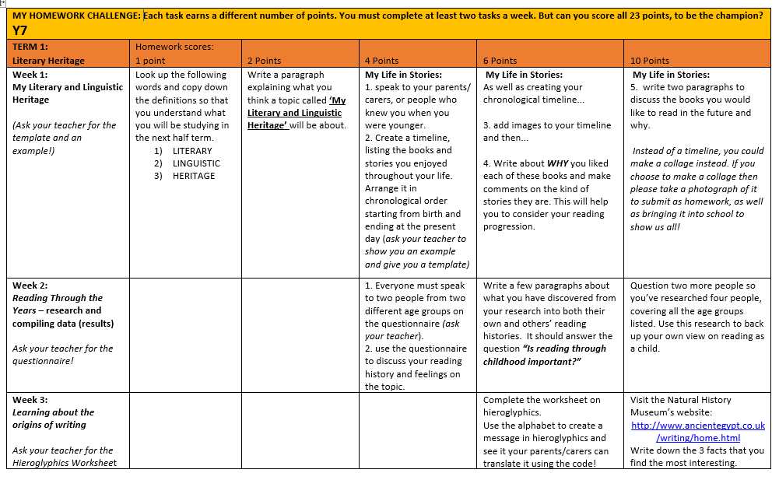
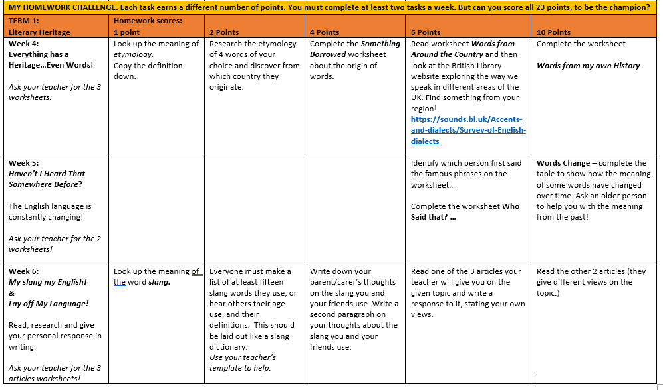
Homework in English
Homework is set weekly and we divide this into two parts:
READING: Year 7 students should read for at least half an hour a week at home.
Ideally, students will be encouraged to read for 15 minutes each night before bed – which amounts to 1 hour, 45 minutes without really noticing!
2. WRITTEN WORK: Year 7 students will complete a further weekly written homework.
This is self-selected from the homework grid supplied at the beginning of each term's work. A minimum amount is set, house points are awarded – and positive phone calls home made – for those who exceed expectations!

Slide 20

Please stay in touch with your child’s English work by:
Talking to them about what they are doing in English.
Having a look at their planner to see what homework they have.
Asking them to bring home their books so you can see what they have been doing in lessons.
If you would like to discuss your child’s progress in English, please feel free to contact the school.

Slide 21


Slide 22
Mathematics
In Mathematics students will be develop their Maths skills and learn how to apply them in everyday life.
Our exam board is Pearson. In KS3 students are in mixed ability groups. KS4 students are split into the groups according to their abilities.
As a part of the whole school, Mathematics also provides electronic version of textbooks (Kerboodle) that could be logged in on any platform.
Students results and homework is recorded on Go4Schools.

Slide 23








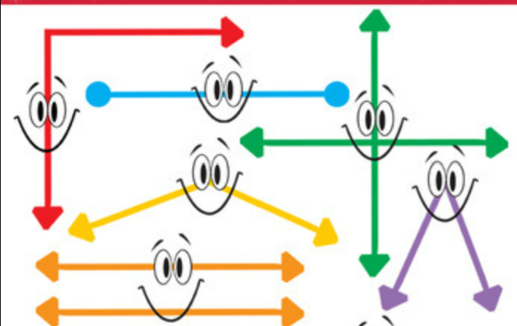


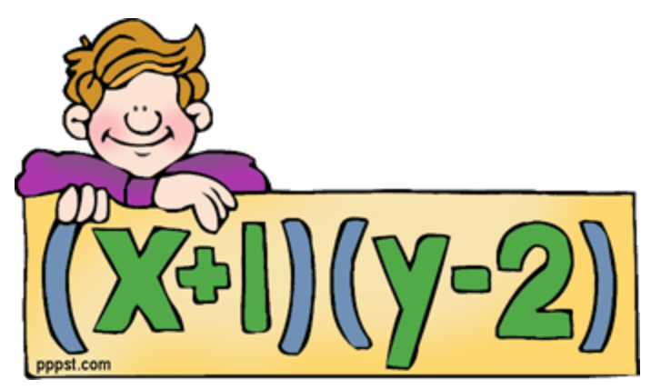




Curriculum map year 7
Term 5
Ratio and
Proportion
Probability
Term 6
Factors and
Multiples
Equations
Symmetry
PPE
Constructions
and
2D Shapes
Term 4
Angles and
2D shapes
Term 3
Graphs
Statistics Transformations and
Term 2
Expressions and
Formulae
Term 1
Measure, Perimeter
and area
Into to Maths
CAT testing
YEAR
Fractions, Decimals
and Percentages
7

Slide 24
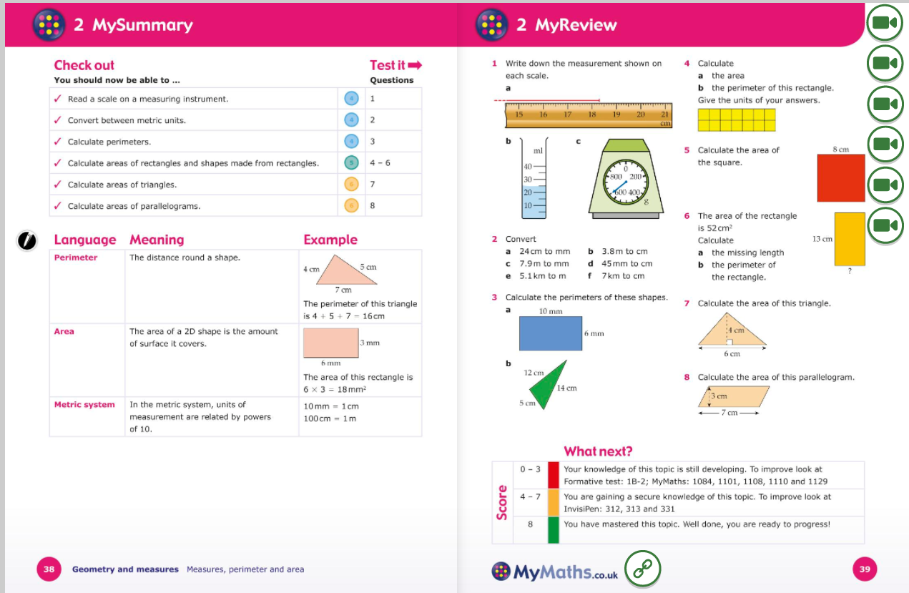
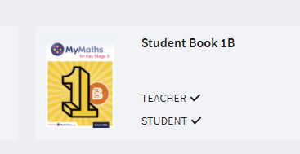

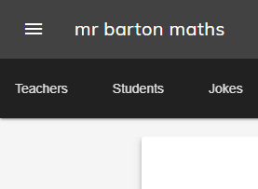
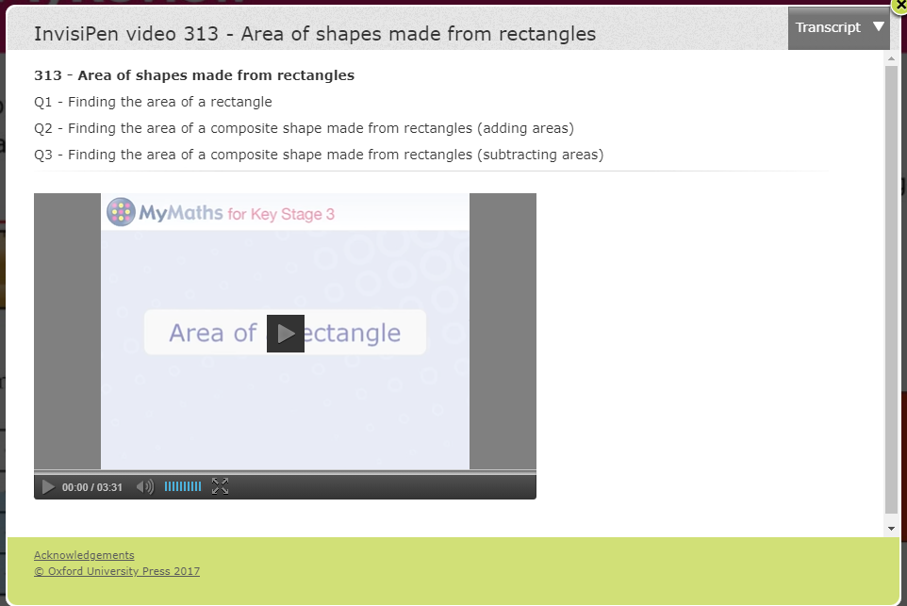


Mathematics resources
Still not sure? Then...

Slide 25
Homework
All homework is to be written in the planner by the pupil during the lesson.
Homework will be given to students on weekly basis.
Students will receive the hard copy and it will also be set on Go 4 Schools so it can be viewed by parents and pupils who lose the homework.
If students need help with homework, they can ask their teachers or attend the Maths Surgery afterschool club on Tuesday.
It is important that homework is completed on time.

Slide 26
Assessments
To build knowledge important for further development of Mathematical skills. Every topic will be followed by an assessment.
Students are allowed to take their books home with them in order to prepare for all the lessons and assessments.
The assessments will be marked and detailed feedback will be provided to all the students.
Following lesson with WWW and EBI students will use their feedback from teachers to write NTIW to improve outcome on their future assessments.

Slide 27


Slide 28
Aim
We aim:
To help students to grow an analytical mind and encourage curiosity about science.
To support students to obtain knowledge, understanding and skills to solve problems.
To encourage students to plan and carry out practicals and draw relevant conclusions.
To present scientific ideas.
To think analytically, and judge arguments and make decisions in scientific and other contexts.

Slide 29
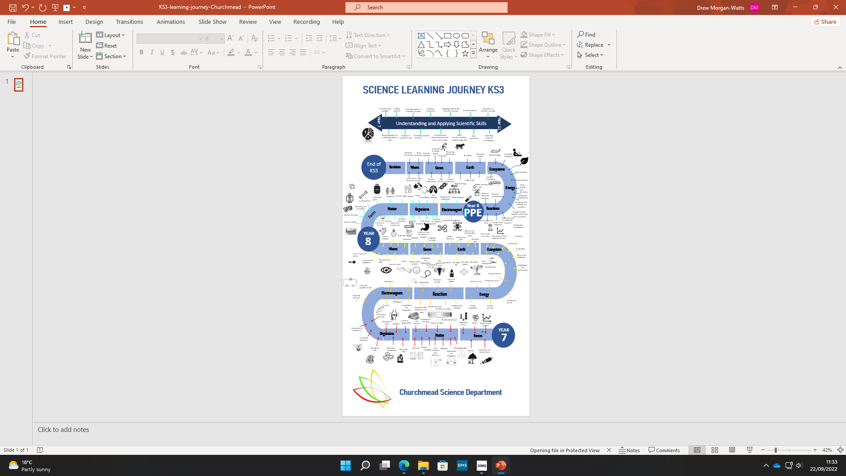

Year 7 Science Curriculum

Slide 30
Classwork, Homework and Assessment
Date | Title | Objective | Video | Homework
6.9.24 Wk 1 1 | Levels of Organisation | State what is meant by a tissue, an organ, and an organ system State the sequence of the hierarchy of organisation in a multicellular organism Use information provided to list the organs found in a given organ system, and state the function of that system | https://www.youtube.com/watch?v=SzKKYYIlJ-c Levels of organisation an organism | Cells | Biology | FuseSchool | Organising a body
7.9.24 Wk1 2 | The Skeleton | Name the main parts in the skeleton List the functions of the muscular skeletal system | https://www.youtube.com/watch?v=tYqL1ajCu6s The Skeleton | Physiology | Biology | FuseSchool | Build your own skeleton
8.9.24 Wk1 3 | Movement: Joint | State where joints are found in the body State how a muscle exerts force during movement Carry out an experiment to make simple observations | https://www.youtube.com/watch?v=NF51ioK6U14 Joints | Physiology | Biology | FuseSchool | Forces for lifting Practical
12.9.24 Wk2 4 | Movement: Muscles | State the function of major muscle groups State the definition of antagonistic muscles Carry out an experiment to study the muscle system in a chicken wing | https://www.youtube.com/watch?v=qwnySVtllTA Muscles | Physiology | Biology | FuseSchool | Investigating how a chicken wing works Practical

Slide 31


Slide 32
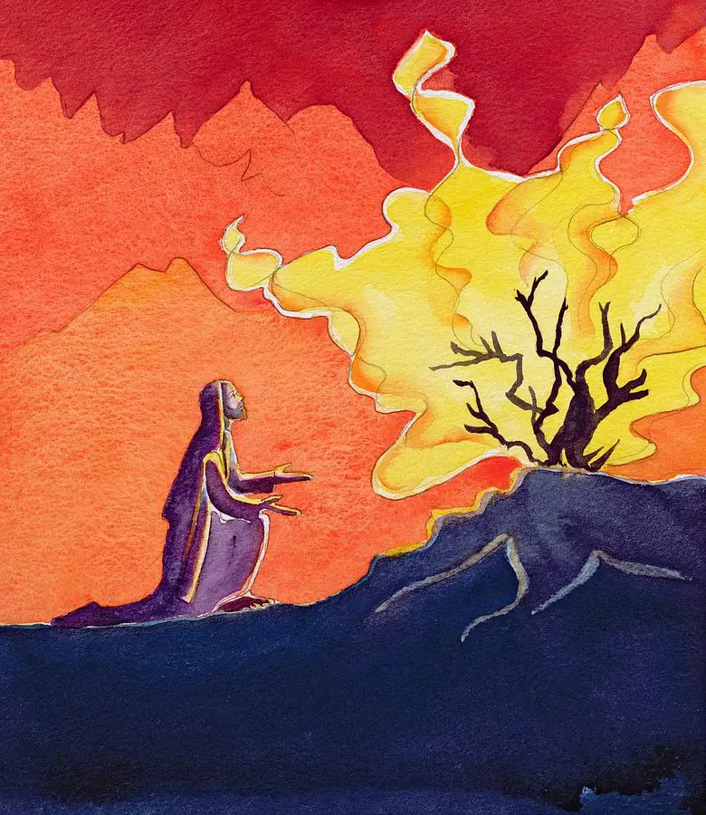

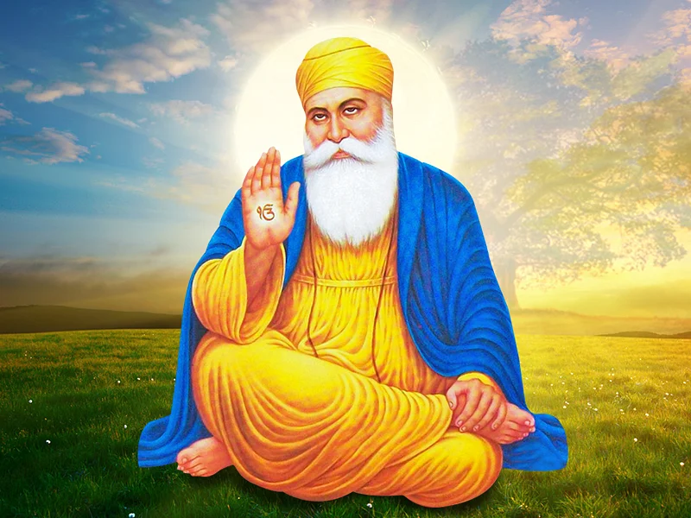
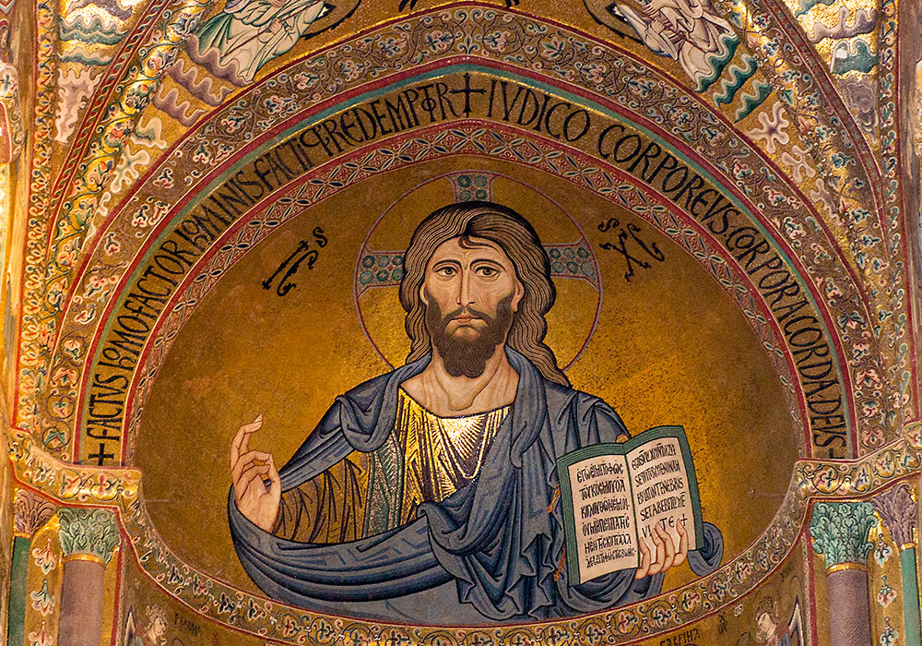

RE: Building something deeper
Useful Links
KS3 Religious Studies - BBC Bitesize
BBC Religion & Ethics
Reonline
RE:Quest
Sacred Space (LOtC)
It is our intent, at Churchmead School, for the Religious Education curriculum to inspire students to engage with the great faiths and belief systems of the world, challenge students to ask the Big Questions, encourage students to grow in their understanding of others and ultimately to learn to flourish in their life.
Year 7
Unit 1- Life in All Its Fullness
Unit 2- Judaism
Unit 3- Christianity
Unit 4- Islam
Year 8
Unit 1- Christianity
Unit 2- Buddhism
Unit 3- Humanism
Unit 4- Sikhism

Slide 33


Slide 34
Key Dates
Term 1: Ends on Fri 25th Oct
Term 2: Mon 4th Nov – Friday 20th Dec (Inset Friday 29th Nov)
Term 3: Wed 6th Jan – Fri 14th Feb
(Inset Friday 6th Jan)
Term 4: Mon 24th Feb – Fri 4th April
(Inset Friday 14th March)
Term 5: Mon 22nd Apr – Fri 23rd May
Term 6: Mon 2nd Jun – Tue 22nd Jul
6 sets of data, (1 per half term)
Main reports sent 3 times a year at Christmas, Easter and End of year
Year 7 Student Progress Evening on Thurs 19th Jun 2025
Term 1; Ends on Fri 19 Oct
Term 2; Mon 29 Oct – Friday 21 Dec
Term 3; Mon 7 Jan – Fri 15 Feb
Term 4; Mon 25 Feb – Friday 5 April
Term 5; Mon 23 Apr – Fri 24 May
Term 6; Mon 3 Jun – Fri 19 Jul

Slide 35


Slide 36
Additional Information
As we strive to raise standards and school budgets continue to stretch, we ask each family to contribute £40 to our school fund to purchase furniture for our outdoor dining area
Communication – All our correspondence is via email and/or text with links to letters or forms. Please use Arbor at Log in to your School | Arbor for all school commuications and to track attendance, behaviour and praise points.

Slide 37


