Slide 1


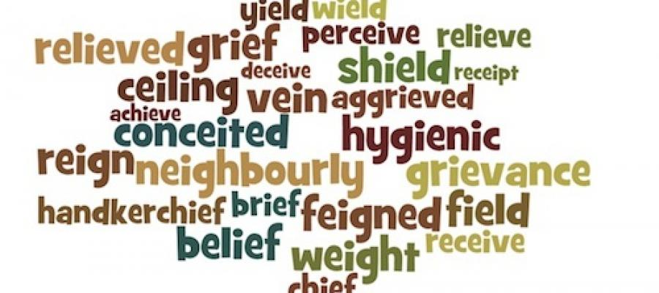

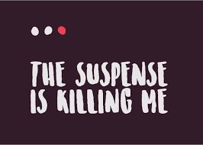
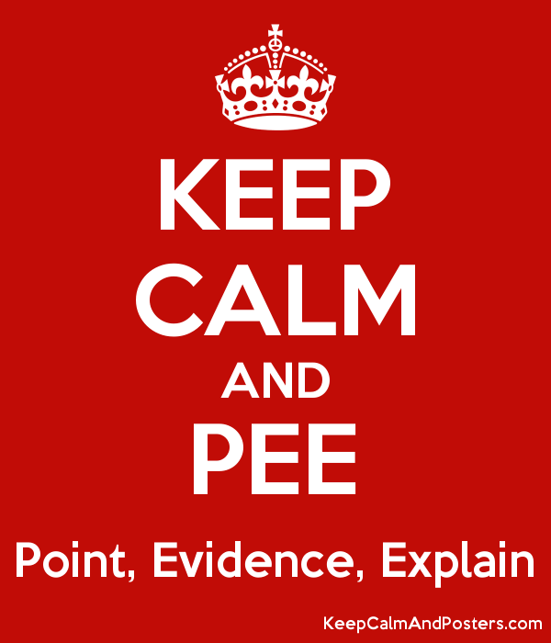
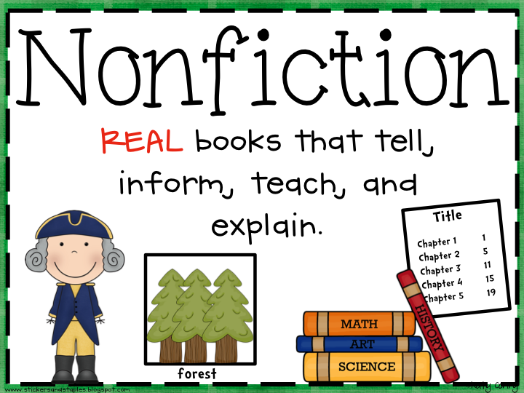


Churchmead School
Believe to Achieve
SPAG:
Apostrophes
Negative Pre-Fixes
Commas
Rules for adding ‘LY’
Hyphens
‘GHT’ words
Parenthesis
Prefixes
Homophones
Spelling: ‘IE’ or ‘EI’
Quotation Marks
Semi-colons
Key Knowledge: (definitions/subject terminology)
Stereotype
Purpose/Audience and Form
Select
Explicit
Implicit
Point, Evidence and Explanation
Technique
Evaluate
Perspectives
Contrast
Analysis
Connotation
Effect
Emphasis
Tone
Description
Synthesis
Language:
Archaic
Personal Pronoun
Adjectives/Nouns
Hyperbole
Alliteration
Verb
Simile
Metaphor
AFOREST
Adverb
Structure:
Repetition
Lists
Paragraph
Suspense
Sentence types and functions
Contrast
Year 7: Non-Fiction Knowledge Mat
Form: (Layout, text type and Purpose)
Newspaper Article
Review
Letter
Leaflet
Website
Speech
Transcript
Report
Advertisement
Autobiography
Biography
Journal/Diary
Argument
Vocabulary/Discourse Markers:
In comparison
On the other hand
However
Vocabulary to evaluate:
Powerfully
Effectively
Emotively
As well as
Furthermore
In addition
SITE Setting
Ideas
Themes
Events
Emotively
Creatively
Successfully

