Slide 1
Year 7 Islam Booklet
Please read the booklet.
Make notes on the booklet.
Answer the Questions at the end of the booklet.
Name…………………………………………….

Slide 2
What are the origins of Islam?
Learning outcomes:
To describe when Islam began
To explain key beliefs in Islam
To evaluate if religions need denominations
Starter:
What do you already know about Islam?

Slide 3
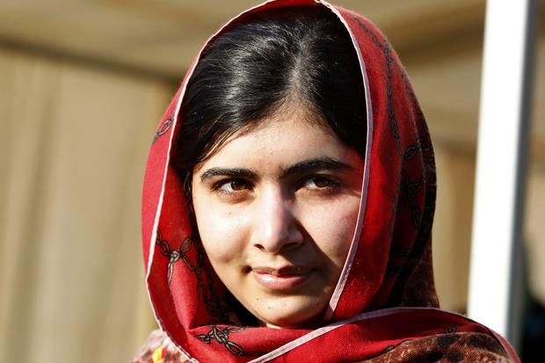
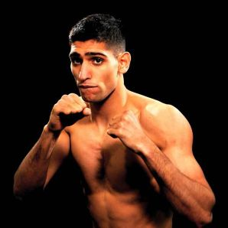
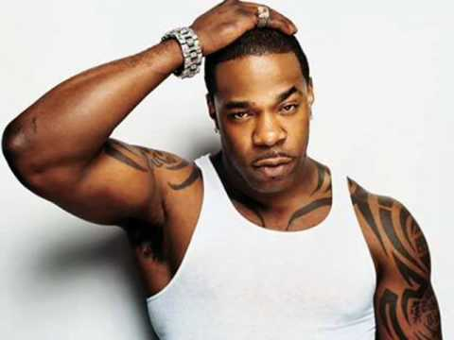
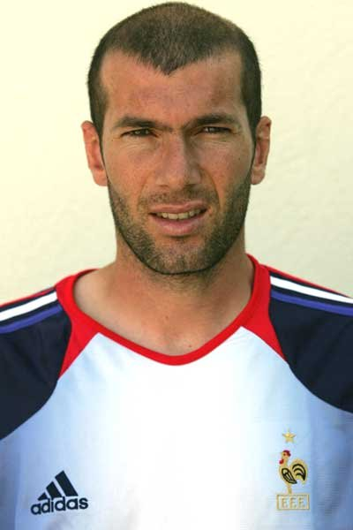
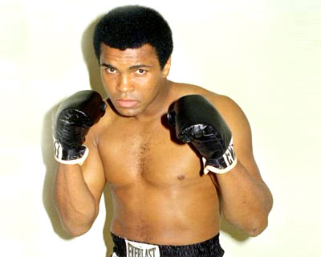
Who are the following celebrities and what do they all have in common?

Slide 4
Who are the following celebrities and what do they all have in common?
Malala Yousafzai
Zinedine Zidane
Amir Khan
Muhammad Ali
Busta Rhymes

Slide 5
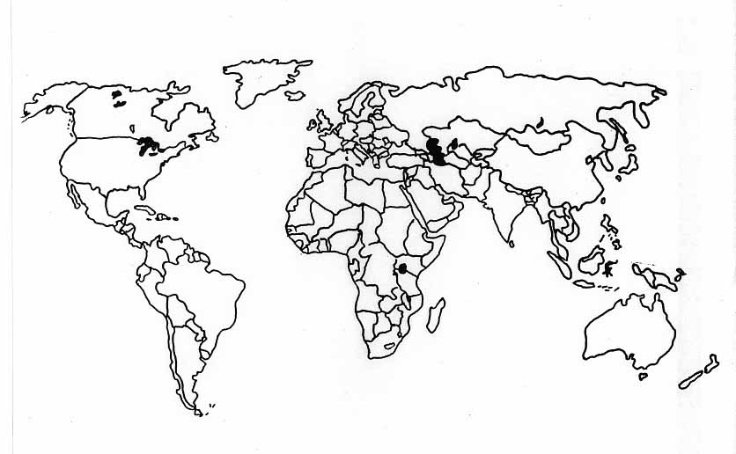
Where did Islam originate from?
Challenge!
Can you name all of these countries?
https://www.truetube.co.uk/film/how-islam-began-ten-minutes
Notes:
http://www.youtube.com/watch?v=ysP-zwpOrXg
Play clip from 5:30-9.30 (4 mins)
Where did it start? Label on map
What countries has is spread to?
What countries have the largest population of Muslims?

Slide 6
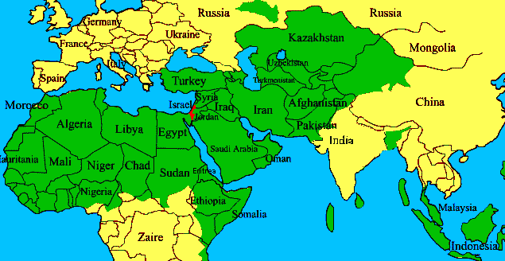
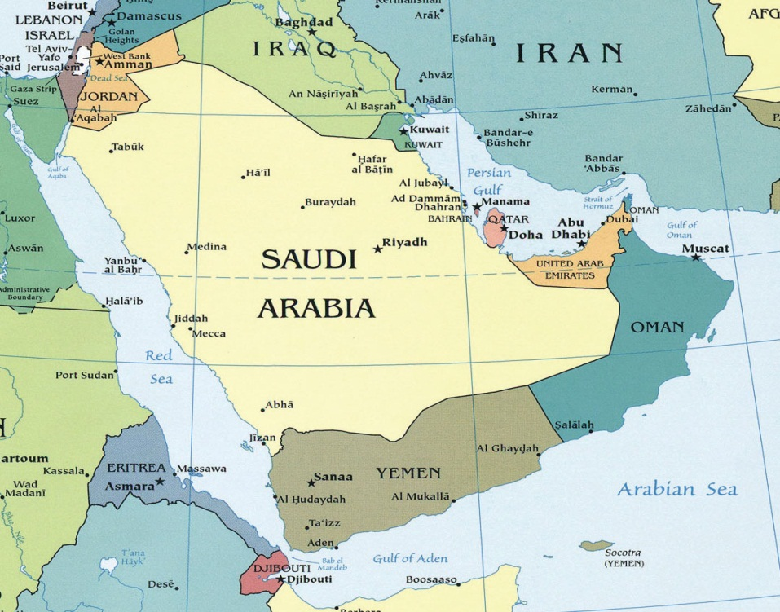
We live here.
Islam began here in Saudi Arabia in around 600 AD.

Slide 7
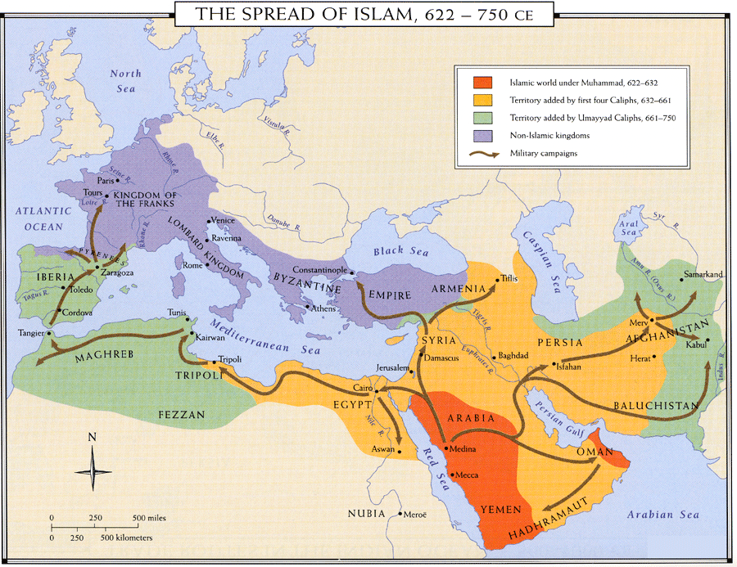
Notes:
Add to their own map

Slide 8
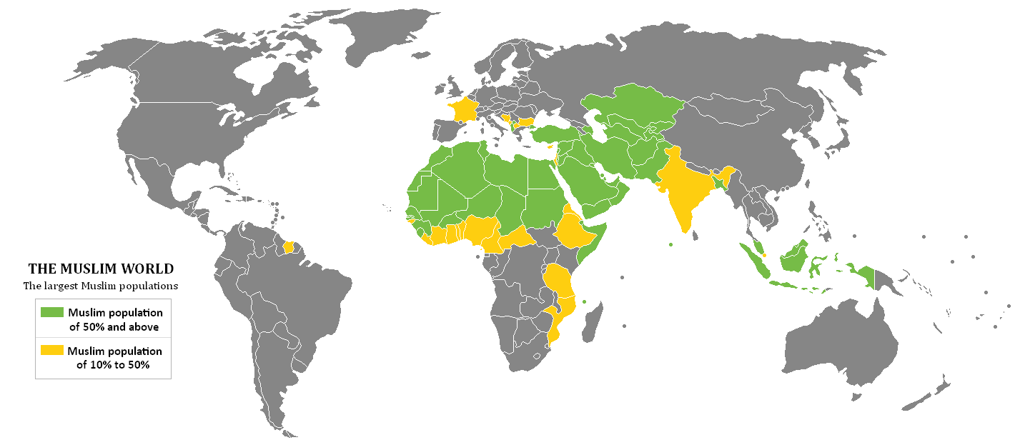
Which countries have the largest Muslim population?

Slide 9
Notes:
Copy down where the largest Muslim populations are

Slide 10
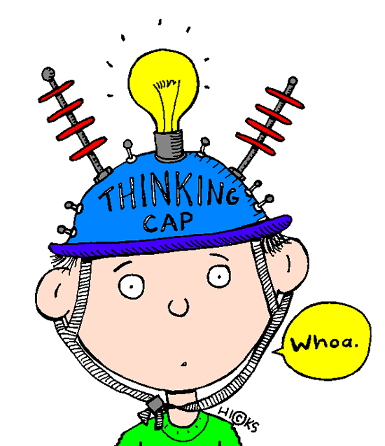
So what do Muslims believe?

Slide 11

So what do Muslims believe?
Muslims believe that there is one God, whom they called ALLAH.
They believe that Allah is ETERNAL which means he was never born and will never die. He made everything, knows everything and is All-powerful, so human beings must worship Him.
Muslims believe that Allah sent PROPHETS to teach people how to live. A prophet is someone who tells people what God wants.

Slide 12
Key Facts about Islam!
Islam is a Monotheistic faith. This means that Muslims only believe in one God.
Islam means peace and a Muslim is someone who submits him/herself to the will of God.
The name Muhammad is the most common name in the world.
The Qur’an is written in the Arabic language.
The following English words are borrowed from Arabic: sofa, candy and algebra.

Slide 13
Fill in the blanks!
Islam is a ________ faith. This means that Muslims only believe in ___ God.
Islam means______ and a Muslim is someone who ________ him/herself to the will of God.
The name _______ is the most common name in the world.
The Qur’an is written in the Arabic______.
The following English words are borrowed from Arabic: ________,_______ and ______.
Candy Language Sofa
Algebra Peace Submits Muhammad Monotheistic

Slide 14

Fill in the blanks!
Islam is a Monotheistic faith. This means that Muslims only believe in one God.
Islam means peace and a Muslim is someone who submits him/herself to the will of God.
The name Muhammad is the most common name in the world.
The Qur’an is written in the Arabic language.
The following English words are borrowed from Arabic: sofa, candy and algebra.

Slide 15
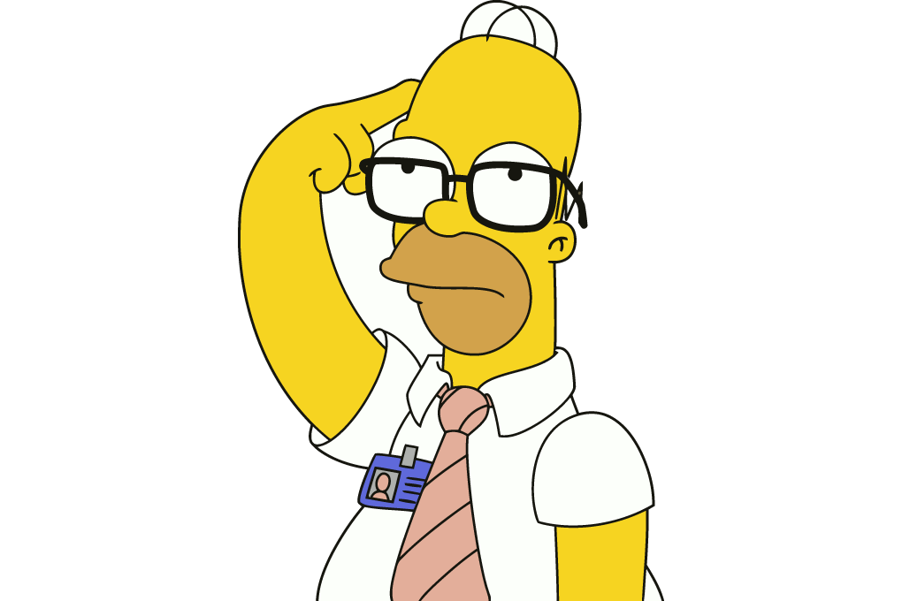
What is a denomination?
Think!
Hint: Sunni…

Slide 16
What is a denomination?
Denomination: a group of religious congregations united under a common faith and name.
Challenge!
Which religions do you know that have denominations?

Slide 17
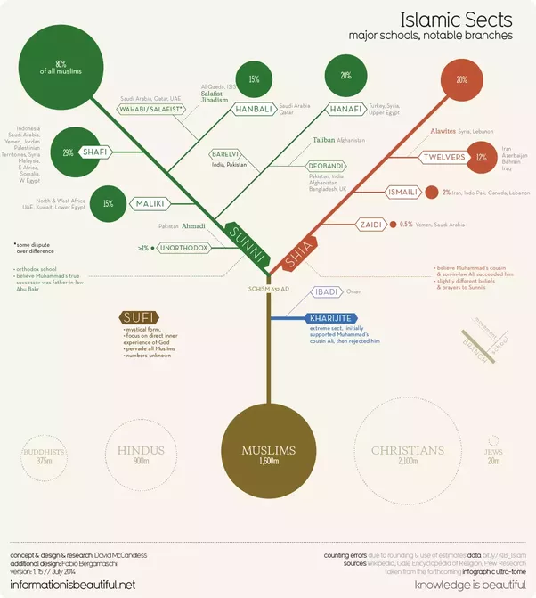
Denominations in Islam
Challenge!
Why would Islam have different denominations?

Slide 18
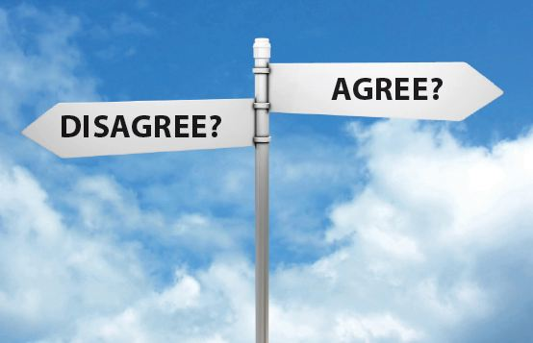

All religions should have denominations.

Slide 19
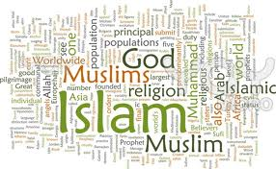
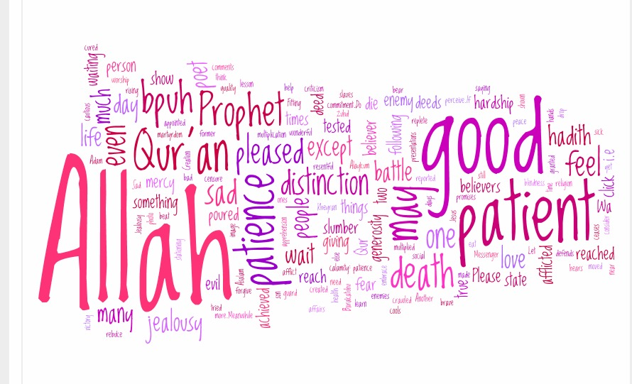
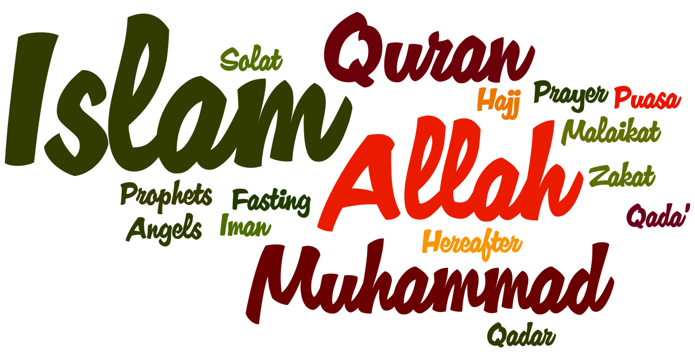
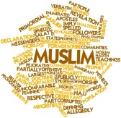
Create a word art based on Islam!

Slide 21

Who was Muhammad (PBUH)?
Learning outcomes:
To describe who Muhammad (PBUH) was
To explain the importance of Muhammad (PBUH)
To evaluate if Muhammad (PBUH) was happy or sad during his life events
Starter:
What do you want to achieve in your life? What would you want to be remembered for?

Slide 22

Where did Islam start?
Hint…We looked at it last lesson!

Slide 23
Who was Muhammad (PBUH)?
Muhammad (PBUH) was…
Challenge!
How would his experiences in life change him?
https://www.youtube.com/watch?v=x_7K9da5Yqg

Slide 24
Timeline of Muhammad’s (PBUH) life
You will receive an A3 sheet with a timeline for Muhammad’s life.
You need to put them into chronological order..
You then need to place them according to how happy Muhammad (PBUH) would be during that event in his life.
Explain at least 5 key events and why you have placed them there.
Challenge!
Can you create some more events to add to the timeline?

Slide 25
☺
How happy or sad Muhammad would have been
1. Muhammad (pbuh) was born in Makkah in about 570CE. He was poor because both of his parents had died by the time he was 6.
☹
Key events in Muhammad’s (PBUH) life

Slide 26
☺
How happy or sad Muhammad would have been
☹
Key events in Muhammad’s (PBUH) life

Slide 27
Key events in Muhammad’s (PBUH) life
Muhammad (pbuh) was born in Makkah in about 570CE. He was poor because both of his parents had died by the time he was 6.
As a young man, Muhammad (pbuh) was already known for his honesty & goodness. When he was 25, he married his employer; a rich 40 year old widow called Khadijah. When he married Khadijah he was rich & respected – his marriage was happy. It seemed that Muhammad had everything which he could possibly want.
Makkah is now a very important town and all Muslims try to visit it at least once in their lifetime.
He was orphaned as a young child and raised by various members of his family.
He could have led a very easy life but he was upset with conditions in Makkah. He hated the way that women & the poor were treated badly, plus drunkenness and gambling. Also some people worshipped idols.
Muhammad (pbuh) said Allah was the creator and he would one day judge them. Some people believed Muhammad (pbuh), but many said he was either lying or mad.
Muhammas (PBUH) was very thoughtful and would often spend nights in prayer. Muslims believe that when Muhammad was about 40, he was visited by the Angel Jibril (Gabriel) in a cave on Mount Hira. The angel told Muhammad (pbuh) to recite something. Muhammad (pbuh) could not read but the angel said that he was Allah’s messenger. These words became the words of the Quran.
Many battles took place between Madinah and Makkah. In 630 Makkah was defeated and Muhammad (pbuh) returned to his home town.
After this Muhammad (pbuh) began to preach about the word of Allah. He said that Allah was the only one God, and that they should not worship any other false idols.
In 622 there was an assassination attempt against Muhammad (pbuh). He and his followers left Makkah, and went to live in Medina. This is where Muhammad (pbuh) set up the first Muslim community.
He went to live with his uncle who was a trader. Eventually Muhammad (pbuh) became a trader too.

Slide 28
Muhammad (pbuh) was born in Makkah in about 570CE. He was poor because both of his parents had died by the time he was 6.
He was orphaned as a young child and raised by various members of his family.
He went to live with his uncle who was a trader. Eventually Muhammad (pbuh) became a trader too.
As a young man, Muhammad (pbuh) was already known for his honesty & goodness. When he was 25, he married his employer; a rich 40 year old widow called Khadijah. When he married Khadijah he was rich & respected – his marriage was happy. It seemed that Muhammad had everything which he could possibly want.
He could have led a very easy life but he was upset with conditions in Makkah. He hated the way that women & the poor were treated badly, plus drunkenness and gambling. Also some people worshipped idols.
Muhammad (pbuh) said Allah was the creator and he would one day judge them. Some people believed Muhammad (pbuh), but many said he was either lying or mad.
After this Muhammad (pbuh) began to preach about the word of Allah. He said that Allah was the only one God, and that they should not worship any other false idols.
Muhammas (PBUH) was very thoughtful and would often spend nights in prayer. Muslims believe that when Muhammad was about 40, he was visited by the Angel Jibril (Gabriel) in a cave on Mount Hira. The angel told Muhammad (pbuh) to recite something. Muhammad (pbuh) could not read but the angel said that he was Allah’s messenger. These words became the words of the Quran.
In 622 there was an assassination attempt against Muhammad (pbuh). He and his followers left Makkah, and went to live in Medina. This is where Muhammad (pbuh) set up the first Muslim community.
Many battles took place between Madinah and Makkah. In 630 Makkah was defeated and Muhammad (pbuh) returned to his home town.
Makkah is now a very important town and all Muslims try to visit it at least once in their lifetime.

Slide 29
"He always joined in household chores and would at times mend his clothes, repair his shoes and sweep the floor. He would milk, tether and feed his animals." (Bukhari)
What does this quote tell us about the importance of Muhammad (PBUH)?
Challenge!
How would this impact on Islam today?

Slide 30
The Prophet was of a slightly above-average height. Amazingly, in gatherings, he would appear taller than those actually taller than him - until the people dispersed. In complexion, he was white with a rosy tinge; pale, but not excessively so. His hair was jet black and wavy, but stopped short of curling, and was kept between his earlobes and shoulders.
What does this quote tell us about the importance of Muhammad (PBUH)?
Challenge!
How would this impact on Islam today?

Slide 31

Why was Muhammad important?
Challenge!
Why is Muhammad (PBUH) known as the last prophet? Why does that make him important?

Slide 32
Which event was the most important in shaping Islam today? Explain your answer.
I think that…..was the most important event in shaping Islam today because…..
Challenge!
Use the quote to support your point. "He always joined in household chores and would at times mend his clothes, repair his shoes and sweep the floor. He would milk, tether and feed his animals." (Bukhari)

Slide 33


Tweet of the day!
Summarise what you have learnt today in less that 35 words! #challenge #lessongoals

Slide 34
Additional Homework
Create a timeline of your own life with key events e.g. birth, first day at school, first holiday etc.
Add in how happy or sad you were in each part and why you were happy or sad

Slide 35
Islam Questions
Explain what Muslims think about God.
Why might a Muslim add the words ‘God willing’ when talking about the future?
Explain the meaning of the word ‘Islam’.
Make a list of the seven qualities of God and explain them in your own words. Try to learn the seven qualities off by heart.
Explain the Muslim idea about predestination.
Explain what is meant by Akhirah.

Slide 36
Islam Questions 2
Explain what is meant by prophethood.
What was the main purpose of the prophets?
Name the five most important prophets in Islam?
How is Ibrahim presented in the Qur’an?
Who revealed the Qur’an to Muhammad?

