Slide 1
Humanism Booklet RE Year 8 Read the booklet. Make notes on the booklet. Answer the questions at the end of the booklet.
Name…………………………………………………….

Slide 2
What is Humanism?
Learning outcomes:
To describe atheists and agnostics
To explain key concepts in Humanism
To evaluate our own understanding of the world
Starter:
Why do people have different beliefs?

Slide 3
‘Rationalism is an attitude of readiness to listen to contrary arguments and to learn from experience. . . of admitting that “I may be wrong and you may be right and, by an effort, we may get nearer the truth”’
Karl Popper, philosopher and Patron of the British Humanist Association
What does this reveal about Humanist beliefs?

Slide 4
‘The Ethiopians say that the gods have flat noses and are black, while the Thracians say that the gods have blues eyes and red hair… And if cattle or horses or lions had hands or could draw or sculpt like men can, then the horses would draw their gods like horses, cattle draw their gods like cattle, and both would depict the bodies of the gods in their own likeness.’
Xenophanes (570 – 475 BC)
What does this reveal about Humanist beliefs?

Slide 5
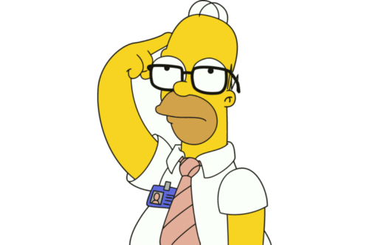
What do Humanists believe?
Watch the clip: https://www.youtube.com/watch?v=P74SNn2f4eE
Complete the sentence:
Humanists believe…because..
Another belief in Humanism is…because…

Slide 6
What Do Humanists Believe?
Humanists have no doctrine or creed they must sign up to. Many will disagree on the specifics of the best way to live. But most will agree with the following key beliefs:
Believe the world is a natural phenomenon with no supernatural side, and science provides the best way to understand it
Are atheists (don’t believe there is a god) or agnostics (believe we can’t know if there is a god)
See no persuasive evidence for an afterlife, nor an ‘ultimate’, external meaning to life, but believe we are instead capable of making our own lives meaningful and supporting others to do the same
Believe morality is a human construct and we should use reason, empathy, compassion, and respect when deciding how to act
Are secularists: they believe in freedom of religion and belief, and that no one, religion or belief should hold a privileged place
Value humanity and celebrate human achievements
In your own words explain what Humanists believe.
Which belief is the most similar or different to religions we have already looked at?
Do you agree or disagree with any of their key beliefs? Why?

Slide 7

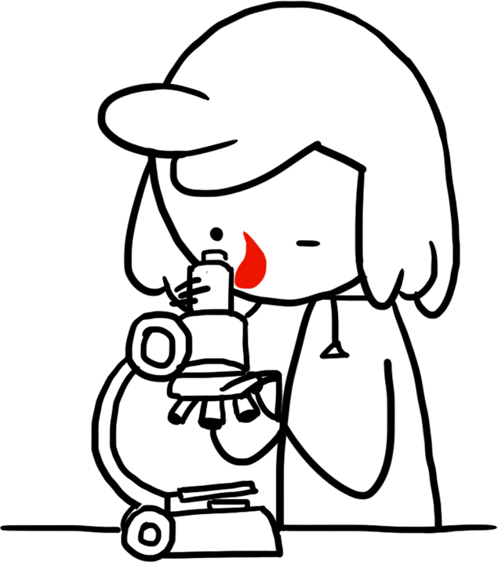
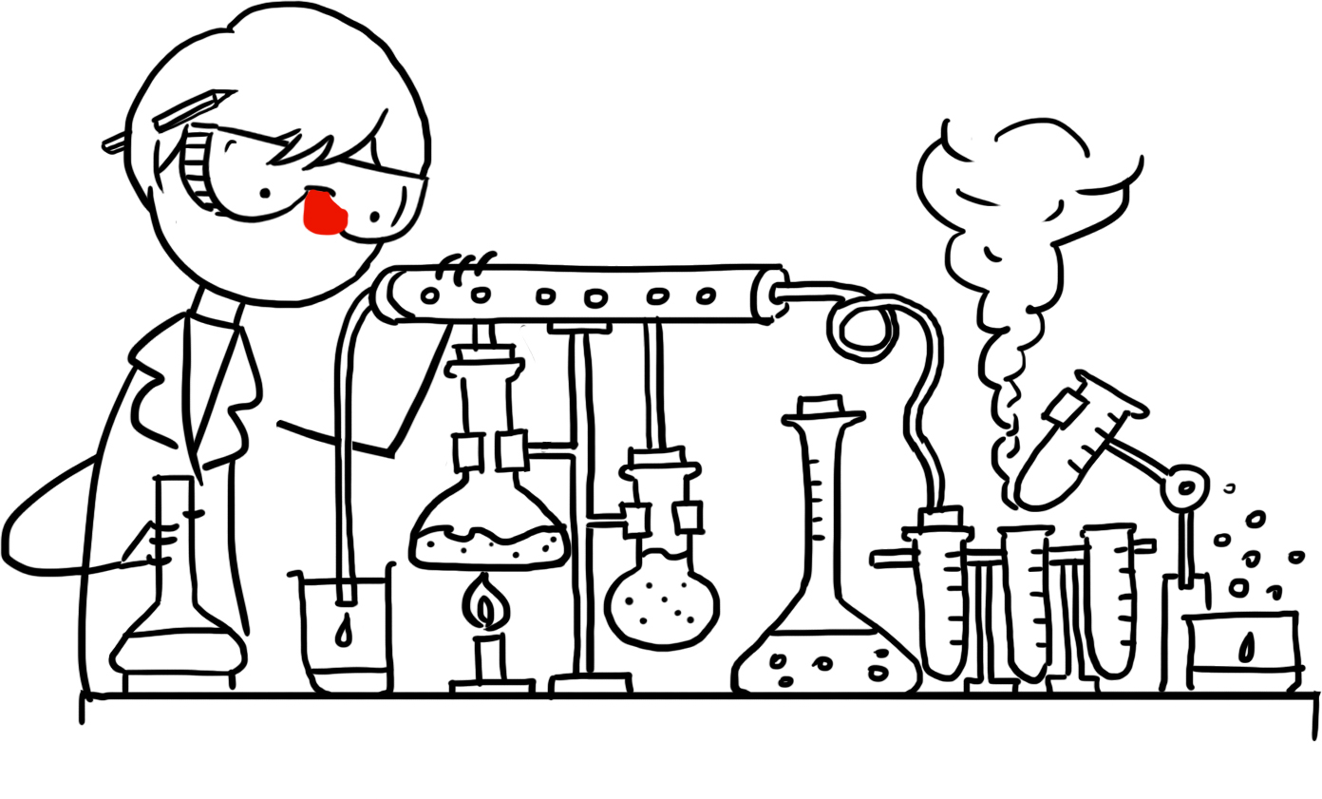
Understanding The World
Do you agree or disagree with their view on the world? Why?
The world is a natural phenomenon.
Everything has a natural cause.
No evidence for any supernatural side.
How can we know what is true?
Reason
Evidence
Science
Claims should be testable.

Slide 8
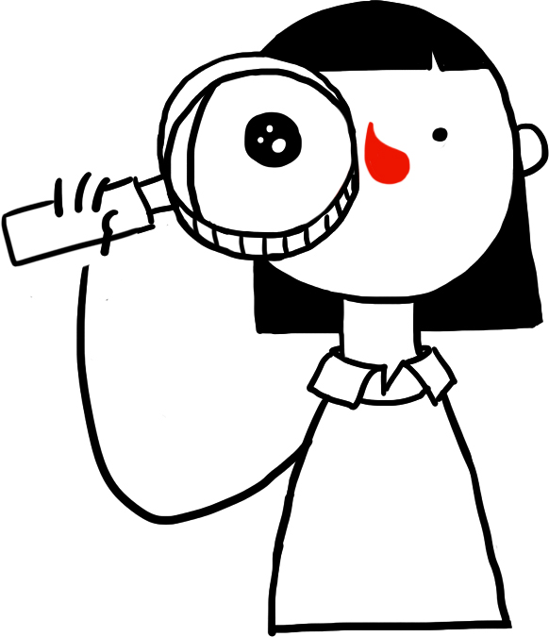
Atheism And Agnosticism
Humanists don’t see any good evidence that a god or gods exist.
Atheists: don’t believe in a god or gods.
Agnostics: believe we can’t know if a god or gods exist.
Humanism is more than just not believing in a god.
For humanists, the most important thing is not whether you believe in a god or not, but how you live your life.
Humanists believe we can be good and happy without the need for a god or a religion.
Do you agree or disagree that how you live your life is the most important thing? Why?

Slide 9
‘Is it so small a thing To have enjoy'd the sun, To have lived light in the spring, To have loved, to have thought, to have done; To have advanced true friends, and beat down baffling foes; That we must feign a bliss Of doubtful future date, And while we dream on this Lose all our present state, And relegate to worlds yet distant our repose?’
From the Hymn of Empedocles, Matthew Arnold (1822-1888)

Slide 10
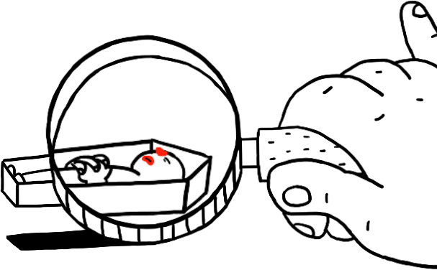

One Life
Death is the end of our personal existence.
There is no good evidence for an afterlife.
After we die, our atoms, genes, and works can survive, and our shared ideas and experiences can live on in the memories of others.

Slide 11
‘In life, the meaning comes in living, as wholly as we can, as abundantly as we can, as bravely as we can, here and now, sharing the experience with others, caring for others as we care for ourselves, and accepting our responsibility for leaving the world better than we found it.’
James Hemming, humanist and child psychologist (1909 – 2008)
What do you think this quote means?
How does it relate to our lesson learning?
Challenge!
Do you agree or disagree with the quote? Why?

Slide 12
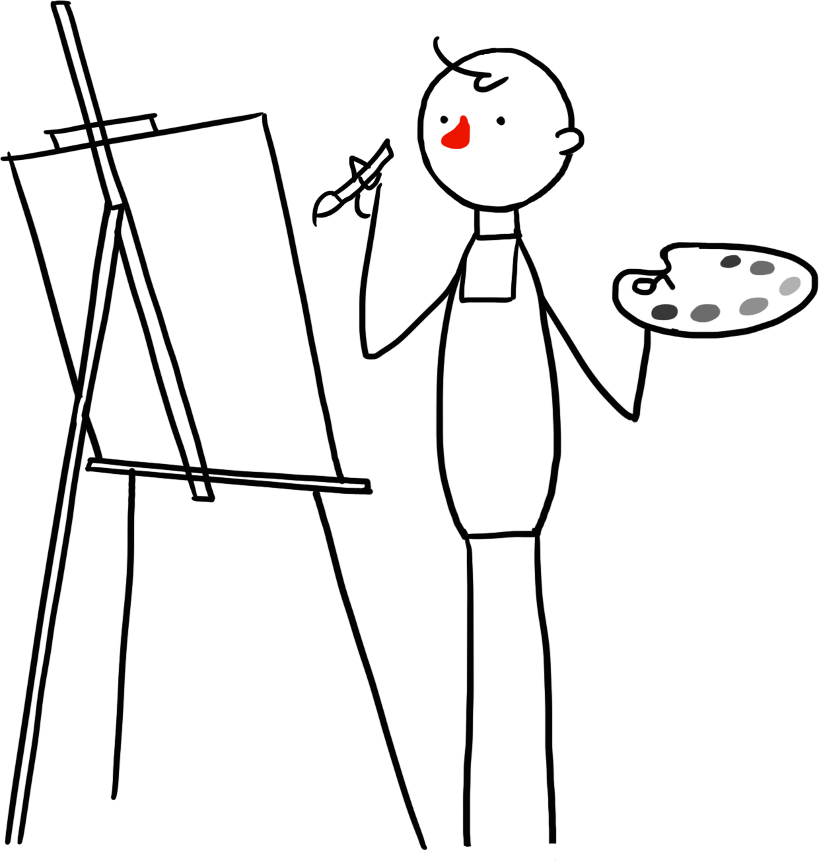
Making Our Lives Meaningful
Challenge!
How do you make your life meaningful?
No ‘ultimate’ external meaning of life.
We can make our own lives meaningful.
Not one single answer.
We should have respect for the many diverse ways of living as long as they do not cause harm to others (or the environment) or restrict others from living a good life themselves.
‘[The good life] would have two general characteristics: that it feels good to live, and that it is more beneficial than not on its impact on others.’
A. C. Grayling, philosopher

Slide 13
‘Why should I consider others?... Myself, I think the only possible answer is the humanist one – because we are naturally social beings; we live in communities; and life in any community, from the family outwards, is much happier, and fuller, and richer if the members are friendly and co-operative than if they are hostile and resentful.’
Margaret Knight, humanist and psychologist
(1903 – 1983)

Slide 14
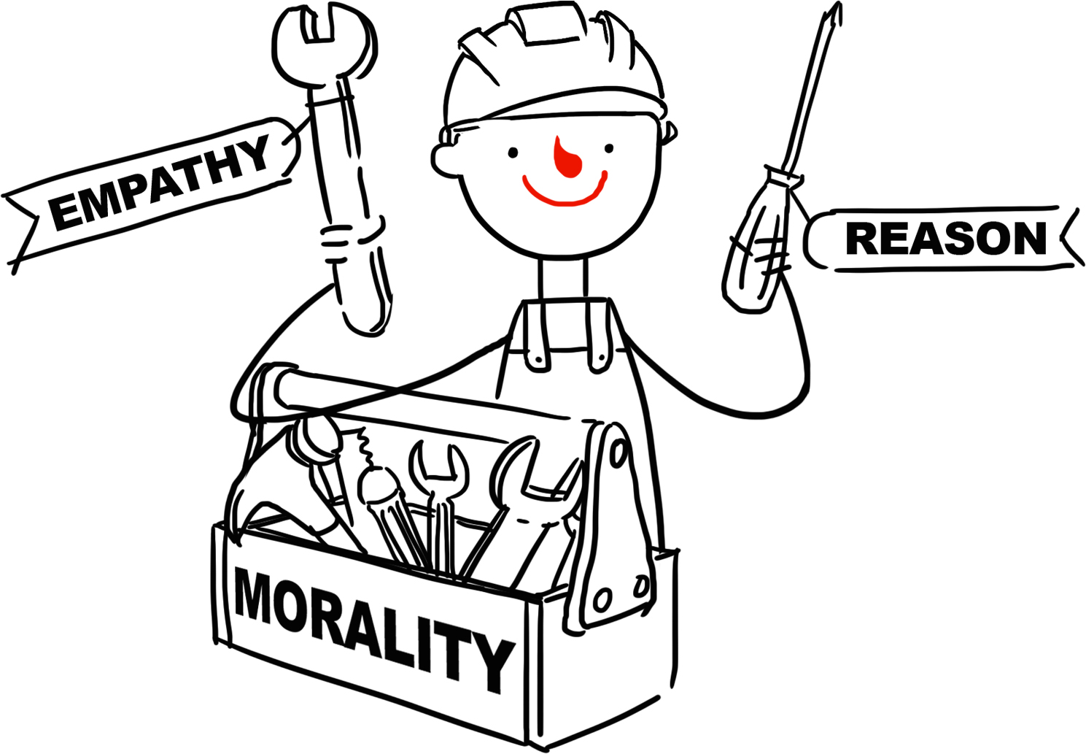
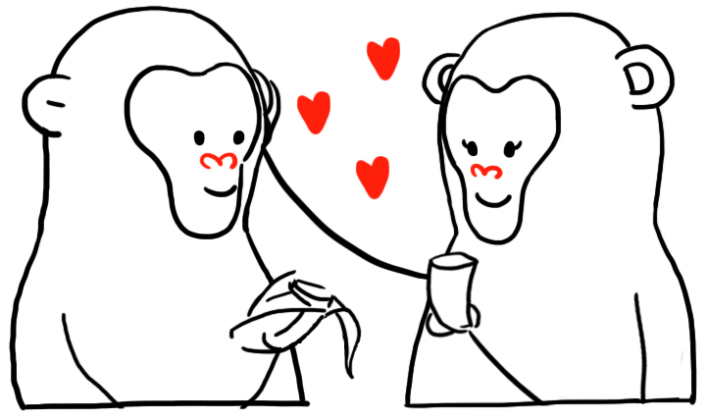
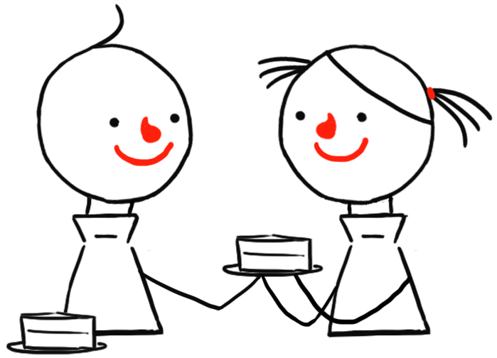
What is the link between the images? How does it relate to our lesson learning today?

Slide 15
Morality As A Human Achievement
Consider the particular situation, think about the consequences and use…
Reason: Thinking carefully and critically
Empathy: Thinking about how others will feel
Compassion: Concern for the suffering of others
Respect for the dignity of all persons: Treating everyone as of value
The Golden Rule
Treat others as you would like to be treated yourself.
Do not treat others in a way you would not like to be treated yourself.
Our morality evolved naturally from the way our species has lived together in communities. It is a project or a journey with the aim of improving human welfare in this life.

Slide 16
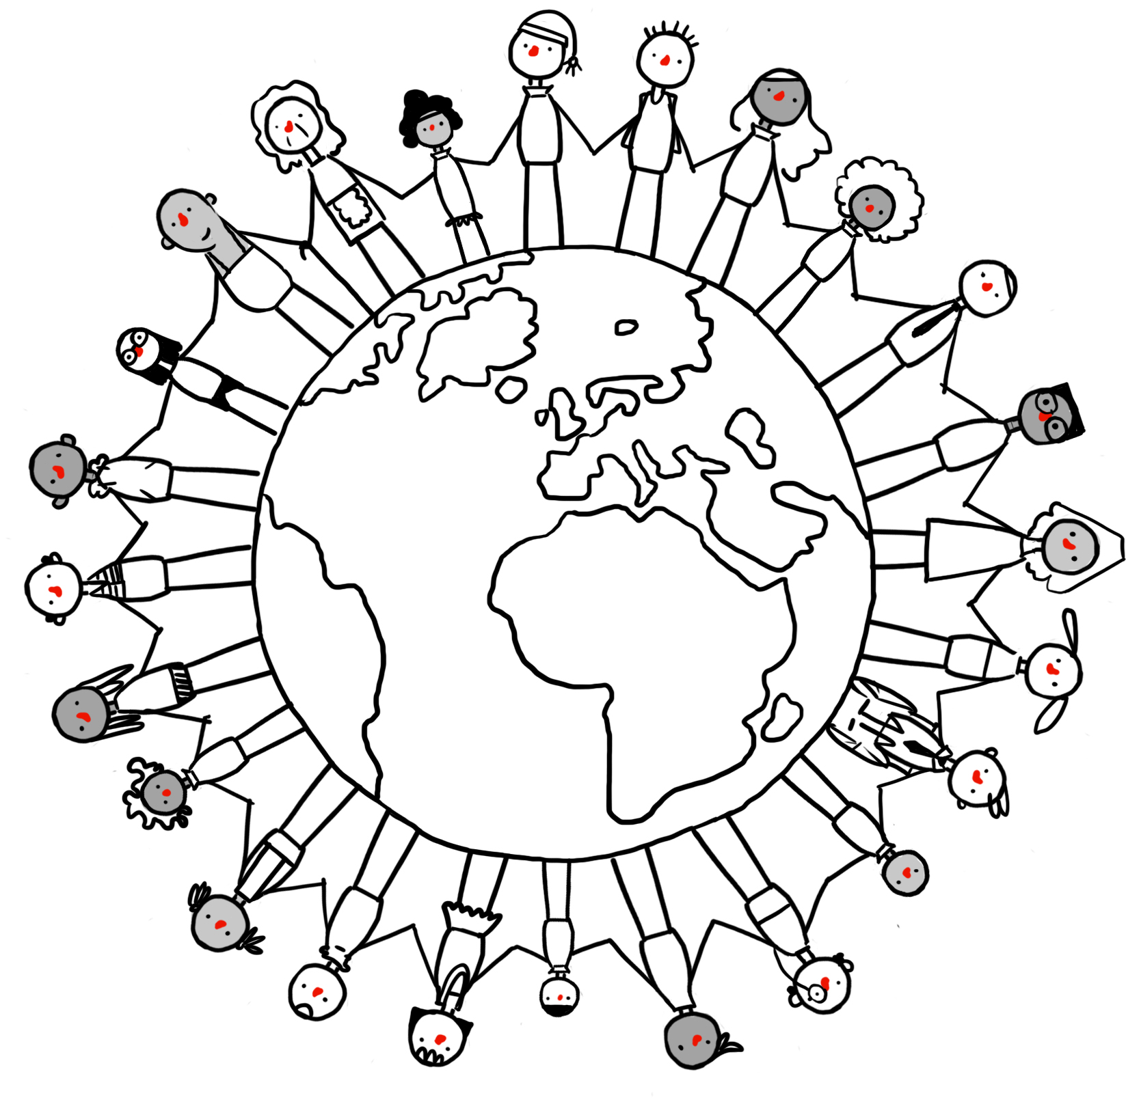
Humanism in society
What would a humanist world look like?
Does Humanism make the world a better or worse place?
Democracy
Secularism
(freedom of belief)
Equality
Free speech
Social Justice
Altruism
Human rights
Responsibility

Slide 17
‘The humanist view of life is progressive and optimistic, in awe of human potential, living without fear of judgment and death, finding enough purpose and meaning in life, love and leaving a good legacy.’
Polly Toynbee, journalist and vice president of the British Humanist Association
Would a religious person agree or disagree with their view of life? Why?

Slide 18
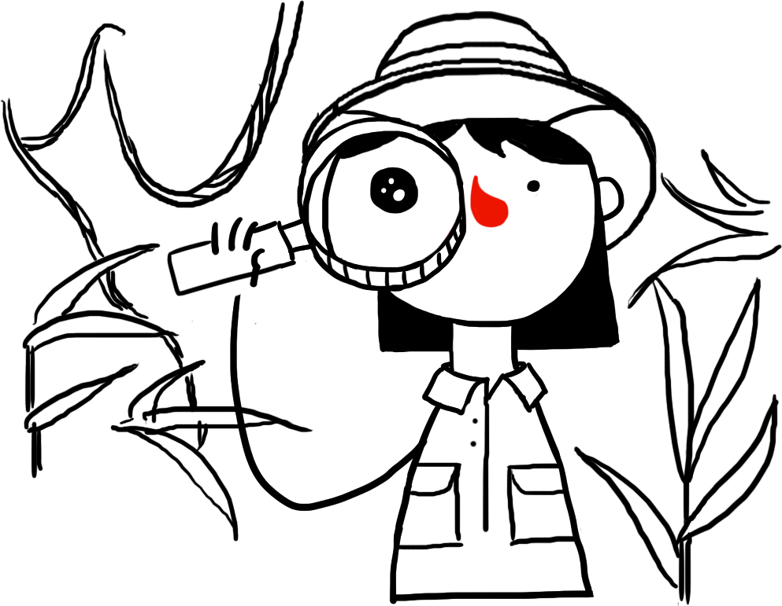
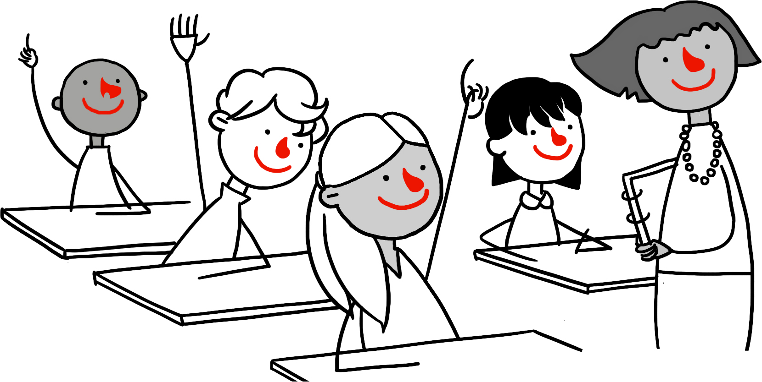
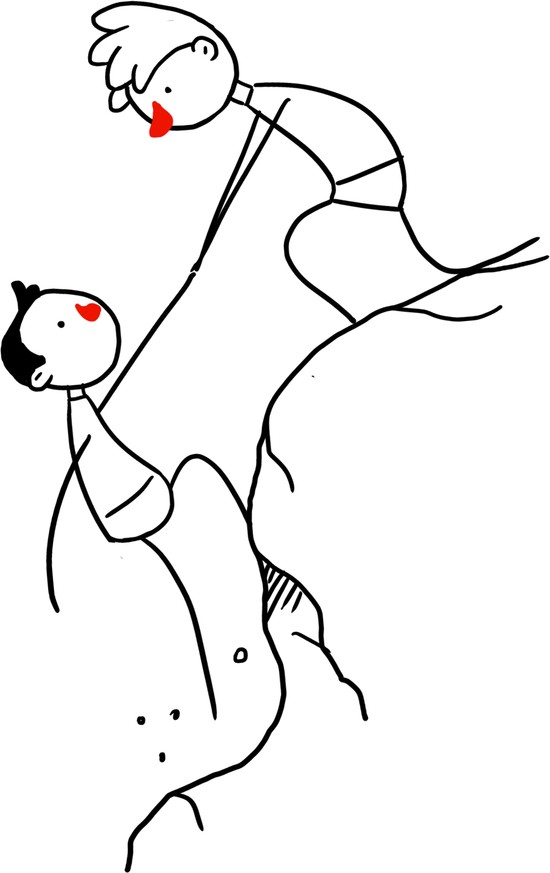
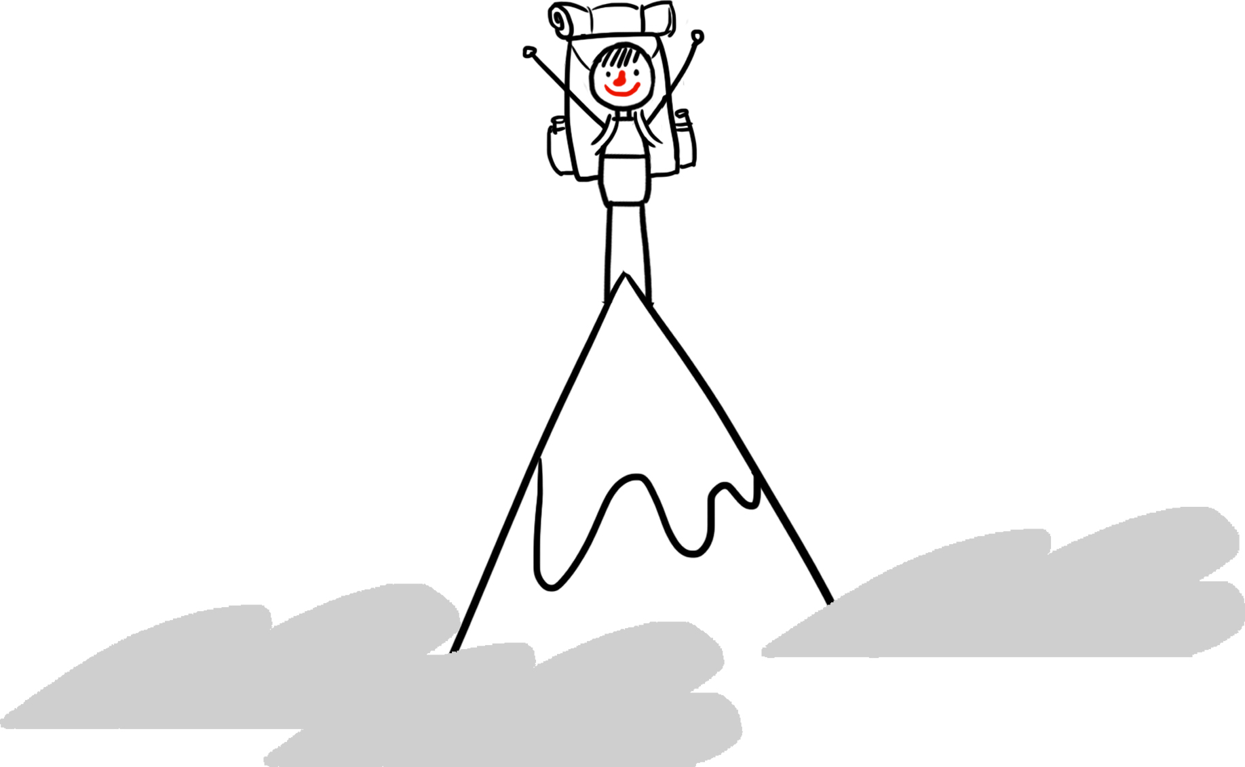
Valuing human achievements and capabilities
Humanists are optimistic about human potential.
Humanists celebrate the many things human beings have accomplished.
What can we celebrate about being human?
What great things have human beings accomplished?

Slide 19
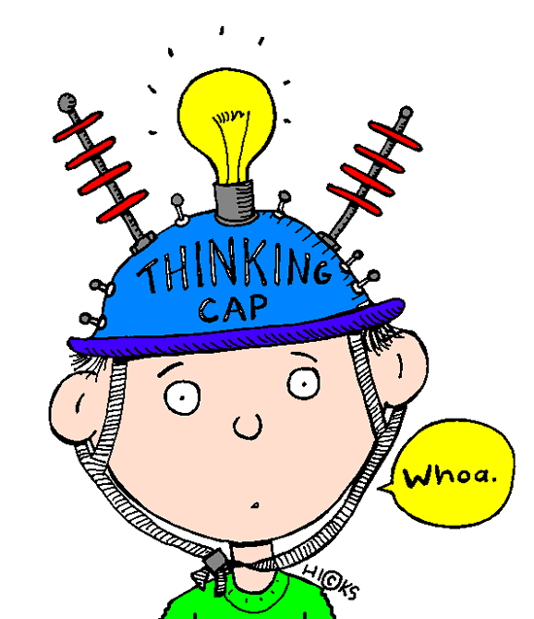
Question 1
Humanists believe...
Science provides the best method for understanding the universe.
Religion is needed for a complete understanding of the universe.

Slide 20

Question 1
Humanists believe...
Science provides the best method for understanding the universe.
Religion is needed for a complete understanding of the universe.

Slide 21
Question 2
A humanist...
Is certain there is no god.
Believes in a god.
Sees no good or persuasive evidence to believe in a god.

Slide 22
Question 2
A humanist...
Is certain there is no god.
Believes in a god.
Sees no good or persuasive evidence to believe in a god.

Slide 23
Question 3
Humanists believe...
After we die we will be resurrected.
We can live on through our genes, our works, and in the memories of others.
This life is just one of the many lives that we will live.

Slide 24
Question 3
Humanists believe...
After we die we will be resurrected.
We can live on through our genes, our works, and in the memories of others.
This life is just one of the many lives that we will live.

Slide 25
Question 4
Humanists believe…
Life has no meaning.
God and an afterlife are necessary for life to have any meaning.
We can make our own lives meaningful and there are many different ways we can do this.

Slide 26
Question 4
Humanists believe…
Life has no meaning.
God and an afterlife are necessary for life to have any meaning.
We can make our own lives meaningful and there are many different ways we can do this.

Slide 27
Question 5
Humanists believe we can work out how to behave by...
Following rules found in books and given by figures of authority.
Using reason and empathy to think about the consequences and how other people will feel.
Just acting on our instincts.

Slide 28
Question 5
Humanists believe we can work out how to behave by...
Following rules found in books and given by figures of authority.
Using reason and empathy to think about the consequences and how other people will feel.
Just acting on our instincts.

Slide 29
Question 6
Humanists believe…
What is right and wrong depends on the effects on human welfare in this life.
What is right and wrong is unchanging, whatever the circumstances.
What is right and wrong is just a matter of personal preference.

Slide 30
Question 6
Humanists believe…
What is right and wrong depends on the effects on human welfare in this life.
What is right and wrong is unchanging, whatever the circumstances.
What is right and wrong is just a matter of personal preference.

Slide 31
Question 7
Humanists believe…
Our morality evolved naturally from living together in communities.
Without god there can be no morality.

Slide 32
Question 7
Humanists believe…
Our morality evolved naturally from living together in communities.
Without god there can be no morality.

Slide 33
Question 8
Humanists believe...
We should allow freedom of religion or belief.
Religion should have a special place in society.
Religion should be banned.

Slide 34
Question 8
Humanists believe...
We should allow freedom of religion or belief.
Religion should have a special place in society.
Religion should be banned.

Slide 35
Question 9
Humanists believe...
Without a god and religion, life is miserable and pointless.
We can lead a good, happy, and meaningful life without the need for a god or religion.

Slide 36
Question 9
Humanists believe...
Without a god and religion, life is miserable and pointless.
We can lead a good, happy, and meaningful life without the need for a god or religion.

Slide 37

What do you think is important for a ‘good life?’

Slide 38
Possible ingredients of ‘the good life’
Food and drink
Relationships
Community
Which one do you agree the most with? Why?
Which one do you disagree the most with? Why?
Money and possessions
Working to benefit humankind
Beauty and wonder
Exploration and discovery
Music
Being kind to others
Learning new things
Completing something difficult
Good health
Developing your talents

Slide 39






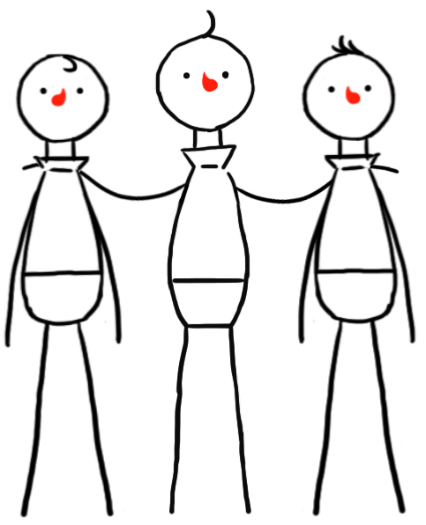

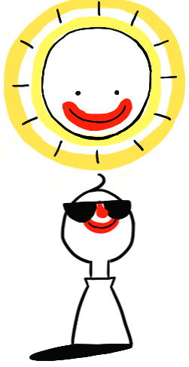
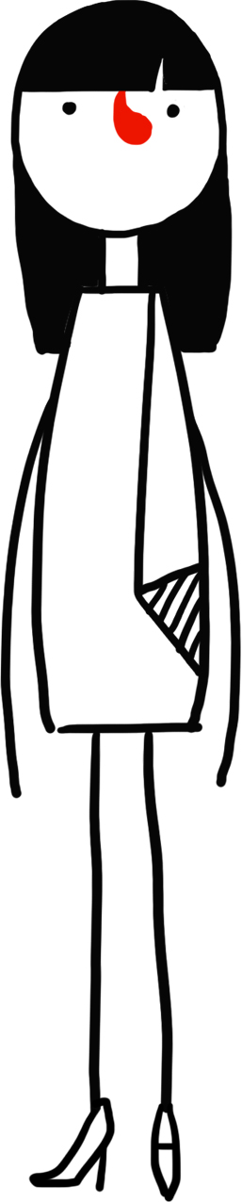




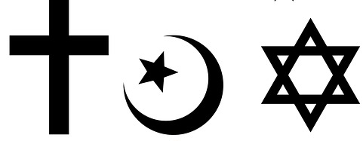
Possible ingredients of ‘the good life’
£

Slide 40
Do humanists have rules to follow?
Learning outcomes:
To describe school rules
To explain reasons schools have rules
To evaluate if humanists have rules to follow
Starter:
Why do we have rules?

Slide 41
What would happen without any rules?
Imagine there were no school rules.
What would happen?

Slide 42
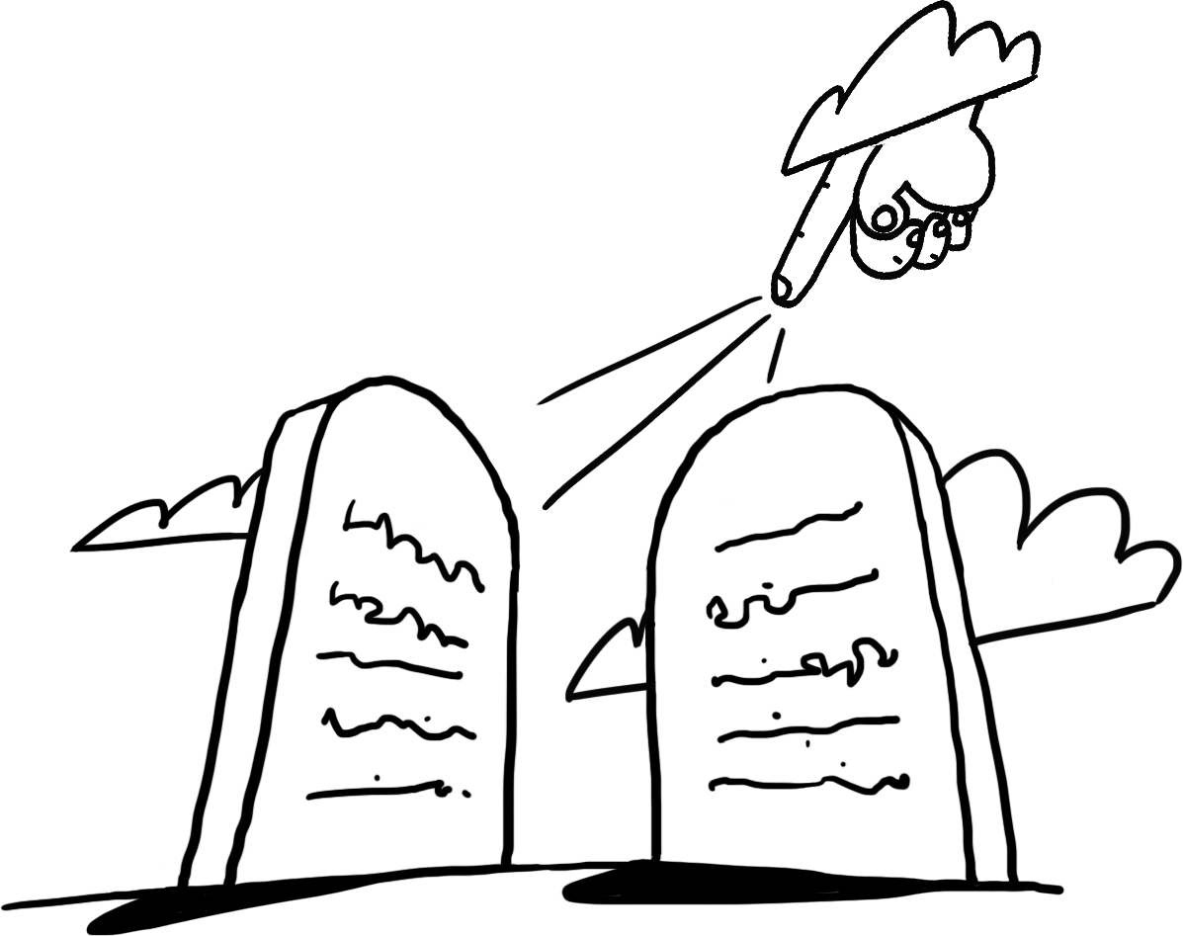
Which rules do you agree and disagree with? Why?
Don’t put your elbows on the table
Don’t steal
Pray every day
Don’t run in the corridor
Keep the Sabbath day holy
Don’t break the speed limit
Put your hand up before you speak
Always tell the truth
Don’t be late
Do not eat the meat from a pig
Don’t be jealous
Always be kind to other people
Challenge!
What rules from the list may a religious person follow? Why?

Slide 43
Where do the rules come from?
Why do we have these rules?
Which of the rules do you feel are the most important and why? Are they good rules or not?
Is it OK to break any of those rules sometimes?
Order the rules on this scale:
Must never be broken OK to break
Challenge!
Reorder the rules according to how easy they are to follow.
Don’t put your elbows on the table
Don’t steal
Pray every day
Don’t run in the corridor
Keep the Sabbath day holy
Don’t break the speed limit
Put your hand up before you speak
Always tell the truth
Don’t be late
Do not eat the meat from a pig
Don’t be jealous
Always be kind to other people

Slide 44

‘You should never lie’
Moral dilemma:
You are playing football with your friend at lunchtime when your friend leaves to go to the toilet. While he is gone, an older child comes over and asks you where your friend is. You know that the older child doesn’t like your friend and plans to hurt him. But you have also been told that it is wrong to lie. There are no teachers around to help.
Should you tell the truth and let your friend get hurt or lie to the older child?
Challenge!
Are there times when lies are needed? Why?

Slide 45
Are there any rules we should never break in any circumstances?
If it’s OK to break rules sometimes, then does that mean rules are pointless?

Slide 46
Key Beliefs Of Humanists
Believe human beings are special and human life is valuable
Don’t believe in a god, or believe we can never know if there is a god
Don’t believe there is any evidence for an afterlife: we should therefore make the most of this life
Humanists believe human beings should try to live full and happy lives and help others do the same

Slide 47
Key Humanist Beliefs About How We Should Act
Rules can often be helpful in society, but…
We should not unthinkingly allow rules or figures of authority to command how we must behave
We need to take individual responsibility for our actions
We should think about the consequences of our actions and use empathy, compassion, and reason to work out what is right and wrong
‘No moral system can rest solely on authority. It can never be sufficient justification for performing any action that someone wishes or commands it.’
AJ Ayer, philosopher (1910 – 1989)

Slide 48
What Would A Humanist Do?
In the lying moral dilemma, do you think a humanist would lie to the older child? Why?

Slide 49
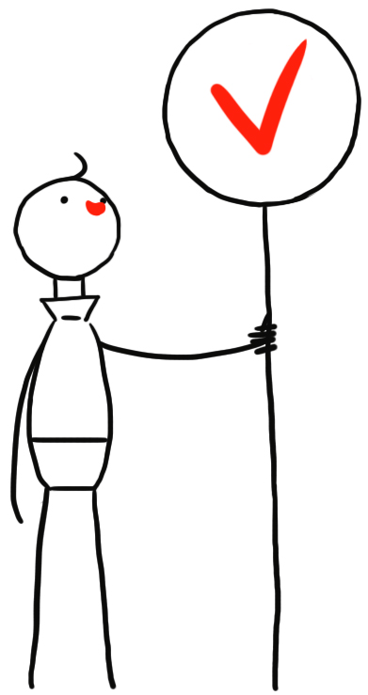
Do You Think That Humanists Have Rules?
Can you think of a good moral rule that we could all live by?

Slide 50
Freeze frame
Show how you would feel if someone was unkind to you?
Show how you think someone else would feel if someone was unkind to them?

Slide 51
Rules from around the world
‘Do not do to others what you would not like for yourself.’ Confucianism, from The Analects of Confucius (about 500 BCE, China)
‘I will act towards others exactly as I would act towards myself.’ Buddhism, from The Siglo-Vada Sutta (about 500 BCE, India)
‘Do not do to others that which would anger you if others did it to you.’ Socrates, (5th century BCE, Greece)
‘Love your neighbour as yourself.’
Judaism/Christianity, Leviticus 19, in The Torah (about 400 BCE, Israel), quoted by Jesus in Matthew 22 and Mark 12 (1st Century CE)
‘None of you truly believes, until he wishes for his brothers what he wishes for himself.’ Islam, a saying of The Prophet Muhammad (7th Century CE, modern day Saudi Arabia)
‘Treat other people as you'd want to be treated in their situation; don't do things you wouldn't want to have done to you.’ Humanism, British Humanist Association (1999 CE, UK)

Slide 52
The Golden Rule
Positive and negative versions of the Golden Rule:
Treat others as you would like to be treated yourself
Do not treat others in a way you would not like to be treated yourself
What does this rule mean?
Is there a difference between the positive and negative versions?

Slide 53

The Universal Golden Rule
The Golden Rule does not need to be given to us by a god or gods.
Humanists believe the Golden Rule evolved naturally due to the fact human beings have long lived together in communities.
It grew from our natural capacity to reason and empathise.
Empathy helps us live together in groups.

Slide 54
The Golden Rule
Would the Golden Rule stop people lying or stealing or killing people?
If people followed it, would they always do the right thing?
If they disobeyed it, would they tend to do bad things?
Would the world be a better place if everyone followed the Golden Rule?
What should happen when people break the Golden Rule?
Is the Golden Rule enough on its own or do we need other rules?

Slide 55
Dear Humanist…
Last week I was on a trip with three of my friends. I was put in charge of buying lunch and so at lunchtime I went to the shop. I wanted to do the right thing so I followed the Golden Rule.
My favourite sandwich is tuna mayonnaise so I bought tuna mayonnaise for everyone. However, when I handed out the sandwiches, Caroline said she would have preferred cheese, Emma said she didn’t like tuna, and Jacob said he was allergic to mayonnaise!
Where did I go wrong?
Yours sincerely,
Sam
Could you have done better than Sam?
What would you have done differently?
Did the Golden Rule not work or was Sam not using it appropriately?
Write a reply to Sam’s letter from a humanist explaining where she went wrong and how she might better employ the Golden Rule next time.

Slide 56
Humanist responses
How might a humanist respond to these statements about rules?
It’s never OK to break a rule.
We can’t be good without rules to guide us.
The Golden Rule doesn’t work because people like different things.

Slide 57
School Rules
Do your school rules have any connection to the Golden Rule?
Would a humanist approve of them?
Could you write a new set of school rules that take the Golden Rule into account?

Slide 58
Humanism Questions
What do humanists believe?
How is what humanists believe linked to atheism?
Why do humanists believe what they believe?
Why do some people believe humanism to do controversial?
How would a Christian respond to humanism?

Slide 59
Humanism Questions
‘Humanism is the best form of religion.’
Evaluate this statement. Writing for and against.
F- For
A- Against
R- Religious Teaching/Argument
C- Conclusion

