Slide 1
How did Hitler gain power 1923-1933?
To recap on the early days of Hitler’s life
To describe the events of 1923-1933
To explain how Hitler managed to gain power

Slide 2
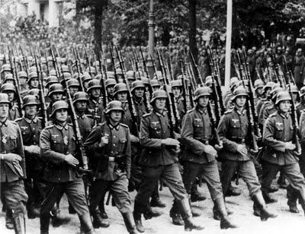
What were Hitler’s policies?
Strong
army

Slide 3
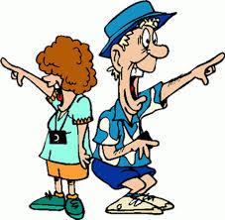
No
foreigners

Slide 4
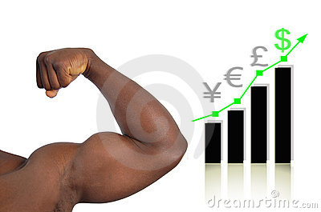
Strong economy

Slide 5
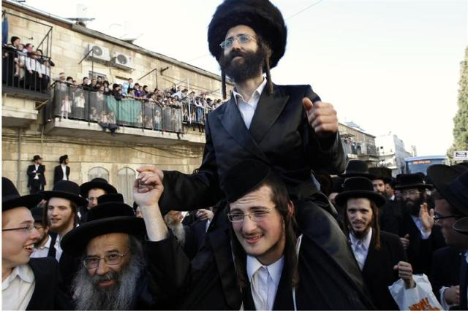
No
Jews

Slide 6
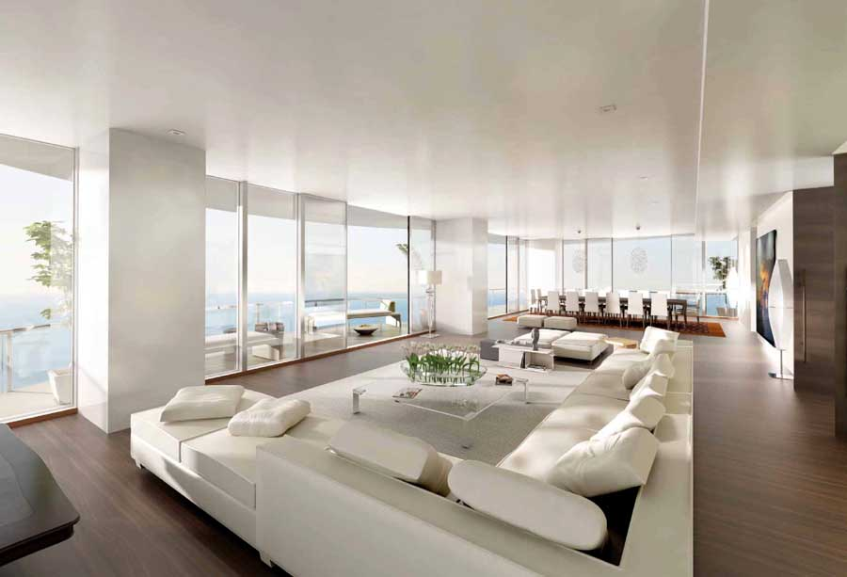
Lebensraum – Living space

Slide 7
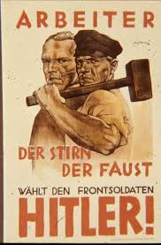
Lots of
jobs
and
workers

Slide 8
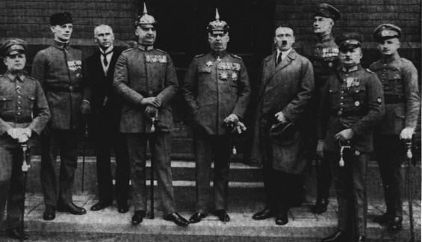
Strong government

Slide 9
Hitler became Fuhrer in 1934.
HOW?

Slide 10
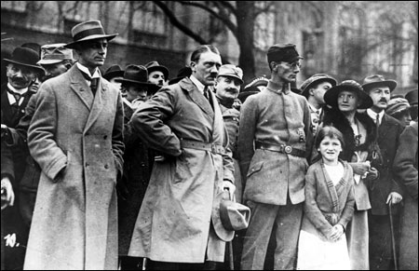
ACTIVITY!
Put the different events in chronological order

Slide 11
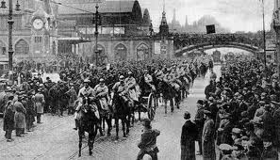
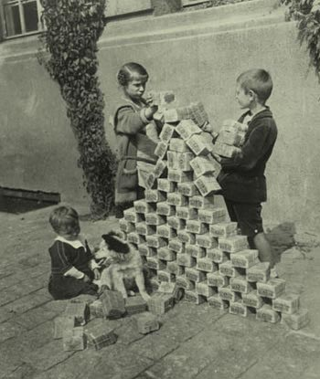
1923 Crises
In 1923 there was an economic crisis. The gov’t printed more & more money until it was worthless. It was called hyperinflation.
Because Germany couldn’t pay France their reparations the French invaded parts of Germany and took goods instead. The small German army couldn’t stop them.

Slide 12
1923 Crises
Germans were angry that the gov’t wasn’t trying to do anything to stop hyper-inflation or get the French out. Hitler decided to stage a ‘putsch’ in Munich, and he, the Nazis and the SA tried to overthrow the gov’t. But he and others were shot and imprisoned instead.

Slide 13
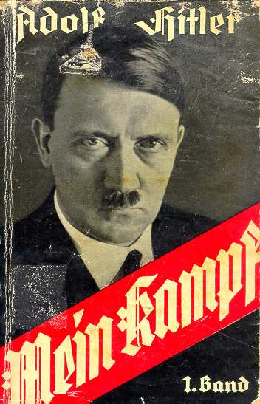
1924-1925
Hitler was sent to prison for trying to overthrow the German government. This got him a lot of press coverage, especially when he decided to write a book about his thoughts, ‘Mein Kampf’.

Slide 14
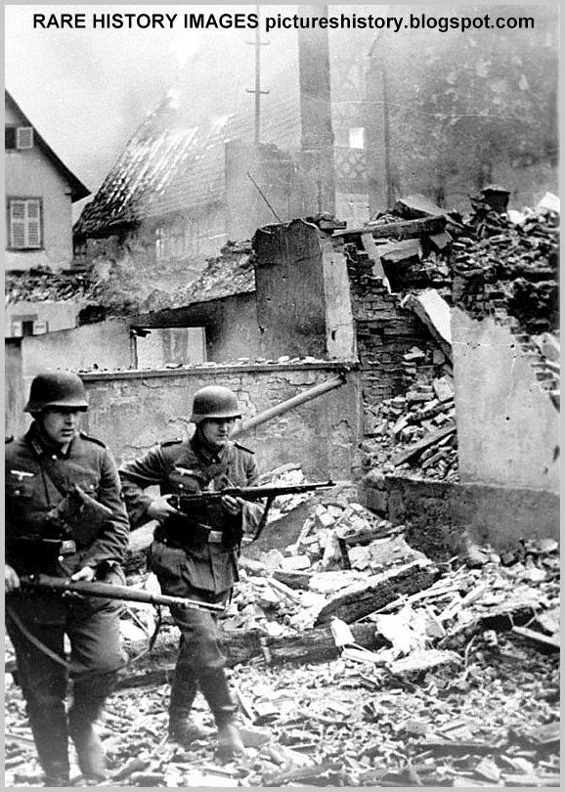
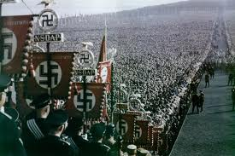
1927 1929
The Great Depression: USA ask for their money back from Germany, who then can’t afford to pay France. France invades the country again.
The Nazis hold their first massive political rally, the Nuremburg Rally, to attract people to their cause.

Slide 15
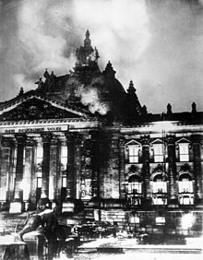
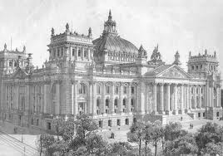
1933 1933
Jan. 1933. The Nazi Party becomes the largest political party in Germany and President Hindenburg is forced to make him Chancellor.
Feb. 1933 the government building is set on fire and the Nazis point the finger at the Communist party. Hitler creates the ‘Enabling Law’ which allows him to make up laws in ‘an emergency’. He bans other political parties.

Slide 16
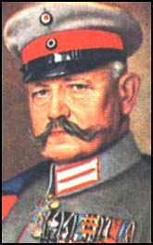
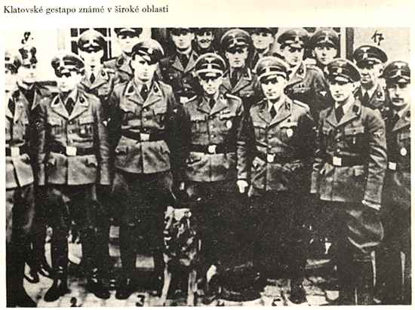
1933 1934
April. 1933. Hitler creates the Gestapo, a secret police to do his bidding and capture political enemies. He sets up the first concentration camp for them.
1934. President Hindenburg dies and Hitler decided to combine his role of Chancellor with that of the President. He renames himself as the ‘Fuhrer’ meaning ‘leader’ in German.

Slide 17
ACTIVITY!
Now number the events in the order of importance. Was there one event more important than the others that helped him?

Slide 18
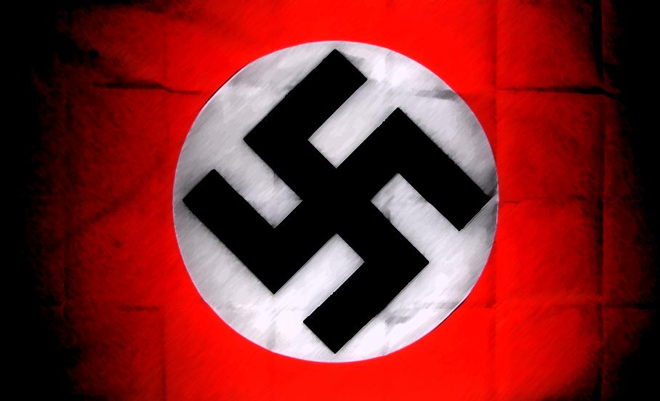
Which was the most important?
I think the most important event that got Hitler into power was…
The least important event was…
I now predict that life in Hitler’s Germany will be like…

