Slide 1
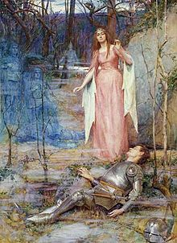
Learning objective:
to understand how Keats uses the conventions and language of the ballad form in his poem ‘La Belle Dame Sans Merci’.

Slide 2
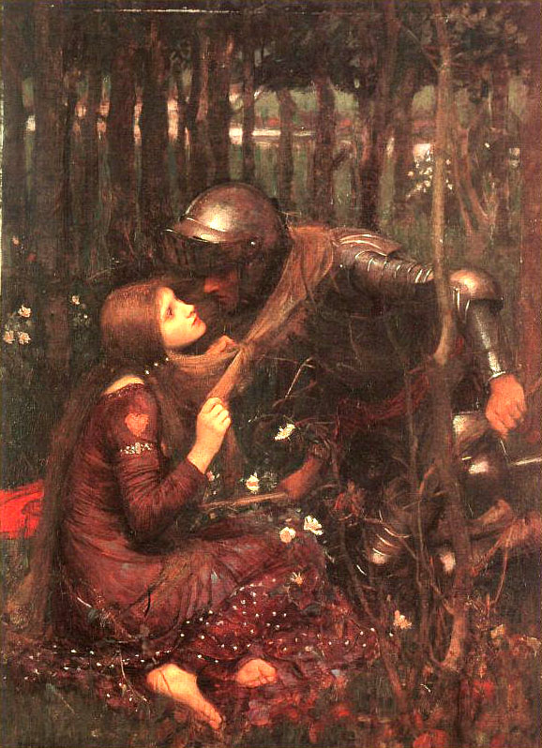
Learning objective:
to understand how Keats uses the conventions and language of the ballad form in his poem ‘La Belle Dame Sans Merci’.
Introduction: Context: Make notes on a word document from the following:
The Medieval tradition of the ballad genre.
Ballads have their roots within the world of Medieval literature and were intended to be sung. The narratives often came from folklore origins and so it is not surprising that Keats focuses on the Medieval, chivalric world of knights and damsels.

Slide 3
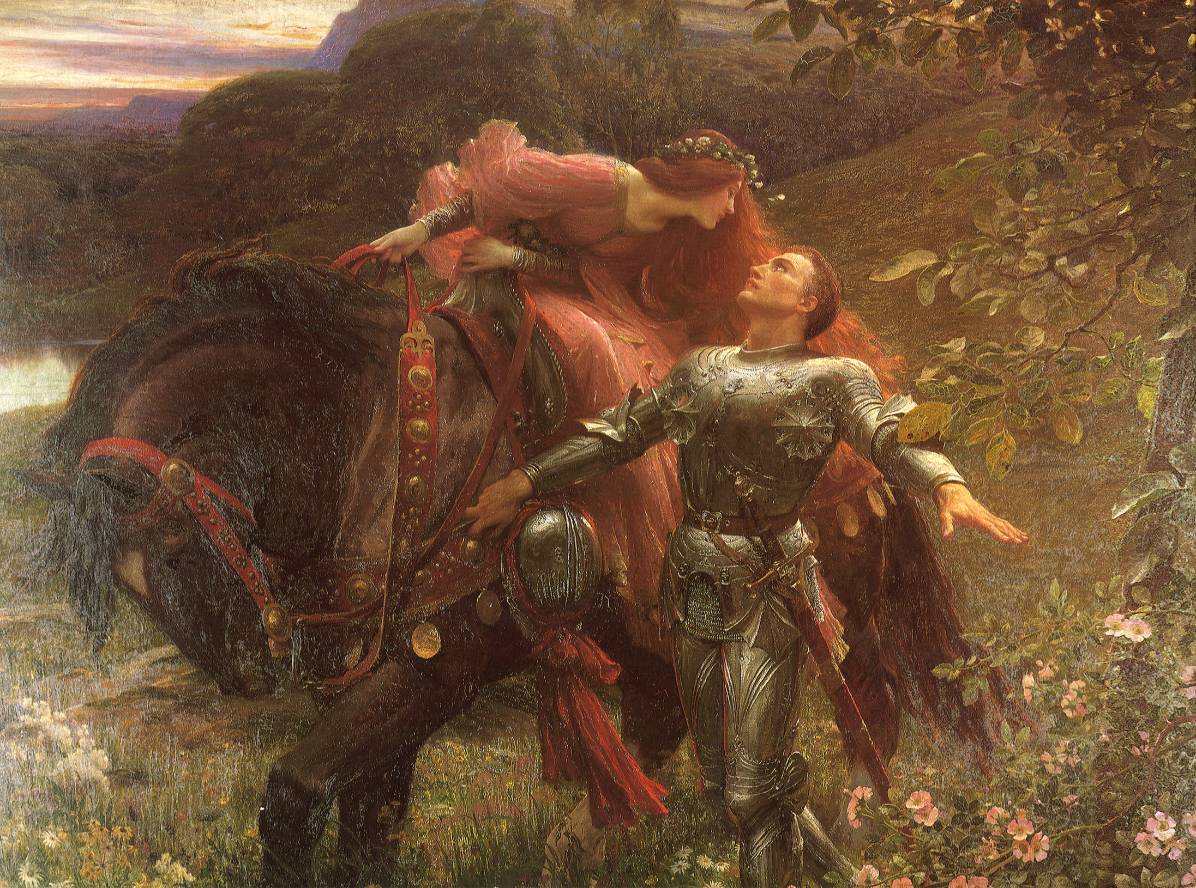
Add your answers to your word document:
Have you read a ballad before?
What do you think the stylistic conventions of a ballad are?

Slide 4
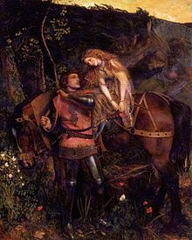
Common stylistic conventions of the ballad:
Compelling story
anonymous protagonists
quatrain verse form
repetitive refrain
simple rhyme scheme
song-like rhythm
archaic language
few descriptive details.
Google anything you don’t understand or ask me! Write the conventions, with definitions, on your word document.

Slide 5
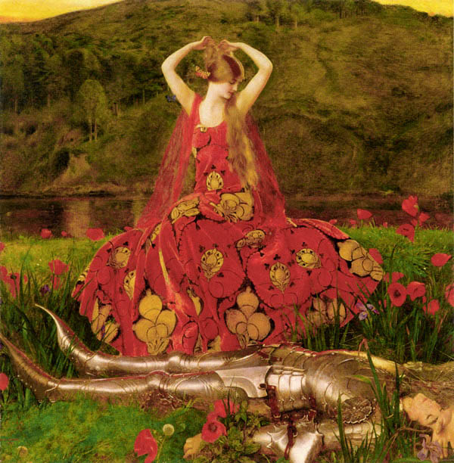
What do you know about the world of courtly romance and the chivalric tradition? Watch the videos below.
https://www.youtube.com/watch?v=T7j0V1AHvBU
https://www.youtube.com/watch?v=64qMWtLgCtY

Slide 6
Link to Pre-Raphaelite artist Frank Dicksee’s painting of La Belle Dame Sans Merci:
http://www.artrenewal.org/pages/artwork.php?artworkid=228&size=large
The pictures on all the slides are some paintings of the Pre-Raphaelite Brotherhood, who were preoccupied with medievalism. Many of their works derived from Arthurian legend (e.g. the Lady of Shalott) and the artist Frank Dicksee portrayed La Belle Dame Sans Merci herself.
Click on the link above. Why does Dicksee depict the Belle Dame wearing red? Write your thoughts on your word document.

Slide 7
Link to Pre-Raphaelite artist Frank Dicksee’s painting of La Belle Dame Sans Merci:
http://www.artrenewal.org/pages/artwork.php?artworkid=228&size=large
Dicksee’s painting evokes connotations of a ‘scarlet woman’, femme fatale, etc.
What is a ‘scarlett woman’ and a ‘femme fatale’?
Write your definitions onto your word document.

Slide 8
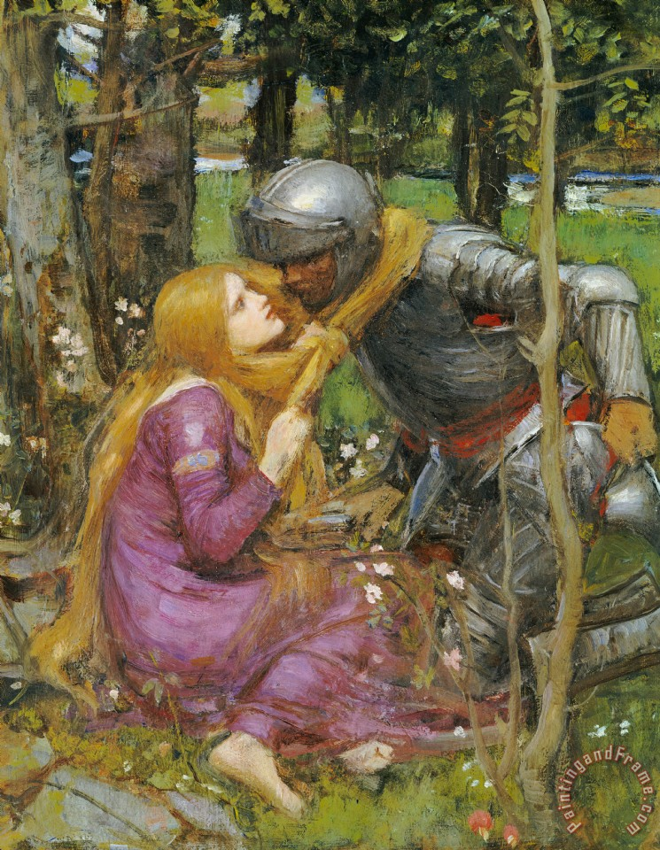
Write notes (on your word document) on the following facts about Keats within the context of the poem.
• Keats was part of the 19th-century Romantic Movement that reacted against 18th-century society’s new interest in science and focused more on nature and the imagination and emotions.
• He composed this poem after an autumnal walk through Winchester in 1819, the year that marked the end of his poetic career: financial troubles were mounting in his personal life and he needed to turn to more lucrative work.
• ‘La Belle Dame Sans Merci’ was written when Keats was just 24. Less than two years later he died of tuberculosis.

Slide 9
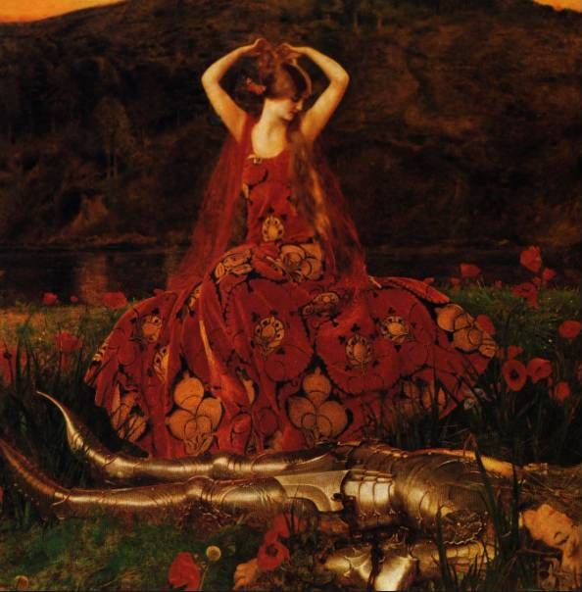
Before reading:
Before the first reading of the poem, you should review and revise your knowledge and understanding of the ballad form. Make sure you know what a ballad is.
Look back at the conventions of a ballad and check you understand all the terminology.

